Slide 1
Testing Time For Countable And Uncountable Nouns
Notes:
Notes for Teacher - < Information for further reference or explanation >
Suggestions: <Ideas/ Images/ Animations / Others – To make better representation of the content >
Source of Multimedia used in this slide - <Please provide source URL where we find the image and the license agreement>
<quiz> <https://pixabay.com/vectors/icon-quiz-questions-questionnaire-6065372/>

Slide 2
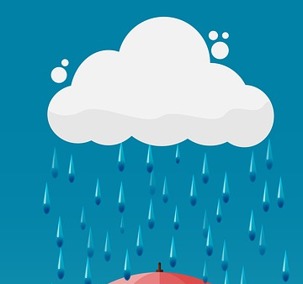
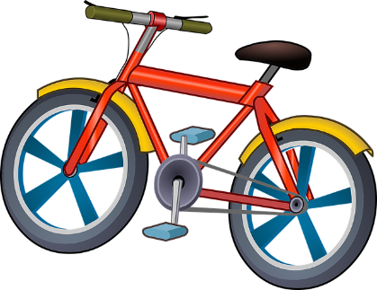
Exercise 1
Write ‘U’ for Uncountable and ‘C’ for Countable Nouns.
1. | 2. | 3.
4. | 5. | 6.
C
U
U
C
U
C
Notes:
Notes for Teacher - < Information for further reference or explanation >
Suggestions: <Ideas/ Images/ Animations / Others – To make better representation of the content >
Source of Multimedia used in this slide - <Please provide source URL where we find the image and the license agreement>
<apple> <https://pixabay.com/vectors/apple-ripe-red-healthy-food-fruit-307356/>
<milk> <https://pixabay.com/vectors/pitcher-pouring-milk-water-clear-310506/>
<coffee> <https://pixabay.com/vectors/drinks-coffee-coffee-mug-hot-coffee-1477040/>
<chair> <https://pixabay.com/illustrations/chair-wooden-hard-seat-seating-316889/>
<rain> <https://pixabay.com/illustrations/rain-umbrella-background-cloud-4391508/>
<bicycle> <https://pixabay.com/vectors/bicycle-small-vehicle-bike-cycle-1456759/>

Slide 3
Exercise 2
Complete the sentences with countable or uncountable nouns.
jam/cheese/butter
I want some ________________ for my toast.
There is a ____outside the door.
My mother bought a _____ and some _____ .
Would you like some ___________________ to drink?
I have two _________ in my bag.
The ________ on the beach is wet.
There are four _________ on the table.
Two ________ are painting the house.
dog
doll
juice
water/juice/coffee/tea
phones
sand
bottles
men
Notes:
Notes for Teacher - < Information for further reference or explanation >
Suggestions: <Ideas/ Images/ Animations / Others – To make better representation of the content >
Source of Multimedia used in this slide - <Please provide source URL where we find the image and the license agreement>

Slide 4
Exercise 3
Complete the sentences with ‘a’, ‘an’ or ‘some’.
There is _______ sand in my shoe.
There is _______ toothbrush in the bathroom.
There is _______ jam in the bottle.
Would you like ____ apple or ____ mango?
Do you want ______ chips with your tea?
Would you like _____ glass of lemon juice ?
There is ____ egg in the nest.
Can I have ______ biscuits and ____ glass of milk please?
some
a
some
an
a
some
a
an
some
a
Notes:
Notes for Teacher - < Information for further reference or explanation >
Suggestions: <Ideas/ Images/ Animations / Others – To make better representation of the content >
Source of Multimedia used in this slide - <Please provide source URL where we find the image and the license agreement>

Slide 5
Exercise 4
Draw and colour for the following and also label your drawing.
A Countable Noun | An Uncountable Noun
Mango | Sand
Notes:
Notes for Teacher - < Information for further reference or explanation >
Suggestions: <Ideas/ Images/ Animations / Others – To make better representation of the content >
Source of Multimedia used in this slide - <Please provide source URL where we find the image and the license agreement>
<mango> <https://pixabay.com/vectors/mango-fruit-tropical-yellow-sweet-4996445/>
<sand> <https://pixabay.com/vectors/desert-dune-sand-landscape-hot-4538309/>

Slide 6
MM INDEX
Slide # | Thumbnail | Source link and Attribution
1 |  | <quiz> https://pixabay.com/vectors/icon-quiz-questions-questionnaire-6065372/
2 |  | <apple> https://pixabay.com/vectors/apple-ripe-red-healthy-food-fruit-307356/ <milk> https://pixabay.com/vectors/pitcher-pouring-milk-water-clear-310506/ <coffee> https://pixabay.com/vectors/drinks-coffee-coffee-mug-hot-coffee-1477040/ <chair> https://pixabay.com/illustrations/chair-wooden-hard-seat-seating-316889/ <rain> https://pixabay.com/illustrations/rain-umbrella-background-cloud-4391508/ <bicycle> https://pixabay.com/vectors/bicycle-small-vehicle-bike-cycle-1456759/
5 |  | <mango> https://pixabay.com/vectors/mango-fruit-tropical-yellow-sweet-4996445/ <sand> https://pixabay.com/vectors/desert-dune-sand-landscape-hot-4538309/
Notes:
Notes for Teacher - < Information for further reference or explanation >
Suggestions: <Ideas/ Images/ Animations / Others – To make better representation of the content >
Source of Multimedia used in this slide - <Please provide source URL where we find the image and the license agreement>

