Slide 1
All About
Common Nouns
and Proper Nouns
Notes:
Notes for Teacher - < Information for further reference or explanation >
Suggestions: <Ideas/ Images/ Animations / Others – To make better representation of the content >
Source of Multimedia used in this slide - <Please provide source URL where we find the image and the license agreement>
1. <board> - <https://pixabay.com/vectors/chalk-board-school-education-303457/>

Slide 2
Nouns
Examples: cat, dog, parrot, boy, Gita, village, Vidya Mandir, Amul Chocolate
Common Nouns | Proper Nouns
dog | Gita
cat | Vidya Mandir
parrot | Amul Chocolate
boy
village
Notes:
Notes for Teacher - The teacher to start the class with a quick recapitulation/review of what they have learnt about nouns so far. This could be done by eliciting examples of noun. After eliciting a few nouns the teacher can write those nouns separately in two columns. With examples like these the students could be asked, as to why they have been grouped separately. (At this point ,there is no right or wrong answer. The question is only to trigger their thinking). From here they can be introduced to nouns and that nouns can be classified as Common or Proper.
Suggestions: <Ideas/ Images/ Animations / Others – To make better representation of the content >
Source of Multimedia used in this slide - <Please provide source URL where we find the image and the license agreement>

Slide 3
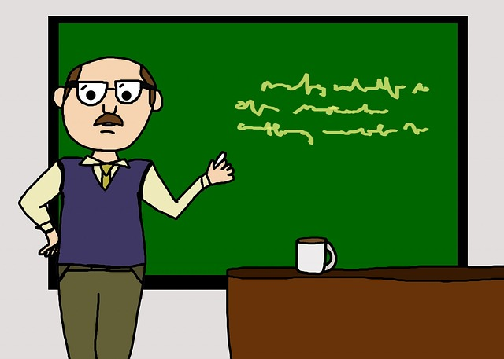
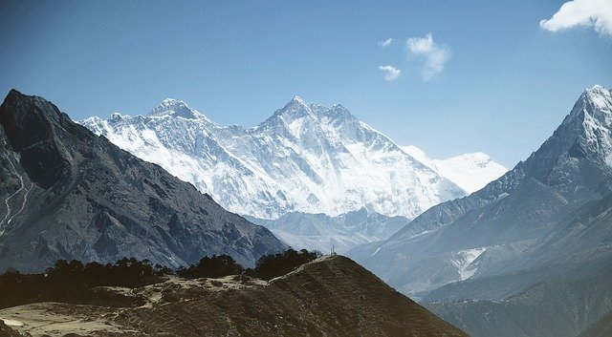
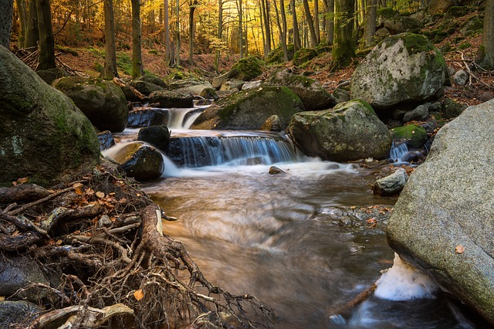
Common Nouns
1
Generic/General People
2
Animals
teacher
3
Places
mountain
girl
4
Things
day
river
Notes:
Notes for Teacher - < Information for further reference or explanation >
Suggestions: <Ideas/ Images/ Animations / Others – To make better representation of the content >
Source of Multimedia used in this slide - <Please provide source URL where we find the image and the license agreement>
<girl> - <https://pixabay.com/illustrations/school-girl-back-to-school-child-3420040/>
<river> - <https://pixabay.com/photos/river-long-exposure-ilse-2952009/>
<mountain> - <https://pixabay.com/photos/mountain-mount-everest-himalaya-1246297/>
<day> - <https://pixabay.com/photos/landscape-sunset-sunrise-beautiful-4013258/>
<teacher> - <https://pixabay.com/illustrations/male-man-teacher-professor-213729/>

Slide 4
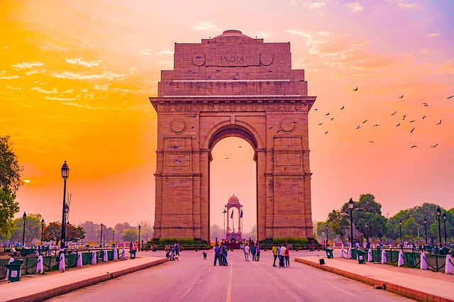
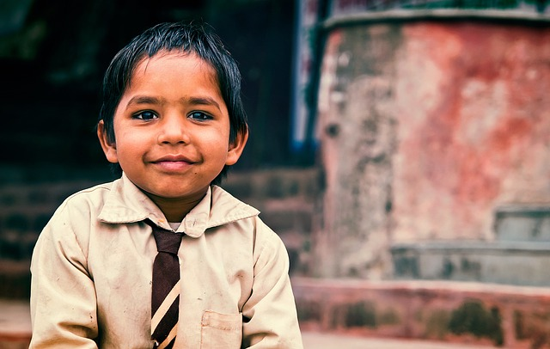
Proper Nouns
Proper nouns are special nouns
Tells names of a very specific/proper person, animal, place or thing.
Always begin with a capital letter.
New Delhi
Amul chocolate
Rohit
Notes:
Notes for Teacher - < Information for further reference or explanation >
Suggestions: <Ideas/ Images/ Animations / Others – To make better representation of the content >
Source of Multimedia used in this slide - <Please provide source URL where we find the image and the license agreement>
<New Delhi> - <https://pixabay.com/photos/travel-delhi-gate-culture-stone-4813658/>
<Amul chocolate> - <https://pixabay.com/photos/amul-dark-treat-chocolate-speakers-3960543/>
<Rohit> - <https://pixabay.com/photos/indian-boy-child-male-asian-1119236/>

Slide 5
Examples
Common Nouns | Proper Nouns
girl | Gita
boy | Raju
day | Monday
school | Vidya Mandir
city | Mumbai
state | Kerala
month | June
river
ocean
mountain
Notes:
Notes for Teacher - < Information for further reference or explanation >
Suggestions: <Ideas/ Images/ Animations / Others – To make better representation of the content >
Source of Multimedia used in this slide - <Please provide source URL where we find the image and the license agreement>

Slide 6
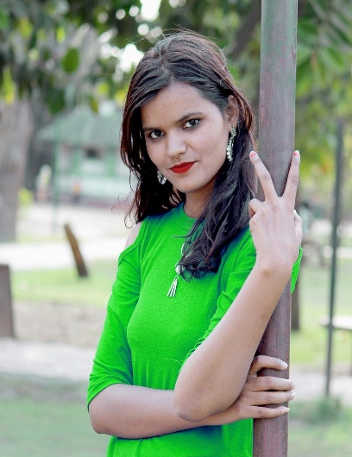
Common Nouns in Sentences
Examples:
The girl is wearing a green dress.
We get water from rivers.
I love my teacher.
We can see the mountains from my house.
I start my day with prayers to God.
Notes:
Notes for Teacher – Examples stated above are just suggestions but students can come up with a variety of nouns. This should be encouraged and taken up by the teacher.
The students should be encouraged to use the common and proper nouns in sentences of their own for better understanding of the concept.
Suggestions: <Ideas/ Images/ Animations / Others – To make better representation of the content >
Source of Multimedia used in this slide - <Please provide source URL where we find the image and the license agreement>
<girl> - <https://pixabay.com/photos/indian-girl-beautiful-girl-indian-3405096/>
<river> - <https://pixabay.com/photos/river-flow-nature-river-landscape-2476010/>
<mountain> - <https://pixabay.com/photos/mountain-mount-everest-himalaya-1246297/>
<teacher> - <https://pixabay.com/illustrations/male-man-teacher-professor-213729/>
<prayer> - <https://pixabay.com/vectors/boy-divine-god-male-man-prayer-1299588/>

Slide 7
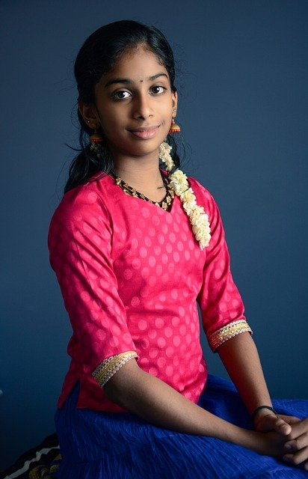
Proper Nouns in Sentences
Examples:
My name is Asha.
My friend is Sneha.
I study in Vidya Mandir school.
New Delhi is the capital of India.
I love to eat Amul Chocolates.
Notes:
Notes for Teacher - < Information for further reference or explanation >
Suggestions: <Ideas/ Images/ Animations / Others – To make better representation of the content >
Source of Multimedia used in this slide - <Please provide source URL where we find the image and the license agreement>
<New Delhi> - <https://pixabay.com/photos/travel-delhi-gate-culture-stone-4813658/>
<Amul chocolate> - <https://pixabay.com/photos/amul-dark-treat-chocolate-speakers-3960543/>
<girl> - <https://pixabay.com/photos/beautiful-young-indian-girl-2271357/>
<two friends> - <https://pixabay.com/photos/models-india-south-india-latina-3582205/>
<school> - <https://pixabay.com/vectors/school-building-education-property-295210/>

Slide 8
MM INDEX
Slide # | Thumbnail | Source link and Attribution
1 |  | <board> - https://pixabay.com/vectors/chalk-board-school-education-303457/
3 |  | <girl> - https://pixabay.com/illustrations/school-girl-back-to-school-child-3420040/ <river> - https://pixabay.com/photos/river-long-exposure-ilse-2952009/ <day> - https://pixabay.com/photos/landscape-sunset-sunrise-beautiful-4013258/
3, 6 |  | <mountain> - https://pixabay.com/photos/mountain-mount-everest-himalaya-1246297/ <teacher> - https://pixabay.com/illustrations/male-man-teacher-professor-213729/
4 |  | <New Delhi> - https://pixabay.com/photos/travel-delhi-gate-culture-stone-4813658/ <Amul chocolate> - https://pixabay.com/photos/amul-dark-treat-chocolate-speakers-3960543/ <Rohit> - https://pixabay.com/photos/indian-boy-child-male-asian-1119236/
6 |  | <girl> - https://pixabay.com/photos/indian-girl-beautiful-girl-indian-3405096/ <river> - https://pixabay.com/photos/river-flow-nature-river-landscape-2476010/ <prayer> - https://pixabay.com/vectors/boy-divine-god-male-man-prayer-1299588/
7 |  | <girl> - https://pixabay.com/photos/beautiful-young-indian-girl-2271357/ <two friends> - https://pixabay.com/photos/models-india-south-india-latina-3582205/ <school> - https://pixabay.com/vectors/school-building-education-property-295210/
Notes:
Notes for Teacher - < Information for further reference or explanation >
Suggestions: <Ideas/ Images/ Animations / Others – To make better representation of the content >
Source of Multimedia used in this slide - <Please provide source URL where we find the image and the license agreement>

