Slide 1
Board Game
for
Proper Nouns
Notes:
Notes for Teacher - < Information for further reference or explanation >
Suggestions: <Ideas/ Images/ Animations / Others – To make better representation of the content >
Source of Multimedia used in this slide -
<board> - < https://pixabay.com/vectors/green-blackboard-chalk-eraser-307835/>

Slide 2
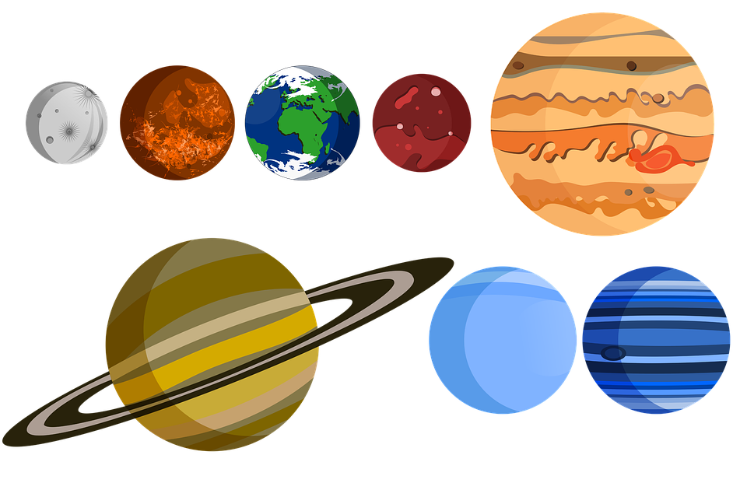
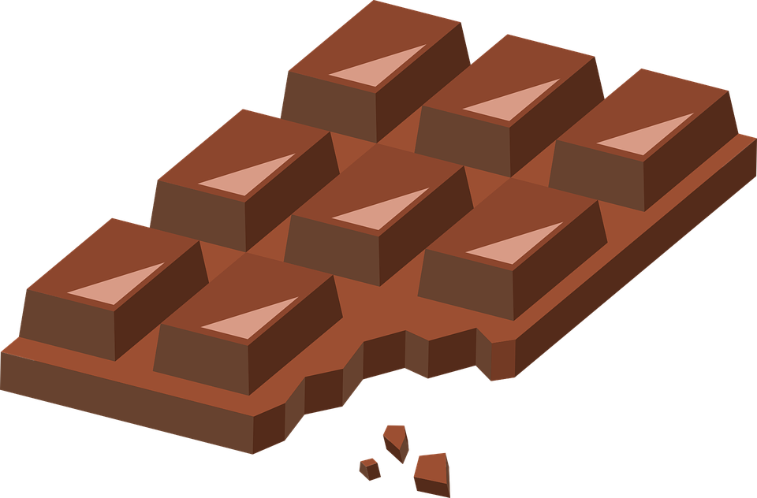
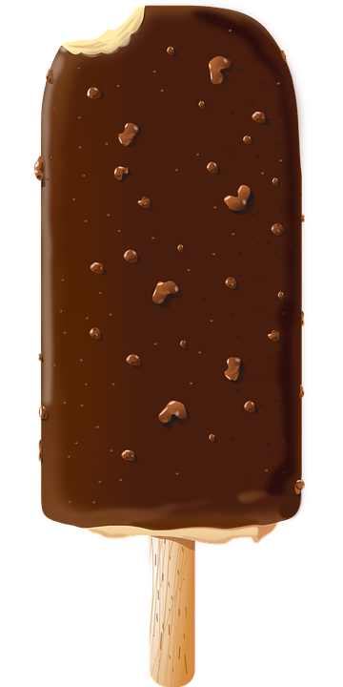
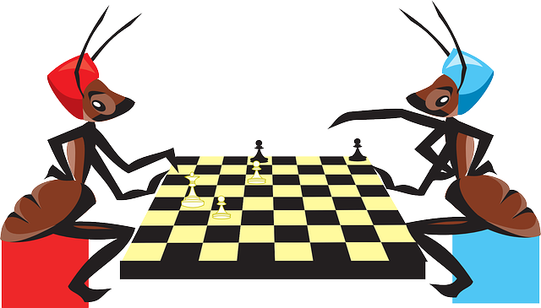
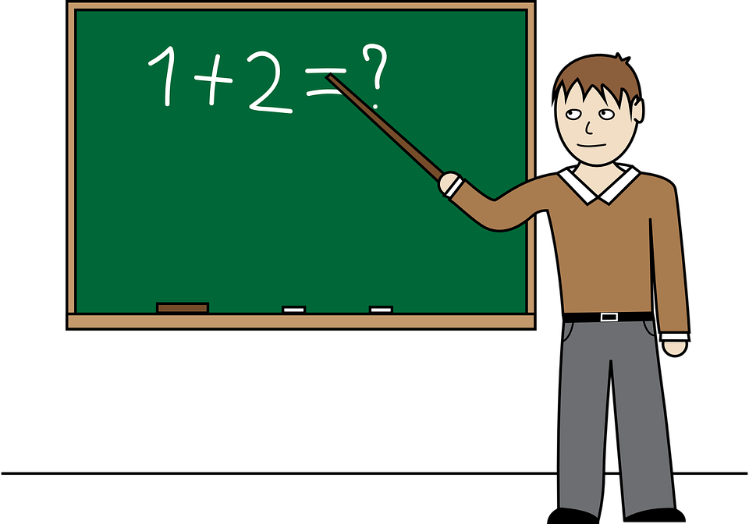
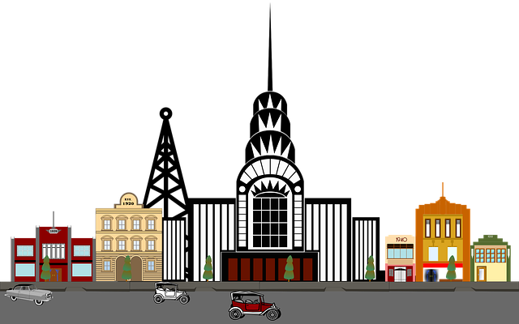
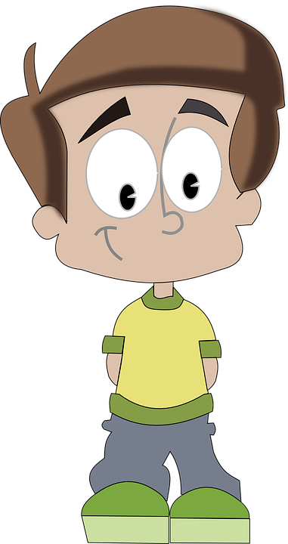
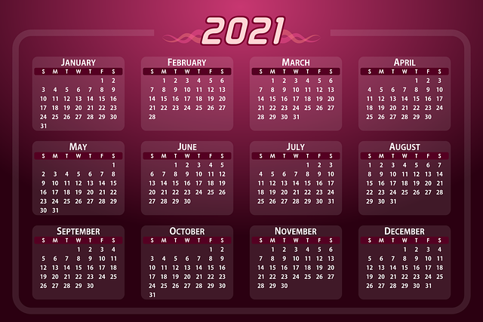
The Game
Finished
Planet
Chocolate
Pet dog
River
Mountain
Glue
Ice cream
Crayon
Game
Doctor
Day of the week
festival
toys
pencil
teacher
city/town
brother
Story book
Month
Notes:
Notes for Teacher - < This slide should not be shown in full screen format.>
Suggestions: <Ideas/ Images/ Animations / Others – To make better representation of the content >
Source of Multimedia used in this slide -
<festival> - <https://pixabay.com/vectors/fireworks-new-year-s-eve-sparkler-1993221/ >
<toys> - <https://pixabay.com/vectors/toys-kids-playing-childhood-child-2411790/ >
<pencil> - <https://pixabay.com/vectors/pencil-sharp-school-supplies-153561/ >
<teacher> - <https://pixabay.com/vectors/teacher-classroom-chalk-board-man-651318/ >
<city> - <https://pixabay.com/illustrations/vintage-clip-art-city-art-deco-2940838/>
<brother> - <https://pixabay.com/vectors/boy-child-kid-teenager-teen-male-160014/ >
<story book> - <https://pixabay.com/vectors/book-read-open-published-write-147292/ >
<Calender> - <https://pixabay.com/vectors/calendar-date-2021-days-weeks-5458418/>
<ice cream> - <https://pixabay.com/vectors/popsicle-ice-pop-dessert-154587/ >
<crayon> - <https://pixabay.com/vectors/crayons-blue-orange-coloring-new-40324/ >
<board game> - <https://pixabay.com/vectors/chess-game-playing-sitting-insects-44566/>
<doctor> - <https://pixabay.com/illustrations/doctor-caricature-cartoon-character-2748707/ >
<Week> - <https://pixabay.com/vectors/calendar-january-month-organizer-152139/>
<pet dog> - <https://pixabay.com/vectors/puppy-dog-leashed-dog-leash-pet-32025/ >
<river> - <https://pixabay.com/vectors/waves-pattern-blue-water-ocean-308721/ >
<mountain> - <https://pixabay.com/vectors/landscape-mountains-panoramic-rocks-159294/ >
<glue> - <https://pixabay.com/vectors/glue-bottle-orange-blue-fluid-306757/ >
<planet> - <https://pixabay.com/illustrations/solar-system-the-universe-4947216/ >
<chocolate> - <https://pixabay.com/vectors/chocolate-sweets-bitten-s%C5%82odycz-2696873/ >
<flag> - <https://pixabay.com/vectors/red-flag-pennon-waving-pennant-303921/>

Slide 3
MM INDEX
Slide # | Thumbnail | Source link and Attribution
1 |  | https://pixabay.com/vectors/green-blackboard-chalk-eraser-307835/
2 |  | Festival: https://pixabay.com/vectors/fireworks-new-year-s-eve-sparkler-1993221/ Toys: https://pixabay.com/vectors/toys-kids-playing-childhood-child-2411790/ Pencil: https://pixabay.com/vectors/pencil-sharp-school-supplies-153561/ Teacher: https://pixabay.com/vectors/teacher-classroom-chalk-board-man-651318/
2 |  | City: https://pixabay.com/illustrations/vintage-clip-art-city-art-deco-2940838/ Brother: https://pixabay.com/vectors/boy-child-kid-teenager-teen-male-160014/ Story book: https://pixabay.com/vectors/book-read-open-published-write-147292/ Calendar: https://pixabay.com/vectors/calendar-date-2021-days-weeks-5458418/
2 |  | Ice cream: https://pixabay.com/vectors/popsicle-ice-pop-dessert-154587/ Crayon: https://pixabay.com/vectors/crayons-blue-orange-coloring-new-40324/ Board game: https://pixabay.com/vectors/chess-game-playing-sitting-insects-44566/ Doctor: https://pixabay.com/illustrations/doctor-caricature-cartoon-character-2748707/
2 |  | Week: https://pixabay.com/vectors/calendar-january-month-organizer-152139/ Pet dog: https://pixabay.com/vectors/puppy-dog-leashed-dog-leash-pet-32025/ River: https://pixabay.com/vectors/waves-pattern-blue-water-ocean-308721/ Mountain: https://pixabay.com/vectors/landscape-mountains-panoramic-rocks-159294/
2 |  | Glue: https://pixabay.com/vectors/glue-bottle-orange-blue-fluid-306757/ Planet: https://pixabay.com/illustrations/solar-system-the-universe-4947216/ Chocolate: https://pixabay.com/vectors/chocolate-sweets-bitten-s%C5%82odycz-2696873/ Flag: https://pixabay.com/vectors/red-flag-pennon-waving-pennant-303921/
Notes:
Notes for Teacher - < Information for further reference or explanation >
Suggestions: <Ideas/ Images/ Animations / Others – To make better representation of the content >
Source of Multimedia used in this slide - <Please provide source URL where we find the image and the license agreement>

