Slide 1
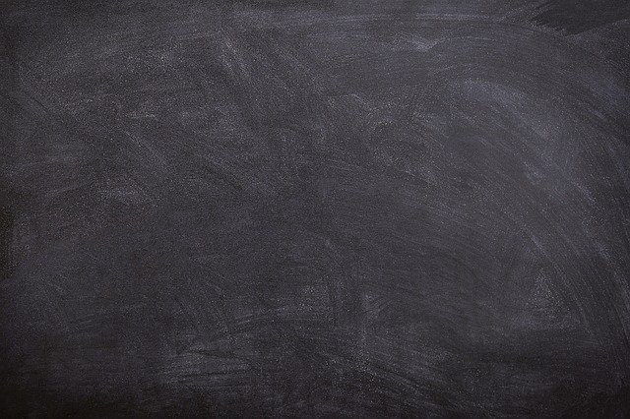
Learning to Write,
Right
Common Nouns and Proper Nouns
Notes:
Notes for Teacher - < Information for further reference or explanation >
Suggestions: <Ideas/ Images/ Animations / Others – To make better representation of the content >
Source of Multimedia used in this slide - <Please provide source URL where we find the image and the license agreement>
1. <black board> - <https://pixabay.com/photos/black-board-chalk-traces-school-1072366/>

Slide 2
Complete the Sentences
1. I take the bus to go to ________ .
school
School
school
2. We met ________ at the park.
shyam
Shyam
Shyam
3. My mother is going to take me to the _______ .
market
Market
market
4. I am so happy that today is a ________.
friday
Friday
Friday
Notes:
Notes for Teacher - < Information for further reference or explanation >
Suggestions: <Ideas/ Images/ Animations / Others – To make better representation of the content >
Source of Multimedia used in this slide - <Please provide source URL where we find the image and the license agreement>

Slide 3
Complete the Sentences
5. We are going to buy some _______.
fruits
Fruits
fruits
6. My pet dog’s name is _______ .
bruno
Bruno
Bruno
7. Our national bird is the ________ .
peacock
Peacock
peacock
8. Grandma read a story from the ____________.
panchatantraPanchatantra
Panchatantra
Notes:
Notes for Teacher - < Information for further reference or explanation >
Suggestions: <Ideas/ Images/ Animations / Others – To make better representation of the content >
Source of Multimedia used in this slide - <Please provide source URL where we find the image and the license agreement>

Slide 4
Complete the Sentences
9. Bina’s birthday is in the month of ___________.
september
September
September
10. Cows eat ______.
grass
Grass
grass
Notes:
Notes for Teacher - < Information for further reference or explanation >
Suggestions: <Ideas/ Images/ Animations / Others – To make better representation of the content >
Source of Multimedia used in this slide - <Please provide source URL where we find the image and the license agreement>

Slide 5
MM INDEX
Slide # | Thumbnail | Source link and Attribution
1 |  | <black board> - https://pixabay.com/photos/black-board-chalk-traces-school-1072366/
Notes:
Notes for Teacher - < Information for further reference or explanation >
Suggestions: <Ideas/ Images/ Animations / Others – To make better representation of the content >
Source of Multimedia used in this slide - <Please provide source URL where we find the image and the license agreement>

