Slide 1
Do I know my Common Nouns and
Proper Nouns?
Notes:
Notes for Teacher –N/A
Suggestions: N/A
Source of Multimedia used in this slide - N/A

Slide 2
Exercise 1
I.
Classify the nouns in the correct group
paper
Kashmir
shoes
teacher
Maruti Cars
balloon
M.G.Road
Atlas Cycle
Common Nouns | Proper Nouns
paper
Kashmir
shoes
Maruti Cars
teacher
M.G.Road
balloon
Atlas Cycle
Notes:
Notes for Teacher –
Suggestions: N/A
Source of Multimedia used in this slide - N/A

Slide 3
Exercise 2
II.
Write the common nouns for the given proper nouns
Proper Nouns | Common Nouns
River Ganga
Gujarat
India
Sandeep
The Jataka Tales
Indian Ocean
any river
state
country
boy/man
book
ocean
Notes:
Notes for Teacher –N/A
Suggestions: N/A
Source of Multimedia used in this slide - N/A

Slide 4
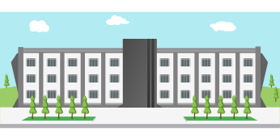
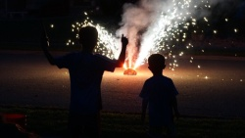
Exercise 3
III.
Fill in the blanks with proper nouns
We get mangoes in the _______ season.
My birthday is in the month of __________.
My mother’s name is _________.
I study in ___________ school.
We burst crackers during _____.
summer
Diwali
Notes:
Notes for Teacher –N/A
Suggestions: N/A
Source of Multimedia used in this slide -
Summer: https://pixabay.com/vectors/season-summer-sun-sunglasses-beach-4432271/
School: https://pixabay.com/vectors/school-design-building-learning-1727586/
Calendar: https://pixabay.com/vectors/calendar-business-2018-week-month-2497192/
Fireworks: https://pixabay.com/photos/fireworks-kids-holiday-celebration-2678425/
Click: https://pixabay.com/illustrations/click-registration-icon-clipart-2339189/

Slide 5
Exercise 4
V.
Make sentences with the given common noun and proper noun
Ball
Sunil
Notes:
Notes for Teacher – N/A
Suggestions: N/A
Source of Multimedia used in this slide –
Ball: https://pixabay.com/vectors/beach-ball-ball-inflatable-beach-575425/

Slide 6
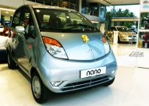
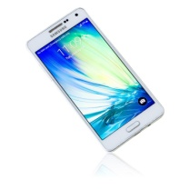
Exercise 5
V.
Draw and name the following
A Common noun | A Proper noun
book
any vehicles
dog
things with the brand name
cat
specific people with their names
boy
girl
Notes:
Notes for Teacher – N/A
Suggestions: N/A
Source of Multimedia used in this slide –
Book: https://pixabay.com/vectors/book-closed-black-blank-library-306468/
Dog: https://pixabay.com/vectors/dog-brown-pet-animal-tail-eskimo-48479/
Cat: https://pixabay.com/vectors/siamese-cat-feline-pet-sitting-48018/
Children: https://pixabay.com/vectors/boys-cartoon-children-comic-2026930/
Nano: https://www.flickr.com/photos/eeko/3532025750-Attribution to Easa Shamih
Cell phone: https://pixabay.com/photos/black-business-cell-cellphone-4766994/
Cricket: https://pixabay.com/vectors/cricket-players-indian-man-2027502/

Slide 7
MM INDEX
Slide # | Thumbnail | Source link and Attribution
4 |  | Summer: https://pixabay.com/vectors/season-summer-sun-sunglasses-beach-4432271/ School: https://pixabay.com/vectors/school-design-building-learning-1727586/ Calendar: https://pixabay.com/vectors/calendar-business-2018-week-month-2497192/ Fireworks: https://pixabay.com/photos/fireworks-kids-holiday-celebration-2678425/ Click: https://pixabay.com/illustrations/click-registration-icon-clipart-2339189
5 |  | Ball: https://pixabay.com/vectors/beach-ball-ball-inflatable-beach-575425/
6 |  | Book: https://pixabay.com/vectors/book-closed-black-blank-library-306468/ Dog: https://pixabay.com/vectors/dog-brown-pet-animal-tail-eskimo-48479/ Cat: https://pixabay.com/vectors/siamese-cat-feline-pet-sitting-48018/ Children: https://pixabay.com/vectors/boys-cartoon-children-comic-2026930/ Nano: https://www.flickr.com/photos/eeko/3532025750-Attribution to Easa Shamih Cell phone: https://pixabay.com/photos/black-business-cell-cellphone-4766994/ Cricket: https://pixabay.com/vectors/cricket-players-indian-man-2027502/

