Slide 1
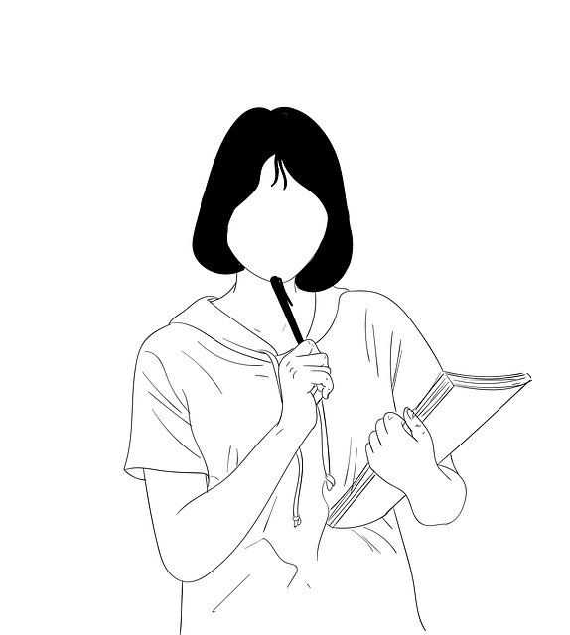
How Well Do I Know My Common Nouns and Proper Nouns?
Notes:
Notes for Teacher - < Information for further reference or explanation >
Suggestions: <Ideas/ Images/ Animations / Others – To make better representation of the content >
Source of Multimedia used in this slide -
<thinking> - <https://pixabay.com/illustrations/girl-student-outline-female-5887692/>

Slide 2
Exercise 1
Common Nouns = pink Proper Nouns = yellow
pig
ball
September
mat
elephant
Friday
Parle-G
fish
Colgate
Diwali
leaf
Chota Bheem
Notes:
Notes for Teacher - < Information for further reference or explanation >
Suggestions: <Ideas/ Images/ Animations / Others – To make better representation of the content >
Source of Multimedia used in this slide - <Please provide source URL where we find the image and the license agreement>

Slide 3
Exercise 2
Write a proper noun each for the given common nouns.
Common Nouns
pencil
dog
father
festival
mountain
Proper Nouns
Natraj
Bruno
Mr Anil Kumar
Diwali
Mt. Everest
Notes:
Notes for Teacher - < Information for further reference or explanation >
Suggestions: <Ideas/ Images/ Animations / Others – To make better representation of the content >
Source of Multimedia used in this slide - <Please provide source URL where we find the image and the license agreement>

Slide 4
Exercise 3
Fill in the blanks with common nouns.
My father works in a _____.
We go to a _______ when we are sick.
A _____ moves on tracks.
Dogs love to eat ______.
We write with a ______.
bank
hospital
train
bones
pencil
Notes:
Notes for Teacher - < Information for further reference or explanation >
Suggestions: <Ideas/ Images/ Animations / Others – To make better representation of the content >
Source of Multimedia used in this slide - <Please provide source URL where we find the image and the license agreement>

Slide 5
Read the following sentences. Underline the common nouns and circle the proper nouns.
Exercise 4
Rakhi is my sister.
These oranges are from Nagpur.
Grandfather is coming home on Thursday.
Chetan can see the river from his house.
It is very cold in December.
Notes:
Notes for Teacher - < Information for further reference or explanation >
Suggestions: <Ideas/ Images/ Animations / Others – To make better representation of the content >
Source of Multimedia used in this slide - <Please provide source URL where we find the image and the license agreement>

Slide 6
Draw and name the following .
Exercise 5
A Common Noun | A Proper Noun
table
Sun
Notes:
Notes for Teacher - < Information for further reference or explanation >
Suggestions: <Ideas/ Images/ Animations / Others – To make better representation of the content >
Source of Multimedia used in this slide -
<table> - <https://pixabay.com/vectors/table-furniture-wooden-1300555/>
<sun> - <https://pixabay.com/vectors/sun-weather-weather-forecast-sunny-157126/>

Slide 7
MM INDEX
Slide # | Thumbnail | Source link and Attribution
1 |  | <thinking> - https://pixabay.com/illustrations/girl-student-outline-female-5887692/
6 |  | <table> - https://pixabay.com/vectors/table-furniture-wooden-1300555/
6 |  | <sun> - https://pixabay.com/vectors/sun-weather-weather-forecast-sunny-157126/
Notes:
Notes for Teacher - < Information for further reference or explanation >
Suggestions: <Ideas/ Images/ Animations / Others – To make better representation of the content >
Source of Multimedia used in this slide - <Please provide source URL where we find the image and the license agreement>

