Slide 1
Acquiring Knowledge on Present Tense
Notes:
Notes for Teacher - < Information for further reference or explanation >
Suggestions: <Ideas/ Images/ Animations / Others – To make better representation of the content >
Source of Multimedia used in this slide - <Please provide source URL where we find the image and the license agreement>
https://pixabay.com/illustrations/past-present-future-monitor-4026781/

Slide 2
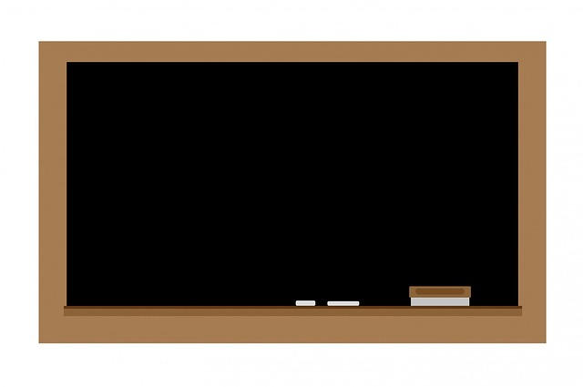
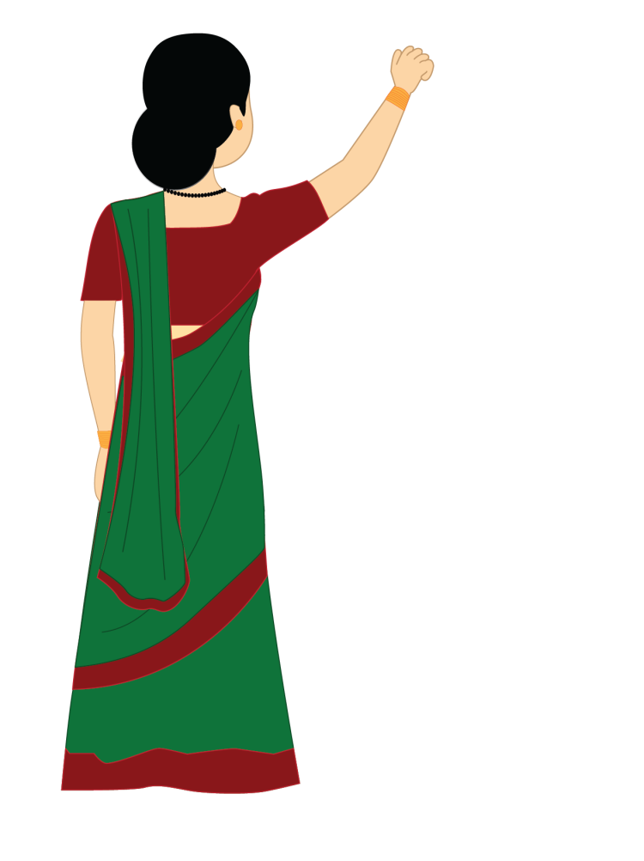
Recapitulation Exercise
Examples:
1. He is tired.
2. Leela likes cakes.
3. The koel sings sweetly.
4. We go to the market everyday..
Notes:
Notes for Teacher - The teacher writes a few sentences on the blackboard and asks the students to identify the verbs in the sentences and elicits the definition of verbs .
Students explain that verbs are words that describe the action of the subject/noun and also give the idea of the state being.
Suggestions: <Ideas/ Images/ Animations / Others – To make better representation of the content >
Source of Multimedia used in this slide -
<teacher> - SSSVV Image Gallery: Search Keyword “teacher”
<black board> - <https://pixabay.com/illustrations/chalkboard-blackboard-chalk-board-163601/>

Slide 3
Tenses
Tense is the form of a verb that shows the time of action.
There are three main tenses :
yesterday
today
tomorrow
Past tense
Present tense
Future tense
Notes:
Notes for Teacher - < >
Suggestions: <Ideas/ Images/ Animations / Others – To make better representation of the content >
Source of Multimedia used in this slide -
<action> - <https://pixabay.com/illustrations/movement-driving-wiggle-3634992/>

Slide 4
Simple Present Tense
It is a Verb Tense that tells about the time of an action that exists presently or is taking place now.
It describes a current activity or state of being.
It is used to describe daily activities, habits and general truths.
Notes:
Notes for Teacher -The teacher writes a few sentences on the blackboard and underlines the verbs and then tells the children that all the underlined verbs are in the present tense form of the verb. The teacher must ensure that she writes only those sentences that contain verbs of the present tense.
Suggestions: <Ideas/ Images/ Animations / Others – To make better representation of the content >
Source of Multimedia used in this slide -
<teacher> - SSSVV Image Gallery: Search Keyword “teacher”
<black board> - <https://pixabay.com/illustrations/chalkboard-blackboard-chalk-board-163601/>

Slide 5
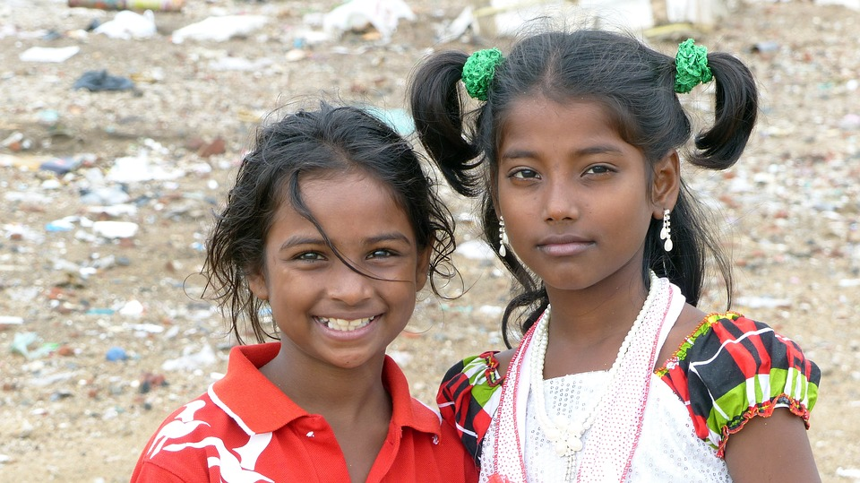
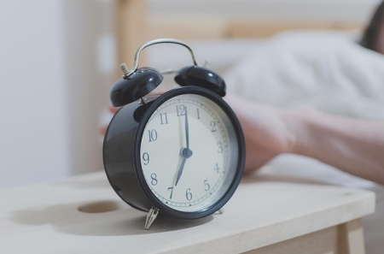
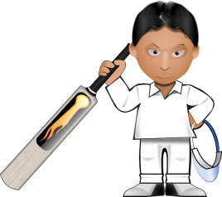
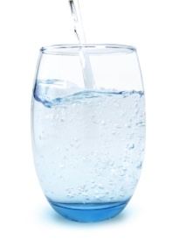
Simple Present Tense
Present tense form of the verb describes daily activities and habits
Examples
1. I go to school with my sister.
2. Nina wakes up at six o’clock in the morning.
3. They play cricket on Sundays.
4. I drink six glasses of water everyday.
5. She cleans the house.
Notes:
Notes for Teacher - < >
Suggestions: <Ideas/ Images/ Animations / Others – To make better representation of the content >
Source of Multimedia used in this slide -
<sisters> - <https://pixabay.com/photos/people-child-portrait-girl-india-3300436/>
<alarm clock> - <https://pixabay.com/photos/morning-clock-alarm-1092771/>
<cricket> - <https://pixabay.com/vectors/cricket-bat-cricketer-player-33064/>
<glass of water> - <https://pixabay.com/photos/glass-of-water-water-glass-thirst-4087606/>
<cleaning> - <https://pixabay.com/vectors/clean-cleaner-cleaning-service-3614744/>

Slide 6
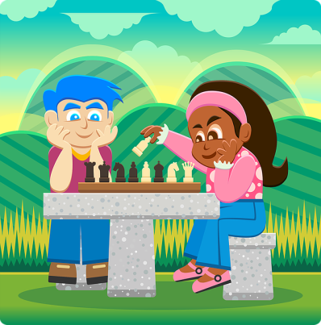
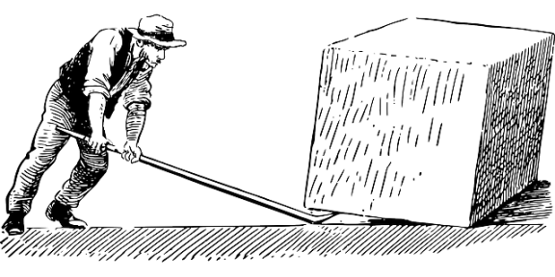
Simple Present Tense
The Present Tense forms of verbs tell us about some universally accepted truths.
Examples:
1. Chess makes children smart.
2. Playing sports builds stronger bones and muscles.
3. Hard work is the key to success.
Notes:
Notes for Teacher - <.>
Suggestions: <Ideas/ Images/ Animations / Others – To make better representation of the content >
Source of Multimedia used in this slide -
<cricket> - <https://pixabay.com/vectors/cricket-bat-cricketer-player-33064/>
<chess> - <https://pixabay.com/vectors/chess-chess-face-off-chess-players-1295462/?
<hardwork> - <https://pixabay.com/vectors/archimedes-lever-quarryman-worker-148273/>

Slide 7
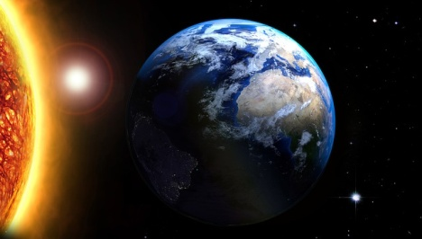
Simple Present Tense
The Simple Present Tense describes scientific facts.
Examples
1. The Earth goes round the Sun.
2. The Earth is the third planet from the Sun.
3. The plants make their own food.
Notes:
Notes for Teacher - <.>
Suggestions: <Ideas/ Images/ Animations / Others – To make better representation of the content >
Source of Multimedia used in this slide -
<rotation> - <https://pixabay.com/illustrations/sun-star-earth-cosmos-rays-balls-1884518/>
<leaf photosynthesis> - <https://pixabay.com/illustrations/plant-photosynthesis-sunlight-leaf-3759893/>
<earth> - < https://pixabay.com/photos/solar-system-sun-mercury-venus-439046/>

Slide 8
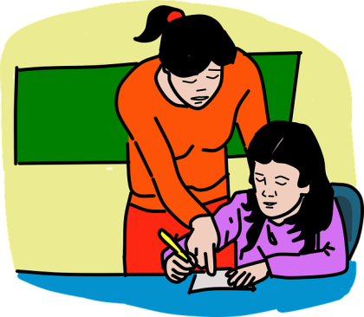
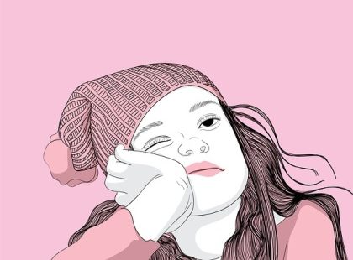
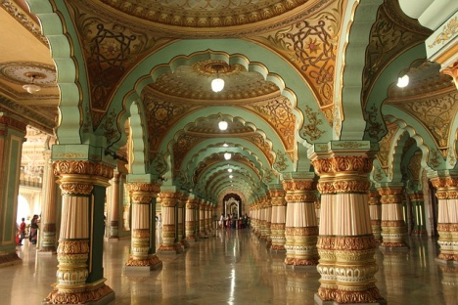
Simple Present Tense
The Simple Present Tense also expresses the state of being.
Examples
1. The teacher gets angry with naughty children.
2. She looks tired.
3. The king and the queen live in this beautiful palace.
4. We wish the best for you.
Notes:
Notes for Teacher - <.>
Suggestions: <Ideas/ Images/ Animations / Others – To make better representation of the content >
Source of Multimedia used in this slide -
<teacher and child> - <https://pixabay.com/vectors/girl-studying-teacher-school-5432233/>
<tired> - <https://pixabay.com/illustrations/girl-bored-sleepy-boredom-couch-5835891/>
<palace> - < https://pixabay.com/photos/palace-india-architecture-old-3767237/>
<best wishes> - <https://pixabay.com/illustrations/best-wish-good-luck-best-wishes-951468/>

Slide 9
MM INDEX
Slide # | Thumbnail | Source link and Attribution
1 |  | https://pixabay.com/illustrations/past-present-future-monitor-4026781/
2,4 |  | <teacher> : SSSVV Gallery. Search Keyword “teacher” <black board> - https://pixabay.com/illustrations/chalkboard-blackboard-chalk-board-163601/
3 |  | <action> - https://pixabay.com/illustrations/movement-driving-wiggle-3634992/
5 |  | <sisters> - https://pixabay.com/photos/people-child-portrait-girl-india-3300436/ <alarm clock> - https://pixabay.com/photos/morning-clock-alarm-1092771/ < glass of water> - https://pixabay.com/photos/glass-of-water-water-glass-thirst-4087606/ <cleaning> - https://pixabay.com/vectors/clean-cleaner-cleaning-service-3614744/
5,6 |  | <cricket> - https://pixabay.com/vectors/cricket-bat-cricketer-player-33064/
6 |  | <chess> - https://pixabay.com/vectors/chess-chess-face-off-chess-players-1295462/ <hardwork> - https://pixabay.com/vectors/archimedes-lever-quarryman-worker-148273/
7 |  | <rotation> - https://pixabay.com/illustrations/sun-star-earth-cosmos-rays-balls-1884518/ <leaf photosynthesis> - https://pixabay.com/illustrations/plant-photosynthesis-sunlight-leaf-3759893/ <earth> - https://pixabay.com/photos/solar-system-sun-mercury-venus-439046/
8 |  | <teacher and child> - https://pixabay.com/vectors/girl-studying-teacher-school-5432233/ <tired> - https://pixabay.com/illustrations/girl-bored-sleepy-boredom-couch-5835891/ <palace> - https://pixabay.com/photos/palace-india-architecture-old-3767237/ <best wishes> - https://pixabay.com/illustrations/best-wish-good-luck-best-wishes-951468/
Notes:
Notes for Teacher - < Information for further reference or explanation >
Suggestions: <Ideas/ Images/ Animations / Others – To make better representation of the content >
Source of Multimedia used in this slide - <Please provide source URL where we find the image and the license agreement>

