Slide 1
Getting to Know about the Past Tense
Notes:
Notes for Teacher - Students will be able to understand the difference between simple present tense and simple past tense, define simple past tense and write sentences in the simple past tense.
Suggestions: <Ideas/ Images/ Animations / Others – To make better representation of the content >
Source of Multimedia used in this slide –
https://pixabay.com/illustrations/past-present-future-monitor-4026781/

Slide 2
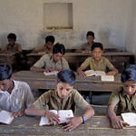
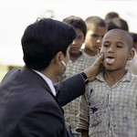
Simple Present Tense
Some Examples:
Mohit studies for his exams. (now)
Priya colours the pictures.(now)
The Sun sets in the West. (scientific fact)
My brother is a doctor. (a state of being)
Notes:
Notes for Teacher – The teacher should briefly review the Verb Tense and Simple Present Tense by writing a few sentences on the blackboard and eliciting responses from the students , by asking questions like – ‘When is Mohit studying for his exams?’, ‘When is Priya colouring a picture?’.
Suggestions: <Ideas/ Images/ Animations / Others – To make better representation of the content >
Source of Multimedia used in this slide -
Student: https://www.flickr.com/photos/10816734@N03/2243054338 by World Bank Photo Collection
Sunset: https://pixabay.com/illustrations/sunset-palm-trees-silhouettes-1651426/
Doctor: https://www.flickr.com/photos/10816734@N03/2183640710 by World Bank Photo Collection
Coloring: https://pixabay.com/photos/crayons-coloring-book-coloring-hand-1445053/

Slide 3
Simple Past Tense
Timeline
Today = What day is today?
What day was yesterday?
More examples
last week
last year
last weekend
before summer
Notes:
Notes for Teacher –
Suggestions: <Ideas/ Images/ Animations / Others – To make better representation of the content >
Source of Multimedia used in this slide -

Slide 4
Simple Past Tense
Talks about action before now
Simple Past Tense
Action can be recent or distant past
How long ago is not important
Notes:
Notes for Teacher –
Suggestions: <Ideas/ Images/ Animations / Others – To make better representation of the content >
Source of Multimedia used in this slide -

Slide 5
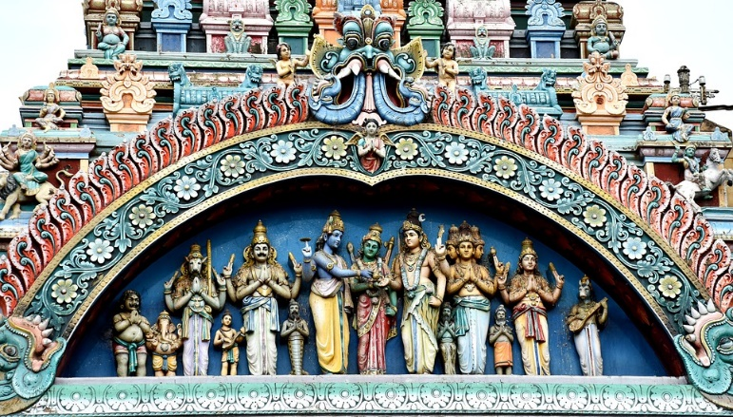
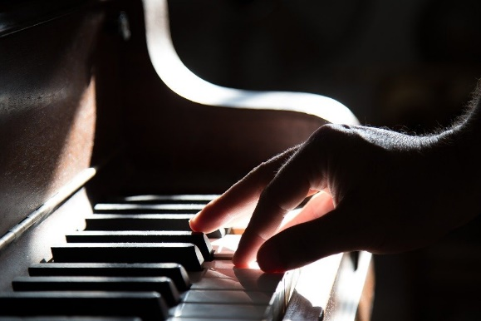
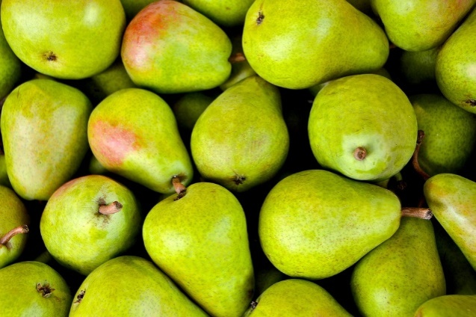
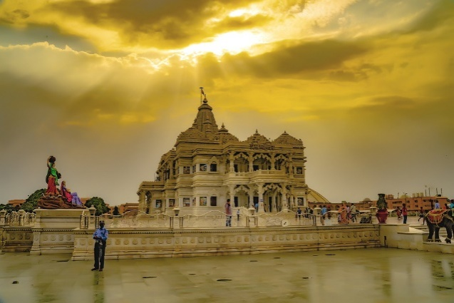
Simple Past Tense: Examples
We lived in Madurai in 2010.
She played the piano for the school function.
I bought some fruit yesterday.
He went to Mathura last night.
Notes:
Notes for Teacher –
Suggestions: <Ideas/ Images/ Animations / Others – To make better representation of the content >
Source of Multimedia used in this slide -
Madurai: https://pixabay.com/photos/meenakshi-sundareswarar-marriage-1576101/
Piano: https://pixabay.com/photos/piano-hand-playing-music-keyboard-801707/
Fruit: https://pixabay.com/photos/fruits-pears-green-fresh-ripe-1534494/
Mathura: https://pixabay.com/photos/indian-temple-vrindavan-mathura-4782316/

Slide 6
Rule 1: Form past tense with regular verb
Subject + verb + ‘d’ (or ‘ied’ or ‘ed’)
I liked the movie. (like + d)
She danced gracefully. (dance + d)
The little child cried when he saw the tiger (cry - y + ied)
He finished his work by seven o’ clock (finish + ed)
She asked for directions to the railway station. (ask + ed)
Notes:
Notes for Teacher –
Suggestions: <Ideas/ Images/ Animations / Others – To make better representation of the content >
Source of Multimedia used in this slide -

Slide 7
Rule 2: Form past tense with irregular verb
Verb changes completely
Irregular Verb | Past Tense | Example
go | went | They went to the shopping mall.
eat | ate | He ate an apple.
buy | bought | He bought a new car.
bring | brought | She brought some books.
do | did | I did my homework in the afternoon.
sing | sang | The little child sang many songs.
Notes:
Notes for Teacher –
Suggestions: <Ideas/ Images/ Animations / Others – To make better representation of the content >
Source of Multimedia used in this slide -

Slide 8
Some common irregular verbs
Irregular Verb | Past Tense
find | found
drive | drove
forget | forgot
break | broke
go | went
keep | kept
hear | heard
know | knew
make | made
Irregular Verb | Past Tense
take | took
build | built
think | thought
write | wrote
understand | understood
meet | met
fly | flew
become | became
come | came
Notes:
Notes for Teacher – The teacher can use the lists of words and give the students enough practice to understand their usage.
Suggestions: <Ideas/ Images/ Animations / Others – To make better representation of the content >
Source of Multimedia used in this slide -

Slide 9
Words that do not change
Present Tense | Past Tense
cut | cut
put | put
hit | hit
shut | shut
beat | beat
fit | fit
read (pronounced as ‘Reed’) | read (pronounced as ‘Red’)
Notes:
Notes for Teacher – The teacher can use the lists of words and give the students enough practice to understand their usage.
Suggestions: <Ideas/ Images/ Animations / Others – To make better representation of the content >
Source of Multimedia used in this slide -

Slide 10
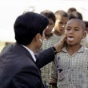
MM INDEX
Slide # | Thumbnail | Source link and Attribution
1 |  | https://pixabay.com/illustrations/past-present-future-monitor-4026781/
2 |  | Student: https://www.flickr.com/photos/10816734@N03/2243054338 by World Bank Photo Collection Sunset: https://pixabay.com/illustrations/sunset-palm-trees-silhouettes-1651426/ Doctor: https://www.flickr.com/photos/10816734@N03/2183640710 by World Bank Photo Collection Coloring: https://pixabay.com/photos/crayons-coloring-book-coloring-hand-1445053/
5 |  | Madurai: https://pixabay.com/photos/meenakshi-sundareswarar-marriage-1576101/ Piano: https://pixabay.com/photos/piano-hand-playing-music-keyboard-801707/ Fruit: https://pixabay.com/photos/fruits-pears-green-fresh-ripe-1534494/ Mathura: https://pixabay.com/photos/indian-temple-vrindavan-mathura-4782316/
Notes:
Notes for Teacher - < Information for further reference or explanation >
Suggestions: <Ideas/ Images/ Animations / Others – To make better representation of the content >
Source of Multimedia used in this slide - <Please provide source URL where we find the image and the license agreement>

