Slide 1
Testing Time - Tenses
Notes:
Notes for Teacher - < Information for further reference or explanation >
Suggestions: <Ideas/ Images/ Animations / Others – To make better representation of the content >
Source of Multimedia used in this slide -
https://pixabay.com/illustrations/recycle-past-present-future-2327550/

Slide 2
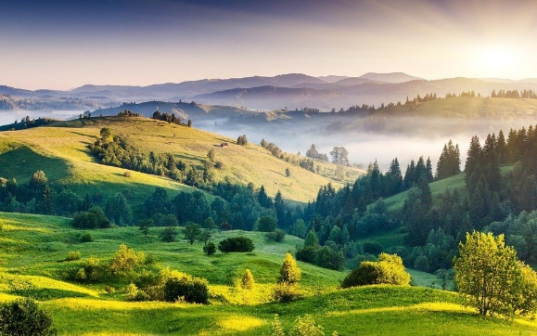
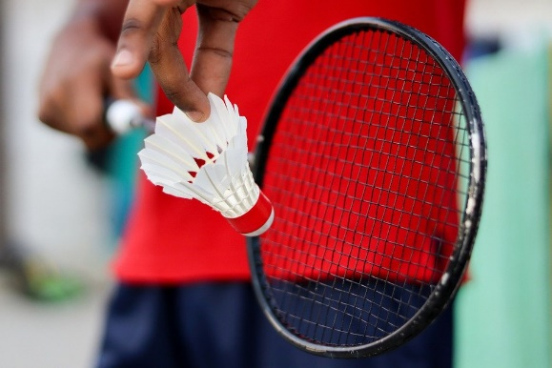
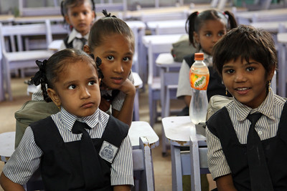
Exercise 1
Underline the Simple Present Tense verbs in the sentences given below.
The Sun rises in the East.
The baby sleeps in the cradle.
I am an engineer.
Rita and Renu always talk in the classroom.
She enjoys the game of badminton.
Notes:
Notes for Teacher - < Information for further reference or explanation >
Suggestions: <Ideas/ Images/ Animations / Others – To make better representation of the content >
Source of Multimedia used in this slide -
Sunrise: https://pixabay.com/photos/hills-india-nature-kodaikanal-2836301/
Badminton: https://pixabay.com/photos/badminton-racket-shuttlecock-sport-6030860/
Engineer: https://pixabay.com/photos/engineer-engineering-civil-engineer-4941163/
Girls: https://www.flickr.com/photos/10816734@N03/3491668419 By World Bank Photo Collection

Slide 3
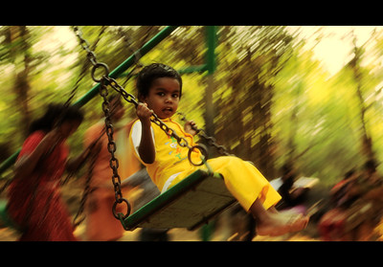
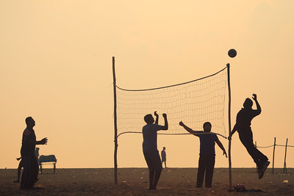
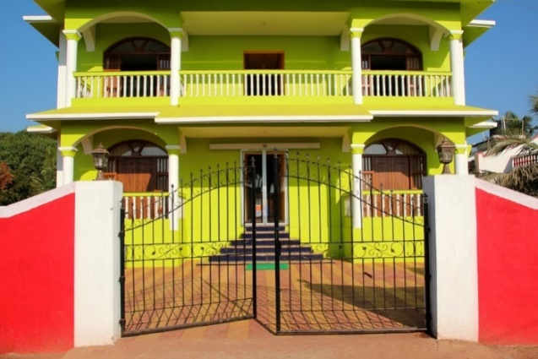
Exercise 2
Underline the Simple Past Tense verbs in the sentences given below.
We did a lot of shopping yesterday.
Mohit went to buy some toys for his younger brother.
My mother took my sister to the park.
He bought a new house last month.
The two boys played with a ball.
Notes:
Notes for Teacher - < Information for further reference or explanation >
Suggestions: <Ideas/ Images/ Animations / Others – To make better representation of the content >
Source of Multimedia used in this slide -
House: https://pixabay.com/photos/house-multicoloured-india-gate-1028456/
Volleyball: https://www.flickr.com/photos/vinothchandar/11562749464/ By Vinoth Chandar
Girl Swing: https://www.flickr.com/photos/vinothchandar/5265847730/ By Vinoth Chandar

Slide 4
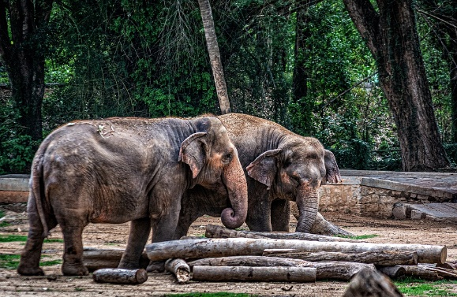
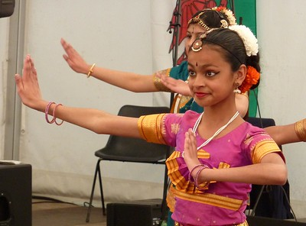
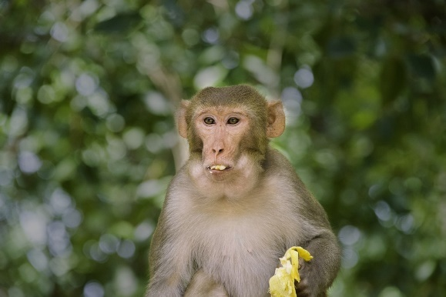
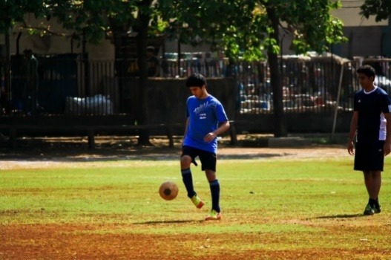
Exercise 3
Complete these sentences with the correct Present Tense form of the verb given in brackets:
The elephant ____ (use) its trunk to pick up things.
The old man _____ (make) wonderful toys.
She ______ (dance) very well.
He ______ (play) football every morning.
Monkeys _____ (eat) bananas and peanuts.
uses
makes
dances
plays
eat
Notes:
Notes for Teacher - < Information for further reference or explanation >
Suggestions: <Ideas/ Images/ Animations / Others – To make better representation of the content >
Source of Multimedia used in this slide -
Monkey: https://pixabay.com/photos/monkey-banana-india-mohan-5356073/
Dance: https://www.flickr.com/photos/26445715@N00/7247901062 By Mike Finn
Elephant: https://pixabay.com/photos/elephants-pachyderm-animal-wild-4509411/
Football: https://pixabay.com/photos/soccer-football-ball-player-man-390559/

Slide 5
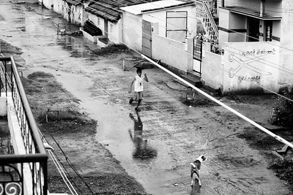
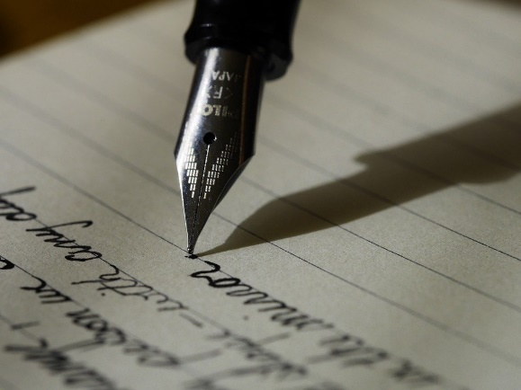
Exercise 4
Convert the verbs in brackets into their correct Past Tense form to complete these sentences
Last year we _____(go) to my uncle’s house.
I _______(wait) ten minutes for the bus.
The dog ________(follow) his master to the shop.
He _____ (write) a letter to his friend.
Where _____(be) you last Saturday?
went
waited
followed
wrote
were
Notes:
Notes for Teacher - < Information for further reference or explanation >
Suggestions: <Ideas/ Images/ Animations / Others – To make better representation of the content >
Source of Multimedia used in this slide -
Letter: https://pixabay.com/photos/writing-write-fountain-pen-ink-1209121/
Dog: https://www.flickr.com/photos/vinothchandar/10960940954/ By Vinoth Chandar

Slide 6
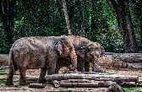
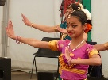
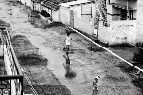
MM INDEX
Slide # | Thumbnail | Source link and Attribution
1 |  | https://pixabay.com/illustrations/recycle-past-present-future-2327550/
2 |  | Sunrise: https://pixabay.com/photos/hills-india-nature-kodaikanal-2836301/ Badminton: https://pixabay.com/photos/badminton-racket-shuttlecock-sport-6030860/ Engineer: https://pixabay.com/photos/engineer-engineering-civil-engineer-4941163/ Girls: https://www.flickr.com/photos/10816734@N03/3491668419 By World Bank Photo Collection
3 |  | House: https://pixabay.com/photos/house-multicoloured-india-gate-1028456/ Volleyball: https://www.flickr.com/photos/vinothchandar/11562749464/ By Vinoth Chandar Girl Swing: https://www.flickr.com/photos/vinothchandar/5265847730/ By Vinoth Chandar
4 |  | Monkey: https://pixabay.com/photos/monkey-banana-india-mohan-5356073/ Dance: https://www.flickr.com/photos/26445715@N00/7247901062 By Mike Finn Elephant: https://pixabay.com/photos/elephants-pachyderm-animal-wild-4509411/ Football: https://pixabay.com/photos/soccer-football-ball-player-man-390559/
5 |  | Letter: https://pixabay.com/photos/writing-write-fountain-pen-ink-1209121/ Dog: https://www.flickr.com/photos/vinothchandar/10960940954/ By Vinoth Chandar
Notes:
Notes for Teacher - < Information for further reference or explanation >
Suggestions: <Ideas/ Images/ Animations / Others – To make better representation of the content >
Source of Multimedia used in this slide - <Please provide source URL where we find the image and the license agreement>

