Slide 1
Worksheet on Tenses
Notes:
Notes for Teacher - < Information for further reference or explanation >
Suggestions: <Ideas/ Images/ Animations / Others – To make better representation of the content >
Source of Multimedia used in this slide - <Please provide source URL where we find the image and the license agreement>
<writing> <https://pixabay.com/illustrations/student-child-homework-boy-male-5677625/>

Slide 2
Exercise 1
Rewrite the sentences in the past tense form of the underlined verbs.
He runs fast.
He wakes up at six o’clock in the morning.
She leaves her things on the table.
I drink coffee in the morning.
He is an engineer with the railways.
She attends music classes regularly.
We live in Bangalore.
He ran fast.
He woke up at six o’clock in the morning.
She left her things on the table.
I drank coffee in the morning.
He was an engineer with the railways.
She attended music classes regularly.
We lived in Bangalore.
Notes:
Notes for Teacher - < Information for further reference or explanation >
Suggestions: <Ideas/ Images/ Animations / Others – To make better representation of the content >
Source of Multimedia used in this slide - <Please provide source URL where we find the image and the license agreement>

Slide 3
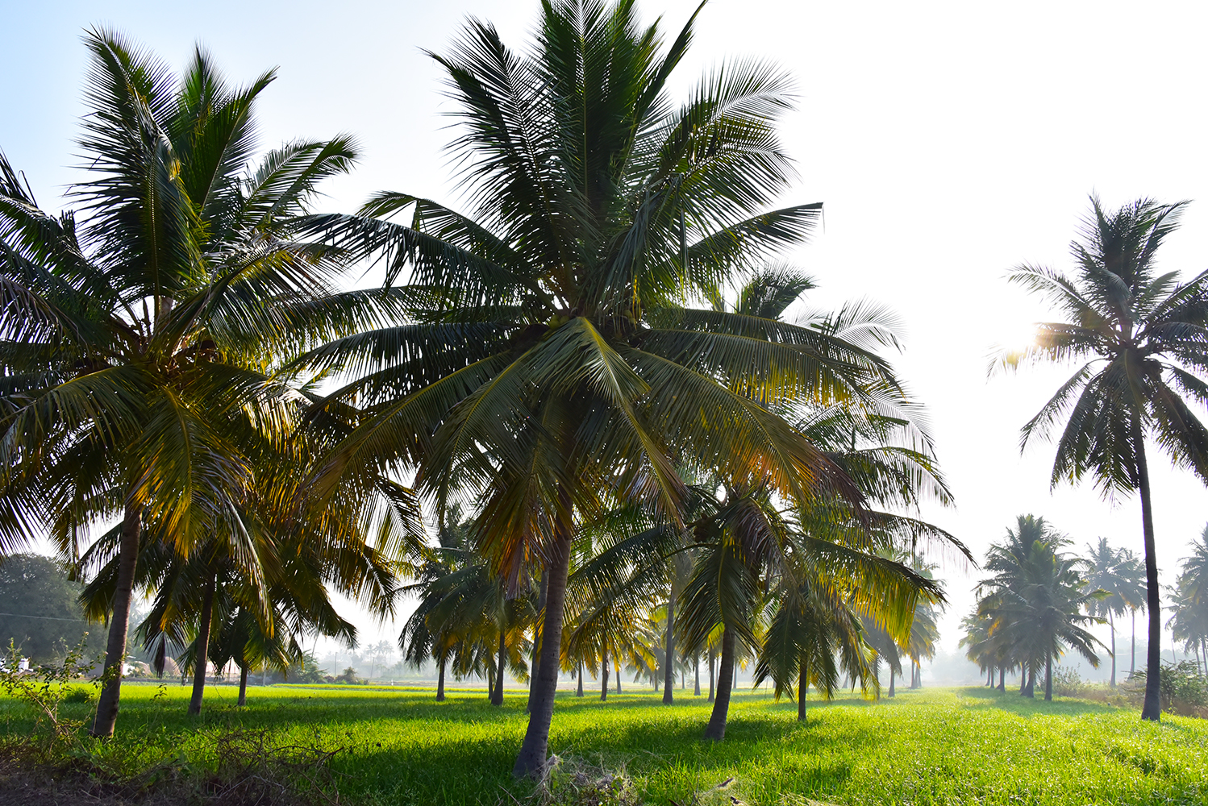
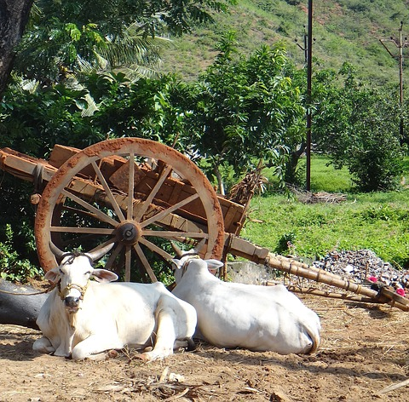
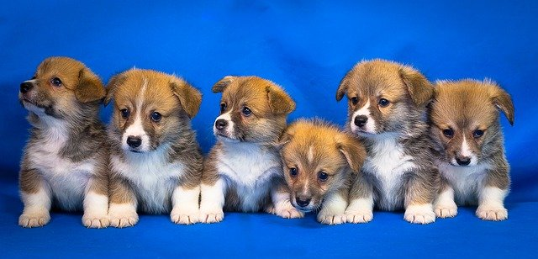
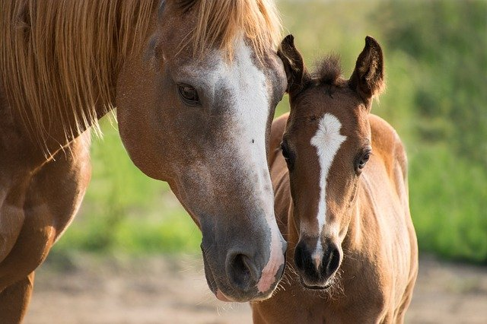
Exercise 2
Fill in the blanks with the words given below:
went
feeds
are
enjoyed
has
lives
takes
drink
A visit to my Grandfather’s farm
In May, I ______ to my grandfather’s house. He _____ in a village. He _____ a big farm. There ____ many animals on his farm. There are two cows, a dog with its puppies and two horses. Every morning he _______ his animals with hay or milk. They ______ water from a pond on the farm. He ______ good care of the farm animals. I _________ the visit to my grandfather‘s farm.
went
lives
has
are
feeds
drink
takes
enjoyed
Notes:
Notes for Teacher - < Information for further reference or explanation >
Suggestions: <Ideas/ Images/ Animations / Others – To make better representation of the content >
Source of Multimedia used in this slide - <Please provide source URL where we find the image and the license agreement>
<farm> <https://pixabay.com/illustrations/farmer-animals-barn-duck-pig-goat-3881993/>

Slide 4
Exercise 3: Mixed - Present and Past Tense
Complete the sentences with the correct form of tense of the verb given in the brackets. Both simple present tense or simple past tense answer is accepted.
Example:
He (open)_________the windows for the bird to fly out.
He opened the windows for the bird to fly out. (opened - PAST Tense)
OR
He opens the windows for the bird to fly out. (opens - PRESENT Tense)
goes/went to school by the school bus
He (go) ___________________________________ .
We (learn) ___________________________________.
It (rain) ___________________________________.
I (meet) ___________________________________.
My sister (helpful) _____________________________.
learned/learn how to draw tall trees
rains/rained heavily in the month of July
met/meet my friends in the garden
helps/helped me do my homework
Notes:
Notes for Teacher - < Information for further reference or explanation >
Suggestions: <Ideas/ Images/ Animations / Others – To make better representation of the content >
Source of Multimedia used in this slide - <Please provide source URL where we find the image and the license agreement>
<test> <https://pixabay.com/illustrations/quiz-exam-test-school-education-5351649/>

Slide 5
MM INDEX
Slide # | Thumbnail | Source link and Attribution
1 |  | <writing> https://pixabay.com/illustrations/student-child-homework-boy-male-5677625/
3 |  | <Farm> SSSVV Image Gallery: Search Keyword “farm” <Cows> https://pixabay.com/photos/woman-cows-cattle-india-wagon-978343/ <Horse> https://pixabay.com/photos/foal-mare-mother-paint-horse-brown-3467629/ <Puppies> https://pixabay.com/photos/welsh-corgi-pembroke-dog-puppy-3097215/
4 |  | <test> https://pixabay.com/illustrations/quiz-exam-test-school-education-5351649/
Notes:
Notes for Teacher - < Information for further reference or explanation >
Suggestions: <Ideas/ Images/ Animations / Others – To make better representation of the content >
Source of Multimedia used in this slide - <Please provide source URL where we find the image and the license agreement>

