Slide 1
Learning About Exclamation Marks
Notes:
Notes for Teacher - < Information for further reference or explanation >
Suggestions: <Ideas/ Images/ Animations / Others – To make better representation of the content >
Source of Multimedia used in this slide - <Please provide source URL where we find the image and the license agreement>
<exclamation marks> <https://pixabay.com/illustrations/exclamation-mark-matter-requests-507768/>

Slide 2
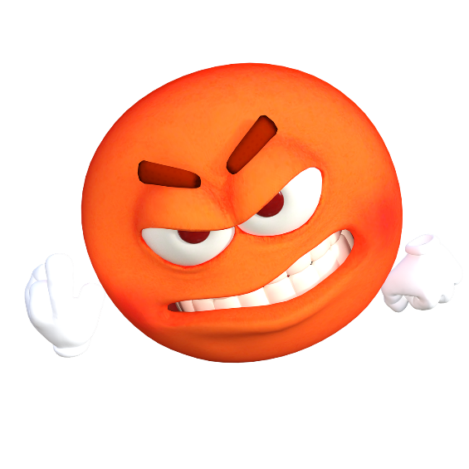
Exclamation Mark
It is used at the end of a sentence when you are expressing a strong emotion.
fear or shock
surprise
anger
Notes:
Notes for Teacher - < Information for further reference or explanation >
Suggestions: <Ideas/ Images/ Animations / Others – To make better representation of the content >
Source of Multimedia used in this slide - <Please provide source URL where we find the image and the license agreement>
<scared> <https://pixabay.com/illustrations/smiley-scared-surprised-fear-shock-1958283/>
<angry> <https://pixabay.com/illustrations/emoticon-emoji-angry-swearing-1669804/>
<surprise> <https://pixabay.com/vectors/graphic-smiley-emoji-emoticon-3850583/>

Slide 3
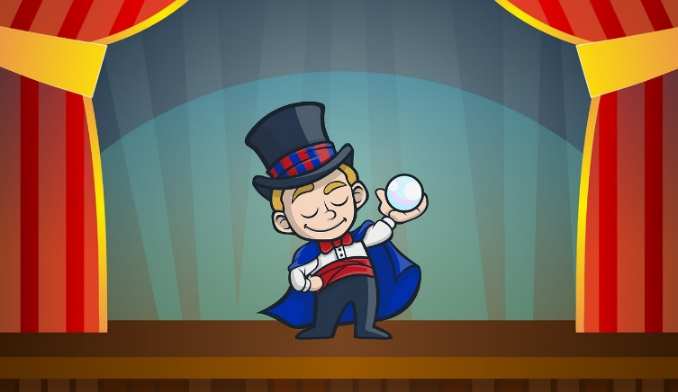
Examples
Help! Help! (expression of fear and helplessness)
That's a beautiful garden! (expression of praise)
What a great magic show! (expression of wonder or surprise)
Happy birthday, Amrita! (expression of greeting or wishing)
Notes:
Notes for Teacher - < Information for further reference or explanation >
Suggestions: <Ideas/ Images/ Animations / Others – To make better representation of the content >
Source of Multimedia used in this slide - <Please provide source URL where we find the image and the license agreement>
<help> <https://pixabay.com/vectors/panic-man-screaming-running-person-149063/>
<garden> <https://pixabay.com/vectors/flowers-garden-summer-sun-colorful-5181243/>
<magic> <https://pixabay.com/illustrations/magic-show-stage-cartoon-circus-3988229/>
<birthday> <https://pixabay.com/illustrations/happy-birthday-card-greeting-pink-1276493/>

Slide 4
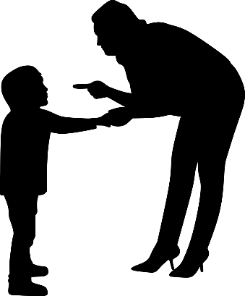
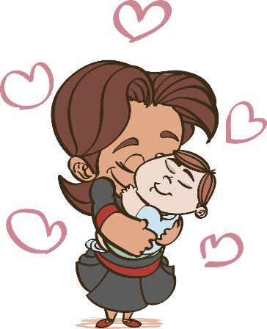
Examples
You are late again! (expression of anger)
That is a huge whale! (expression of surprise)
Congratulations! You have won the match. (expression of happiness or excitement)
Thank God! He saved the baby’s life. (expression of relief)
Notes:
Notes for Teacher - < Information for further reference or explanation >
Suggestions: <Ideas/ Images/ Animations / Others – To make better representation of the content >
Source of Multimedia used in this slide - <Please provide source URL where we find the image and the license agreement>
<angry> <https://pixabay.com/vectors/discipline-angry-woman-mother-4145087/>
<whale> <https://pixabay.com/vectors/whale-humpback-blowhole-mammal-36828/>
<trophy> <https://pixabay.com/vectors/trophy-winner-cup-champion-gold-4145177/>
<baby> <https://pixabay.com/vectors/mom-love-family-baby-maternity-4839682/>

Slide 5
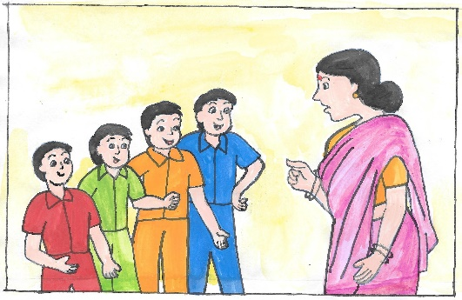
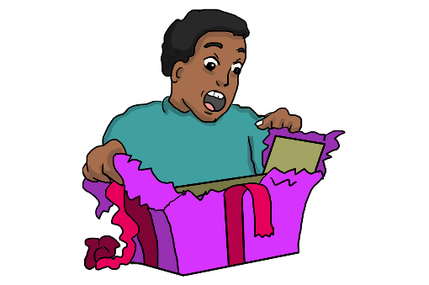
Rule 1
Use an exclamation mark to express a strong emotion, surprise, or to draw attention to something.
The storm is coming! (Drawing attention)
I love my teacher! (Strong emotion)
What is this! (surprise)
Notes:
Notes for Teacher - < Information for further reference or explanation >
Suggestions: <Ideas/ Images/ Animations / Others – To make better representation of the content >
Source of Multimedia used in this slide - <Please provide source URL where we find the image and the license agreement>
<storm> <https://pixabay.com/illustrations/cloud-flash-storm-rain-4510143/>
<teacher> <SSSVV>
<surprise> <https://pixabay.com/illustrations/surprised-face-surprised-surprise-3311671/>

Slide 6
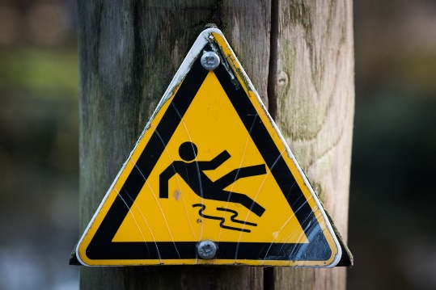
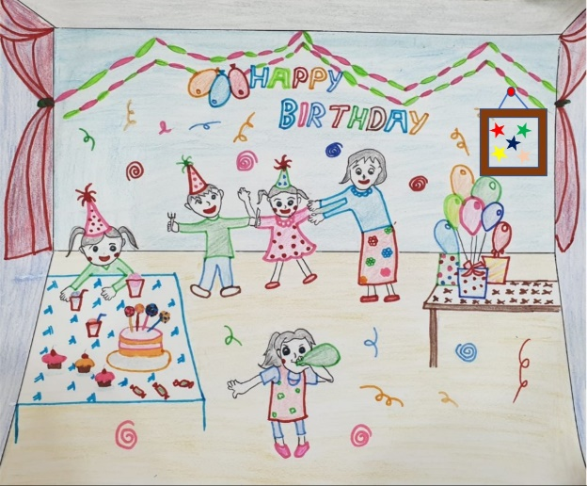
Rule 2
We use an exclamation mark at the end of a command, an interjection or an emphatic declaration.
“Stop!“ he shouted. You have jumped the red light.
“Don’t walk on the wet grass!”
“How wonderful!“
Notes:
Notes for Teacher - < Information for further reference or explanation >
Suggestions: <Ideas/ Images/ Animations / Others – To make better representation of the content >
Source of Multimedia used in this slide - <Please provide source URL where we find the image and the license agreement>
<stop> <https://pixabay.com/vectors/traffic-sign-stop-road-sign-157617/>
<slippery> <https://pixabay.com/photos/slippery-signal-sign-wet-yellow-637562/>
<birthday party> <SSSVV>

Slide 7
Rule 3
We can begin sentences with ‘What’ and ‘How’ and use the exclamation mark to express feelings of surprise or appreciation.
What a cute puppy!
How fast you ran!
What a performance!
Notes:
Notes for Teacher - < Information for further reference or explanation >
Suggestions: <Ideas/ Images/ Animations / Others – To make better representation of the content >
Source of Multimedia used in this slide - <Please provide source URL where we find the image and the license agreement>
<cute pappa> <https://pixabay.com/illustrations/dog-pet-puppy-animal-cute-cartoon-5497928/>
<running> <https://pixabay.com/illustrations/runner-silhouette-man-woman-5403258/>
<dance> <https://pixabay.com/vectors/silhouette-indian-dancer-beautiful-3837379/>

Slide 8
MM INDEX
Slide # | Thumbnail | Source link and Attribution
1 |  | <exclamation marks> https://pixabay.com/illustrations/exclamation-mark-matter-requests-507768/
2 |  | <scared> https://pixabay.com/illustrations/smiley-scared-surprised-fear-shock-1958283/ <angry> https://pixabay.com/illustrations/emoticon-emoji-angry-swearing-1669804/ <surprise> https://pixabay.com/vectors/graphic-smiley-emoji-emoticon-3850583/
3 |  | <help> https://pixabay.com/vectors/panic-man-screaming-running-person-149063/ <garden> https://pixabay.com/vectors/flowers-garden-summer-sun-colorful-5181243/ <magic> https://pixabay.com/illustrations/magic-show-stage-cartoon-circus-3988229/ <birthday> https://pixabay.com/illustrations/happy-birthday-card-greeting-pink-1276493/
4 |  | <angry> https://pixabay.com/vectors/discipline-angry-woman-mother-4145087/ <whale> https://pixabay.com/vectors/whale-humpback-blowhole-mammal-36828/ <trophy> https://pixabay.com/vectors/trophy-winner-cup-champion-gold-4145177/ <baby> https://pixabay.com/vectors/mom-love-family-baby-maternity-4839682/
5 |  | <storm> https://pixabay.com/illustrations/cloud-flash-storm-rain-4510143/ <teacher> <SSSVV: Search Keyword “teacher”> <surprise> https://pixabay.com/illustrations/surprised-face-surprised-surprise-3311671/
6 |  | <stop> https://pixabay.com/vectors/traffic-sign-stop-road-sign-157617/ <slippery> https://pixabay.com/photos/slippery-signal-sign-wet-yellow-637562/ <birthday party> <SSSVV: Search Keyword “birthday”>
7 |  | <cute puppy> https://pixabay.com/illustrations/dog-pet-puppy-animal-cute-cartoon-5497928/ <running> https://pixabay.com/illustrations/runner-silhouette-man-woman-5403258/ <dance> https://pixabay.com/vectors/silhouette-indian-dancer-beautiful-3837379/
Notes:
Notes for Teacher - < Information for further reference or explanation >
Suggestions: <Ideas/ Images/ Animations / Others – To make better representation of the content >
Source of Multimedia used in this slide - <Please provide source URL where we find the image and the license agreement>

