Slide 1
Punctuation
Notes:
Notes for Teacher - < Information for further reference or explanation >
Suggestions: <Ideas/ Images/ Animations / Others – To make better representation of the content >
Source of Multimedia used in this slide - <Please provide source URL where we find the image and the license agreement>
<quiz time> <https://pixabay.com/vectors/quiz-time-quiz-time-answer-sign-2453148/>

Slide 2
Quiz Time
.
FULL STOP
He loves to eat bitter things
?
What is your favourite subject
!
Stop that man
!
Keep quiet
Notes:
Notes for Teacher - < Information for further reference or explanation >
Suggestions: <Ideas/ Images/ Animations / Others – To make better representation of the content >
Source of Multimedia used in this slide - <Please provide source URL where we find the image and the license agreement>
<classroom> <https://pixabay.com/illustrations/school-children-desks-school-4321808/>

Slide 3
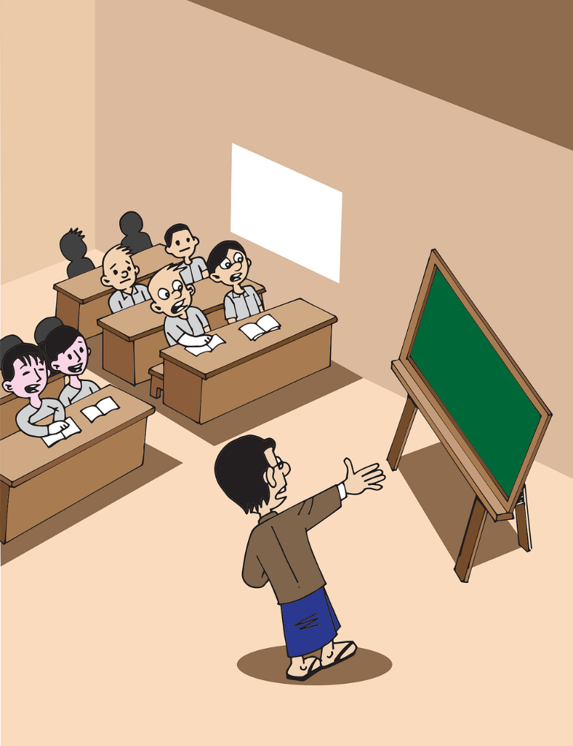
Quiz Time
!
What lovely weather
.
FULL STOP
Anu is a talented girl
?
Where do you live in Delhi
Notes:
Notes for Teacher - < Information for further reference or explanation >
Suggestions: <Ideas/ Images/ Animations / Others – To make better representation of the content >
Source of Multimedia used in this slide - <Please provide source URL where we find the image and the license agreement>
<classroom> <https://pixabay.com/vectors/myanmar-burma-school-classroom-5221135/>

Slide 4
Quiz Time
We study English Mathematics Science History and Geography at school
.
FULL STOP
,
COMMA
,
,
,
.
Pawan Deepak and Suman are participating in the quiz competition
.
FULL STOP
,
COMMA
,
.
I bought some fruits vegetables milk and sweets from the supermarket
.
FULL STOP
,
COMMA
,
,
,
.
Notes:
Notes for Teacher - < Information for further reference or explanation >
Suggestions: <Ideas/ Images/ Animations / Others – To make better representation of the content >
Source of Multimedia used in this slide - <Please provide source URL where we find the image and the license agreement>

Slide 5
MM INDEX
Slide # | Thumbnail | Source link and Attribution
1 |  | <quiz time> https://pixabay.com/vectors/quiz-time-quiz-time-answer-sign-2453148/
2 |  | <classroom> https://pixabay.com/illustrations/school-children-desks-school-4321808/
3 |  | <classroom> https://pixabay.com/vectors/myanmar-burma-school-classroom-5221135/
Notes:
Notes for Teacher - < Information for further reference or explanation >
Suggestions: <Ideas/ Images/ Animations / Others – To make better representation of the content >
Source of Multimedia used in this slide - <Please provide source URL where we find the image and the license agreement>

