Slide 1
Identification Of Punctuation
Notes:
Notes for Teacher - < Information for further reference or explanation >
Suggestions: <Ideas/ Images/ Animations / Others – To make better representation of the content >
Source of Multimedia used in this slide - <Please provide source URL where we find the image and the license agreement>
<punctuation marks> <https://pixabay.com/illustrations/punctuation-marks-word-language-2999583/>

Slide 2
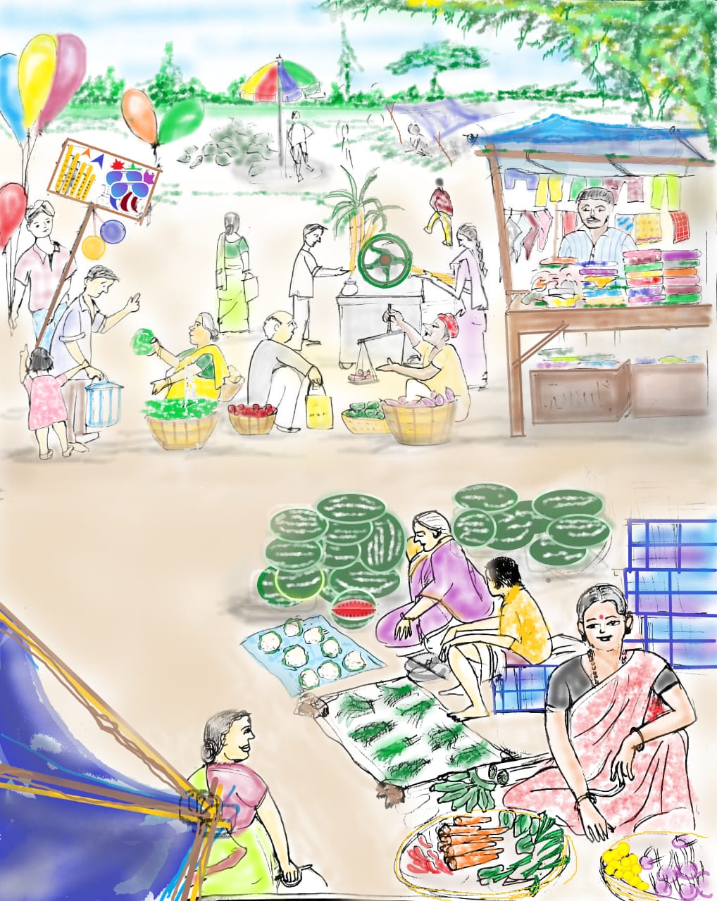
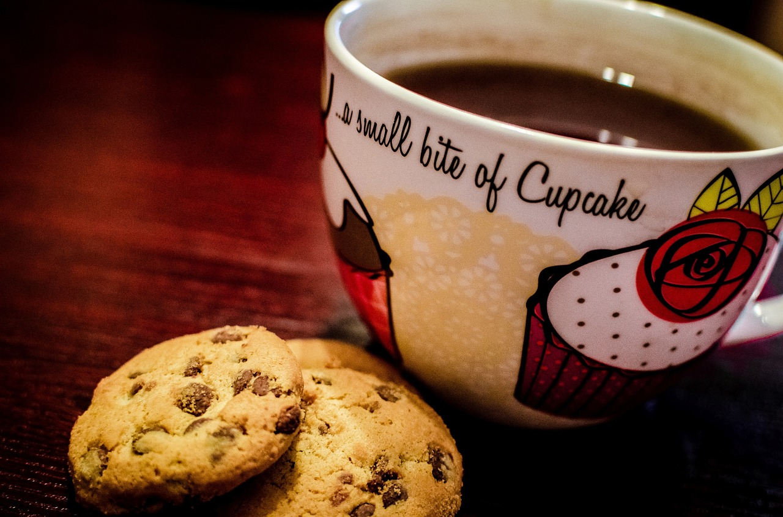
Exercise 1
Put the correct punctuation marks in the blanks to complete the sentences. Full Stop(.) Comma(,) Question Mark(?) and an Exclamation Mark (!)
.
He hates milk
Who is your class teacher
Pawan Deepak and Suman are playing hide and seek
My mother bought meat fish and vegetables at the supermarket
Anu is a good girl
We had coffee biscuits and grapes
Where did you buy this motorcycle
?
,
.
,
.
.
,
.
?
Notes:
Notes for Teacher - < Information for further reference or explanation >
Suggestions: <Ideas/ Images/ Animations / Others – To make better representation of the content >
Source of Multimedia used in this slide - <Please provide source URL where we find the image and the license agreement>
<coffee> <https://pixabay.com/photos/cookies-coffee-dessert-espresso-933050/>
<market> <SSSVV>

Slide 3
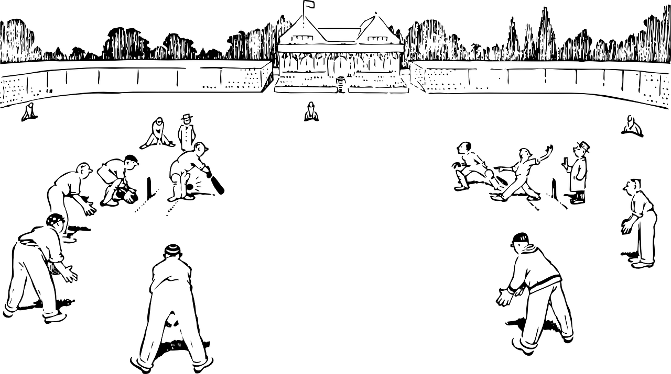
Exercise 2
Complete the following sentences using how, what and such at the appropriate places.
______cold it is!
_______a beautiful garden!
She is ______a nice girl!
______lovely weather!
______ a great game!
______generous she is!
______a hot day!
How
Such
such
What
What
How
What
Notes:
Notes for Teacher - < Information for further reference or explanation >
Suggestions: <Ideas/ Images/ Animations / Others – To make better representation of the content >
Source of Multimedia used in this slide - <Please provide source URL where we find the image and the license agreement>
<heat> <https://pixabay.com/illustrations/heat-sweat-summer-hot-sun-warmth-4270426/>
<game> <https://pixabay.com/vectors/cricket-ground-pitch-sports-sketch-32265/>
<garden> <https://pixabay.com/vectors/flowers-garden-summer-sun-colorful-5181243/>

Slide 4
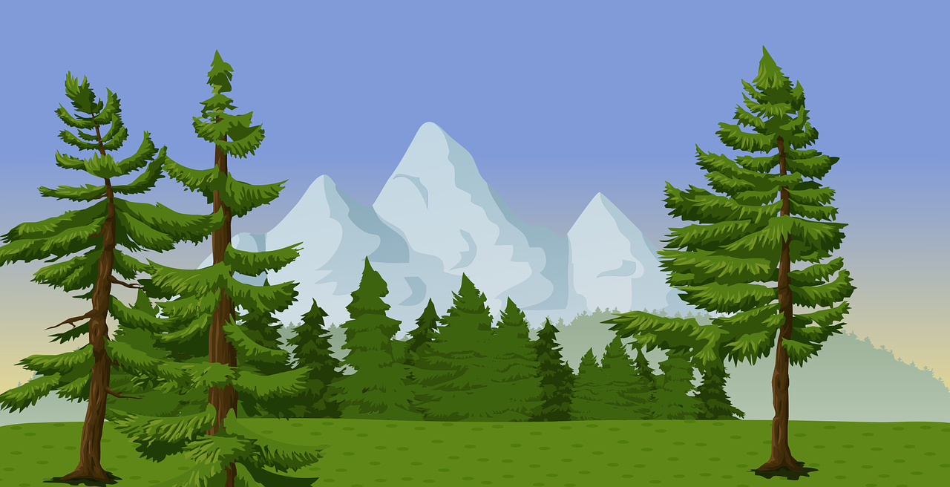
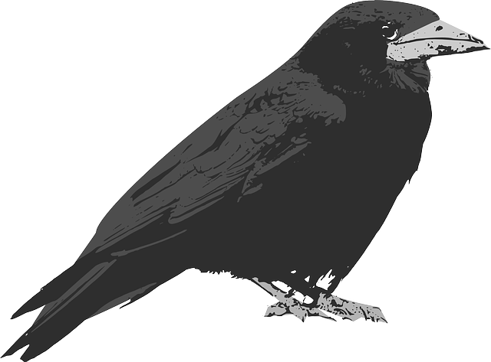
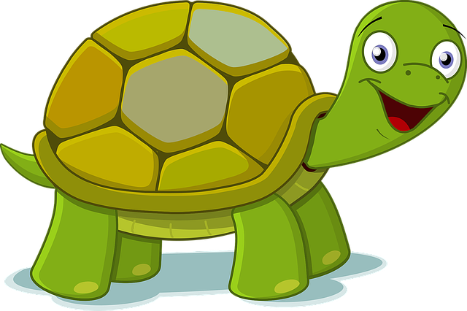
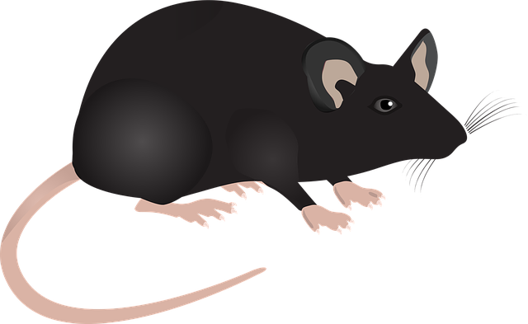
Exercise 3
Rewrite the passage using the correct punctuation marks like capital letters, commas, full stops, question marks and exclamation marks.
once upon a time there lived four friends in a forest they were a mouse a crow a deer and a tortoise
one day all the four friends were chatting under a tree and they suddenly heard a scream: it was their friend, the tortoise! He was trapped in a hunter’s net
‘’Oh” exclaimed the deer, “What do we do now “
The Four Friends And A Hunter
Notes:
Notes for Teacher - < Information for further reference or explanation >
Suggestions: <Ideas/ Images/ Animations / Others – To make better representation of the content >
Source of Multimedia used in this slide - <Please provide source URL where we find the image and the license agreement>
Forest: https://pixabay.com/vectors/evergreen-forest-landscape-2025158/
Deer: https://pixabay.com/vectors/deer-application-bambi-wild-animals-1157862/
Crow: https://pixabay.com/vectors/raven-crow-grey-black-147530/
Tortoise: https://pixabay.com/vectors/animals-cartoon-green-happy-1298747/
Mouse: https://pixabay.com/vectors/lab-mouse-mouse-science-lab-animal-1471870/

Slide 5
Exercise 3 - Answer
Once upon a time there lived four friends in a forest. They were a mouse, a crow, a deer and a tortoise.
One day all the four friends were talking under a tree and they suddenly heard a scream. It was their friend, the tortoise! He was trapped in a hunter’s net.
“Oh!” exclaimed the deer, “What do we do now?”
The Four Friends And A Hunter
Notes:
Notes for Teacher - < Information for further reference or explanation >
Suggestions: <Ideas/ Images/ Animations / Others – To make better representation of the content >
Source of Multimedia used in this slide - <Please provide source URL where we find the image and the license agreement>
<4 friends> <https://youtu.be/MLfaKlvR-gc?t=14>

Slide 6
MM INDEX
Slide # | Thumbnail | Source link and Attribution
1 |  | Punctuation marks: https://pixabay.com/illustrations/punctuation-marks-word-language-2999583/
2 |  | Coffee: https://pixabay.com/photos/cookies-coffee-dessert-espresso-933050/
2 |  | Market: SSSVV: Search Keyword “market”
3 |  | Heat: https://pixabay.com/illustrations/heat-sweat-summer-hot-sun-warmth-4270426/
3 |  | Game: https://pixabay.com/vectors/cricket-ground-pitch-sports-sketch-32265/
3 |  | Garden: https://pixabay.com/vectors/flowers-garden-summer-sun-colorful-5181243/
4,5 |  | Forest: https://pixabay.com/vectors/evergreen-forest-landscape-2025158/ Deer: https://pixabay.com/vectors/deer-application-bambi-wild-animals-1157862/ Crow: https://pixabay.com/vectors/raven-crow-grey-black-147530/ Tortoise: https://pixabay.com/vectors/animals-cartoon-green-happy-1298747/ Mouse: https://pixabay.com/vectors/lab-mouse-mouse-science-lab-animal-1471870/
Notes:
Notes for Teacher - < Information for further reference or explanation >
Suggestions: <Ideas/ Images/ Animations / Others – To make better representation of the content >
Source of Multimedia used in this slide - <Please provide source URL where we find the image and the license agreement>

