Slide 1
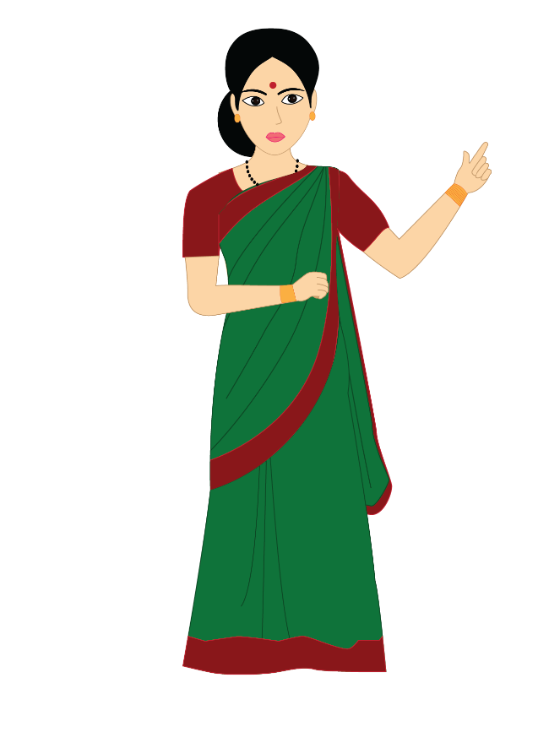
Use of A, AN and THE
Notes:
Notes for Teacher - < Information for further reference or explanation >
Suggestions: <Ideas/ Images/ Animations / Others – To make better representation of the content >
Source of Multimedia used in this slide - <Please provide source URL where we find the image and the license agreement>
<Teacher> <SSSVV Image Gallery: Search Keyword “teacher”>

Slide 2
Vowels and Consonants
Vowels
a e i o u
b c d f g h j k l m n p q r s t v w x y z
Consonants
Articles are used before nouns.
‘An’ for Vowels
‘A’, ‘The’ for Consonants
Notes:
Notes for Teacher - < Information for further reference or explanation >
Suggestions: <Ideas/ Images/ Animations / Others – To make better representation of the content >
Source of Multimedia used in this slide - <Please provide source URL where we find the image and the license agreement>

Slide 3
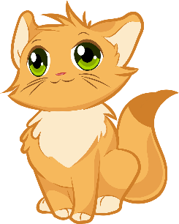
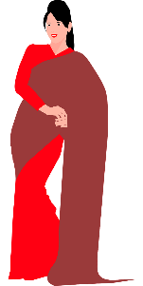
Articles - ‘A’ and ‘An’
Used to introduce a naming word
Used to talk about one person, animal or thing
a cat
(animal)
a table
(thing)
a woman
(person)
an apple
(thing)
a dog
(animal)
Notes:
Notes for Teacher - < Information for further reference or explanation >
Suggestions: <Ideas/ Images/ Animations / Others – To make better representation of the content >
Source of Multimedia used in this slide - <Please provide source URL where we find the image and the license agreement>
<cat> <https://pixabay.com/vectors/kitten-cute-cat-animals-furry-4794761/>
<table> <https://pixabay.com/vectors/table-furniture-wooden-1300555/>
<woman> <https://pixabay.com/vectors/woman-saree-indian-young-fashion-5546375/>
<apple> <https://pixabay.com/vectors/apple-red-fruit-fresh-ripe-juicy-25236/>
<dog> <https://pixabay.com/illustrations/dog-puppy-cute-cartoon-animal-3431913/>

Slide 4
Use of Articles - ‘A’ and ‘An’
Use ‘A’ when the first letter of the
naming word is a consonant
Use ‘An’ when the first letter of the
naming word is a vowel
a cat
(starts with a consonant)
an apple
(starts with a vowel)
Notes:
Notes for Teacher - < Information for further reference or explanation >
Suggestions: <Ideas/ Images/ Animations / Others – To make better representation of the content >
Source of Multimedia used in this slide - <Please provide source URL where we find the image and the license agreement>
<cat> <https://pixabay.com/vectors/kitten-cute-cat-animals-furry-4794761/>
<apple> <https://pixabay.com/vectors/apple-red-fruit-fresh-ripe-juicy-25236/>

Slide 5
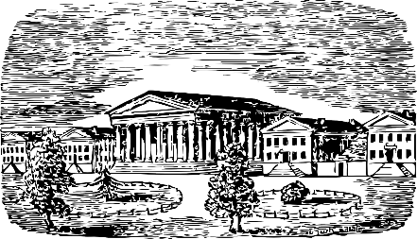
Exceptions to Use of ‘A’ and ‘An’
Use ‘A’ when the naming word starts with
the vowel ‘u’ and the ‘u’ sounds like ‘you’
Use ‘An’ when the naming word starts with
the consonant ‘h’ and the ‘h’ is silent
a uniform
a utensil
a university
an honest man
an hour
Notes:
Notes for Teacher - < Information for further reference or explanation >
Suggestions: <Ideas/ Images/ Animations / Others – To make better representation of the content >
Source of Multimedia used in this slide - <Please provide source URL where we find the image and the license agreement>
<uniform> <https://pixabay.com/vectors/asian-cartoon-child-kids-mural-1294104/>
<utensil> <https://pixabay.com/vectors/pan-pot-cooking-food-kitchen-156154/>
<university> <https://pixabay.com/vectors/building-education-university-48570/>
<honest man> <https://pixabay.com/vectors/repairman-worker-man-repair-staff-6177431/>
<time> <https://pixabay.com/illustrations/clock-watch-time-hour-minute-2936333/>

Slide 6
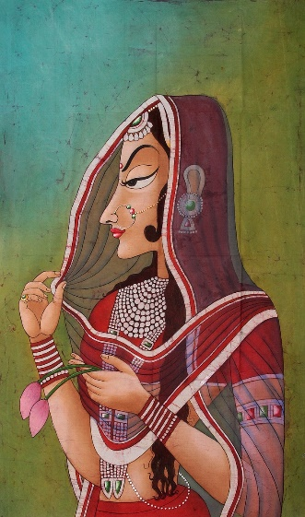
Article – ‘The’
Used for special names
Used for specific objects which are known to
the person speaking and the person listening
Give me the books on the table.
The picture is very nice.
Notes:
Notes for Teacher - < Information for further reference or explanation >
Suggestions: <Ideas/ Images/ Animations / Others – To make better representation of the content >
Source of Multimedia used in this slide - <Please provide source URL where we find the image and the license agreement>
<pile of books> <https://pixabay.com/vectors/books-pile-icon-textbook-6395239/>
<picture> <https://pixabay.com/photos/painting-lady-india-840164/>
<table> <https://pixabay.com/vectors/table-furniture-wooden-1300555/>

Slide 7
MM INDEX
Slide # | Thumbnail | Source link and Attribution
1 |  | SSSVV Image Gallery Search Keyword “teacher”
3,4 |  | <cat> https://pixabay.com/vectors/kitten-cute-cat-animals-furry-4794761/
3 |  | <table> https://pixabay.com/vectors/table-furniture-wooden-1300555/ <woman> https://pixabay.com/vectors/woman-saree-indian-young-fashion-5546375/ <dog> https://pixabay.com/illustrations/dog-puppy-cute-cartoon-animal-3431913/
3, 4 |  | <apple> https://pixabay.com/vectors/apple-red-fruit-fresh-ripe-juicy-25236/
5 |  | <uniform> https://pixabay.com/vectors/asian-cartoon-child-kids-mural-1294104/ <utensil> https://pixabay.com/vectors/pan-pot-cooking-food-kitchen-156154/ <university> https://pixabay.com/vectors/building-education-university-48570/ <honest man> https://pixabay.com/vectors/repairman-worker-man-repair-staff-6177431/ <time> https://pixabay.com/illustrations/clock-watch-time-hour-minute-2936333/
6 |  | <table> https://pixabay.com/vectors/table-furniture-wooden-1300555/ <pile of books> https://pixabay.com/vectors/books-pile-icon-textbook-6395239/ <picture> https://pixabay.com/photos/painting-lady-india-840164/
Notes:
Notes for Teacher - < Information for further reference or explanation >
Suggestions: <Ideas/ Images/ Animations / Others – To make better representation of the content >
Source of Multimedia used in this slide - <Please provide source URL where we find the image and the license agreement>

