Slide 1
Pair Activity for Filling the Correct Article
Notes:
Notes for Teacher - < Information for further reference or explanation >
Suggestions: <Ideas/ Images/ Animations / Others – To make better representation of the content >
Source of Multimedia used in this slide - <Please provide source URL where we find the image and the license agreement>
<pair activity> <https://pixabay.com/vectors/classroom-comic-characters-1297775/>

Slide 2
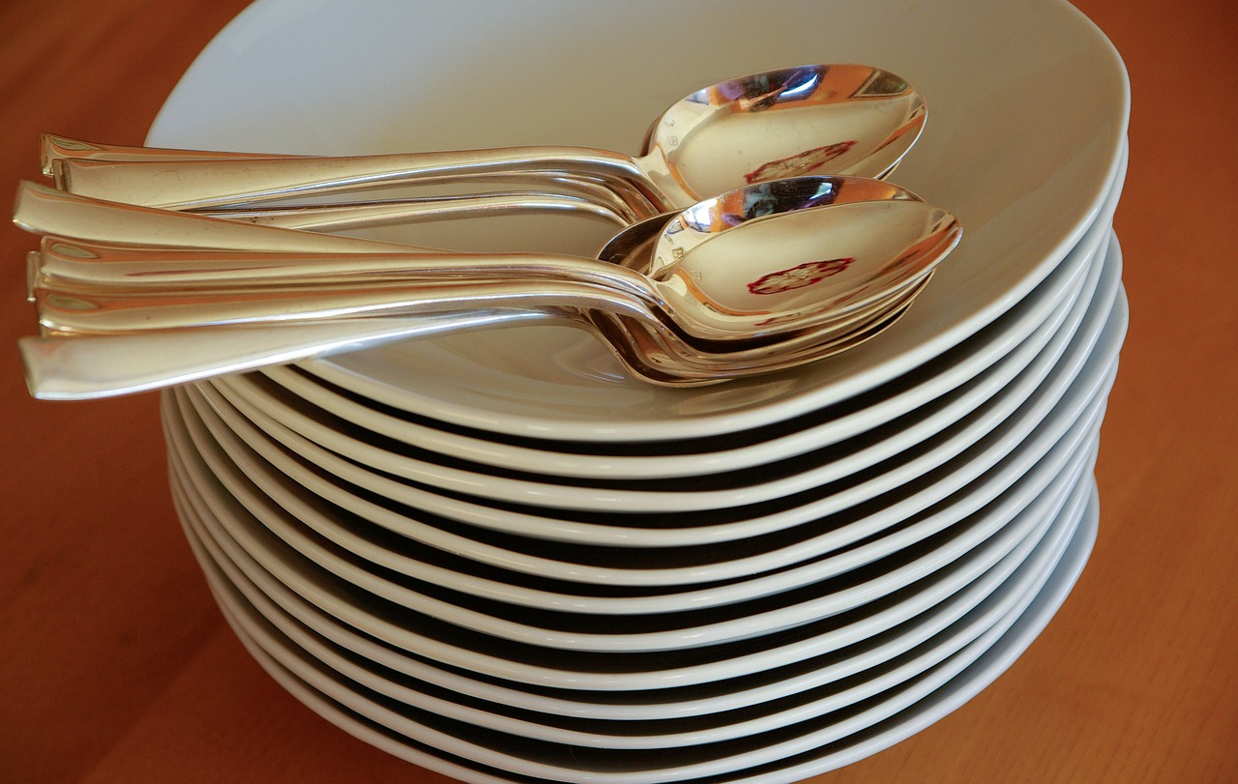
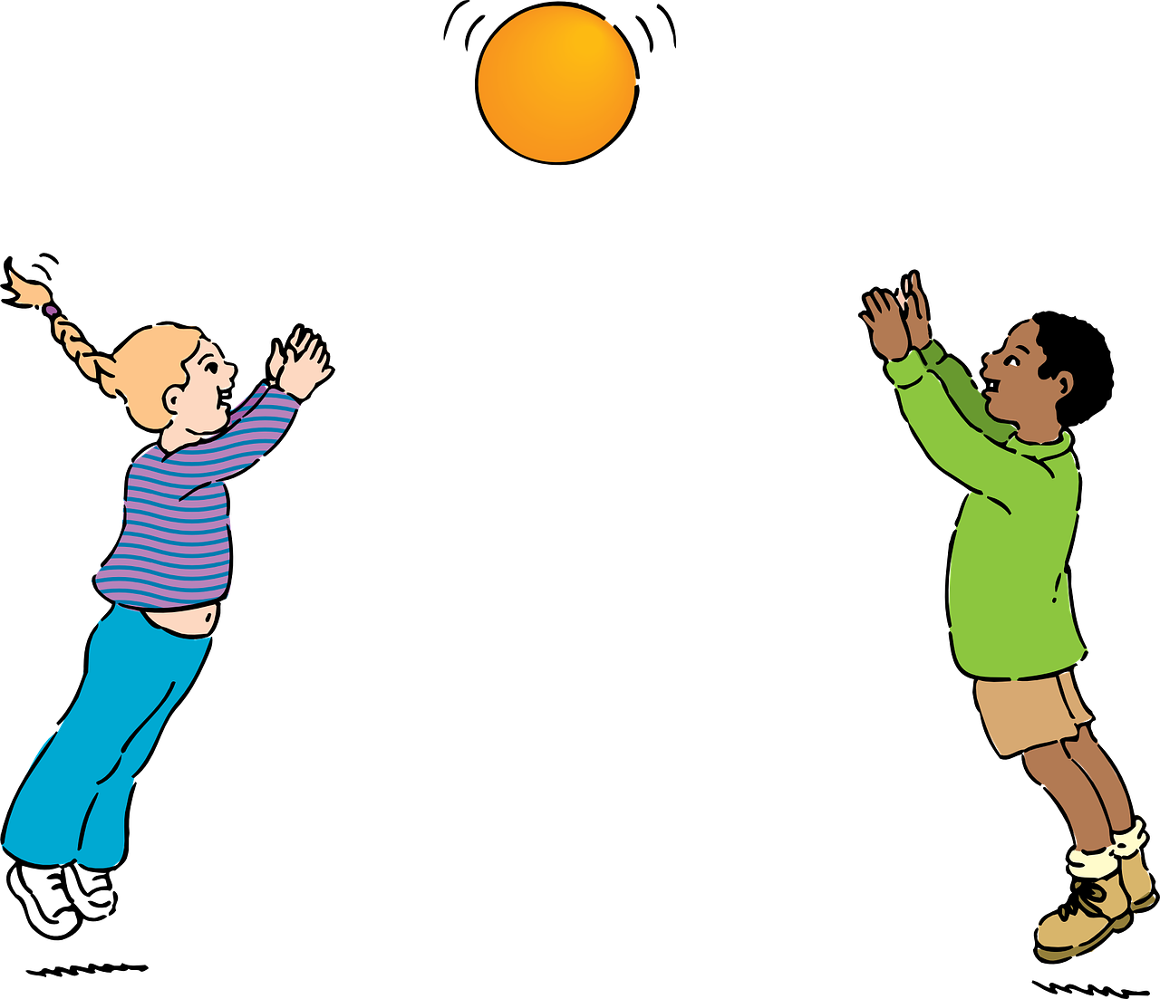
Set A
Fill in the blanks with ‘A’, ‘AN’ and ‘THE’
_____ plates are on the dining table
I want ___ burger.
There is ___ orange in the basket.
____ students are playing.
She is ___ good singer.
The
a
an
The
a
Notes:
Notes for Teacher - < Information for further reference or explanation >
Suggestions: <Ideas/ Images/ Animations / Others – To make better representation of the content >
Source of Multimedia used in this slide - <Please provide source URL where we find the image and the license agreement>
<pile of plates> <https://pixabay.com/photos/plates-spoons-silverware-stack-598366/>
<burger> <https://pixabay.com/illustrations/burger-hamburger-cheeseburger-6166191/>
<fruit basket> <https://pixabay.com/vectors/fruits-basket-fruits-basket-apple-5429751/>
<playing> <https://pixabay.com/vectors/playing-ball-kids-boy-girl-31339/>
<singing> <https://pixabay.com/vectors/singer-female-silhouette-woman-4753813/>

Slide 3
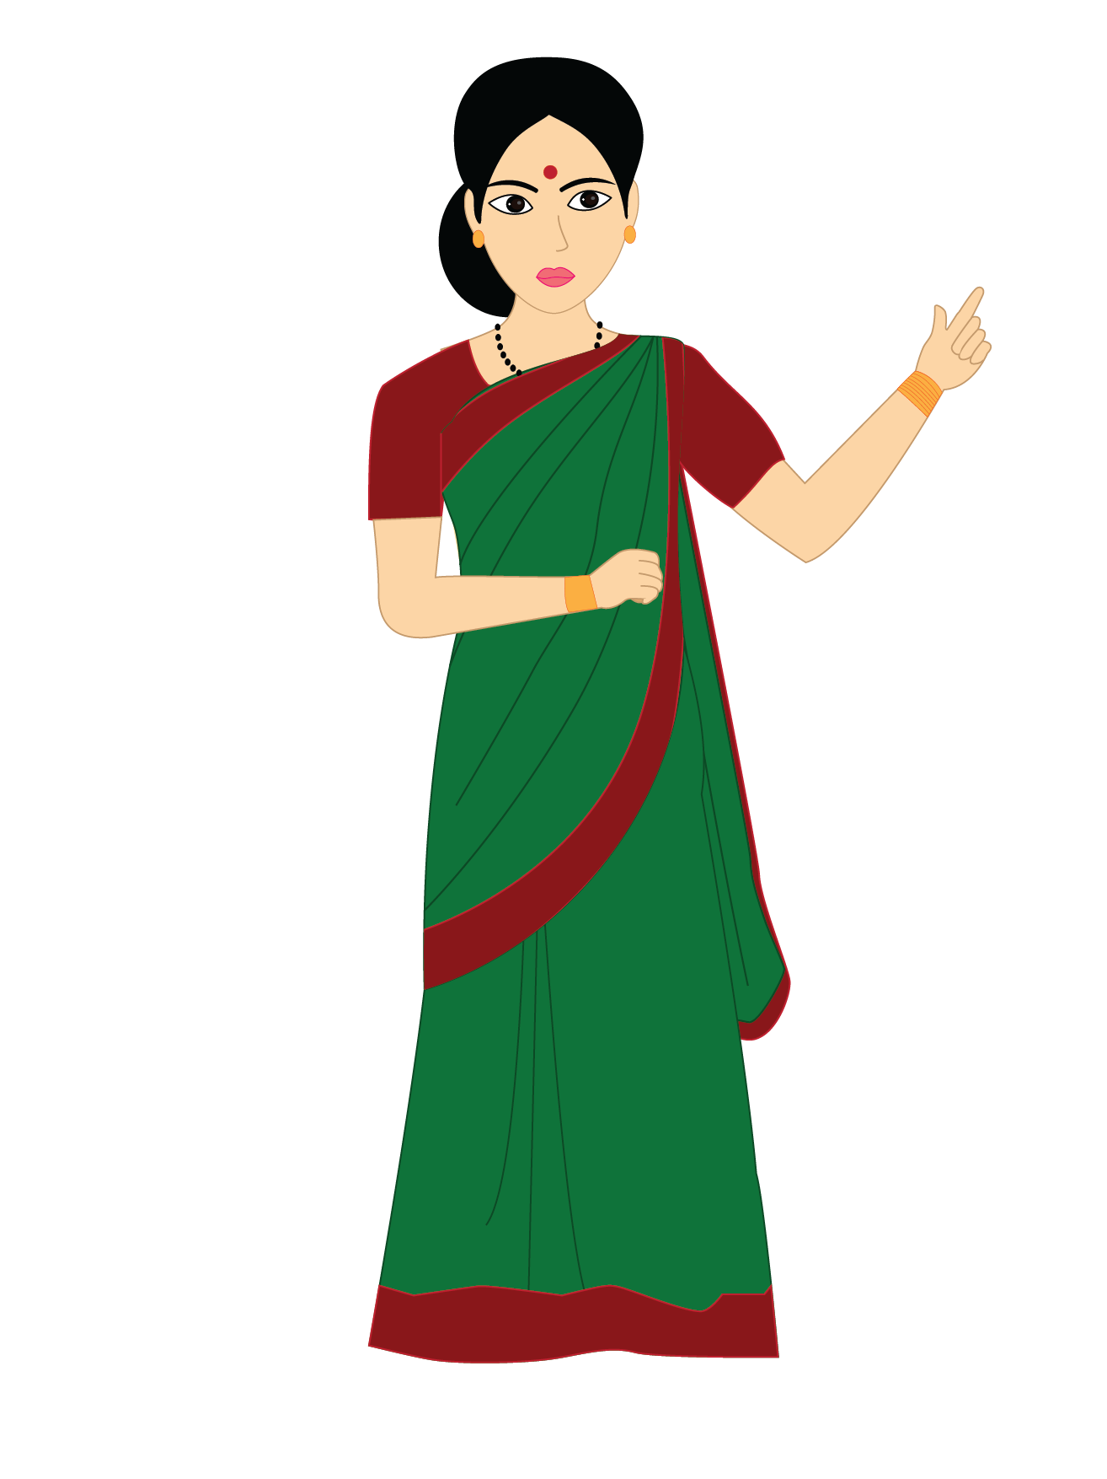
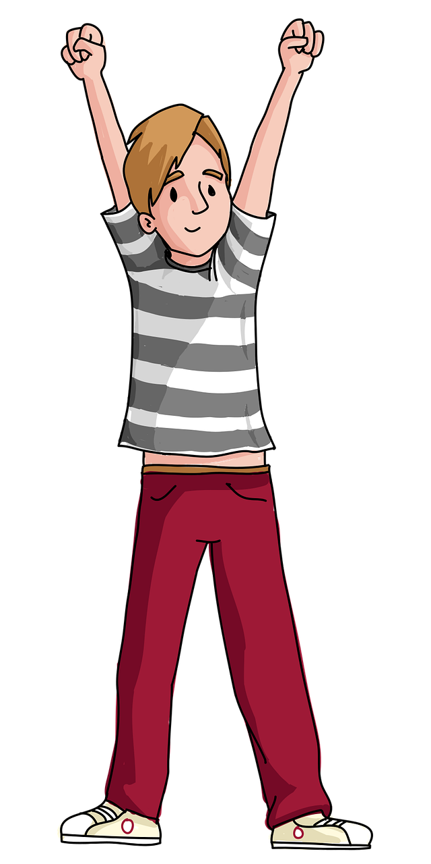
Set B
Fill in the blanks with ‘A’, ‘AN’ and ‘THE’
I have got ____beautiful pen.
He is in __rush.
A teacher is ___important person.
He is ___ best in our class.
I saw ___owl in the garden.
a
a
an
the
an
Notes:
Notes for Teacher - < Information for further reference or explanation >
Suggestions: <Ideas/ Images/ Animations / Others – To make better representation of the content >
Source of Multimedia used in this slide - <Please provide source URL where we find the image and the license agreement>
<fountain pen> <https://pixabay.com/vectors/draw-drawing-fountain-ink-pen-1293329/>
<man in a hurry> <https://pixabay.com/vectors/boy-guy-happy-jump-male-man-1299541/>
<teacher> <SSSVV>
<best boy> <https://pixabay.com/vectors/boy-happy-gesture-celebrating-6204403/>
<owl> <https://pixabay.com/illustrations/owl-tree-wise-animal-limb-owlet-4491495/>

Slide 4
MM INDEX
Slide # | Thumbnail | Source link and Attribution
1 |  | <pair activity> https://pixabay.com/vectors/classroom-comic-characters-1297775/
2 |  | <pile of plates> https://pixabay.com/photos/plates-spoons-silverware-stack-598366/ <burger> https://pixabay.com/illustrations/burger-hamburger-cheeseburger-6166191/ <fruit basket> https://pixabay.com/vectors/fruits-basket-fruits-basket-apple-5429751/ <playing> https://pixabay.com/vectors/playing-ball-kids-boy-girl-31339/ <singing> https://pixabay.com/vectors/singer-female-silhouette-woman-4753813/
3 |  | <fountain pen> https://pixabay.com/vectors/draw-drawing-fountain-ink-pen-1293329/ <man in a hurry> https://pixabay.com/vectors/boy-guy-happy-jump-male-man-1299541/ <teacher> <SSSVV Image Gallery: Search Keyword “teacher”> <best boy> https://pixabay.com/vectors/boy-happy-gesture-celebrating-6204403/ <owl> https://pixabay.com/illustrations/owl-tree-wise-animal-limb-owlet-4491495/
Notes:
Notes for Teacher - < Information for further reference or explanation >
Suggestions: <Ideas/ Images/ Animations / Others – To make better representation of the content >
Source of Multimedia used in this slide - <Please provide source URL where we find the image and the license agreement>

