Slide 1
Usage of Articles
Notes:
Notes for Teacher - < Information for further reference or explanation >
Suggestions: <Ideas/ Images/ Animations / Others – To make better representation of the content >
Source of Multimedia used in this slide - <Please provide source URL where we find the image and the license agreement>
<boy> <https://pixabay.com/vectors/boy-book-reding-child-school-311392/>

Slide 2
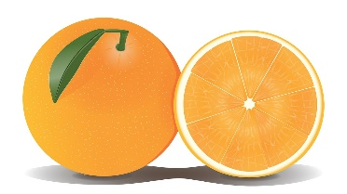
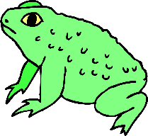
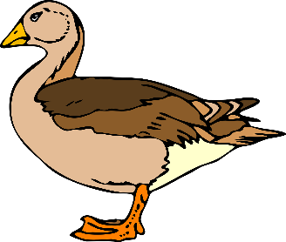
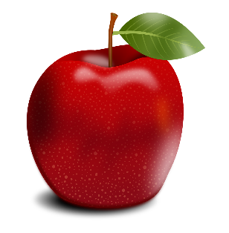
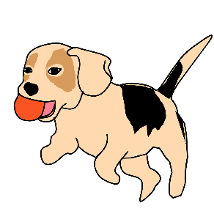
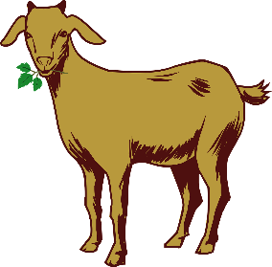
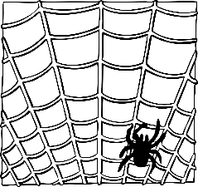
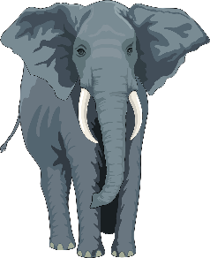
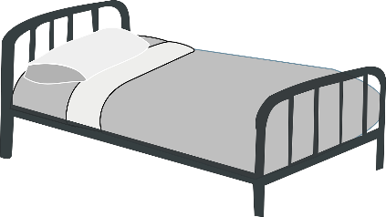
Fill in the blanks with ‘a’ or ‘an’.
Exercise 1
____ orange
____ frog
____dog
____umbrella
____elephant
an
____ duck
____apple
____spider
____goat
____bed
a
a
an
a
a
an
a
an
a
Notes:
Notes for Teacher - < Information for further reference or explanation >
Suggestions: <Ideas/ Images/ Animations / Others – To make better representation of the content >
Source of Multimedia used in this slide - <Please provide source URL where we find the image and the license agreement>
<orange> <https://pixabay.com/illustrations/orange-fruit-citrus-juicy-vitamin-756391/>
<frog> <https://pixabay.com/vectors/frog-amphibian-warty-tropical-46406/>
<dog> <https://pixabay.com/illustrations/dog-animal-playing-catch-vector-2329172/>
<umbrella> <https://pixabay.com/illustrations/umbrella-storm-rain-clipart-drops-4523513/>
<elephant> <https://pixabay.com/vectors/elephant-animal-trunk-tusks-wild-48422/>
<duck> <https://pixabay.com/vectors/duck-standing-brown-beige-bird-24389/>
<apple> <https://pixabay.com/illustrations/apple-apple-tree-fruits-fruit-food-1986660/>
<spider> <https://pixabay.com/vectors/spider-web-insect-animal-halloween-310443/>
<goat> <https://pixabay.com/vectors/goat-drawing-animal-1456762/>
<bed> <https://pixabay.com/vectors/bed-metal-motel-pillow-gray-hotel-310382/>

Slide 3
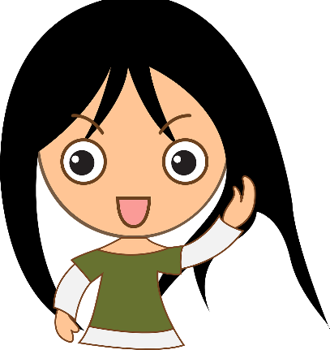
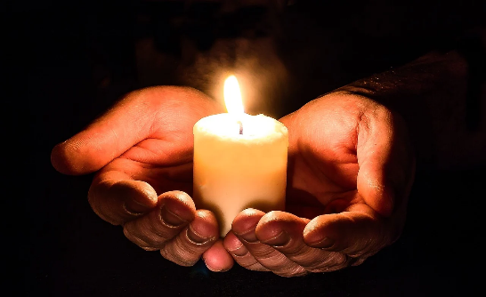
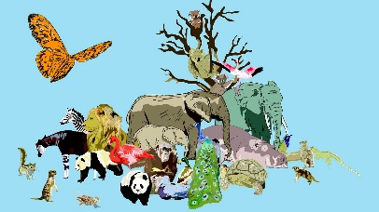
Exercise 2
Choose the right article – a/an/the
a
a
Once upon ___ time there was ____ little girl who found ____ huge mushroom in ____ countryside.
Ramu spent his holidays at _____ seaside.
Mother lit ____ candles at night.
I have ____ umbrella in my bag.
Arun went to _____ zoo with his parents.
a
the
the
the
an
the
Notes:
Notes for Teacher - < Information for further reference or explanation >
Suggestions: <Ideas/ Images/ Animations / Others – To make better representation of the content >
Source of Multimedia used in this slide - <Please provide source URL where we find the image and the license agreement>
<girl> <https://pixabay.com/vectors/girl-happy-laughing-cartoon-anime-311628/>
<beach> <https://pixabay.com/vectors/beach-tropical-landscape-blue-42375/>
<candles> <https://pixabay.com/photos/hands-open-candle-candlelight-1926414/>
<umbrella> <https://pixabay.com/illustrations/umbrella-storm-rain-clipart-drops-4523513/>
<zoo> <https://pixabay.com/illustrations/zoo-animals-peacock-lion-hippo-3327357/>

Slide 4
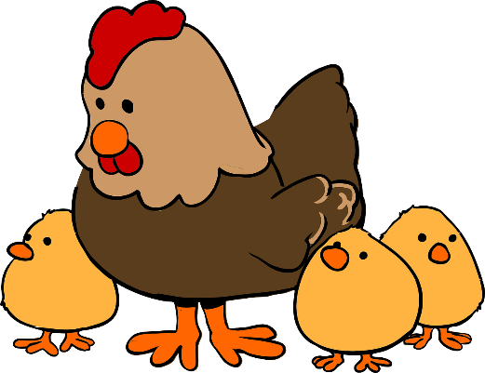
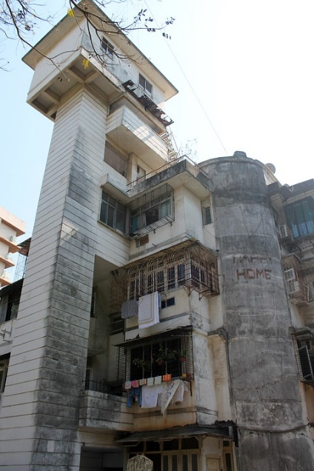
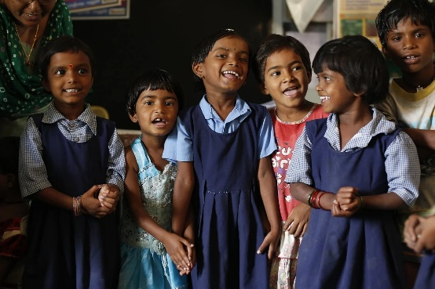
Exercise 2
Choose the right article – a/an/the
the
Krishna feeds ____ chickens on his farm.
Sarita likes to read ____ books her mother buys for her.
Lata put ____orange in her bag.
The class went on ____field trip.
I live in ____apartment.
the
an
a
an
Notes:
Notes for Teacher - < Information for further reference or explanation >
Suggestions: <Ideas/ Images/ Animations / Others – To make better representation of the content >
Source of Multimedia used in this slide - <Please provide source URL where we find the image and the license agreement>
<hen> <https://pixabay.com/vectors/chicken-hen-cute-family-animals-159496/>
<book> <https://pixabay.com/vectors/books-open-reading-literature-32522/>
<orange> <https://pixabay.com/illustrations/orange-fruit-citrus-juicy-vitamin-756391/>
<children> <https://pixabay.com/photos/children-india-education-classroom-876543/>
<apartment> <https://pixabay.com/photos/pune-india-asia-apartment-building-4939602/>

Slide 5
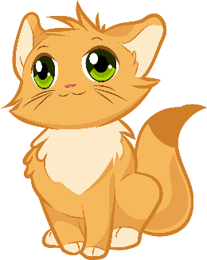
Exercise 3
Complete the sentences:
a
Tom is ____cat.
This is ____ apple.
Can you tell me ____ story?
She is ____ doctor.
Mickey is ____mouse.
an
a
a
a
Notes:
Notes for Teacher - < Information for further reference or explanation >
Suggestions: <Ideas/ Images/ Animations / Others – To make better representation of the content >
Source of Multimedia used in this slide - <Please provide source URL where we find the image and the license agreement>
<apple> <https://pixabay.com/illustrations/apple-apple-tree-fruits-fruit-food-1986660/>
<book> <https://pixabay.com/vectors/books-open-reading-literature-32522/>
<cat> <https://pixabay.com/vectors/kitten-cute-cat-animals-furry-4794761/> <doctor> <https://pixabay.com/vectors/cartoon-checkup-clinic-comic-2027771/>
<mouse> <https://pixabay.com/vectors/mouse-mouse-silhouette-lab-mouse-2814846/>

Slide 6
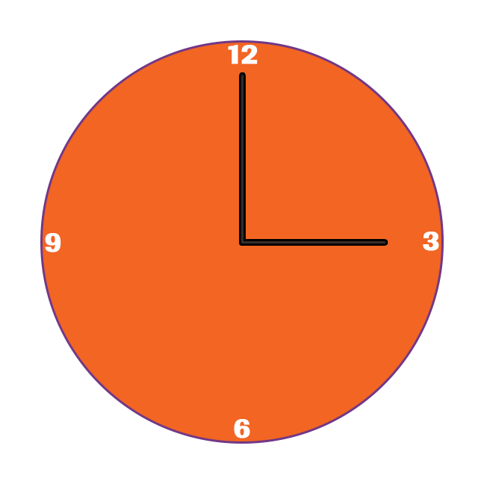
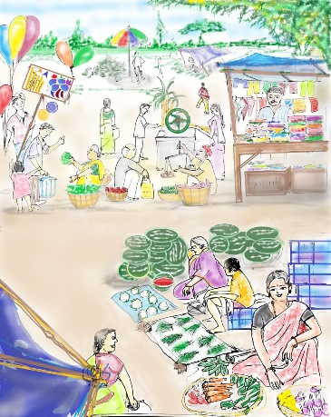
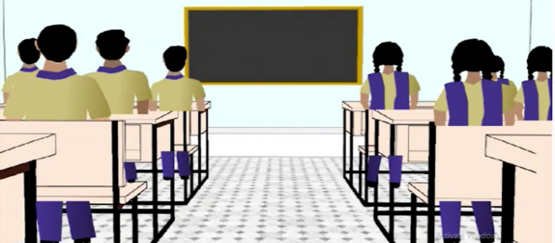
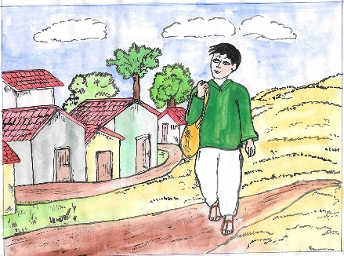
Exercise 3
Complete the sentences:
an
I will finish my work in ____hour.
We went to ____market yesterday.
They will meet in ____school.
He is ___smart boy.
She gives me ____umbrella when it rains.
the
the
a
an
Notes:
Notes for Teacher - < Information for further reference or explanation >
Suggestions: <Ideas/ Images/ Animations / Others – To make better representation of the content >
Source of Multimedia used in this slide - <Please provide source URL where we find the image and the license agreement>
<umbrella> <https://pixabay.com/illustrations/umbrella-storm-rain-clipart-drops-4523513/>
<market> <SSSVV Image Gallery: Search Keyword “market”>
<classroom> <SSSVV Image Gallery: Search Keyword “classroom”>
<clock> <SSSVV Image Gallery: Search Keyword “clock”>
<farmer boy> <SSSVV Image Gallery: Search Keyword “farmer boy”>

Slide 7
MM INDEX
Slide # | Thumbnail | Source link and Attribution
1 |  | <boy> https://pixabay.com/vectors/boy-book-reding-child-school-311392/
2 |  | <orange> https://pixabay.com/illustrations/orange-fruit-citrus-juicy-vitamin-756391/ <frog> https://pixabay.com/vectors/frog-amphibian-warty-tropical-46406/ <dog> https://pixabay.com/illustrations/dog-animal-playing-catch-vector-2329172/ <umbrella> https://pixabay.com/illustrations/umbrella-storm-rain-clipart-drops-4523513/ <elephant> https://pixabay.com/vectors/elephant-animal-trunk-tusks-wild-48422/ <duck> https://pixabay.com/vectors/duck-standing-brown-beige-bird-24389/ <apple> https://pixabay.com/illustrations/apple-apple-tree-fruits-fruit-food-1986660/ <spider> https://pixabay.com/vectors/spider-web-insect-animal-halloween-310443/ <goat> https://pixabay.com/vectors/goat-drawing-animal-1456762/ <bed> https://pixabay.com/vectors/bed-metal-motel-pillow-gray-hotel-310382/
3 |  | <girl> https://pixabay.com/vectors/girl-happy-laughing-cartoon-anime-311628/ <beach> https://pixabay.com/vectors/beach-tropical-landscape-blue-42375/ <candles> https://pixabay.com/photos/hands-open-candle-candlelight-1926414/ <umbrella> https://pixabay.com/illustrations/umbrella-storm-rain-clipart-drops-4523513/ <zoo> https://pixabay.com/illustrations/zoo-animals-peacock-lion-hippo-3327357
4 |  | <hen> https://pixabay.com/vectors/chicken-hen-cute-family-animals-159496/ <book> https://pixabay.com/vectors/books-open-reading-literature-32522/ <orange> https://pixabay.com/illustrations/orange-fruit-citrus-juicy-vitamin-756391/ <children> https://pixabay.com/photos/children-india-education-classroom-876543/ <apartment> https://pixabay.com/photos/pune-india-asia-apartment-building-4939602/
5 |  | <apple> https://pixabay.com/illustrations/apple-apple-tree-fruits-fruit-food-1986660/ <book> https://pixabay.com/vectors/books-open-reading-literature-32522/ <cat> https://pixabay.com/vectors/kitten-cute-cat-animals-furry-4794761/ <doctor> https://pixabay.com/vectors/cartoon-checkup-clinic-comic-2027771/ <mouse> https://pixabay.com/vectors/mouse-mouse-silhouette-lab-mouse-2814846/
6 |  | <umbrella> https://pixabay.com/illustrations/umbrella-storm-rain-clipart-drops-4523513/ <market> <SSSVV Image Gallery: Search Keyword “market”> <classroom> <SSSVV Image Gallery: Search Keyword “classroom”> <clock> <SSSVV Image Gallery: Search Keyword “clock”> <farmer boy> <SSSVV Image Gallery: Search Keyword “farmer boy”>
Notes:
Notes for Teacher - < Information for further reference or explanation >
Suggestions: <Ideas/ Images/ Animations / Others – To make better representation of the content >
Source of Multimedia used in this slide - <Please provide source URL where we find the image and the license agreement>

