Slide 1
Skill Of Paragraph Writing
Notes:
Notes for Teacher - < Information for further reference or explanation >
Suggestions: <Ideas/ Images/ Animations / Others – To make better representation of the content >
Source of Multimedia used in this slide - <Please provide source URL where we find the image and the license agreement>
<writing> <https://pixabay.com/illustrations/writing-hand-writing-hand-pen-1891073/>

Slide 2
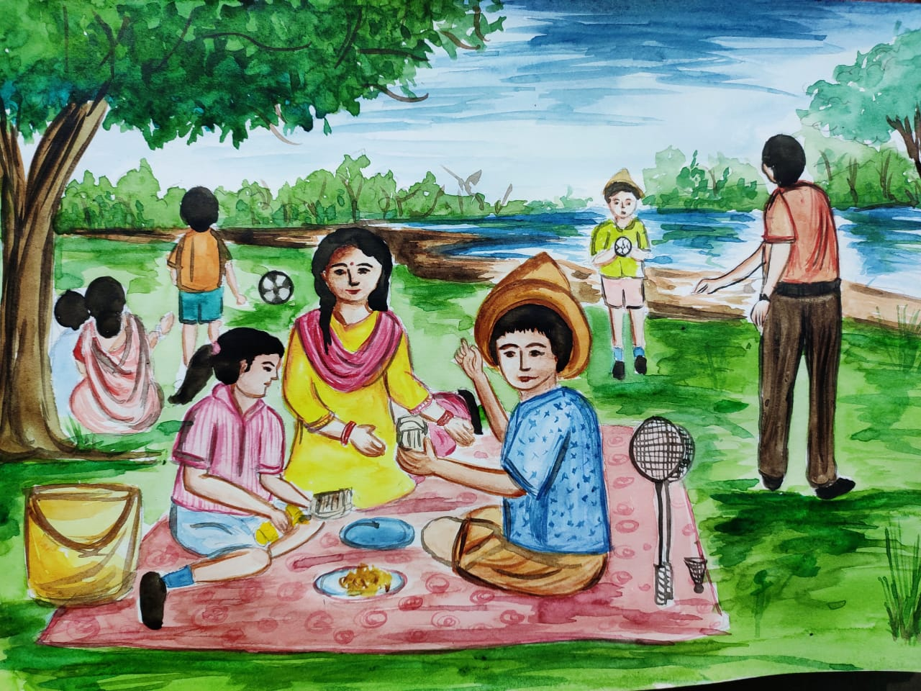
Observe this picture
Notes:
Notes for Teacher - < Information for further reference or explanation >
Suggestions: <Ideas/ Images/ Animations / Others – To make better representation of the content >
Source of Multimedia used in this slide - <Please provide source URL where we find the image and the license agreement>
<picnic> <SSSVV>

Slide 3
What is Paragraph Writing?
A paragraph is a group of sentences.
Usually has around 5 to 7 sentences.
Puts ideas together.
Notes:
Notes for Teacher - < Information for further reference or explanation >
Suggestions: <Ideas/ Images/ Animations / Others – To make better representation of the content >
Source of Multimedia used in this slide - <Please provide source URL where we find the image and the license agreement>
<thinking> <https://pixabay.com/vectors/thinking-outside-the-box-33399/>

Slide 4
We can use some of these sentence patterns
I/We can see ___________
This is __________
They are __________
This is __________
We too __________
Notes:
Notes for Teacher - < Information for further reference or explanation >
Suggestions: <Ideas/ Images/ Animations / Others – To make better representation of the content >
Source of Multimedia used in this slide - <Please provide source URL where we find the image and the license agreement>
<picnic> <SSSVV>

Slide 5
What do you see
very happy
picnic spot
bank of a river
watching the children play
during vacation
serving food
playing ball
family members
Notes:
Notes for Teacher - < Information for further reference or explanation >
Suggestions: <Ideas/ Images/ Animations / Others – To make better representation of the content >
Source of Multimedia used in this slide - <Please provide source URL where we find the image and the license agreement>
<picnic> <SSSVV>

Slide 6
Lead Questions
Where is the scene taking place?
When does such a scene take place?
What place is this?
Who are the people in the picture?
How do they look?
What are they doing? Describe the picture.
Do you go on picnics too?
It is on the riverbank.
It takes place during vacations/holidays.
It is a picnic spot/riverbank.
The people in the picture are family members.
They look very happy.
Father is playing ball with his son. Mother is serving food. Grandmother is watching the children play.
We too go on picnics with our family.
Notes:
Notes for Teacher - < Information for further reference or explanation >
Suggestions: <Ideas/ Images/ Animations / Others – To make better representation of the content >
Source of Multimedia used in this slide - <Please provide source URL where we find the image and the license agreement>
<picnic> <SSSVV>

Slide 7
Picnic – Paragraph Writing
This is a picnic spot. It is on the bank of a river. Such scenes take place during vacation. The people in the picture are family members. We can see the father playing ball with his son. The mother is serving food to the children. Grandmother is watching the children play. They all look very happy. We too go on such picnics with our family.
Notes:
Notes for Teacher - < Information for further reference or explanation >
Suggestions: <Ideas/ Images/ Animations / Others – To make better representation of the content >
Source of Multimedia used in this slide - <Please provide source URL where we find the image and the license agreement>
<picnic> <SSSVV>

Slide 8
MM INDEX
Slide # | Thumbnail | Source link and Attribution
1 |  | <writing> https://pixabay.com/illustrations/writing-hand-writing-hand-pen-1891073/
3 |  | <thinking> https://pixabay.com/vectors/thinking-outside-the-box-33399/
2, 5, 6, 7 |  | <picnic> <SSSVV Image Gallery: Search Keyword “picnic>
Notes:
Notes for Teacher - < Information for further reference or explanation >
Suggestions: <Ideas/ Images/ Animations / Others – To make better representation of the content >
Source of Multimedia used in this slide - <Please provide source URL where we find the image and the license agreement>

