Slide 1
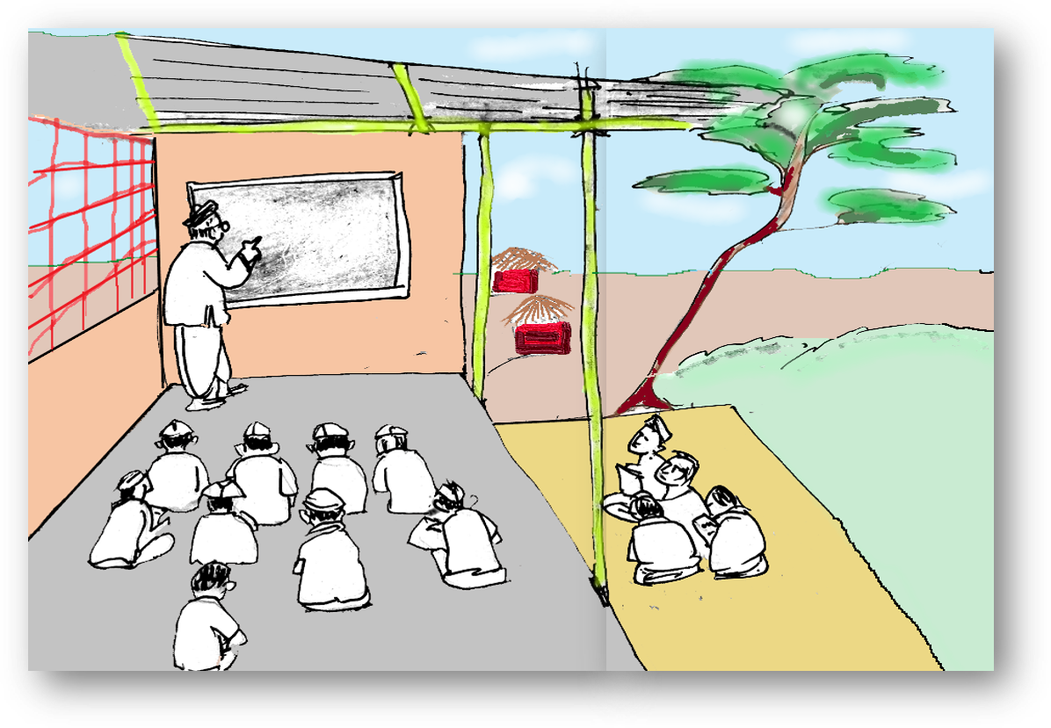
Paragraph Writing In Teams
Notes:
Notes for Teacher - < Information for further reference or explanation >
Suggestions: <Ideas/ Images/ Animations / Others – To make better representation of the content >
Source of Multimedia used in this slide - <Please provide source URL where we find the image and the license agreement>
<classroom> <SSSVV>

Slide 2
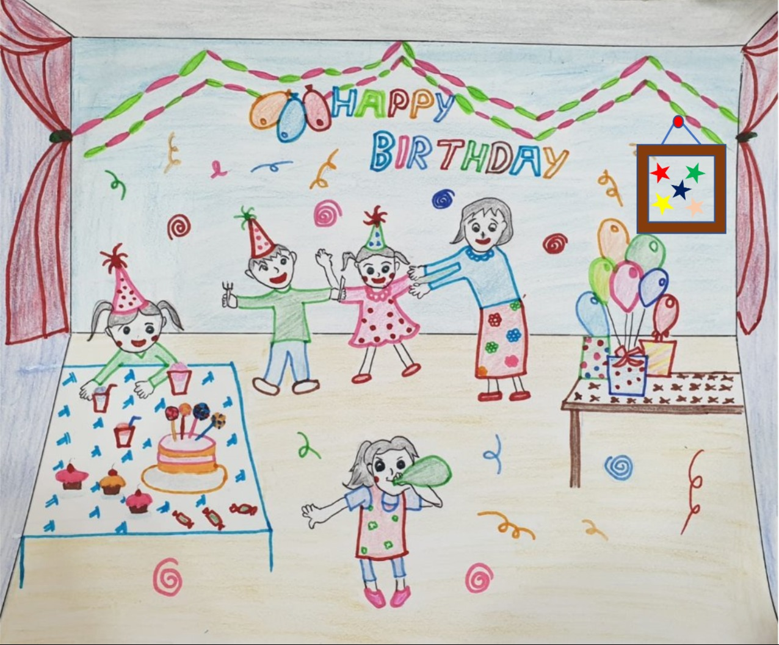
Birthday Party
birthday party | mother and her friends | decorated with colourful balloons
cakes with candles | very happy | on this special day
Notes:
Notes for Teacher - < Information for further reference or explanation >
Suggestions: <Ideas/ Images/ Animations / Others – To make better representation of the content >
Source of Multimedia used in this slide - <Please provide source URL where we find the image and the license agreement>
<birthday party> <SSSVV>

Slide 3
Birthday Party – Lead Questions
What scene is this?
Who do you see?
How does the room look?
What else do you see?
How do they all look?
Why is the birthday girl happy?
It is a birthday party.
We see a birthday girl, her mother and her friends.
The room is decorated with colourful balloons.
The birthday cake with candles on it to be cut.
They all look very happy.
She is happy because she is with her mother and friends on this special day.
Notes:
Notes for Teacher - < Information for further reference or explanation >
Suggestions: <Ideas/ Images/ Animations / Others – To make better representation of the content >
Source of Multimedia used in this slide - <Please provide source URL where we find the image and the license agreement>
<birthday party> <SSSVV>

Slide 4
Birthday Party – Paragraph Writing
This is a birthday party. We can see the birthday girl along with her mother and friends. The room is decorated with colourful balloons. The birthday cake with candles is ready to be cut. They all look very happy. The birthday girl is very happy because she is with her mother and friends on this special day.
Notes:
Notes for Teacher - < Information for further reference or explanation >
Suggestions: <Ideas/ Images/ Animations / Others – To make better representation of the content >
Source of Multimedia used in this slide - <Please provide source URL where we find the image and the license agreement>
<birthday party> <SSSVV>

Slide 5
MM INDEX
Slide # | Thumbnail | Source link and Attribution
1 |  | <classroom> <SSSVV Image Gallery: Search Keyword “class”>
2 |  | <birthday party> <SSSVV Image Gallery: Search Keyword “birthday”>
Notes:
Notes for Teacher - < Information for further reference or explanation >
Suggestions: <Ideas/ Images/ Animations / Others – To make better representation of the content >
Source of Multimedia used in this slide - <Please provide source URL where we find the image and the license agreement>

