Slide 1
Check Time For Paragraph Writing
Notes:
Notes for Teacher - < Information for further reference or explanation >
Suggestions: <Ideas/ Images/ Animations / Others – To make better representation of the content >
Source of Multimedia used in this slide - <Please provide source URL where we find the image and the license agreement>
<clock> <SSSVV>

Slide 2
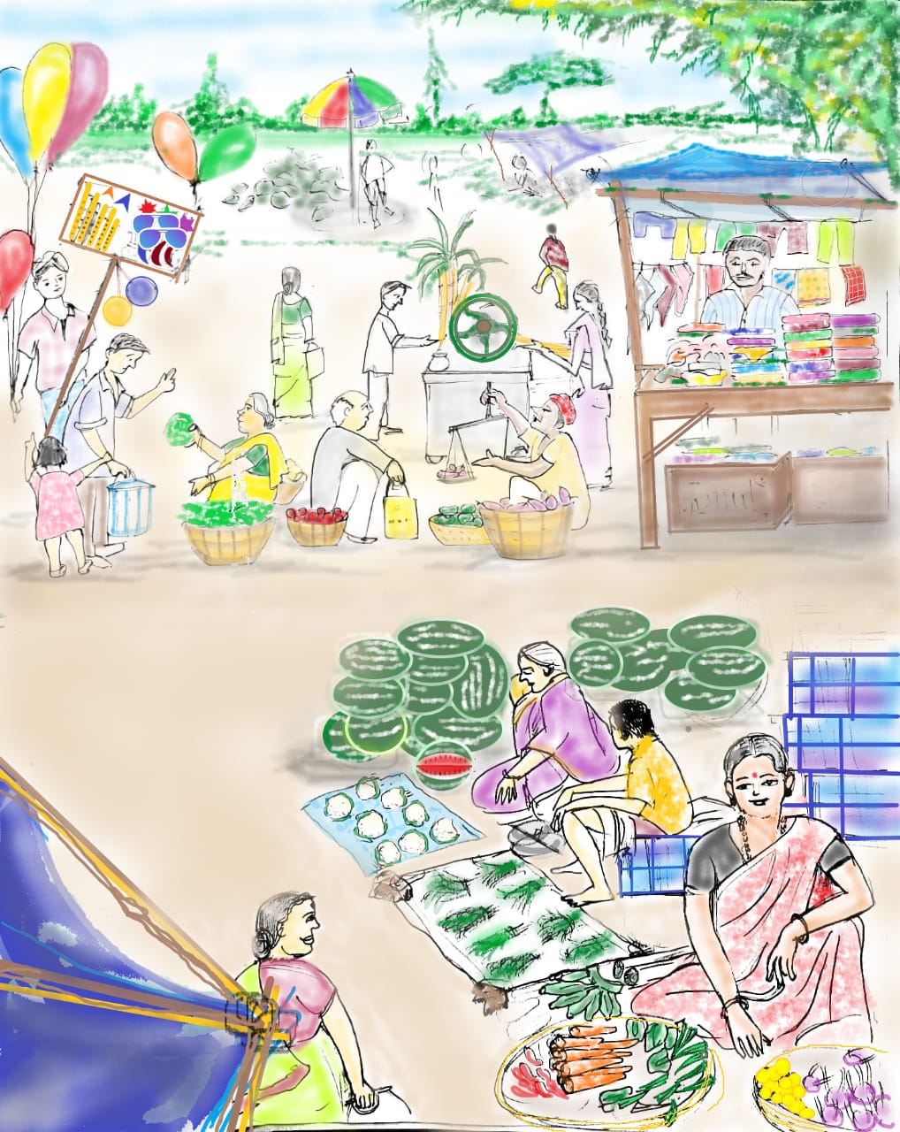
Write a Paragraph
Write a paragraph of about 5 to 7 sentences on this picture. Use the clues given.
market place | very busy place | to buy things
people and stalls | vegetable hawker | fresh leafy vegetables
lots of fruits | clothes also sold | go with my parents
Notes:
Notes for Teacher - < Information for further reference or explanation >
Suggestions: <Ideas/ Images/ Animations / Others – To make better representation of the content >
Source of Multimedia used in this slide - <Please provide source URL where we find the image and the license agreement>
<marketplace> <SSSVV>

Slide 3
A Market
A market place is a very busy place. People go to the market place to buy the things they need. There are several people and stalls where we can buy and sell things. We can see a vegetable hawker selling fresh leafy vegetables. Lots of fruits like watermelons, oranges and bananas are being sold. We can also see clothes being sold on carts. I too like going to the market with my parents.
Notes:
Notes for Teacher - < Information for further reference or explanation >
Suggestions: <Ideas/ Images/ Animations / Others – To make better representation of the content >
Source of Multimedia used in this slide - <Please provide source URL where we find the image and the license agreement>
<marketplace> <SSSVV>

Slide 4
MM INDEX
Slide # | Thumbnail | Source link and Attribution
1 |  | <clock> <SSSVV Image Gallery: Search Keyword “clock”>
2,3 |  | <marketplace> <SSSVV Image Gallery: Search Keyword “market”>
Notes:
Notes for Teacher - < Information for further reference or explanation >
Suggestions: <Ideas/ Images/ Animations / Others – To make better representation of the content >
Source of Multimedia used in this slide - <Please provide source URL where we find the image and the license agreement>

