Slide 1
Using Different Pronouns in Sentences
Notes:
Notes for Teacher - < Information for further reference or explanation >
Suggestions: <Ideas/ Images/ Animations / Others – To make better representation of the content >
Source of Multimedia used in this slide - <Please provide source URL where we find the image and the license agreement>
<kids with banner> <https://pixabay.com/illustrations/child-clipart-cute-design-teacher-2782666/>

Slide 2
What are Pronouns?
A word that takes the place of a noun
1
Pronoun
2
Masculine/Feminine
3
Singular/Plural
Examples: you, me, I, my
Notes:
Notes for Teacher – The teacher could start the class by asking the students to give a few sentences with nouns in them. Teacher may write down some simple sentences said by the students.
Teacher may then underline the nouns in those sentences and rewrite those sentences substituting the nouns with pronouns.
Teacher can do a recap of the pronouns already learnt (he, she, it, we, they). Thus, the concept of pronouns can be explained.
Suggestions: <Ideas/ Images/ Animations / Others – To make better representation of the content >
Source of Multimedia used in this slide - <Please provide source URL where we find the image and the license agreement>

Slide 3
Pronouns
Types of pronouns
Subject Pronoun
Object Pronoun
Possessive Pronoun
Notes:
Notes for Teacher - < Information for further reference or explanation >
Suggestions: <Ideas/ Images/ Animations / Others – To make better representation of the content >
Source of Multimedia used in this slide - <Please provide source URL where we find the image and the license agreement>

Slide 4
Pronoun - Example
Too repetitive
The table is very nice. The table is big. The table is used by the teacher. The table has foldable legs. The table has a red top. I want to buy the table.
We can use the pronoun ‘it’.
The table is very nice. It is big. It is used by the teacher. It has foldable legs. It has a red top. I want to buy it.
Notes:
Notes for Teacher - < Information for further reference or explanation >
Suggestions: <Ideas/ Images/ Animations / Others – To make better representation of the content >
Source of Multimedia used in this slide - <Please provide source URL where we find the image and the license agreement>
<table> <https://pixabay.com/vectors/table-furniture-wooden-1300555/>

Slide 5
Pronoun (You) - Example
You is a second person pronoun.
It is used to talk about someone other than yourself.
You can be both singular and plural.
Example: Singular
You are a good boy. Will you come to school tomorrow?
Example: Plural
You all go to the class. All of you sit down.
Notes:
Notes for Teacher - < Information for further reference or explanation >
Suggestions: <Ideas/ Images/ Animations / Others – To make better representation of the content >
Source of Multimedia used in this slide - <Please provide source URL where we find the image and the license agreement>
<boy reading> <https://pixabay.com/vectors/boy-book-reding-child-school-311392/>
<classroom> <https://pixabay.com/illustrations/school-children-desks-school-4321808/>

Slide 6
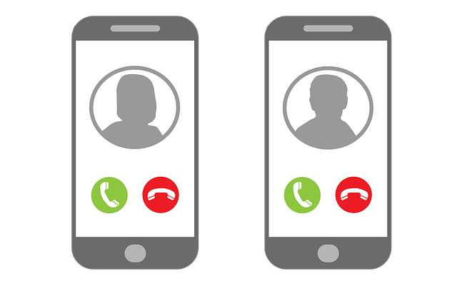
Pronoun ‘I’, ‘Me’ and ‘My’
These pronouns are used where you talk about yourself. They are used as singular pronouns.
Pronoun ‘I’
Example: I go to school at 7 AM.
I like to eat chocolates.
Pronoun ‘me’
Example: Call me when you are ready.
Please call me tomorrow.
Pronoun ‘my’
Example: My sister is a singer.
My favourite game is football.
Notes:
Notes for Teacher - < Information for further reference or explanation >
Suggestions: <Ideas/ Images/ Animations / Others – To make better representation of the content >
Source of Multimedia used in this slide - <Please provide source URL where we find the image and the license agreement>
<chocolate> <https://pixabay.com/vectors/chocolate-bar-chocolate-candy-sweet-303382/>
<phone call> <https://pixabay.com/illustrations/telephoning-a-phone-call-5030997/>
<singer> <https://pixabay.com/illustrations/fantasy-microphone-singer-moon-4066241/>

Slide 7
MM INDEX
Slide # | Thumbnail | Source link and Attribution
1 |  | <kids with banner> https://pixabay.com/illustrations/child-clipart-cute-design-teacher-2782666/
4 |  | <table> https://pixabay.com/vectors/table-furniture-wooden-1300555/
5 |  | <boy reading> https://pixabay.com/vectors/boy-book-reding-child-school-311392/ <classroom> https://pixabay.com/illustrations/school-children-desks-school-4321808/
6 |  | <chocolate> https://pixabay.com/vectors/chocolate-bar-chocolate-candy-sweet-303382/ <phone call> https://pixabay.com/illustrations/telephoning-a-phone-call-5030997/ <sisters> https://pixabay.com/illustrations/fantasy-microphone-singer-moon-4066241/
Notes:
Notes for Teacher - < Information for further reference or explanation >
Suggestions: <Ideas/ Images/ Animations / Others – To make better representation of the content >
Source of Multimedia used in this slide - <Please provide source URL where we find the image and the license agreement>

