Slide 1
Ball Game with Pronouns
Notes:
Notes for Teacher - < Information for further reference or explanation >
Suggestions: <Ideas/ Images/ Animations / Others – To make better representation of the content >
Source of Multimedia used in this slide - <Please provide source URL where we find the image and the license agreement>

Slide 2
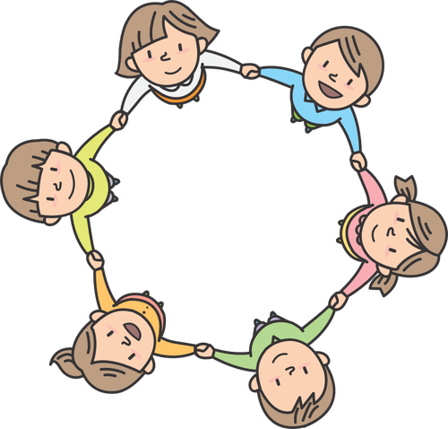
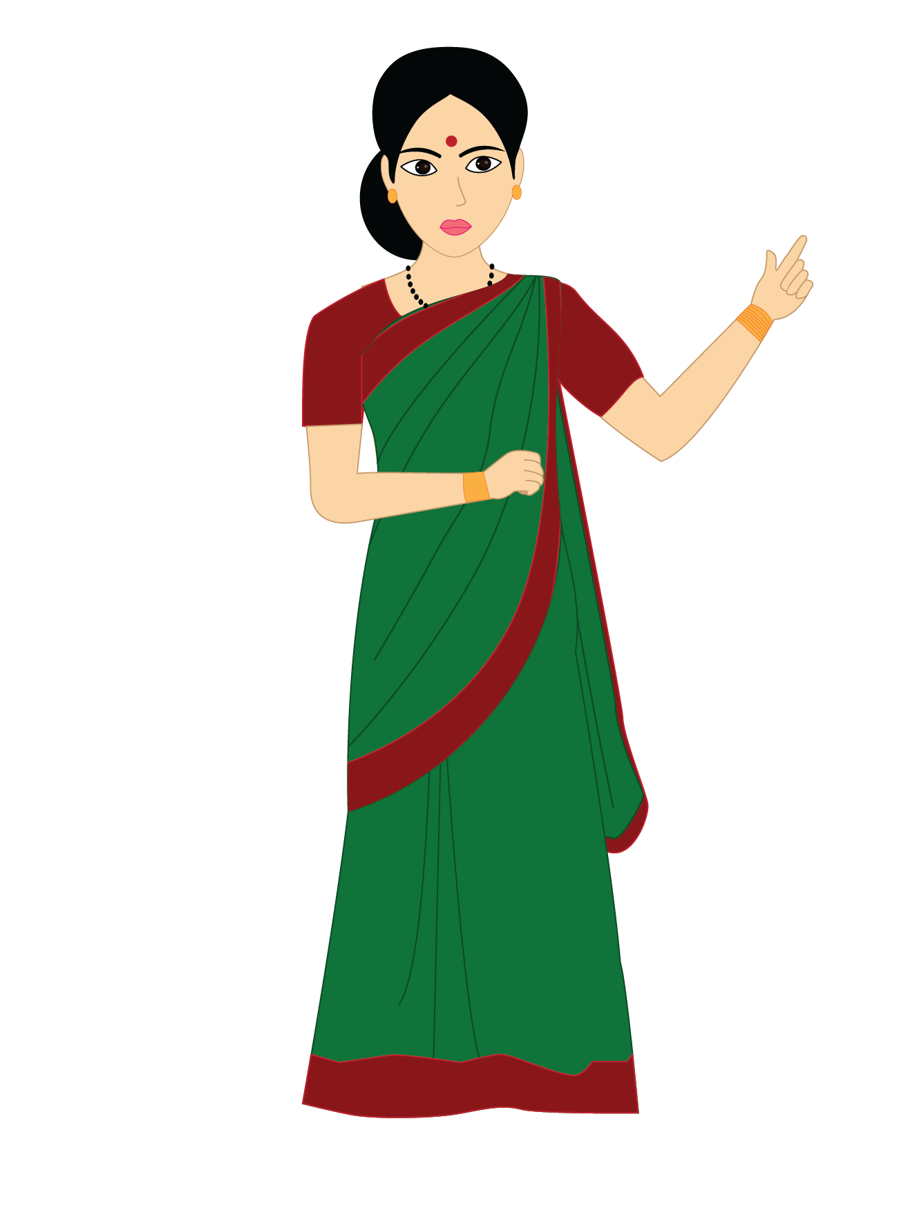
Ball Game With Pronouns
Meena is playing with a ball.
The cat is drinking milk.
She is playing with a ball.
It is drinking milk.
Notes:
Notes for Teacher - Procedure:
Step 1: Make students stand in a circle.
Step 2: Teacher stands in the center and throws the ball to one of the student.
Step 3: Teacher reads out a sentence with a noun.
Step 4: Teacher asks the student who has the ball to change the noun into pronoun.
Step 5: Now the student throws the ball to another student.
Step 6: Teacher reads out another sentence.
Step 7: Now the other boy with the ball uses pronoun in place of noun.
Suggestions: <Ideas/ Images/ Animations / Others – To make better representation of the content >
Source of Multimedia used in this slide - <Please provide source URL where we find the image and the license agreement>
Kids : https://publicdomainvectors.org/en/free-clipart/Children-in-circle/66748.html
Ball : https://pixabay.com/illustrations/smiley-face-smile-sphere-1043868/
Teacher : SSSVV Gallery

Slide 3
MM INDEX
Slide # | Thumbnail | Source link and Attribution
1 |  | Boy : https://pixabay.com/illustrations/children-s-soccer-boy-girl-4035400/
2 |  | Kids :https://openclipart.org/detail/285099/children-in-circle
2 |  | Teacher : SSSVV Image Gallery: Search Keyword “teacher”
2 |  | Ball : https://pixabay.com/illustrations/smiley-face-smile-sphere-1043868/
Notes:
Notes for Teacher - < Information for further reference or explanation >
Suggestions: <Ideas/ Images/ Animations / Others – To make better representation of the content >
Source of Multimedia used in this slide - <Please provide source URL where we find the image and the license agreement>

