Slide 1
Exercises on Usage of Pronouns
Notes:
Notes for Teacher - < Information for further reference or explanation >
Suggestions: <Ideas/ Images/ Animations / Others – To make better representation of the content >
Source of Multimedia used in this slide - <Please provide source URL where we find the image and the license agreement>
<kid writing> <https://pixabay.com/illustrations/student-child-homework-boy-male-5677625/>

Slide 2
Match the Following
My friends
My friends
she
she
The girl
The girl
it
it
You and I
You and I
he
he
Amit
Amit
they
they
A car
A car
we
we
Notes:
Notes for Teacher - < Information for further reference or explanation >
Suggestions: <Ideas/ Images/ Animations / Others – To make better representation of the content >
Source of Multimedia used in this slide - <Please provide source URL where we find the image and the license agreement>

Slide 3
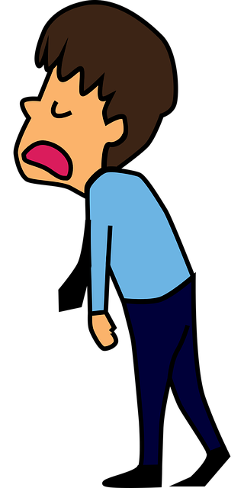
Fill in the Blanks
Select the correct pronoun given in bracket and fill in the blanks: (he, it, their, they, she, mine, both)
Ram and Shyam said ______ must go to school on Friday.
Arvind thought that ______ could stay at home today.
This is not your pen. It is_________.
Jack and Jill were fishing when _____ of them fell into the water.
they
he
mine
both
Notes:
Notes for Teacher - < Information for further reference or explanation >
Suggestions: <Ideas/ Images/ Animations / Others – To make better representation of the content >
Source of Multimedia used in this slide - <Please provide source URL where we find the image and the license agreement>
<boys> <SSSVV Image Gallery: Search Keyword “school”> Cropped
<tired> <https://pixabay.com/vectors/man-employee-exhausted-tired-5754626/>
<pen> <https://pixabay.com/illustrations/pen-to-write-writing-ballpoint-3156806/>
<fishing> <https://pixabay.com/vectors/bait-fish-fishing-hook-2026318/>

Slide 4
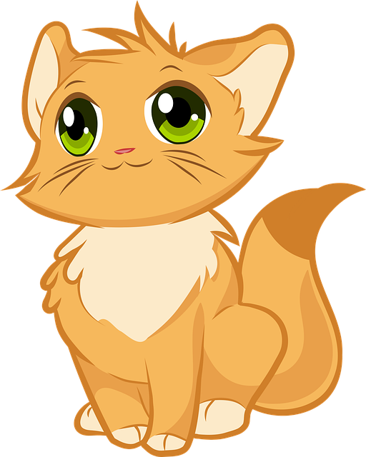
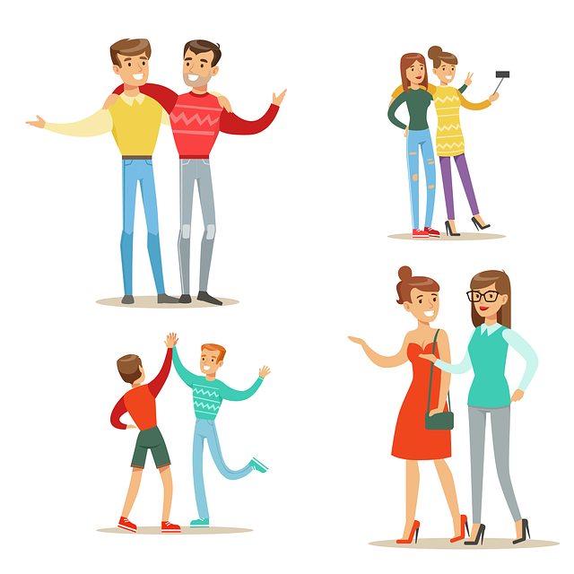
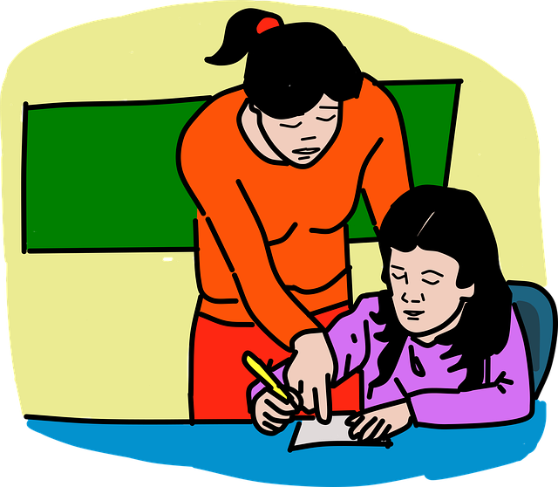
Fill in the Blanks
Select the correct pronoun given in bracket and fill in the blanks: (he, it, their, they, she, mine, both)
The cat was sick, and ______ could not play.
Ajay and Anil were friends. ______ parents were also good friends.
Mala studies in my school. ______ is my sister’s friend.
it
Their
She
Notes:
Notes for Teacher - < Information for further reference or explanation >
Suggestions: <Ideas/ Images/ Animations / Others – To make better representation of the content >
Source of Multimedia used in this slide - <Please provide source URL where we find the image and the license agreement>
<cat> <https://pixabay.com/vectors/kitten-cute-cat-animals-furry-4794761/>
<family> <https://pixabay.com/vectors/friends-people-friendship-family-4187953/>
<girls> <https://pixabay.com/vectors/girl-studying-teacher-school-5432233/>

Slide 5
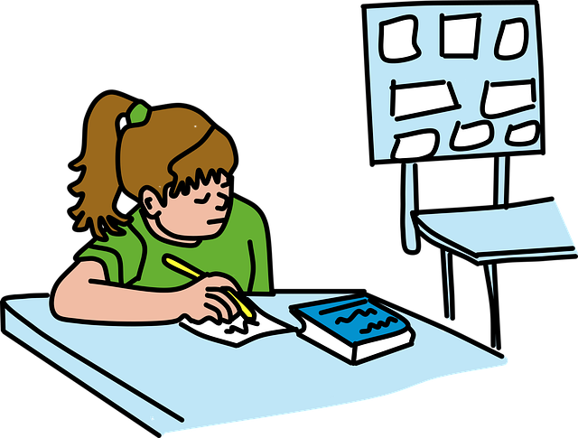
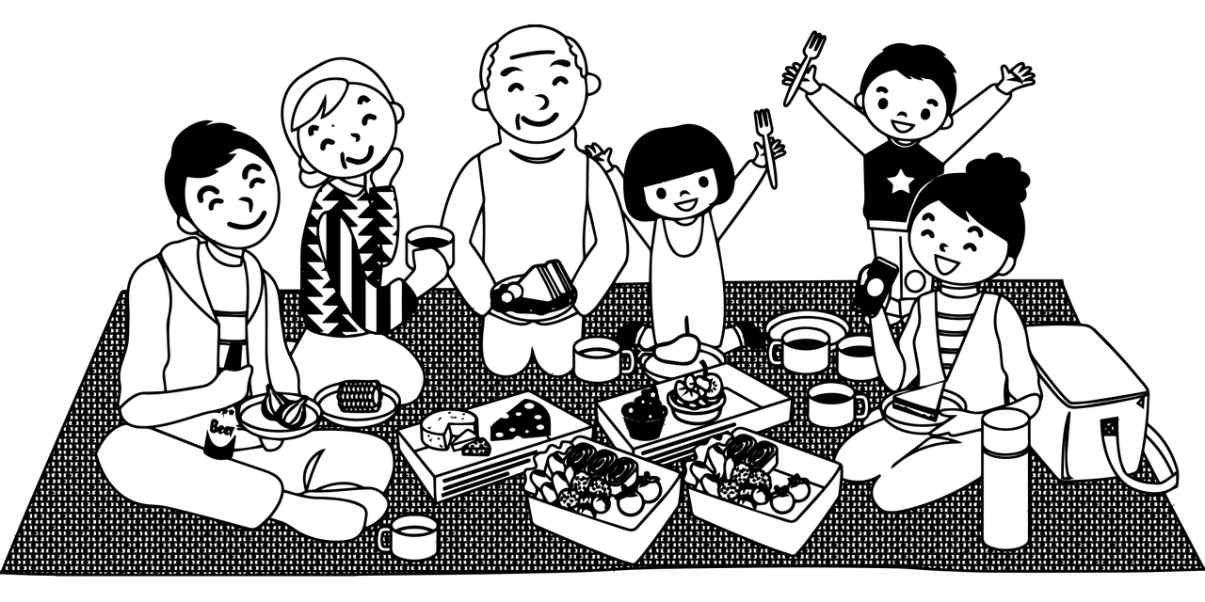
Rewrite the Following
Rewrite the following sentences using appropriate pronouns in place of the underlined nouns:
Mala is having an English test tomorrow.
Satish forgot to pack his umbrella this morning.
Children are going on a trip this weekend.
She is having an English test tomorrow.
He forgot to pack his umbrella this morning.
They are going on a trip this weekend.
Notes:
Notes for Teacher - < Information for further reference or explanation >
Suggestions: <Ideas/ Images/ Animations / Others – To make better representation of the content >
Source of Multimedia used in this slide - <Please provide source URL where we find the image and the license agreement>
<writing> <https://pixabay.com/vectors/school-little-girl-studying-5485391/>
<umbrella> <https://pixabay.com/illustrations/umbrella-storm-rain-clipart-drops-4523513/>
<picnic> <https://pixabay.com/vectors/picnic-family-picnic-picnic-basket-4246392/>

Slide 6
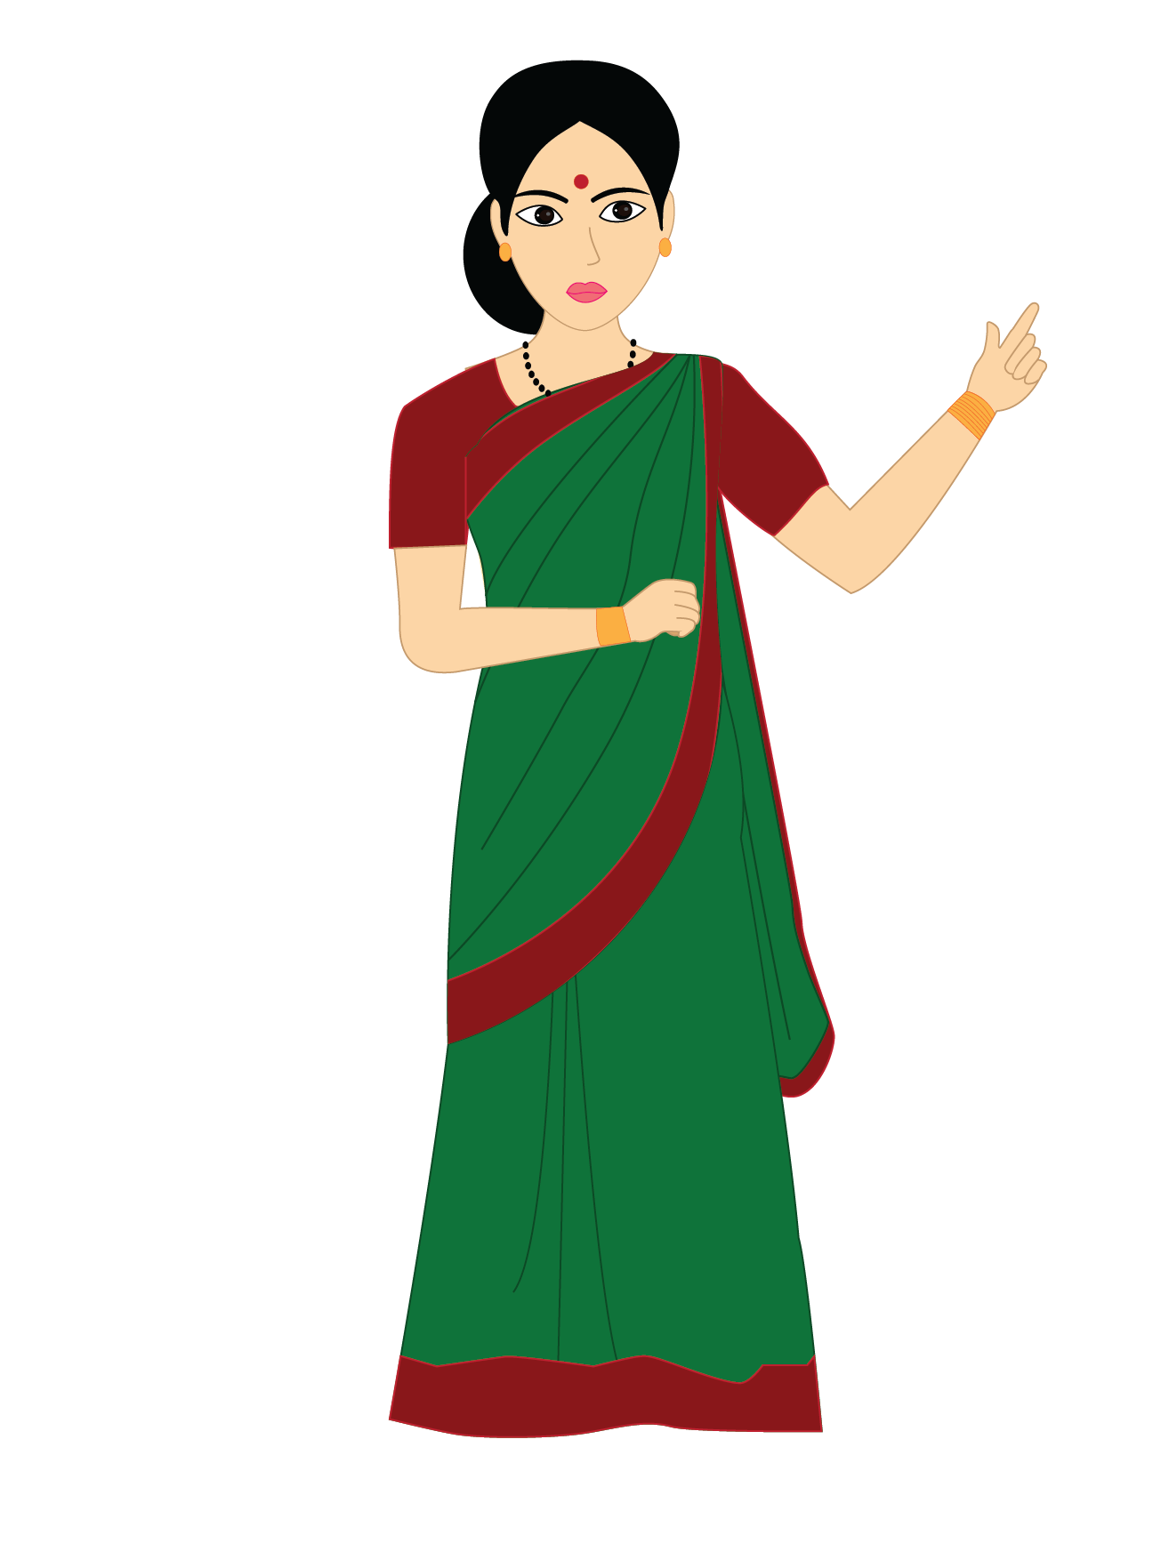
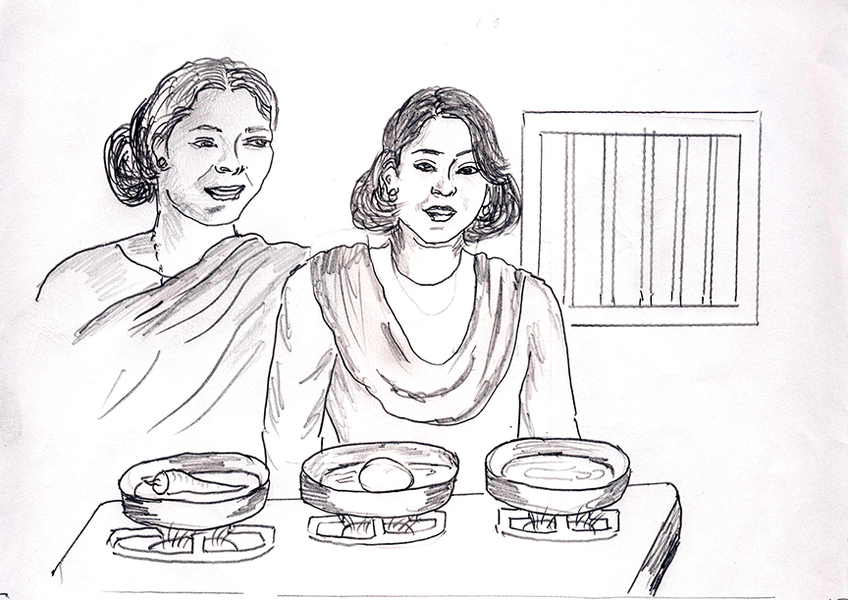
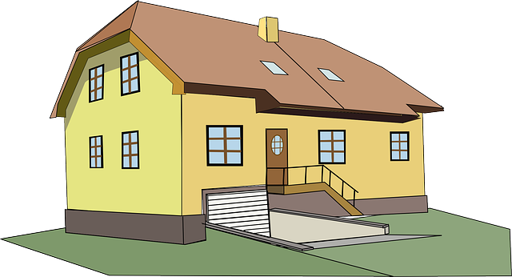
Make Sentences
Make sentences of your own with the following pronouns.
My _______________________
You _______________________
Her _______________________
Their _______________________
My mother is a teacher.
You have a new book.
Her mother is a good cook.
Their house is very big.
Notes:
Notes for Teacher - < Information for further reference or explanation >
Suggestions: <Ideas/ Images/ Animations / Others – To make better representation of the content >
Source of Multimedia used in this slide - <Please provide source URL where we find the image and the license agreement>
<teacher> <SSSVV Image Gallery: Search Keyword “teacher”>
<book> <https://pixabay.com/illustrations/book-reading-read-coffee-knowledge-4155805/>
<cook> <SSSSVV Image Gallery: Search Keyword “cook”>
<big house> <https://pixabay.com/vectors/house-home-2-story-yellow-big-304341/>

Slide 7
MM INDEX
Slide # | Thumbnail | Source link and Attribution
1 |  | <kid writing> https://pixabay.com/illustrations/student-child-homework-boy-male-5677625/
3 |  | <boys> <SSSVV Image Gallery: Search Keyword “school”> <tired> https://pixabay.com/vectors/man-employee-exhausted-tired-5754626/ <pen> https://pixabay.com/illustrations/pen-to-write-writing-ballpoint-3156806/ <fishing> https://pixabay.com/vectors/bait-fish-fishing-hook-2026318/
4 |  | <cat> https://pixabay.com/vectors/kitten-cute-cat-animals-furry-4794761/ <family> https://pixabay.com/vectors/friends-people-friendship-family-4187953/ <girls> https://pixabay.com/vectors/girl-studying-teacher-school-5432233/
5 |  | <writing> https://pixabay.com/vectors/school-little-girl-studying-5485391/ <umbrella> https://pixabay.com/illustrations/umbrella-storm-rain-clipart-drops-4523513/ <picnic> https://pixabay.com/vectors/picnic-family-picnic-picnic-basket-4246392/
6 |  | <teacher> <SSSVV Image Gallery: Search Keyword “teacher”> <book> https://pixabay.com/illustrations/book-reading-read-coffee-knowledge-4155805/ <cook> <SSSSVV Image Gallery: Search Keyword “cook”> <big house> https://pixabay.com/vectors/house-home-2-story-yellow-big-304341/
Notes:
Notes for Teacher - < Information for further reference or explanation >
Suggestions: <Ideas/ Images/ Animations / Others – To make better representation of the content >
Source of Multimedia used in this slide - <Please provide source URL where we find the image and the license agreement>

