Slide 1
Sentence Formation
Notes:
Notes for Teacher - < Information for further reference or explanation >
Suggestions: <Ideas/ Images/ Animations / Others – To make better representation of the content >
Source of Multimedia used in this slide - <Please provide source URL where we find the image and the license agreement>
<sentence formation> <https://pixabay.com/photos/writer-writing-paper-letter-author-605764/>

Slide 2
What is a Sentence?
A Group of words that has a definitive meaning.
Always begins with a capital letter.
We speak to each other in sentences.
is
a
apple
fruit
Framed to give a meaning
Apple
is
a
fruit
Complete sentence
Group of words
Notes:
Notes for Teacher - < Information for further reference or explanation >
Suggestions: <Ideas/ Images/ Animations / Others – To make better representation of the content >
Source of Multimedia used in this slide - <Please provide source URL where we find the image and the license agreement>

Slide 3
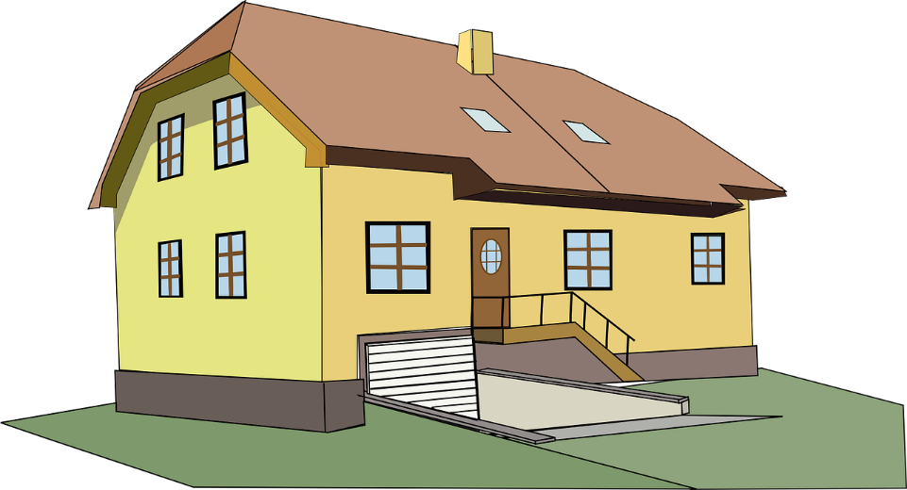
Sentence Formation Examples
‘big house’
We live in a big house.
This is a complete sentence.
This gives no proper idea.
Notes:
Notes for Teacher - < Information for further reference or explanation >
Suggestions: <Ideas/ Images/ Animations / Others – To make better representation of the content >
Source of Multimedia used in this slide - <Please provide source URL where we find the image and the license agreement>
<big house> <https://pixabay.com/vectors/house-home-2-story-yellow-big-304341/>
<thinking> <https://pixabay.com/vectors/deep-thought-mind-question-1296377/>

Slide 4
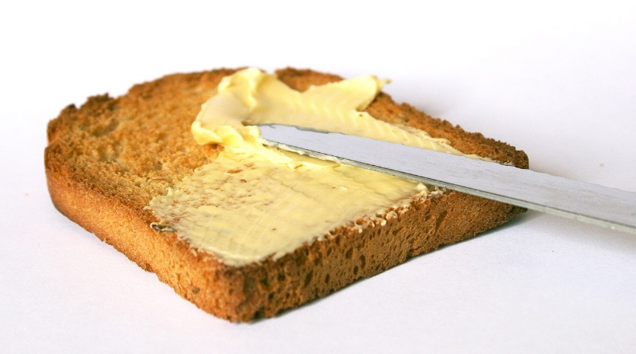
Sentence Formation
The order of words in a sentence is also very important.
Live in a house big we.
We live in a big house.
Subject
Verb
Object
Lunch for Shiva bread and butter ate.
Shiva ate bread and butter for lunch.
Subject
Verb
Object
Notes:
Notes for Teacher - < Information for further reference or explanation >
Suggestions: <Ideas/ Images/ Animations / Others – To make better representation of the content >
Source of Multimedia used in this slide - <Please provide source URL where we find the image and the license agreement>
<bread and butter> <https://pixabay.com/photos/breakfast-bread-butter-1242529/>
<big house> <https://pixabay.com/vectors/house-home-2-story-yellow-big-304341/>
<wrong> <https://pixabay.com/fr/vectors/incorrect-effacer-supprimer-annuler-294245/>
<correct> <https://pixabay.com/fr/vectors/ch%c3%a8que-correct-vert-marque-cocher-157822/>

Slide 5
Ending Sentences
There are 4 types of sentences:
.
Statements:
The sky is blue.
ends with a full stop
Every sentence ends with a ‘Punctuation Mark’
Commands:
Do your homework.
ends with a full stop
?
Questions:
ends with a ‘?’
Do you play football?
!
Exclamations:
ends with a ‘!’
How beautiful the sky is!
Notes:
Notes for Teacher - < Information for further reference or explanation >
Suggestions: <Ideas/ Images/ Animations / Others – To make better representation of the content >
Source of Multimedia used in this slide - <Please provide source URL where we find the image and the license agreement>

Slide 6
Points to Remember
Think before writing
Start with a capital letter
Describe the action
End with a ‘Punctuation Mark’
Read the sentence to check if it is alright
Notes:
Notes for Teacher - < Information for further reference or explanation >
Suggestions: <Ideas/ Images/ Animations / Others – To make better representation of the content >
Source of Multimedia used in this slide -

Slide 7
MM INDEX
Slide # | Thumbnail | Source link and Attribution
1 |  | <sentence formation> https://pixabay.com/photos/writer-writing-paper-letter-author-605764/
3,4 |  | <big house> https://pixabay.com/vectors/house-home-2-story-yellow-big-304341/
3 |  | <thinking> https://pixabay.com/vectors/deep-thought-mind-question-1296377/
4 |  | <bread and butter> https://pixabay.com/photos/breakfast-bread-butter-1242529/
4 |  | <wrong> https://pixabay.com/fr/vectors/incorrect-effacer-supprimer-annuler-294245/
4 |  | <correct> https://pixabay.com/fr/vectors/ch%c3%a8que-correct-vert-marque-cocher-157822/
Notes:
Notes for Teacher - < Information for further reference or explanation >
Suggestions: <Ideas/ Images/ Animations / Others – To make better representation of the content >
Source of Multimedia used in this slide - <Please provide source URL where we find the image and the license agreement>

