Slide 1
Sentence Building
Notes:
Notes for Teacher - < Information for further reference or explanation >
Suggestions: <Ideas/ Images/ Animations / Others – To make better representation of the content >
Source of Multimedia used in this slide - <Please provide source URL where we find the image and the license agreement>
<writing> <https://pixabay.com/vectors/hand-pen-writing-holding-pen-5431113/>

Slide 2
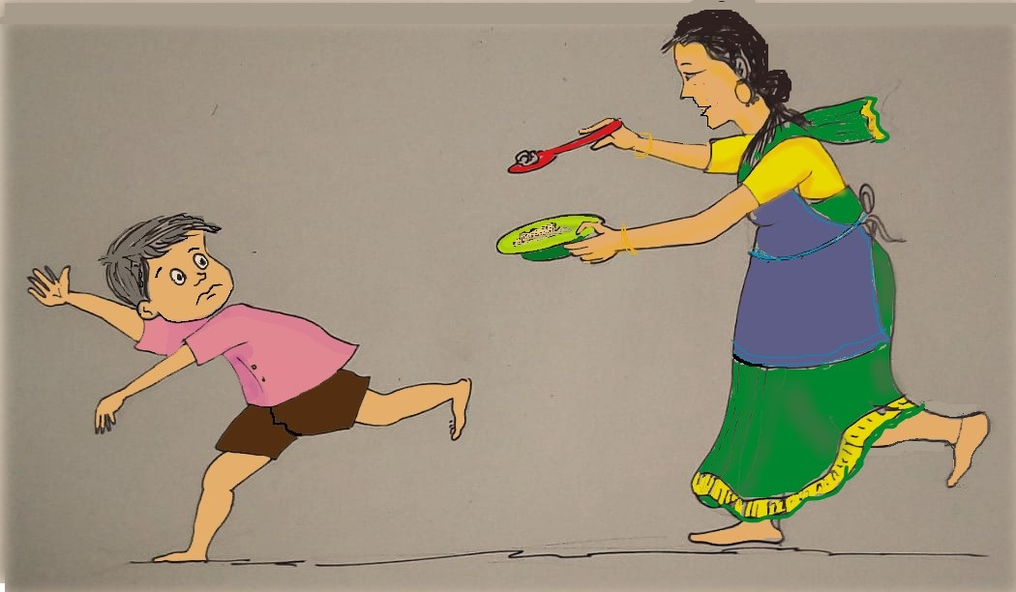
Exercise 1
See the picture and fill in the blanks.
The boy is ____________.
Mother is having a ____________ and a __________ in her hands.
The boy is wearing a __________ shirt.
running
spoon
bowl
pink
Notes:
Notes for Teacher - < Information for further reference or explanation >
Suggestions: <Ideas/ Images/ Animations / Others – To make better representation of the content >
Source of Multimedia used in this slide - <Please provide source URL where we find the image and the license agreement>
<mother chasing the son> <SSSVV – mother running behind son>

Slide 3
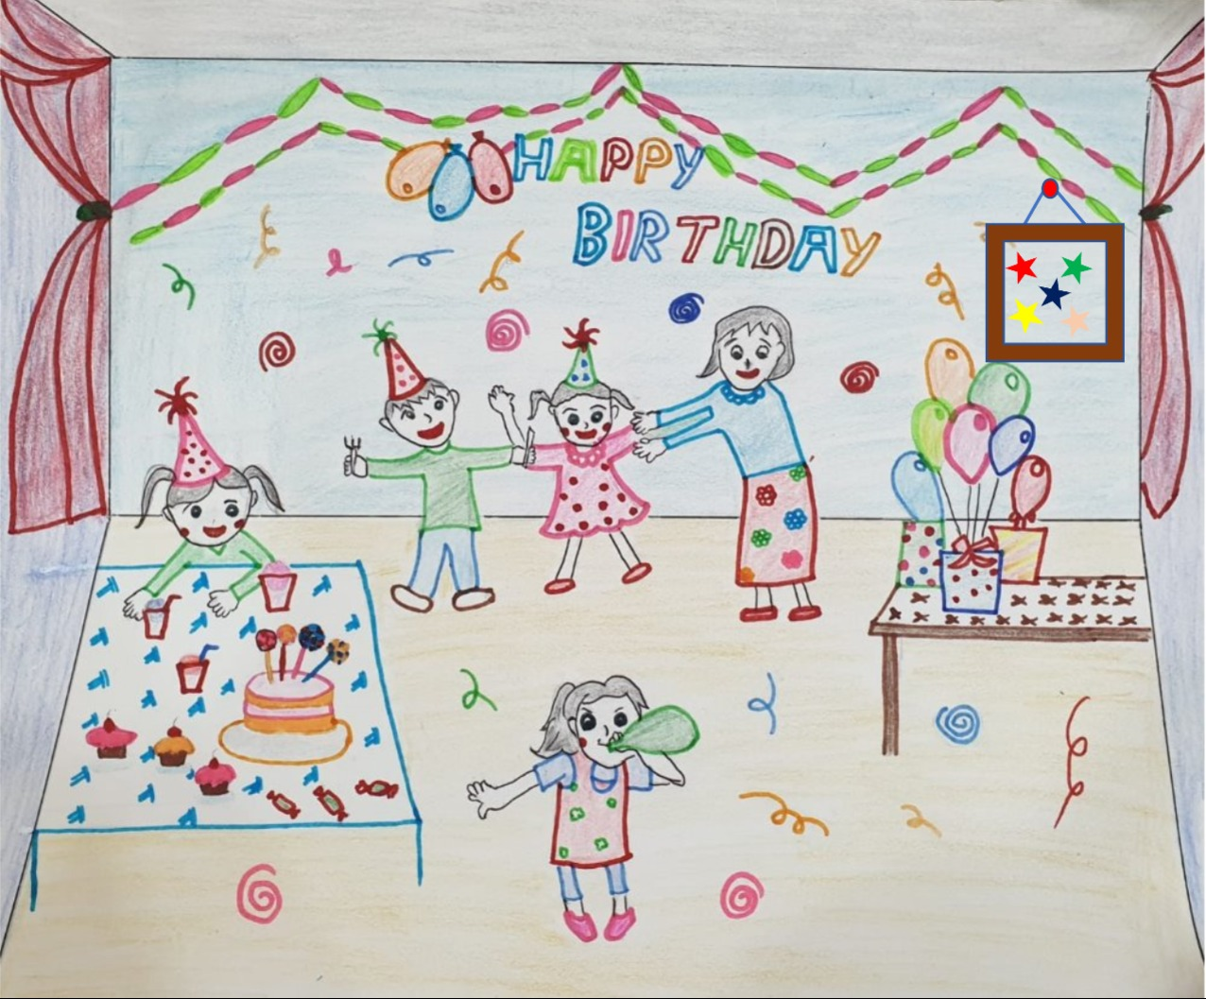
Exercise 2
Write three sentences seeing the picture given below using any of the words given.
Words: cake, balloons, children, birthday, caps, boy, girl
It is a birthday party.
The house is decorated with balloons and festoons.
There is a birthday cake on the table.
All the boys and girls are wearing caps.
Notes:
Notes for Teacher - < Information for further reference or explanation >
Suggestions: <Ideas/ Images/ Animations / Others – To make better representation of the content >
Source of Multimedia used in this slide - <Please provide source URL where we find the image and the license agreement>
<birthday party> <SSSVV - Birthday party>

Slide 4
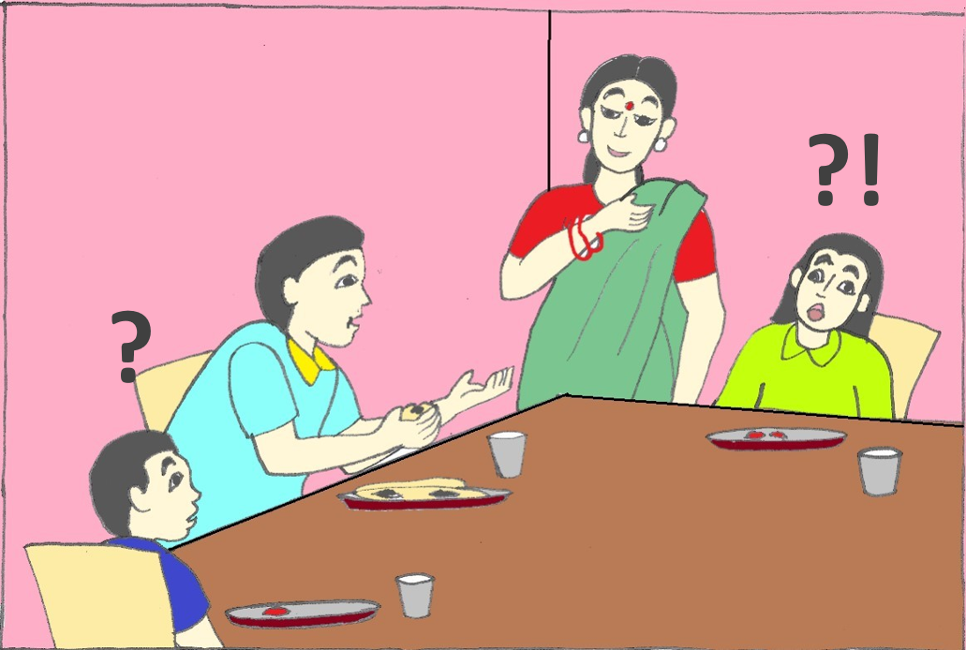
Exercise 3
Arrange the words in order in the following sentences by seeing the picture:
Talking father children to is the.
Wearing green is girl a frock the.
Has bangles two hand on her mother.
Many plates table are how there the on?
Father is talking to the children.
The girl is wearing a green frock.
Mother has two bangles on her hand.
How many plates are there on the table?
Notes:
Notes for Teacher - < Information for further reference or explanation >
Suggestions: <Ideas/ Images/ Animations / Others – To make better representation of the content >
Source of Multimedia used in this slide - <Please provide source URL where we find the image and the license agreement>
<family> <SSSVV - <family, father, mother>

Slide 5
MM INDEX
Slide # | Thumbnail | Source link and Attribution
1 |  | <writing> https://pixabay.com/vectors/hand-pen-writing-holding-pen-5431113/
2 |  | <mother chasing the son> <SSSVV Image Gallery: Search Keyword “mother”>
3 |  | <birthday party> <SSSVV Image Gallery: Search Keyword “birthday party”>
4 |  | <family> <SSSVV Image Gallery: Search Keyword “family”>
Notes:
Notes for Teacher - < Information for further reference or explanation >
Suggestions: <Ideas/ Images/ Animations / Others – To make better representation of the content >
Source of Multimedia used in this slide - <Please provide source URL where we find the image and the license agreement>

