Slide 1
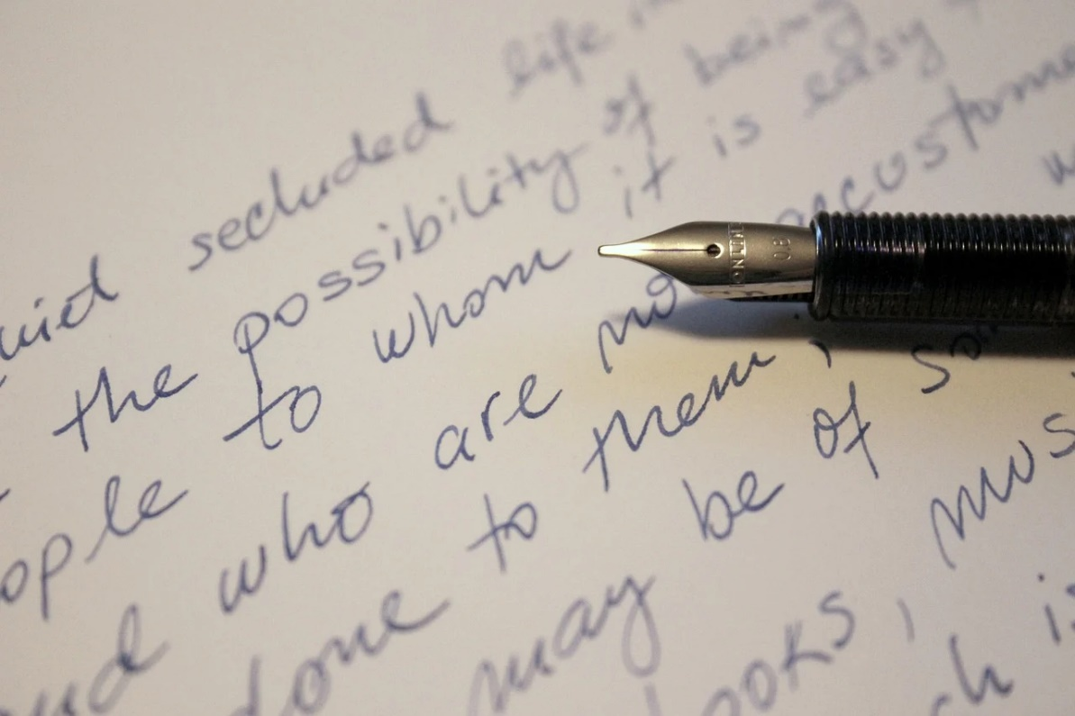
Sentence Formation
Notes:
Notes for Teacher - < Information for further reference or explanation >
Suggestions: <Ideas/ Images/ Animations / Others – To make better representation of the content >
Source of Multimedia used in this slide - <Please provide source URL where we find the image and the license agreement>
<sentences> <https://pixabay.com/photos/letter-handwriting-ink-pen-written-761653/>

Slide 2
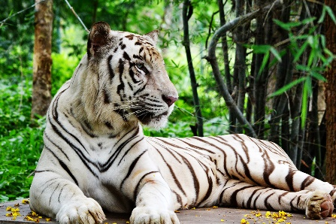
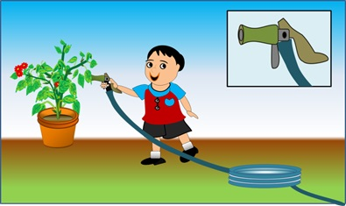
Exercise 1
Re-arrange the words in order to make meaningful sentences:
1. fish the bubbles blows colourful
2. tiger black dots has the on body its
3. friend my wears sunglasses
4. finish first homework your play then to go and
5. playing garden in children are the
Ans. The fish blows colourful bubbles.
Ans. The tiger has black dots on its body.
Ans. My friend wears sunglasses.
Ans. Finish your homework first and then go to play.
Ans. Children are playing in the garden.
Notes:
Notes for Teacher - < Information for further reference or explanation >
Suggestions: <Ideas/ Images/ Animations / Others – To make better representation of the content >
Source of Multimedia used in this slide - <Please provide source URL where we find the image and the license agreement>
<fish with bubbles> <https://pixabay.com/vectors/fish-bubbles-silhouette-eye-look-305723/>
<tiger> <SSSVV - tiger>
<sunglasses> <https://pixabay.com/vectors/sunglasses-ray-glasses-shades-304666/>
<writing> <https://pixabay.com/illustrations/writer-to-write-notebook-idea-men-795286/>
<garden> <SSSVV - garden>

Slide 3
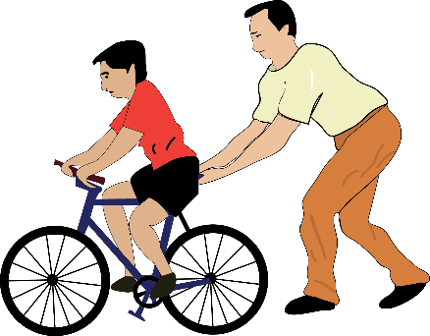
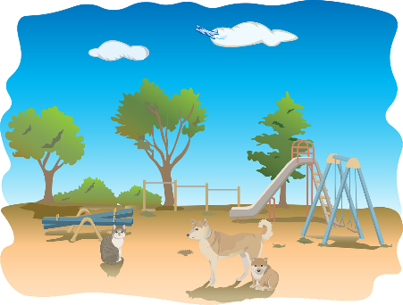
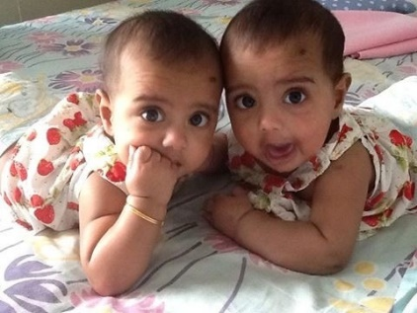
Exercise 2
Write the following sentences with right punctuation and capitalisation:
1. we like to ride bicycles
2. what is your favourite colour
3. my favourite place in school is the playground
4. i like to eat chocolates
5. i have one sister and her name is nithya
Ans. We like to ride bicycles.
Ans. What is your favourite colour?
Ans. My favourite place in school is the playground.
Ans. I like to eat chocolates.
Ans. I have one sister and her name is Nithya.
Notes:
Notes for Teacher - < Information for further reference or explanation >
Suggestions: <Ideas/ Images/ Animations / Others – To make better representation of the content >
Source of Multimedia used in this slide - <Please provide source URL where we find the image and the license agreement>
<bicycle> <SSSVV> <cycle, father>
<colour> <https://pixabay.com/vectors/palette-paints-colours-wooden-23406/>
<playground> <https://pixabay.com/vectors/playground-animals-dog-cat-tree-3044380/>
<toffee> <https://pixabay.com/vectors/cartoon-candy-sweet-food-sugar-2462970/>
<sisters> <SSSVV> <girls>

Slide 4
Exercise 3
Answer the following questions:
Q1.
What is a sentence?
A sentence is a group of words put together in such a way that they convey a meaning.
Q2.
What are the different types of sentences?
Statements
Questions
Exclamations
Commands/requests/suggestions/advice
Q3.
What is it that is very important in a sentence?
The order of words in a sentence is very important.
Notes:
Notes for Teacher - < Information for further reference or explanation >
Suggestions: <Ideas/ Images/ Animations / Others – To make better representation of the content >
Source of Multimedia used in this slide - <Please provide source URL where we find the image and the license agreement>
<teacher> <SSSVV – teacher>

Slide 5
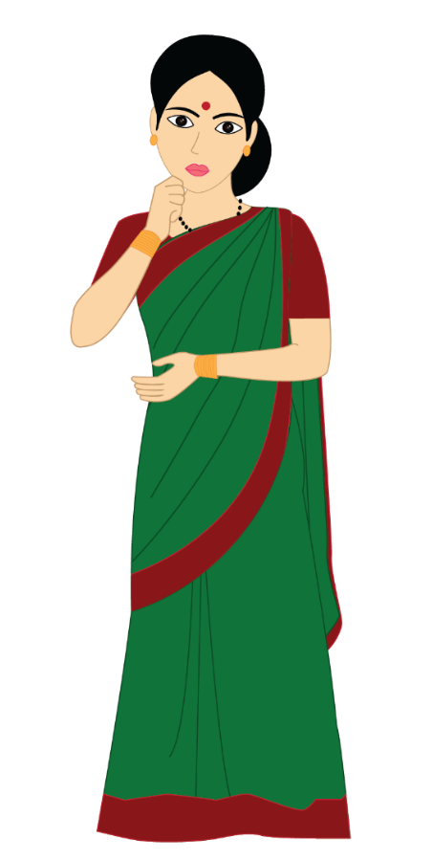
Exercise 3
Answer the following questions:
Q4.
What are the important points to remember while building a sentence?
Think before writing
Start with a capital letter
Describe the action
End with a ‘punctuation mark’
Read the sentence to check whether it is alright
Notes:
Notes for Teacher - < Information for further reference or explanation >
Suggestions: <Ideas/ Images/ Animations / Others – To make better representation of the content >
Source of Multimedia used in this slide - <Please provide source URL where we find the image and the license agreement>
<teacher> <SSSVV – teacher>

Slide 6
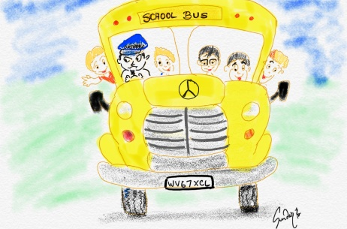
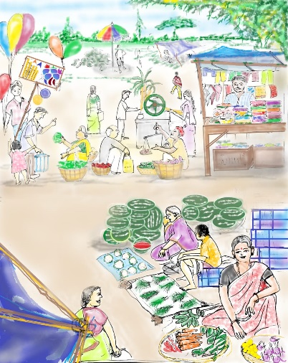
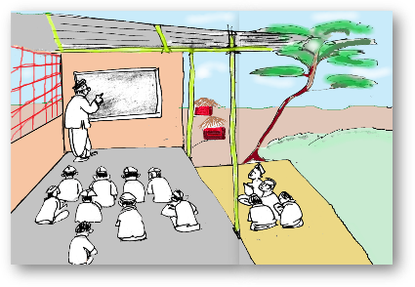
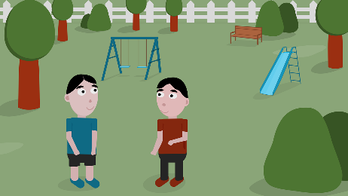
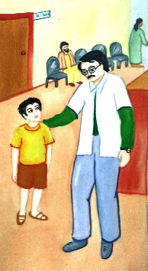
Exercise 4
Match the following to make complete sentences:
Rama and Krishna
Rama and Krishna
to buy books
to buy books
Teacher told the children
Teacher told the children
by school bus
by school bus
My father
My father
are brothers
are brothers
He went to the market
He went to the market
to sit quietly in the class
to sit quietly in the class
They all go to school
They all go to school
is a doctor
is a doctor
Notes:
Notes for Teacher - < Information for further reference or explanation >
Suggestions: <Ideas/ Images/ Animations / Others – To make better representation of the content >
Source of Multimedia used in this slide - <Please provide source URL where we find the image and the license agreement>
<brothers> <https://pixabay.com/illustrations/children-park-two-boys-kids-5349118/>
<bus> <SSSVV - Safety Rules safety-rules-7866 Road Safety, Bus Travel>
<doctor> <SSSVV - Doctor doctor-5355 Doctor, Doctor examining a child, hospital, medicine, medical, blood transfusion>
<classroom> <SSSVV - Olden classroom olden classrooms Classroom, caste, discrimination>
<market> <SSSVV - Rural market, vegetable market, market at the village>

Slide 7
MM INDEX
Slide # | Thumbnail | Source link and Attribution
1 |  | <sentences> https://pixabay.com/photos/letter-handwriting-ink-pen-written-761653/
2 |  | <fish with bubbles> https://pixabay.com/vectors/fish-bubbles-silhouette-eye-look-305723/ <tiger> <SSSVV Image Gallery: Search Keyword “tiger”> <sunglasses> https://pixabay.com/vectors/sunglasses-ray-glasses-shades-304666/ <writing> https://pixabay.com/illustrations/writer-to-write-notebook-idea-men-795286/ <garden> <SSSVV Image Gallery: Search Keyword “garden”>
3 |  | <bicycle> <SSSVV Image Gallery: Search Keyword “cycle”> <colour> https://pixabay.com/vectors/palette-paints-colours-wooden-23406/ <playground> https://pixabay.com/vectors/playground-animals-dog-cat-tree-3044380/ <toffee> https://pixabay.com/vectors/cartoon-candy-sweet-food-sugar-2462970/ <sisters> <SSSVV Image Gallery: Search Keyword “girls”>
5 |  | <teacher> <SSSVV Image Gallery: Search Keyword “teacher”>
6 |  | <brothers> https://pixabay.com/illustrations/children-park-two-boys-kids-5349118/ <bus> <SSSVV Image Gallery: Search Keyword “Safety Rules”> <doctor> <SSSVV Image Gallery: Search Keyword “Doctor”> <classroom> <SSSVV Image Gallery: Search Keyword “Olden classroom”> <market> <SSSVV Image Gallery: Search Keyword “Rural market”>
Notes:
Notes for Teacher - < Information for further reference or explanation >
Suggestions: <Ideas/ Images/ Animations / Others – To make better representation of the content >
Source of Multimedia used in this slide - <Please provide source URL where we find the image and the license agreement>

