Slide 1
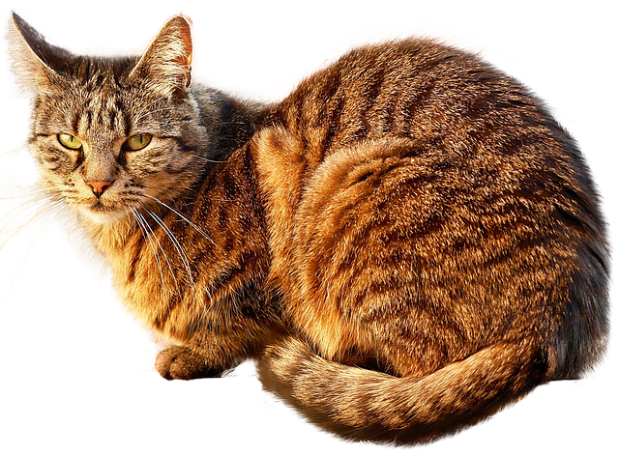
Knowing All About Genders
Notes:
Notes for Teacher - < Information for further reference or explanation >
Suggestions: <Ideas/ Images/ Animations / Others – To make better representation of the content >
Source of Multimedia used in this slide -
1. <Cat> - <https://pixabay.com/photos/cat-free-cat-animal-red-tomcat-2973097/>

Slide 2
Gender Nouns
Neuter
Feminine
Masculine
Common
Notes:
Notes for Teacher - < Information for further reference or explanation >
Suggestions: <Ideas/ Images/ Animations / Others – To make better representation of the content >
Source of Multimedia used in this slide - <Please provide source URL where we find the image and the license agreement>

Slide 3
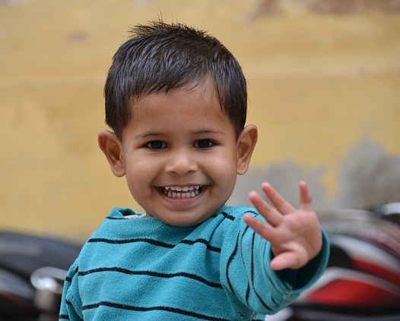
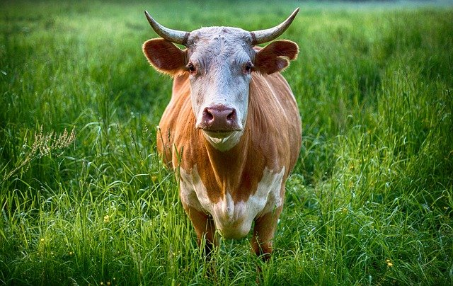
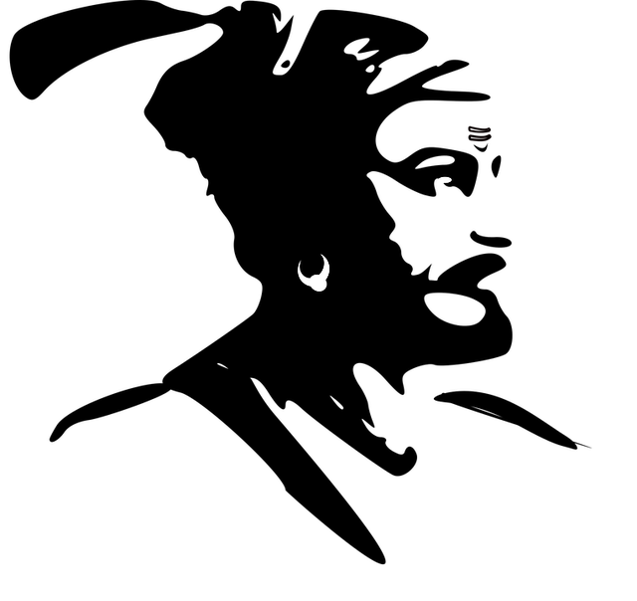
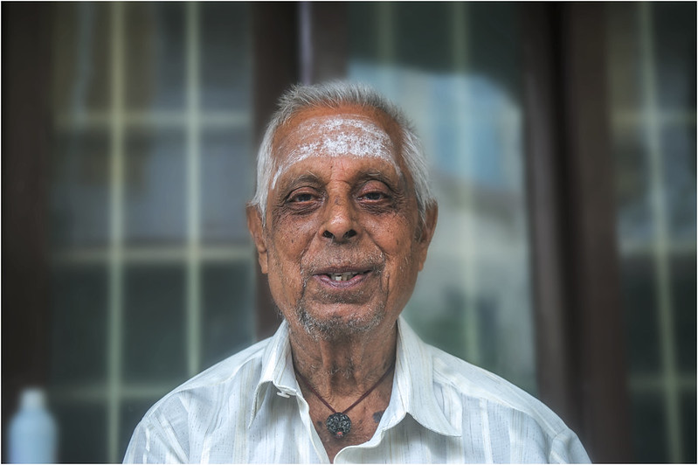
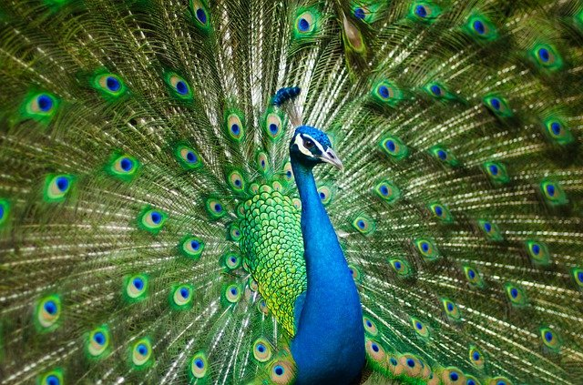
Masculine Gender
Masculine noun
Used for men, boys and male animals and birds
Boy
Man
Bull
King
Grandfather
Peacock
Notes:
Notes for Teacher - < Information for further reference or explanation >
Suggestions: <Ideas/ Images/ Animations / Others – To make better representation of the content >
Source of Multimedia used in this slide - <Please provide source URL where we find the image and the license agreement>
Boy: https://pixabay.com/photos/child-merry-india-pleasure-young-787712/
Man: https://pixabay.com/photos/sikh-india-indian-people-turban-4686761/
Bull: https://pixabay.com/photos/bull-cow-animal-farm-agriculture-2438032/
King: https://pixabay.com/vectors/india-indian-leaders-1295113/
Grandfather: https://www.flickr.com/photos/47850033@N08/36119610724 By Nithi Anand
Peacock: https://pixabay.com/photos/peafowl-peacock-bird-feathers-2363750/

Slide 4
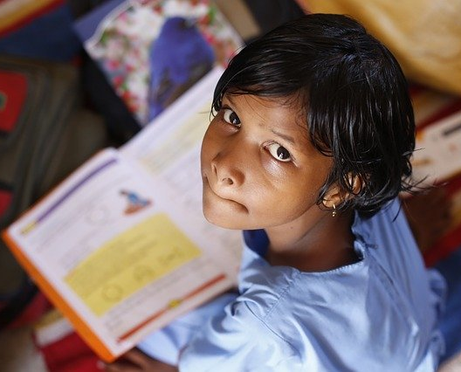
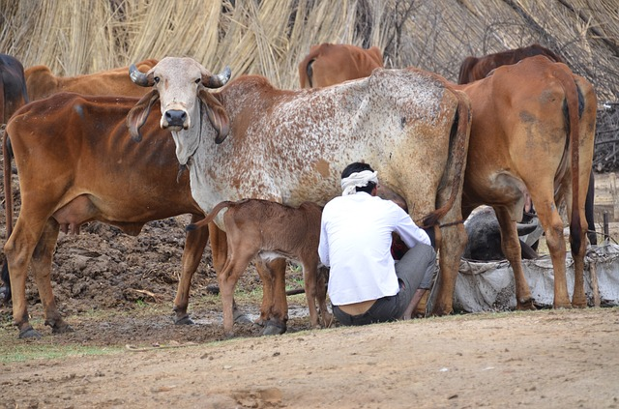
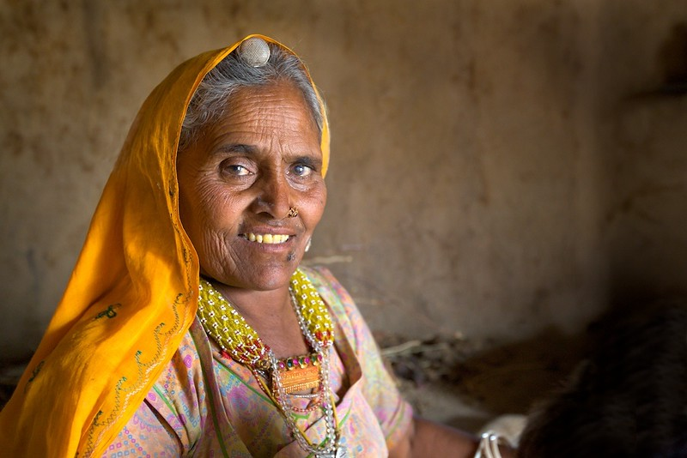
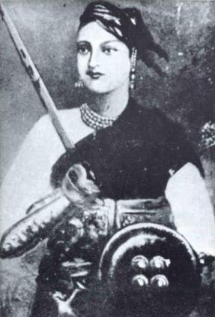
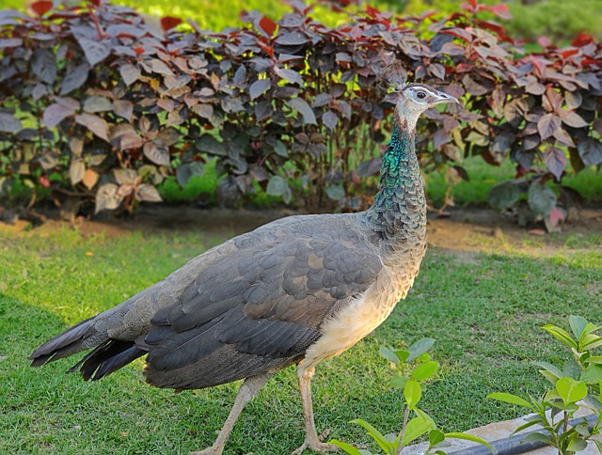
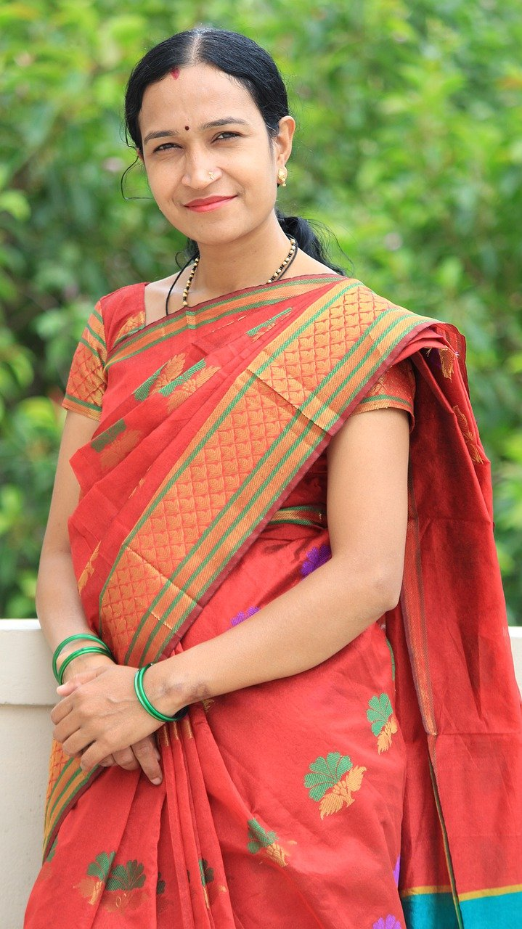
Feminine Gender
Feminine noun
Used for women, girls and female animals and birds
Girl
Cow
Grandmother
Queen
Woman
Peahen
Notes:
Notes for Teacher - < Information for further reference or explanation >
Suggestions: <Ideas/ Images/ Animations / Others – To make better representation of the content >
Source of Multimedia used in this slide - <Please provide source URL where we find the image and the license agreement>
Girl: https://pixabay.com/photos/children-infant-girl-school-306607/
Woman: https://pixabay.com/photos/women-indian-female-mother-woman-4419738/
Grandmother: https://www.flickr.com/photos/88475677@N00/3593372477 By Michael Foley
Queen: https://commons.wikimedia.org/wiki/File:Rani_of_jhansi.jpg
Cow: https://pixabay.com/photos/mammals-india-cows-to-milk-farmer-787702/
Peahen: https://pixabay.com/photos/peahen-bird-peafowl-nature-animal-4859288/

Slide 5
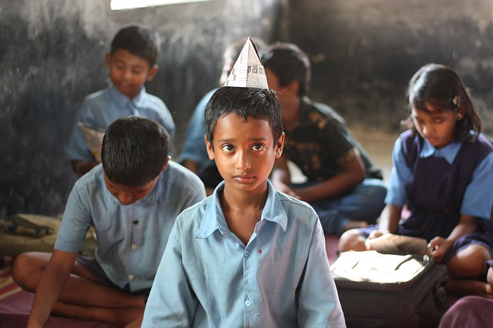
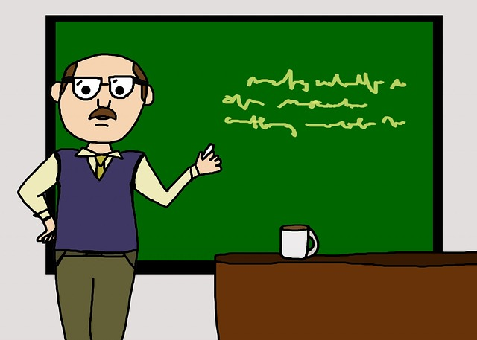
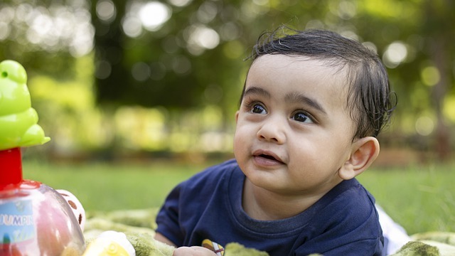
Common Gender
Common nouns
Male and Female
doctor
student
dancer
baby
pilot
teacher
Notes:
Notes for Teacher - < Information for further reference or explanation >
Suggestions: <Ideas/ Images/ Animations / Others – To make better representation of the content >
Source of Multimedia used in this slide - <Please provide source URL where we find the image and the license agreement>
<doctor> - <https://pixabay.com/illustrations/doctor-laptop-office-medical-male-3212067/>
<baby> - <https://pixabay.com/photos/child-baby-cute-little-innocence-3268264/>
<dancer> - <https://pixabay.com/vectors/silhouette-indian-dancer-beautiful-3837379/>
<pilot> - <https://pixabay.com/vectors/airplane-airport-par-avion-people-1295845/>
<student> - <https://pixabay.com/photos/confused-school-kid-confusion-4640878/>
<teacher> - <https://pixabay.com/illustrations/male-man-teacher-professor-213729/>

Slide 6
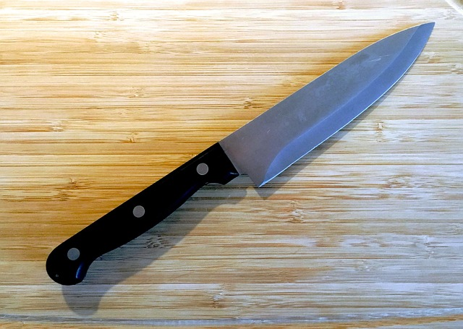
Neuter Gender
Neuter nouns
Objects like machines, tools, places
table
pen
computer
broom
book
knife
Notes:
Notes for Teacher - < Information for further reference or explanation >
Suggestions: <Ideas/ Images/ Animations / Others – To make better representation of the content >
Source of Multimedia used in this slide - <Please provide source URL where we find the image and the license agreement>
<table> - <https://pixabay.com/vectors/table-furniture-wooden-1300555/>
<pen> - <https://pixabay.com/vectors/pen-black-ink-ballpoint-feather-33077/>
<broom> - <https://pixabay.com/vectors/brooms-cleaning-household-tool-1294961/>
<book> - <https://pixabay.com/photos/book-read-page-text-literature-3773783/>
<computer> - <https://pixabay.com/illustrations/computer-desktop-pc-office-work-5509452/>
<knife> - <https://pixabay.com/photos/knife-board-kitchen-food-cut-2162020/>

Slide 7
MM INDEX
Slide # | Thumbnail | Source link and Attribution
1 |  | Cat: https://pixabay.com/photos/cat-free-cat-animal-red-tomcat-2973097/
3 |  | Boy: https://pixabay.com/photos/child-merry-india-pleasure-young-787712/ Man: https://pixabay.com/photos/sikh-india-indian-people-turban-4686761/ Bull: https://pixabay.com/photos/bull-cow-animal-farm-agriculture-2438032/ King: https://pixabay.com/vectors/india-indian-leaders-1295113/ Grandfather: https://www.flickr.com/photos/47850033@N08/36119610724 By Nithi Anand Peacock: https://pixabay.com/photos/peafowl-peacock-bird-feathers-2363750/
4 |  | Girl: https://pixabay.com/photos/children-infant-girl-school-306607/ Woman: https://pixabay.com/photos/women-indian-female-mother-woman-4419738/ Grandmother: https://www.flickr.com/photos/88475677@N00/3593372477 By Michael Foley Queen: https://commons.wikimedia.org/wiki/File:Rani_of_jhansi.jpg Cow: https://pixabay.com/photos/mammals-india-cows-to-milk-farmer-787702/ Peahen: https://pixabay.com/photos/peahen-bird-peafowl-nature-animal-4859288/
5 |  | Doctor: https://pixabay.com/illustrations/doctor-laptop-office-medical-male-3212067/ Baby: https://pixabay.com/photos/baby-india-cute-indian-gujarat-5074000/ Dancer: https://pixabay.com/vectors/silhouette-indian-dancer-beautiful-3837379/ Pilot: https://pixabay.com/vectors/airplane-airport-par-avion-people-1295845/ Student: https://pixabay.com/photos/confused-school-kid-confusion-4640878/ Teacher: https://pixabay.com/illustrations/male-man-teacher-professor-213729/
6 |  | Table: https://pixabay.com/vectors/table-furniture-wooden-1300555/ Pen: https://pixabay.com/vectors/pen-black-ink-ballpoint-feather-33077/ Broom: https://pixabay.com/vectors/brooms-cleaning-household-tool-1294961/ Computer: https://pixabay.com/illustrations/computer-desktop-pc-office-work-5509452/ Book: https://pixabay.com/photos/book-read-page-text-literature-3773783/ Knife: https://pixabay.com/photos/knife-board-kitchen-food-cut-2162020/
Notes:
Notes for Teacher - < Information for further reference or explanation >
Suggestions: <Ideas/ Images/ Animations / Others – To make better representation of the content >
Source of Multimedia used in this slide - <Please provide source URL where we find the image and the license agreement>

