Slide 1
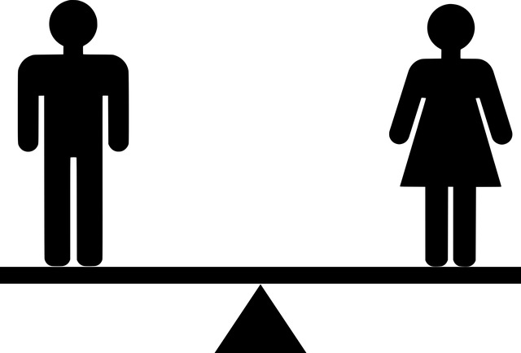
Fun With Genders
Notes:
Notes for Teacher –
Explain the four genders before commencing the game of cards.
Explain the procedure of the game to the class before commencing the activity.
Encourage all students to participate.>
Suggestions: <Ideas/ Images/ Animations / Others – To make better representation of the content >
Source of Multimedia used in this slide - <Please provide source URL where we find the image and the license agreement>
<Gender> - <https://pixabay.com/vectors/equal-equality-equilibrium-gender-5366151/>

Slide 2
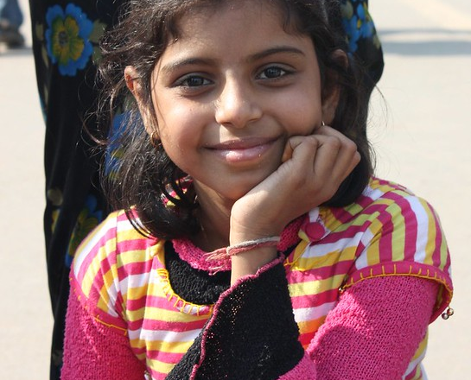
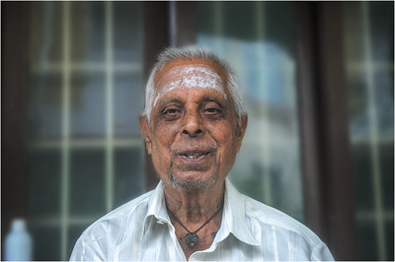
Name the Gender
bull elephant
cousin
Feminine
Masculine
Neuter
Common
aunt
car
Masculine
Feminine
Common
Neuter
Notes:
Notes for Teacher - < Information for further reference or explanation >
Suggestions: <Ideas/ Images/ Animations / Others – To make better representation of the content >
Source of Multimedia used in this slide - <Please provide source URL where we find the image and the license agreement>
<girl> <https://www.flickr.com/photos/67769030@N07/6254346545> By Arian Zwegers
<apple> <https://pixabay.com/vectors/apple-red-fruit-fresh-ripe-juicy-25236/>
<oldman> <https://www.flickr.com/photos/47850033@N08/36119610724> By Nithi Anand
<baby> <https://pixabay.com/vectors/toddler-crawling-baby-purple-kid-303750/>

Slide 3
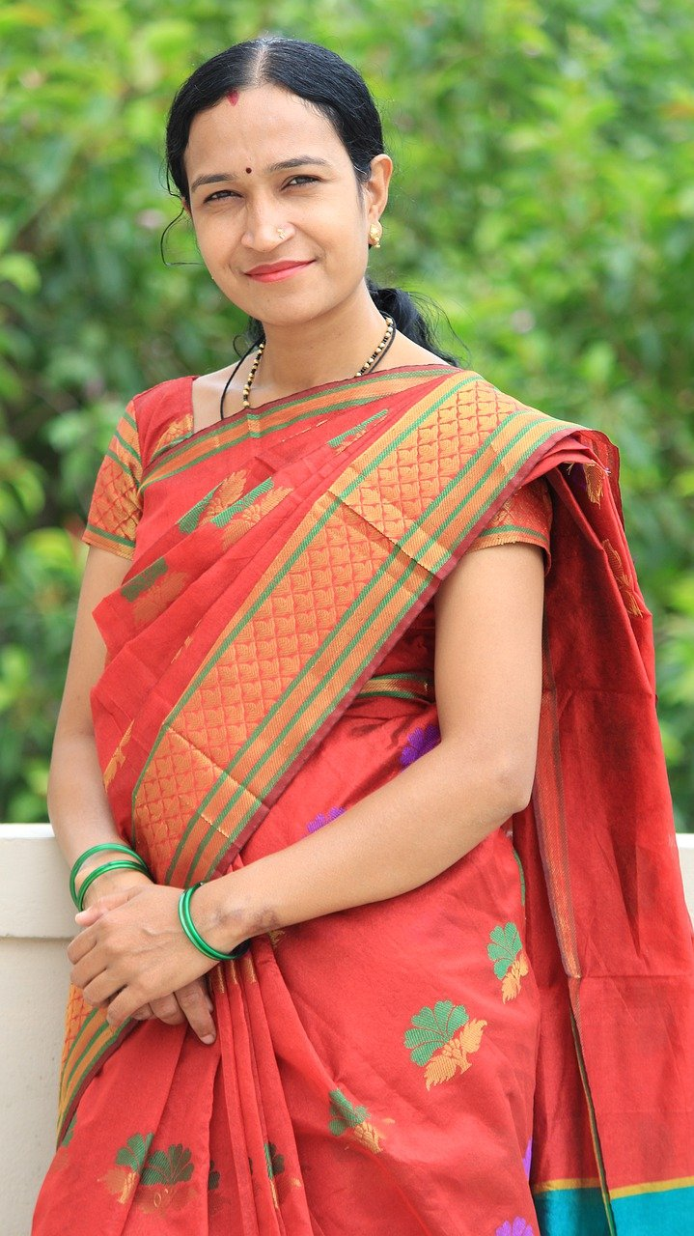
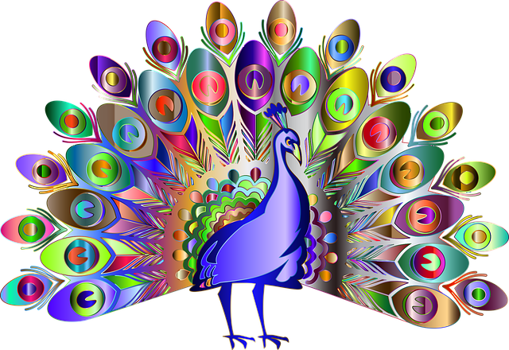
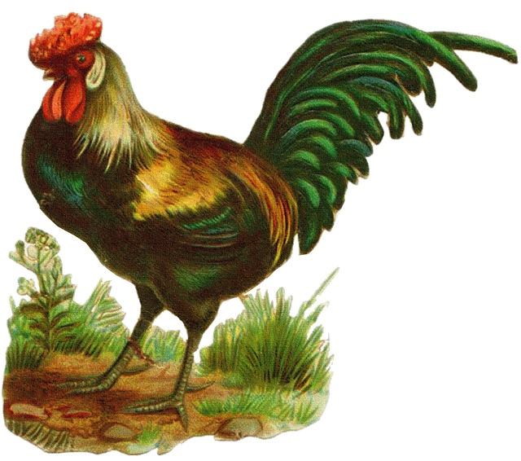
Name the Gender
pilot
computer
Masculine
Common
Feminine
Neuter
grand
mother
teacher
Masculine
Feminine
Neuter
Common
Notes:
Notes for Teacher - < Information for further reference or explanation >
Suggestions: <Ideas/ Images/ Animations / Others – To make better representation of the content >
Source of Multimedia used in this slide - <Please provide source URL where we find the image and the license agreement>
<peacock> <https://pixabay.com/vectors/peacock-bird-animal-decorative-4955655/>
<lady> <https://pixabay.com/photos/women-indian-female-mother-woman-4419738/>
<rooster> <https://pixabay.com/illustrations/rooster-vintage-drawing-chicken-948405/>
<table> <https://pixabay.com/vectors/table-furniture-wooden-1300555/>

Slide 4
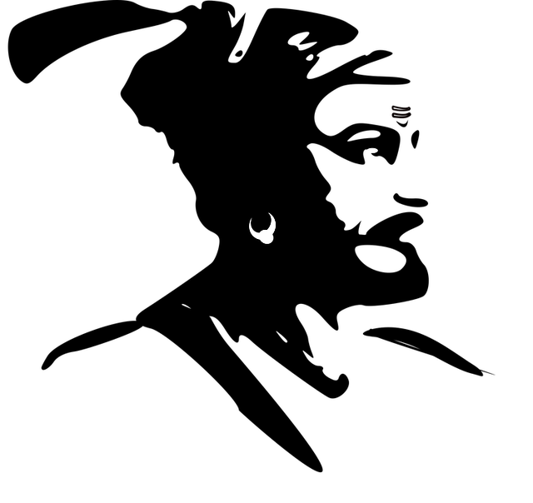
Name the Gender
mother
doctor
Masculine
Feminine
Neuter
Common
tigress
school
Masculine
Feminine
Common
Neuter
Notes:
Notes for Teacher - < Information for further reference or explanation >
Suggestions: <Ideas/ Images/ Animations / Others – To make better representation of the content >
Source of Multimedia used in this slide - <Please provide source URL where we find the image and the license agreement>
<lion> <https://pixabay.com/vectors/lion-animal-brown-yellow-mammal-46893/>
<book> <https://pixabay.com/illustrations/book-reading-read-coffee-knowledge-4155805/>
<king> <https://pixabay.com/vectors/india-indian-leaders-1295113/>
<astronaut> <https://pixabay.com/vectors/table-furniture-wooden-1300555/>

Slide 5
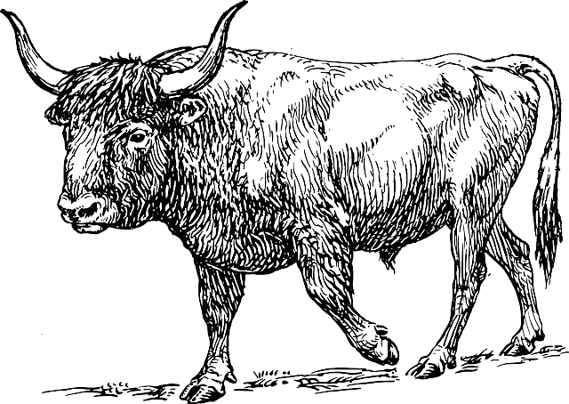
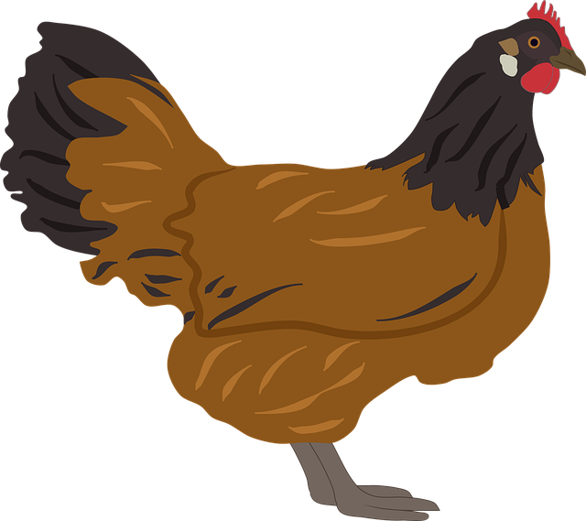
Name the Gender
father
friend
Feminine
Masculine
Masculine
Common
woman
child
Neuter
Feminine
Neuter
Common
Notes:
Notes for Teacher - < Information for further reference or explanation >
Suggestions: <Ideas/ Images/ Animations / Others – To make better representation of the content >
Source of Multimedia used in this slide - <Please provide source URL where we find the image and the license agreement>
<hen> <https://pixabay.com/vectors/chicken-hen-poultry-bird-farm-5412952/>
<hospital> <https://pixabay.com/illustrations/hospital-building-medical-clinic-5025895/>
<ball> <https://pixabay.com/vectors/football-ball-sport-soccer-round-157930/>
<bull> <https://pixabay.com/vectors/bull-walking-horns-farm-animal-47793/>

Slide 6
MM INDEX
Slide # | Thumbnail | Source link and Attribution
1 |  | <Gender> - https://pixabay.com/vectors/equal-equality-equilibrium-gender-5366151/
2 |  | <girl> https://www.flickr.com/photos/67769030@N07/6254346545 By Arian Zwegers <apple> https://pixabay.com/vectors/apple-red-fruit-fresh-ripe-juicy-25236/ <oldman> https://www.flickr.com/photos/47850033@N08/36119610724 By Nithi Anand <baby> https://pixabay.com/vectors/toddler-crawling-baby-purple-kid-303750/
3 |  | <peacock> https://pixabay.com/vectors/peacock-bird-animal-decorative-4955655/ <lady> https://pixabay.com/photos/women-indian-female-mother-woman-4419738/ <rooster> https://pixabay.com/illustrations/rooster-vintage-drawing-chicken-948405/ <table> https://pixabay.com/vectors/table-furniture-wooden-1300555/
4 |  | <lion> https://pixabay.com/vectors/lion-animal-brown-yellow-mammal-46893/ <book> https://pixabay.com/illustrations/book-reading-read-coffee-knowledge-4155805/ <king> https://pixabay.com/vectors/india-indian-leaders-1295113/ <astronaut> https://pixabay.com/vectors/table-furniture-wooden-1300555/
5 |  | <hen> https://pixabay.com/vectors/chicken-hen-poultry-bird-farm-5412952/ <hospital> https://pixabay.com/illustrations/hospital-building-medical-clinic-5025895/ <ball> https://pixabay.com/vectors/football-ball-sport-soccer-round-157930/ <bull> https://pixabay.com/vectors/bull-walking-horns-farm-animal-47793/
Notes:
Notes for Teacher - < Information for further reference or explanation >
Suggestions: <Ideas/ Images/ Animations / Others – To make better representation of the content >
Source of Multimedia used in this slide - <Please provide source URL where we find the image and the license agreement>

