Slide 1
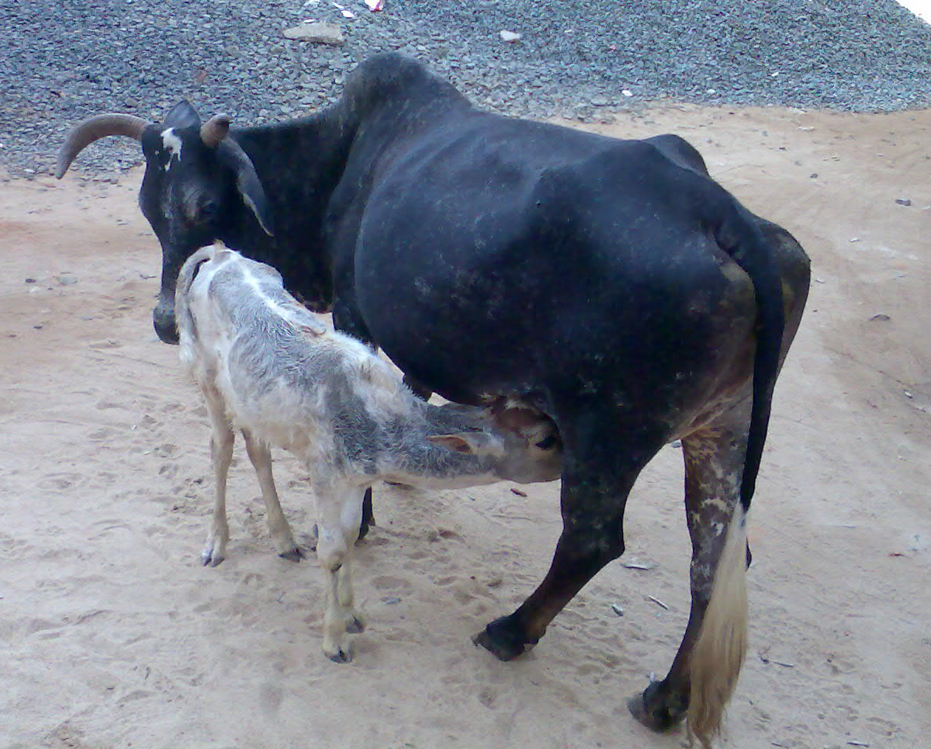
CARING FOR OUR CATTLE
Notes:
SSSVV Gallery

Slide 2
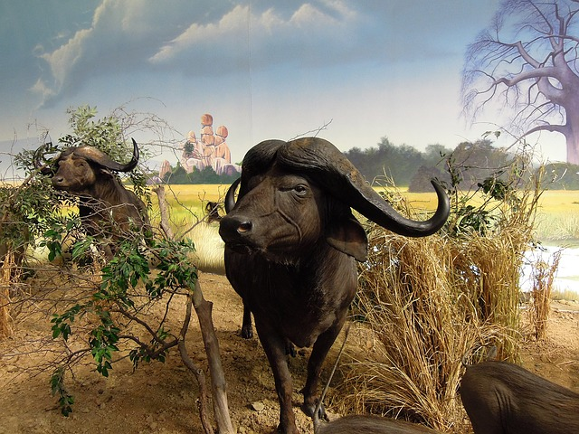
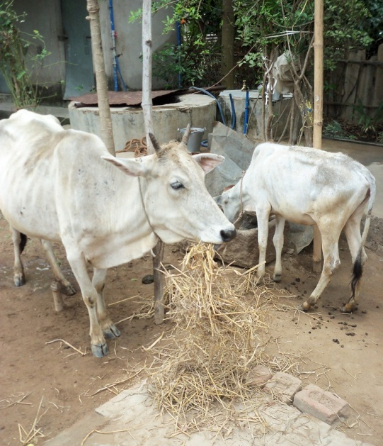
CATTLE FARMING
It means the raising of cattle or cows and buffaloes from their birth up to the point when they become fully developed to produce food and milk for our use.
Notes:
Buffalo: CC: https://pixabay.com/en/buffalo-affalo-cape-buffaloes-256544/
SSSVV Gallery

Slide 3
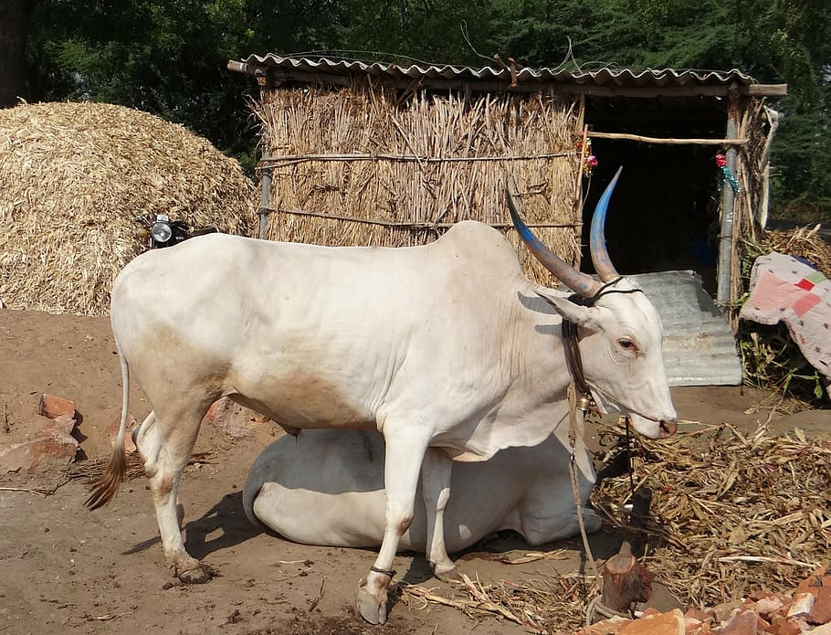
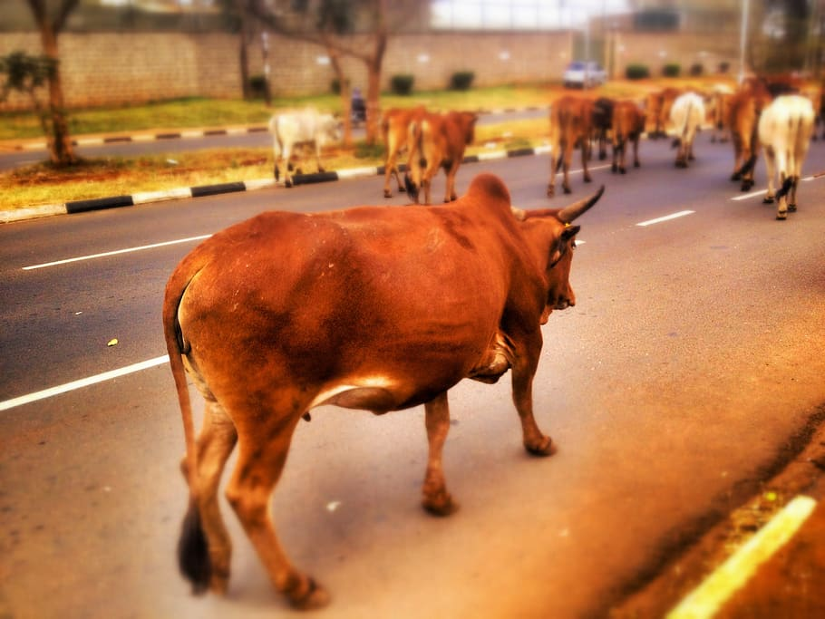
CATTLE FARMING
There are over 800 breeds of cattle all over the world.
India has around 37 pure cattle breeds.
Gir ,Gujarat
Known for their milking ability.
It has a higher yield of milk.
Sahiwal, Punjab, Uttar Pradesh & Haryana
Primarily used in dairy production. Easily identifiable from their red colour.
Notes:
https://www.pxfuel.com/en/free-photo-jhmdl
https://www.pxfuel.com/en/free-photo-xpsbh

Slide 4
CATTLE FARMING
3. Kankrej Bhuj , North Gujarat & Rajasthan.
Largest cattle breeds in India.
4. Vechur Kerala -Low milk yield .
They are among the smallest cattle breeds in India.
5. Kasaragod dwarf cattle
Kerala -Known for their mineral rich milk.
Red Sindhi Sindh -Widely kept for milk production

Slide 5
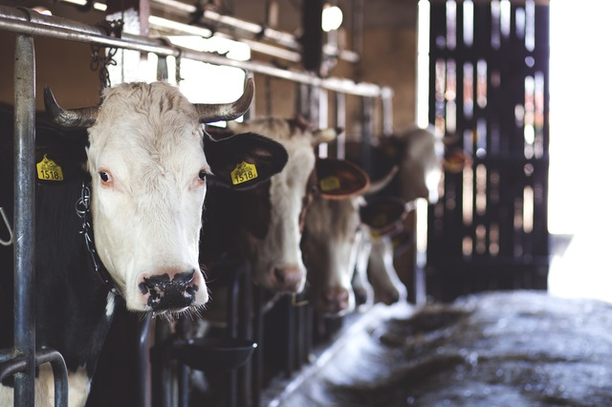
CATTLE FARMING - Shelter
A shelter is constructed using materials such as cloth, corrugated iron or timber etc.
Shelter facilities include well ventilated roof sheds which protect the cattle from rain, cold and sun.
Notes:
Notes to Teacher:
All the daily needs of the cattle are taken care of in a farm.
The cattle basically need adequate food, water, air, shelter & proper treatment.
Image Source:
Shelter: CC: https://www.pexels.com/photo/white-cow-in-cattle-house-69170/

Slide 6
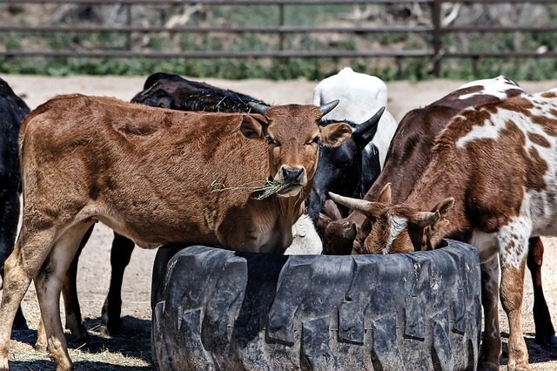
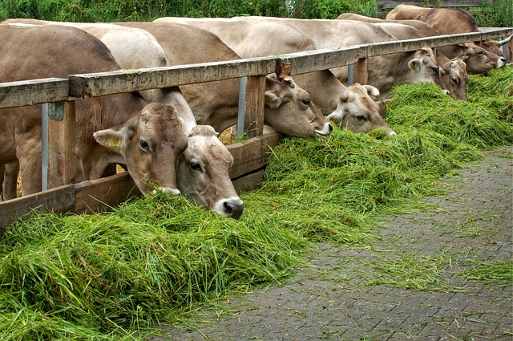
Food requirement
Feeding cattle includes supply of uncontaminated and balanced diet.
Diet includes roughages and concentrates.
Notes:
Grass: CC : https://pixabay.com/en/food-eat-grass-cow-animal-1516975/
Food: CC: https://pixabay.com/en/cow-cattle-farm-animal-beef-rural-419081/

Slide 7
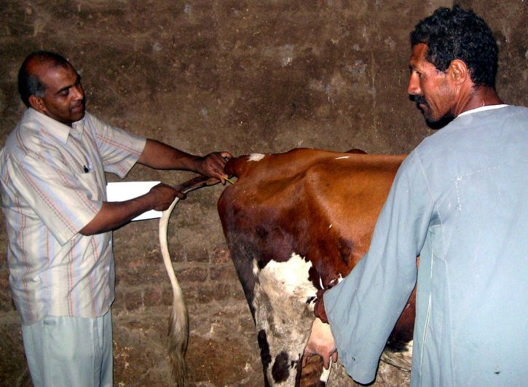
Veterinary Care
Cattle should be kept free from diseases in order to maintain a high yield.
A vet visit to the shelter is a must once a month.
Notes:
Notes to Teacher:
Cattle should be kept free from diseases in order to maintain a high yield. A vet visit to the shelter is a must once a month. They provide the cattle with all sort of vaccines at appropriate times. Thus, through scientific and systematic management of cattle farms, strong and healthy cattle are raised. Good quality and increased production of milk too is obtained.
Image Source:
https://pixnio.com/science/veterinary-medicine/veterinarian-performs-a-check-up-during-a-regular-visit-to-a-small-farm-in-egypts

Slide 8
MM Index
Slide# | Thumbnail | Source and Attribution
2 |  | Buffalo: CC: https://pixabay.com/en/buffalo-affalo-cape-buffaloes-256544/
3 |  | https://www.pxfuel.com/en/free-photo-jhmdl
3 |  | https://www.pxfuel.com/en/free-photo-xpsbh
5 |  | Shelter: CC: https://www.pexels.com/photo/white-cow-in-cattle-house-69170/
6 |  | Grass: CC : https://pixabay.com/en/food-eat-grass-cow-animal-1516975/
6 |  | Food: CC: https://pixabay.com/en/cow-cattle-farm-animal-beef-rural-419081/
7 |  | https://pixnio.com/science/veterinary-medicine/veterinarian-performs-a-check-up-during-a-regular-visit-to-a-small-farm-in-egypts

