Slide 1
Earthworm - A farmer's best friend
Notes:
http://www.publicdomainfiles.com/show_file.php?id=13927475425048

Slide 2
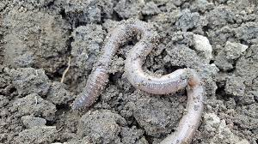
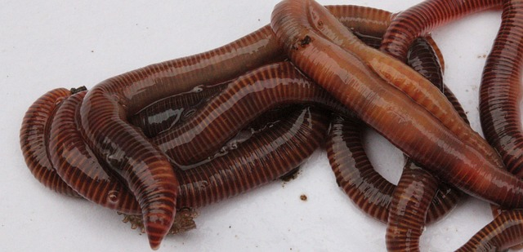
Introduction
Earthworms are vital for good soil.
They aerate the soil as they move by burrowing small holes.
They process organic matter in their bodies and return vital compounds to the soil thus increasing the nutrients available to the plants.
Notes:
https://www.maxpixel.net/Earthworm-Nightcrawlers-Animal-Soil-Worm-Garden-2205286
https://pixabay.com/en/worms-garden-compost-lure-nature-2784915/

Slide 3
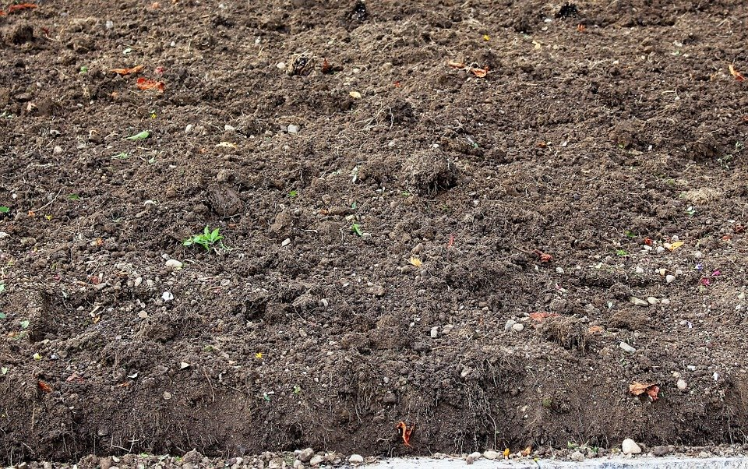
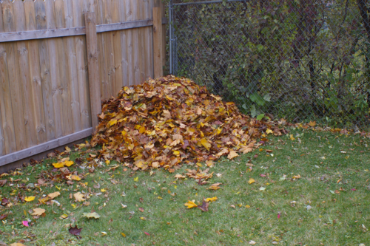
Earthworm - Improves soil nutrient
Earthworms create humus that contains important nutrients useful for plant growth.
The worms feed on plant debris such as manure, grass, leaves, and dead roots as well as the soil.
Notes:
Notes to Teacher:
Humus - which is a dark brown black type of soil that hold important nutrients in place for plant growth and use.
Image:
https://pixabay.com/da/photos/humus-jorden-dyrkbar-efter%C3%A5r-brak-459624/
https://www.flickr.com/photos/uberculture/4065501747 – CC BY 2.0 - Jeremy Noble

Slide 4
Earthworm - Improves soil nutrient
The food they eat is rich in mineral and organic compounds so their cast becomes richer in nutrients than the soils around them.
Cerebral ganglion
Sensory papillae
Mouth
Proboscis
Anus
Rhynchocoel
Intestine
Lateral nerve cord
Stomach
Notes:
Original contribution – rushmish@gmail.com

Slide 5
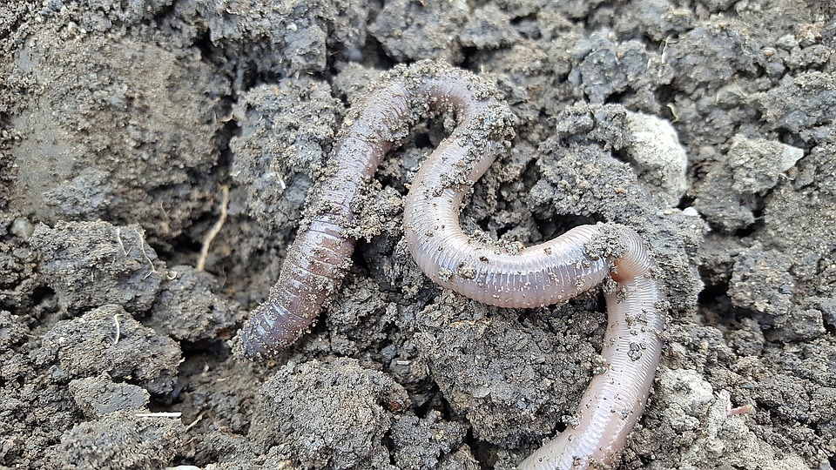
Earthworm - Improves soil nutrient
When the worms die, the body of the worm decomposes quickly which further contribute to the nitrogen content of the soil.
Notes:
https://pixabay.com/photos/earthworm-nightcrawlers-soil-worm-2205286/

Slide 6
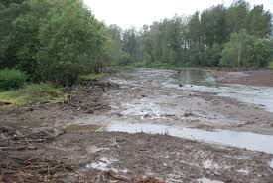
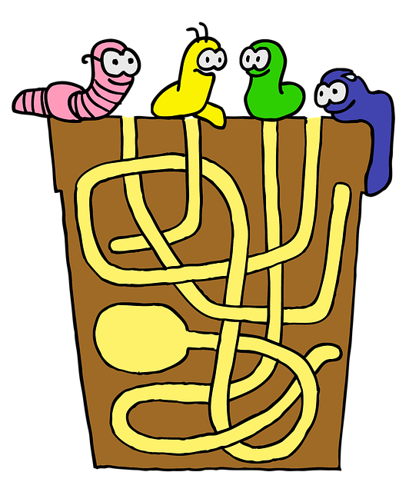
Earthworm – Better drainage
Improve drainage and prevent soil erosion and water logging, because burrowing help to loosen and aerate the soil.
Research has found that soil with earthworms drains as much as 10 times faster than soil without earthworms.
Notes:
https://www.flickr.com/photos/portlandcorps/15699311271 – CC BY 2.0 - Portland Corps
https://pixabay.com/en/labyrinth-flowerpot-worm-maggot-758076/

Slide 7
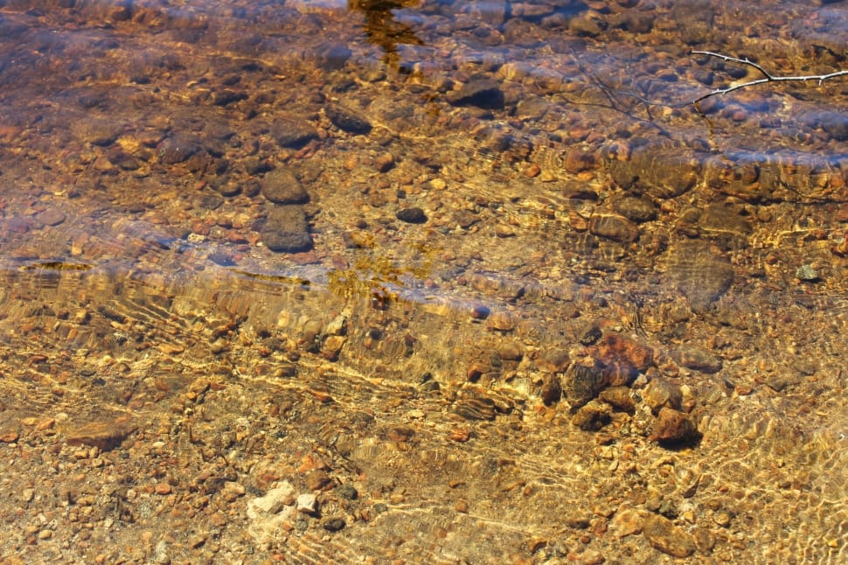
Earthworm – Improved Soil structure
The casts of earthworms help to cement the soil particles together.
These sticky substances “glue" the mineral particles together.
Notes:
https://www.peakpx.com/632122/wet-fresh-clear-water-nature-nature-physical-geography

Slide 8
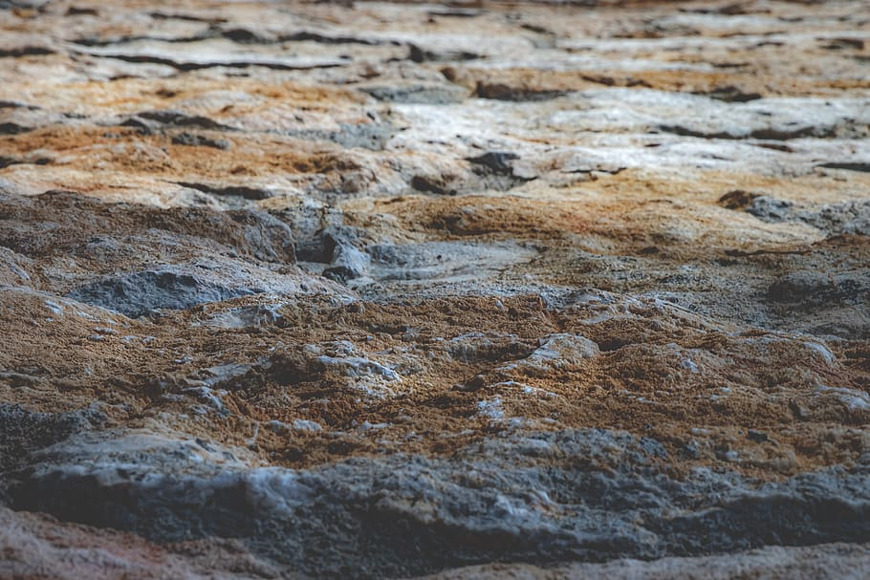
Earthworm – Improved Soil structure
The mineral particles help to protect the organic matter to some extent from microbial attacks, thus preserving it for a longer time in the soil.
Notes:
https://www.pxfuel.com/en/free-photo-xgbjf

Slide 9
Earthworm – Improved Soil structure
Worm castings improve the structure and fertility of every type of soil.
The castings are water soluble so they have an immediate positive impact on plant growth.
Notes:
https://pixabay.com/photos/green-grow-grow-up-plant-rain-2551467/

Slide 10
MM Index
Slide# | Thumbnail | Source and Attribution
1 |  | http://www.publicdomainfiles.com/show_file.php?id=13927475425048
2 |  | https://www.maxpixel.net/Earthworm-Nightcrawlers-Animal-Soil-Worm-Garden-2205286
2 |  | https://pixabay.com/en/worms-garden-compost-lure-nature-2784915/
3 |  | https://pixabay.com/da/photos/humus-jorden-dyrkbar-efter%C3%A5r-brak-459624/
3 |  | https://www.flickr.com/photos/uberculture/4065501747 – CC BY 2.0 - Jeremy Noble
4 |  | Original contribution – rushmish@gmail.com

Slide 11
MM Index
Slide# | Thumbnail | Source and Attribution
5 |  | https://pixabay.com/photos/earthworm-nightcrawlers-soil-worm-2205286/
6 |  | https://www.flickr.com/photos/portlandcorps/15699311271 – CC BY 2.0 - Portland Corps https://pixabay.com/en/labyrinth-flowerpot-worm-maggot-758076/
7 |  | https://www.peakpx.com/632122/wet-fresh-clear-water-nature-nature-physical-geography
8 |  | https://www.pxfuel.com/en/free-photo-xgbjf
9 |  | https://pixabay.com/photos/green-grow-grow-up-plant-rain-2551467/

