Slide 1
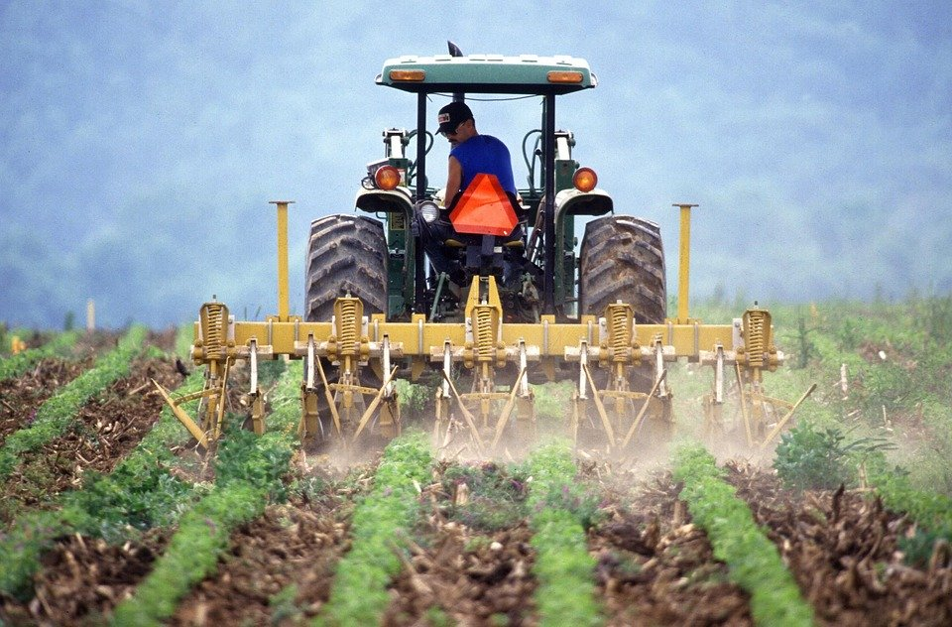
Modern agricultural tools
Notes:
Notes for Teacher - < Information for further reference or explanation >
Suggestions: <Ideas/ Images/ Animations / Others – To make better representation of the content >
Source of Multimedia Objects (Image/audio/ Video/Animation) used in this slide -
https://pixabay.com/photos/soil-tilling-farmer-tractor-386749/

Slide 2
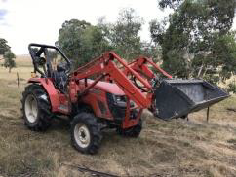
Walking Tractor
It is an agricultural machine which has a single axle and is operated by handles.
It has medium motor power and strength.
It is mostly used for horticultural and ornamental work.
Notes:
https://www.maxpixel.net/Field-Farmer-Rural-Equipment-Tractor-Farming-Farm-2404716

Slide 3
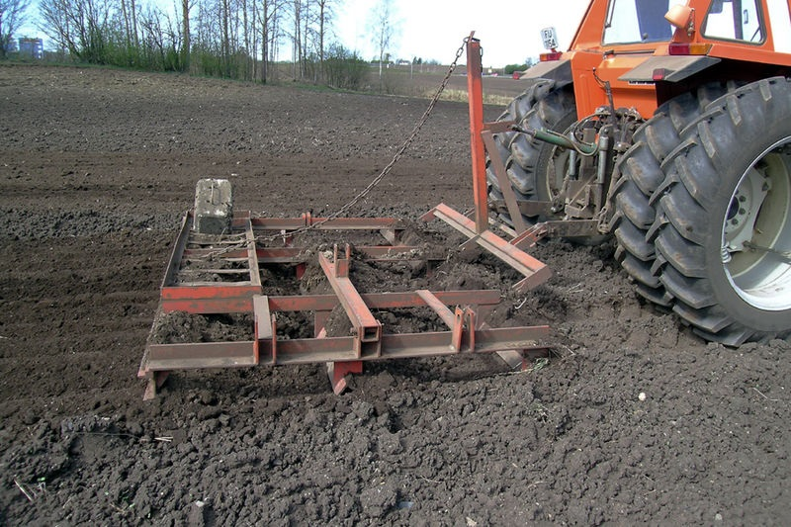
DRAG
Drag is an agricultural equipment which has a frame made of wood, and metal teeth and the hook- like structure that attaches to a tractor.
Notes:
https://commons.wikimedia.org/wiki/File:Slodd.jpg - Public domain

Slide 4
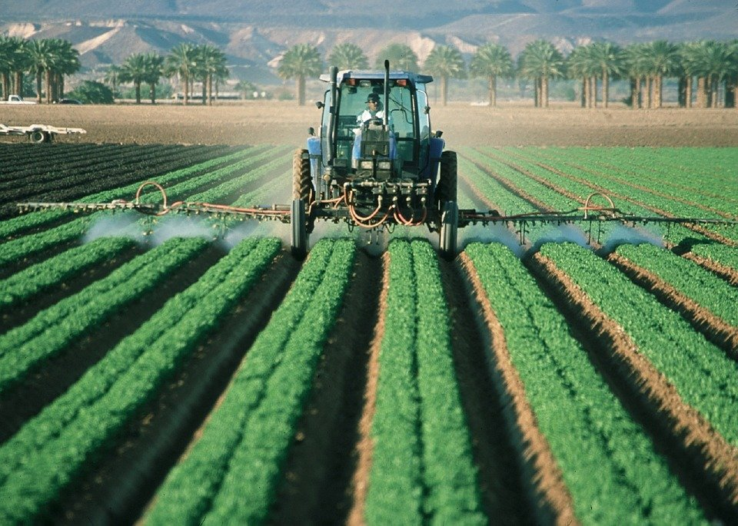
Sprayer
Sprayer is a farm equipment used to spray water, insecticide, pesticide, etc.
It is composed of a liquid tank, pressure pump, cap, mouth, tank and pressure valve, belts, hose, faucet and nozzle
Notes:
https://pixabay.com/photos/farmer-tractor-agriculture-farm-880567/

Slide 5
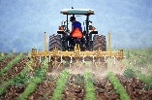
MM Index
Slide# | Thumbnail | Source and Attribution
1 |  | https://pixabay.com/photos/soil-tilling-farmer-tractor-386749/
2 |  | https://www.maxpixel.net/Field-Farmer-Rural-Equipment-Tractor-Farming-Farm-2404716
3 |  | https://commons.wikimedia.org/wiki/File:Slodd.jpg - Public domain
4 |  | https://pixabay.com/photos/farmer-tractor-agriculture-farm-880567/

