Slide 1
AGRICULTURE IN ANCIENT INDIA

Slide 2
AGRICULTURE IN ANCIENT HISTORY
History of Agriculture
Both go hand in hand
History of Civilisation

Slide 3
AGRICULTURE IN ANCIENT HISTORY
The Greek diplomat Megasthenes (300 BC) in his book ”Indika” provides an eyewitness account of Indian agriculture at that time.
In that book he mentions about India as follows :
India has many huge mountains which abound in fruit-trees of every kind, and many vast plains of great fertility.
The greater part of the soil is under irrigation, and in addition to cereals, millets and different varieties of pulses are also cultivated.

Slide 4
RECORDING OF OUR AGRICULTURAL PRACTICES IN ANCIENT INDIA
Types of lands
Types of Crops
Planting Time
Agricultural Practices
Land Preparation
Water Management
Manuring

Slide 5
TYPES OF LANDS
Rigveda identified productive and non-productive soils.
The Amarkosha (c. 400 BC) described 12 types of lands, depending upon the fertility of the soil, irrigation, and physical characteristics.

Slide 6
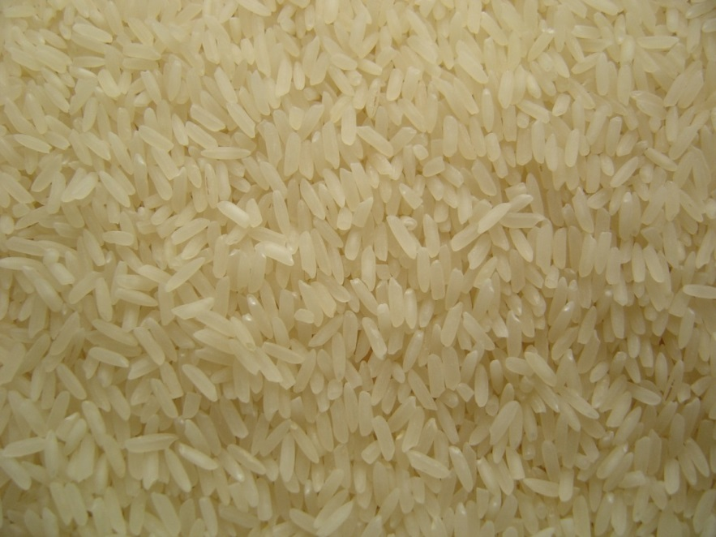
TYPE OF CROPS
It is believed that rice was cultivated along the banks of the Indian river Ganges in the sixth millennium BC.
Rice
Notes:
https://pxhere.com/en/photo/1259248

Slide 7
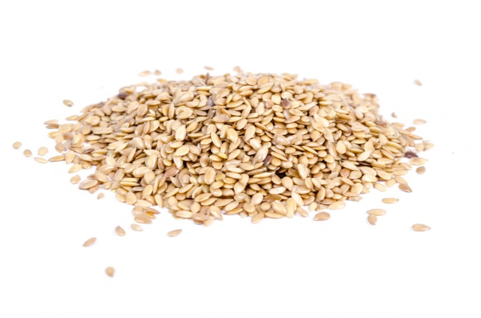
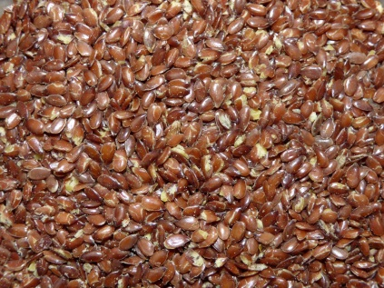
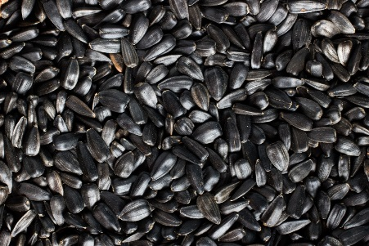
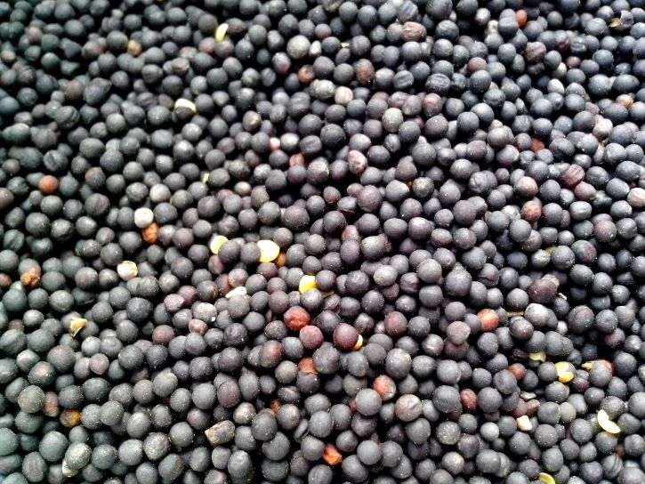
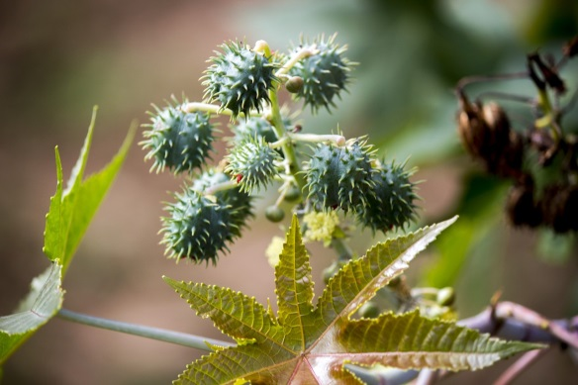
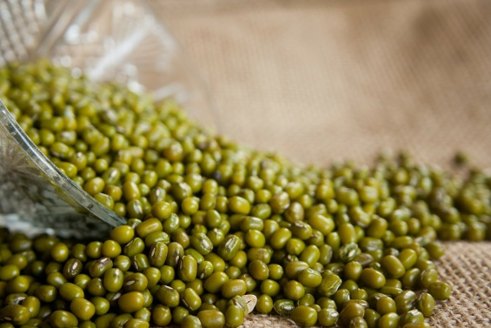
TYPE OF CROPS
Other crops cultivated in India 3000 to 6000 years ago, include:
Sesame Seeds
Linseed
Safflower
Mustard Seeds
Castor Seeds
Mung Beans
Notes:
Sesame Seeds: https://www.publicdomainpictures.net/en/view-image.php?image=69665&picture=sesame-heap
Linseed: https://www.publicdomainpictures.net/en/view-image.php?image=260555&picture=linseed
Sunflower seeds : https://pxhere.com/en/photo/818540
Mustard seeds : https://pixnio.com/flora-plants/seeds/colza-seeds
Castor Seeds: https://pixabay.com/photos/castor-seed-seeds-tree-nature-2536904/
Mung Beans: https://pixabay.com/photos/mung-beans-vigna-radiata-moong-bean-166996/

Slide 8
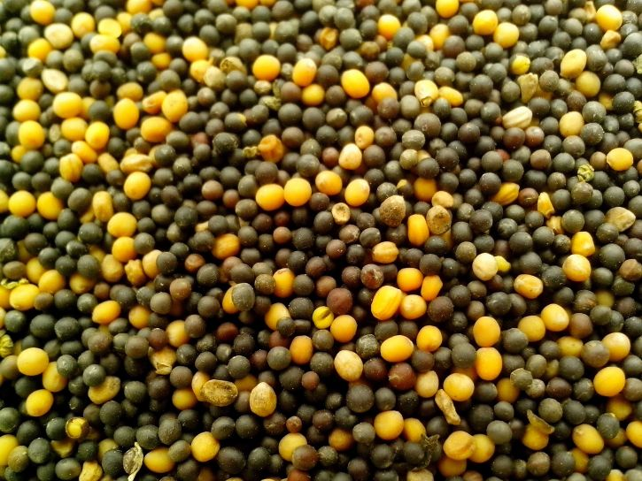
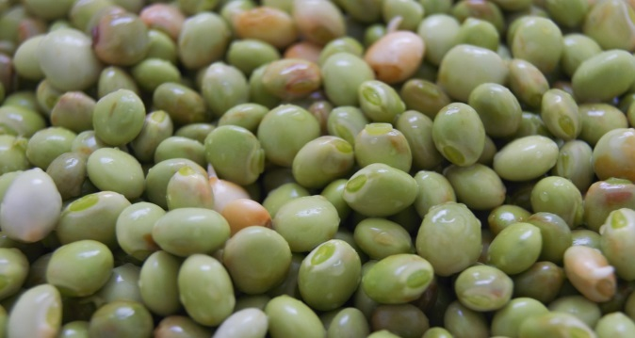
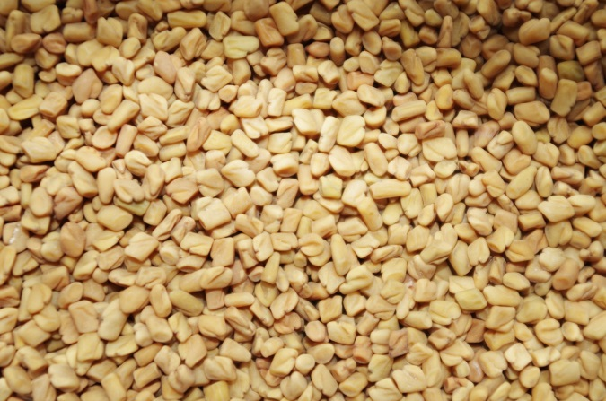
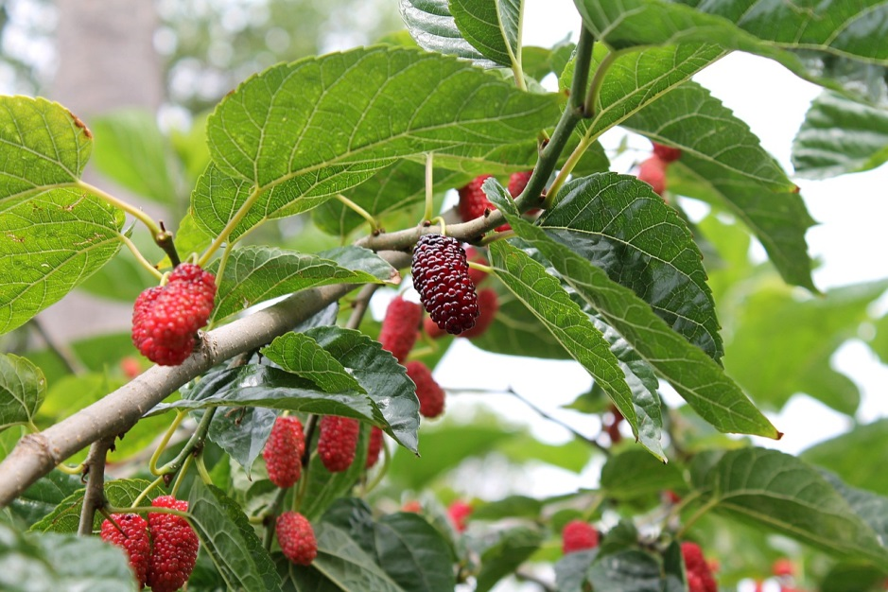
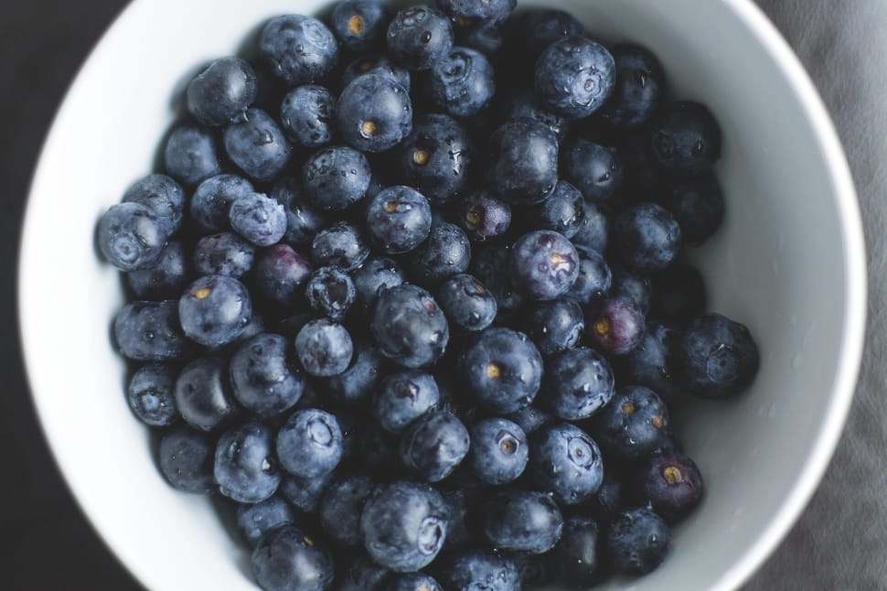
TYPES OF CROPS
Field Pea
Pigeon Pea
Fenugreek Seeds
Mulberry
Black Plum
Notes:
Field Pea: https://pixnio.com/flora-plants/seeds/soybean-seed-canola-peas-seed-of-field-pea-and-sunflower
Fenugreek Seeds: https://pixabay.com/photos/fenugreek-seeds-health-pepper-meal-1049596/
Mulberry: https://pixabay.com/photos/mulberry-mulberry-red-mulberry-tree-2353908/
Black Plum : https://www.peakpx.com/583965/plum-berry-fruit-lot – CC0
Pigeon Pea: https://pixabay.com/photos/pigeon-peas-pigeon-peas-green-3874445/

Slide 9
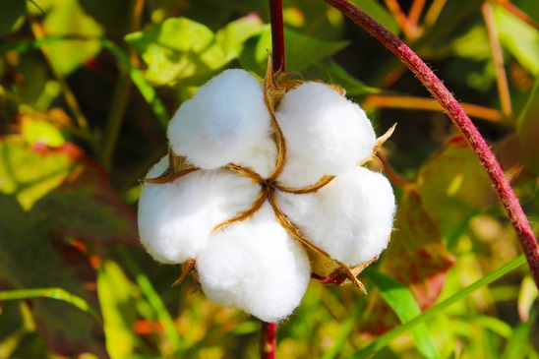
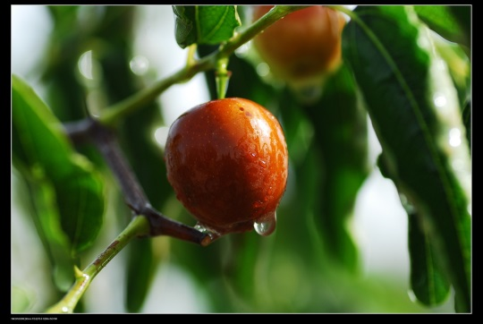
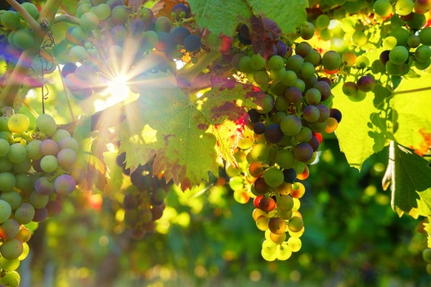
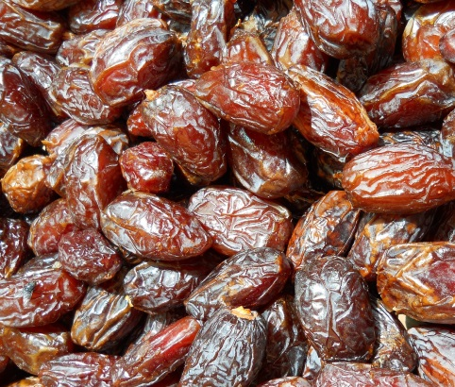
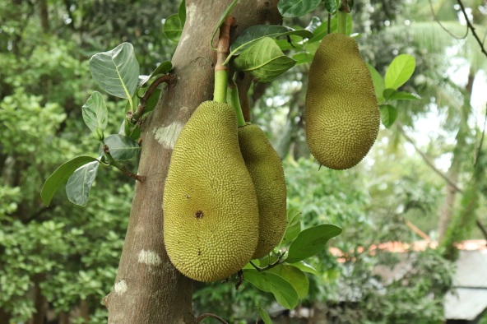
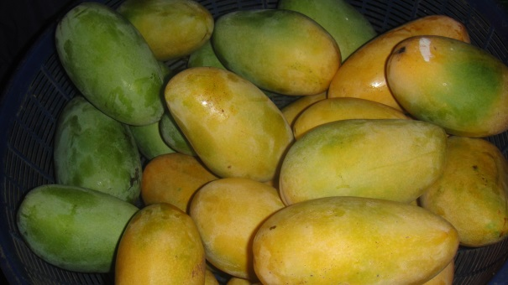
TYPES OF CROPS
Cotton
Jujubes
Grapes
Jack Fruit
Mango
Dates
Notes:
Cotton: https://pixabay.com/photos/cotton-tajikistan-buttermilk-3760799/
Jujubes: https://www.maxpixel.net/Jujube-Red-Dates-Xinjiang-Jujube-Food-940598
Grapes: https://pixabay.com/photos/grapes-sun-sunbeam-fruit-vines-3550729/
Dates: https://pixabay.com/illustrations/dates-fruit-sweet-dry-food-3579610/
Jack Fruit: https://pixabay.com/photos/jackfruit-fruit-fresh-tropical-3412939/
Mango: https://www.publicdomainpictures.net/en/view-image.php?image=27755&picture=mango

Slide 10
PLANTING TIME
Krishi-Parashara (c.400 BC) and Brhat Samhita predict rains for a particular season.

Slide 11
LAND PREPARATION
In Rig-Veda, farmers adopted repeated ploughings of land before sowing seeds.

Slide 12
WATER MANAGEMENT
Rigveda, Kashyapa Samhita, Kautilya's Arthashastra mentions irrigation of crops by river water through channels as well as irrigation from wells, rivers, tanks, canals etc

Slide 13
MANURING
In Krishi-Parashara, it is mentioned that crops grown without manure will not grow well.
There is also a description of a method of preparing manure from cow dung.

Slide 14
MANURING
Kautilya also tells the use of cow dung, animal bones, fishes, and milk as manure long back.

Slide 15
MANURING
Varahamihira’s Brhat Samhita, also recommends growing sesame to flowering stage and then using it as green manure.

Slide 16
MM Index
Slide# | Thumbnail | Source and Attribution
6 |  | https://pxhere.com/en/photo/1259248
7 |  | Sesame Seeds: https://www.publicdomainpictures.net/en/view-image.php?image=69665&picture=sesame-heap
7 |  | Linseed: https://www.publicdomainpictures.net/en/view-image.php?image=260555&picture=linseed
7 |  | Sunflower seeds : https://pxhere.com/en/photo/818540
7 |  | Mustard seeds : https://pixnio.com/flora-plants/seeds/colza-seeds
7 |  | Castor Seeds: https://pixabay.com/photos/castor-seed-seeds-tree-nature-2536904/ Mung Beans: https://pixabay.com/photos/mung-beans-vigna-radiata-moong-bean-166996/
8 |  | Pigeon Pea: https://pixabay.com/photos/pigeon-peas-pigeon-peas-green-3874445/

Slide 17
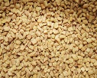
MM Index
Slide# | Thumbnail | Source and Attribution
8 |  | Field Pea: https://pixnio.com/flora-plants/seeds/soybean-seed-canola-peas-seed-of-field-pea-and-sunflower Fenugreek Seeds: https://pixabay.com/photos/fenugreek-seeds-health-pepper-meal-1049596/
8 |  | Mulberry: https://pixabay.com/photos/mulberry-mulberry-red-mulberry-tree-2353908/ Black Plum : https://www.peakpx.com/583965/plum-berry-fruit-lot – CC0
9 |  | Cotton: https://pixabay.com/photos/cotton-tajikistan-buttermilk-3760799/
9 |  | Jujubes: https://www.maxpixel.net/Jujube-Red-Dates-Xinjiang-Jujube-Food-940598
9 |  | Grapes: https://pixabay.com/photos/grapes-sun-sunbeam-fruit-vines-3550729/
9 |  | Dates: https://pixabay.com/illustrations/dates-fruit-sweet-dry-food-3579610/
9 |  | Jack Fruit: https://pixabay.com/photos/jackfruit-fruit-fresh-tropical-3412939/
9 |  | Mango: https://www.publicdomainpictures.net/en/view-image.php?image=27755&picture=mango

