Slide 1
Origin of Manure and Pesticides
Notes:
SSSVV Gallery

Slide 2
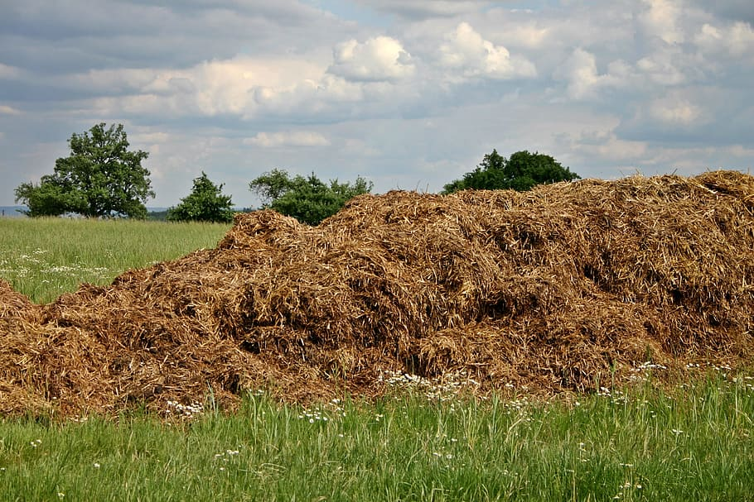
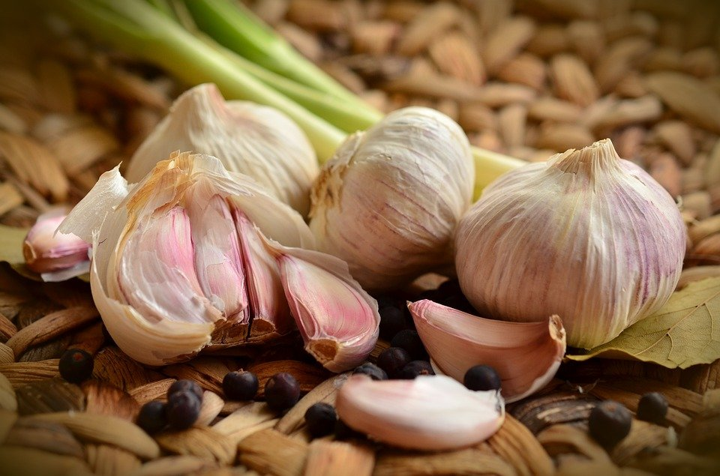
EARLY HISTORY
In ancient civilisations such as that of Sumer, Mesopotamia and Vedic India:
a. Man added plant nutrients to soil
b. Used natural repellents to control pests
Notes:
https://www.pxfuel.com/en/free-photo-ohpto
https://pixabay.com/da/photos/hvidl%C3%B8g-knold-krydderi-mad-1336883/

Slide 3
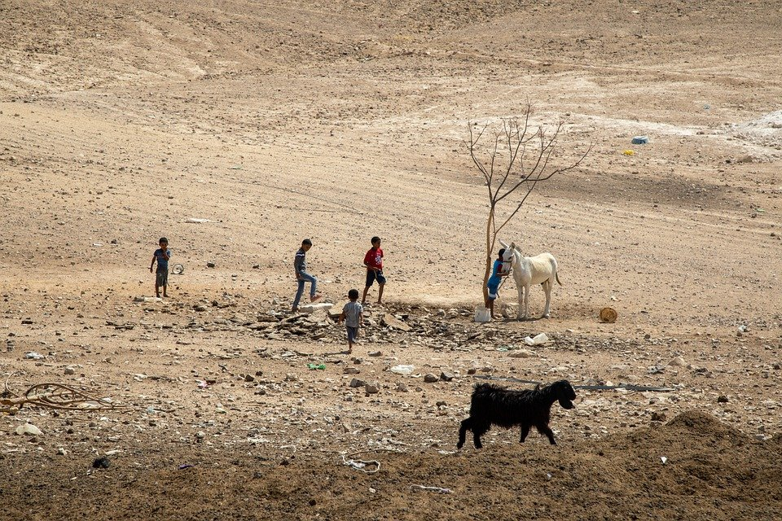
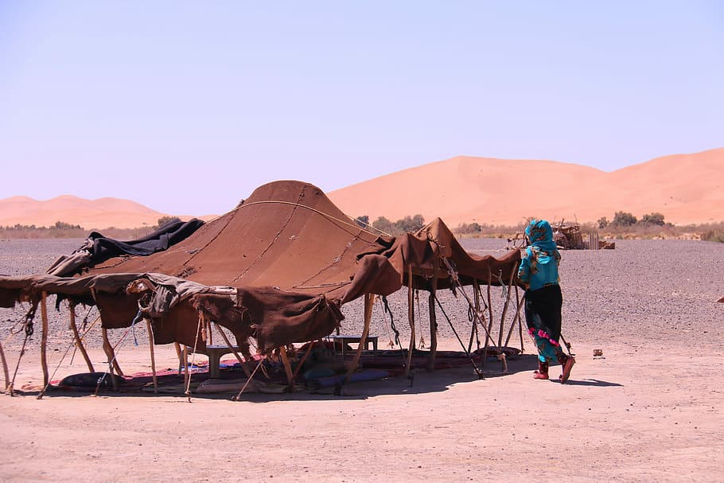
HOW DID IT ALL START?
Many thousands of years ago, humans lived a nomadic existence moving from place to place with their livestock, which could include cattle, sheep, goats and pigs.
Notes:
https://www.pxfuel.com/en/free-photo-efkzp
https://pixabay.com/da/photos/nomader-nomadisk-livsstil-beduin-5590680/

Slide 4
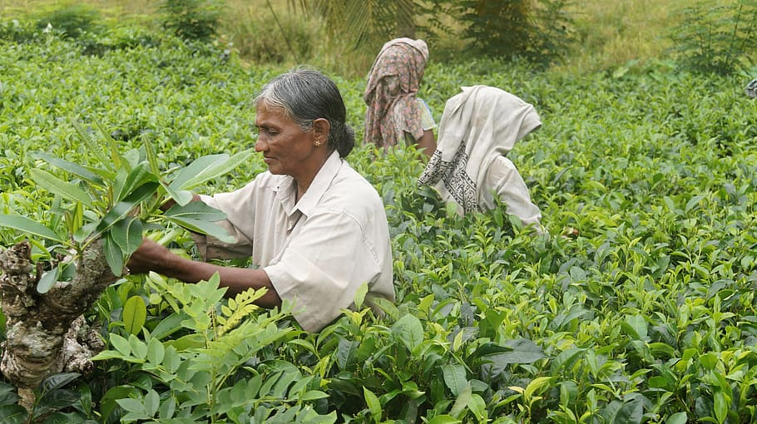
HOW DID IT ALL START?
They would grow crops for their own need, exploiting the land until it was no longer of much use.
Notes:
https://www.piqsels.com/en/public-domain-photo-fmrlg

Slide 5
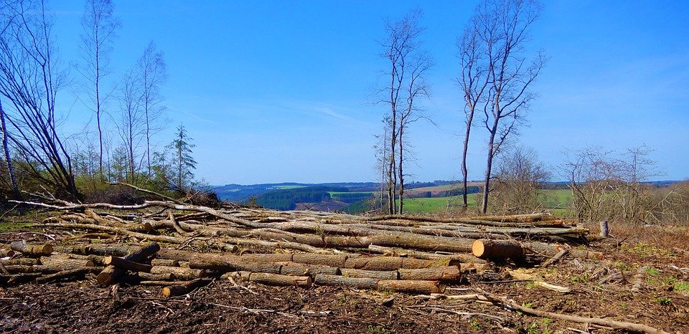
HOW DID IT ALL START?
Using slash and burn technique they would move on to a new patch of land, without any sense of permanent ownership.
Notes:
https://pixabay.com/da/photos/natur-skovbrug-skovrydning-tr%C3%A6-5155047/

Slide 6

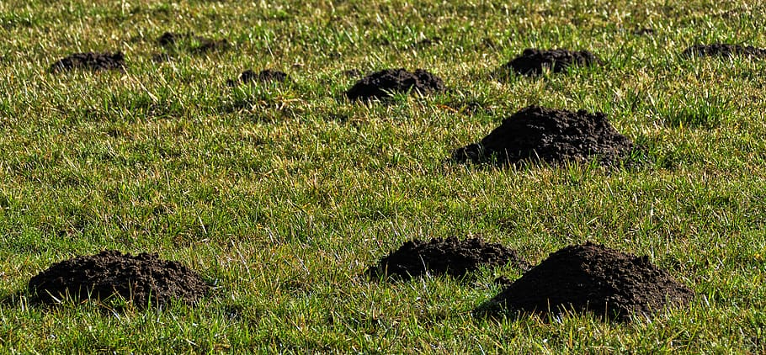
HOW DID IT ALL START?
Europe’s first farmer – used the dung from their herds of cattle, sheep, goats and pigs as a slow release fertiliser for crops 8000 years ago.
In the Vedic texts there are repeated references to agricultural technology and practices, including iron implements.
Notes:
https://www.pxfuel.com/en/free-photo-irmjm
https://freesvg.org/qubodup-sickle

Slide 7
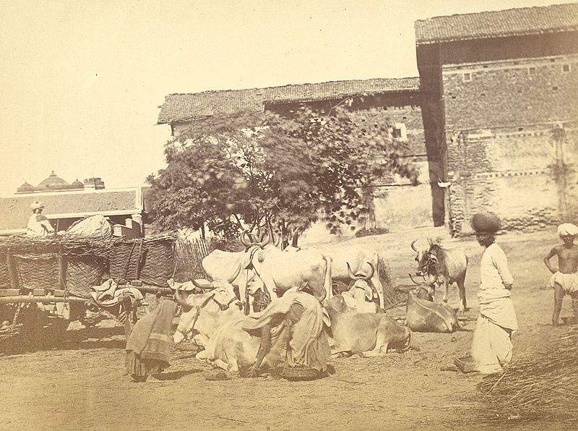
HOW DID IT ALL START
Cow dung provided for fertiliser. Cows and bulls are worshipped in India.
Notes:
https://commons.wikimedia.org/wiki/File:Women_gathering_cowdung,_Ahmadabad_(c._1870).jpg – Public Domain

Slide 8
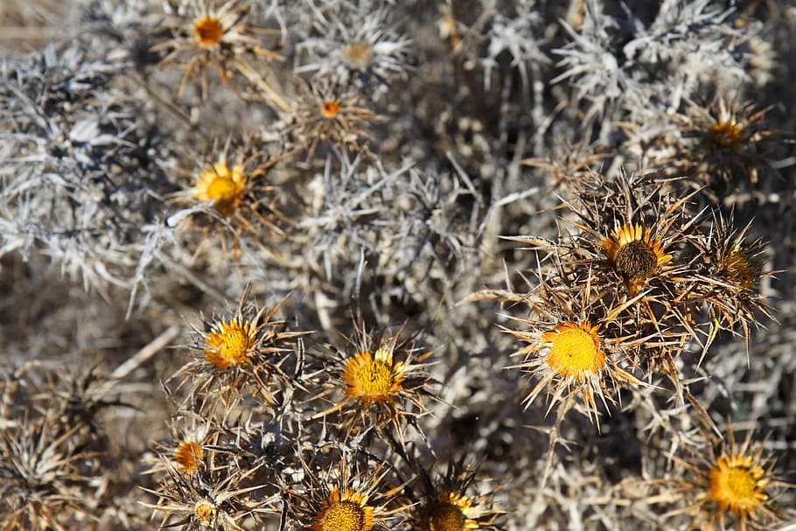
HOW DID IT ALL START
Pyrethrum, which derived from the dried flower of Chrysanthemum cineraria folium “Pyrethrum Daisies”, has been used as an insecticide for over 2000 years.
Notes:
https://www.pxfuel.com/en/free-photo-elieq

Slide 9
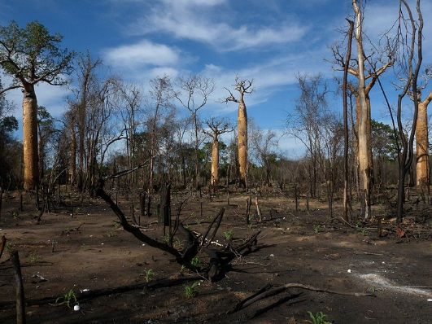
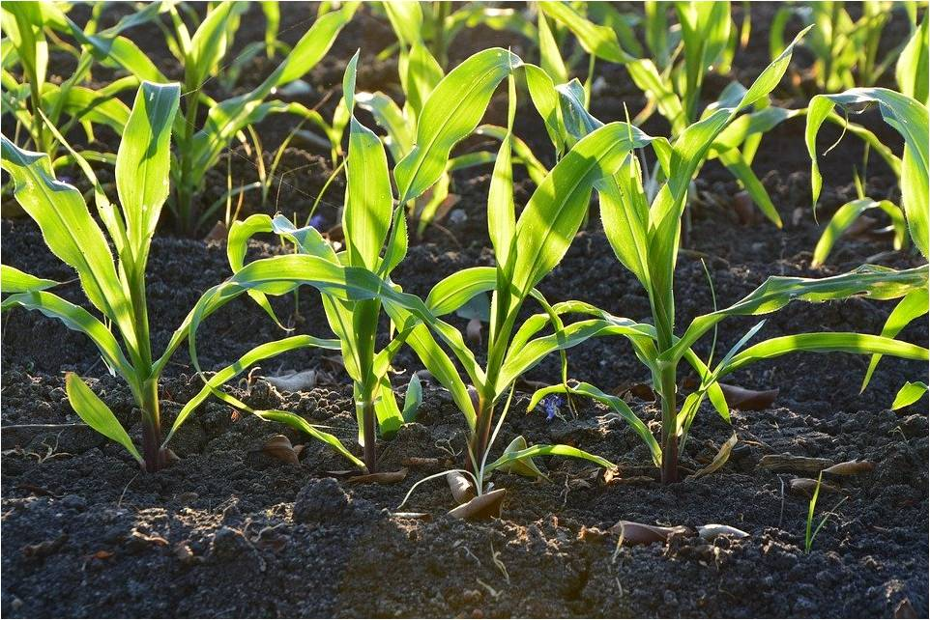
BEGINNING THE USE OF MANURE
Nomadic existence of humans
Slash and burn cultivation and moves on to new patch of land
Observes healthier and more abundant plants near dung-heap
Establishes connection of dung with better yielding plants
Notes:
https://commons.wikimedia.org/wiki/File:Slash_and_Burn_Agriculture,_Morondava,_Madagascar.jpg – CC BY 2.0 - originally posted to Flickr as Slash and Burn Agriculture, Morondava, MadagascarAuthorFrank Vassen from Brussels, Belgium
https://pixabay.com/da/photos/majs-landbrug-jord-plante-snavs-1841271/

Slide 10
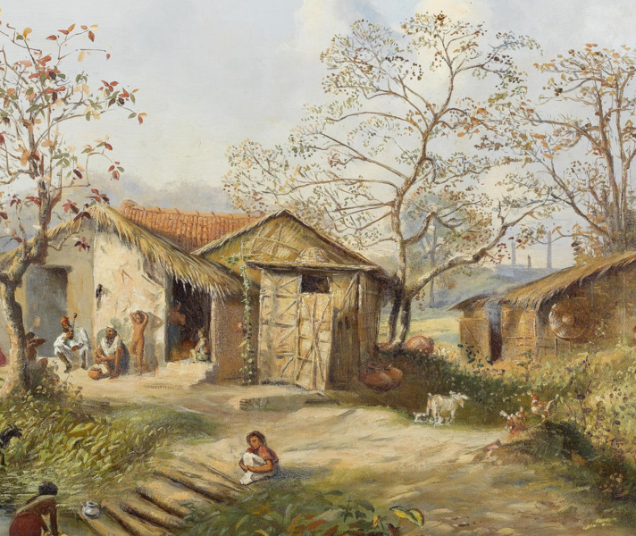
BEGINNING THE USE OF MANURE
To improve yield starts adding dung and controls pests
Realises it is very slow-acting, so humans stay in the same place for long
Establishes long-term relationship with land
Leads to land ownership and personal wealth – current social structure
Notes:
https://commons.wikimedia.org/wiki/File:An_Indian_village.png – Public Domain

Slide 11
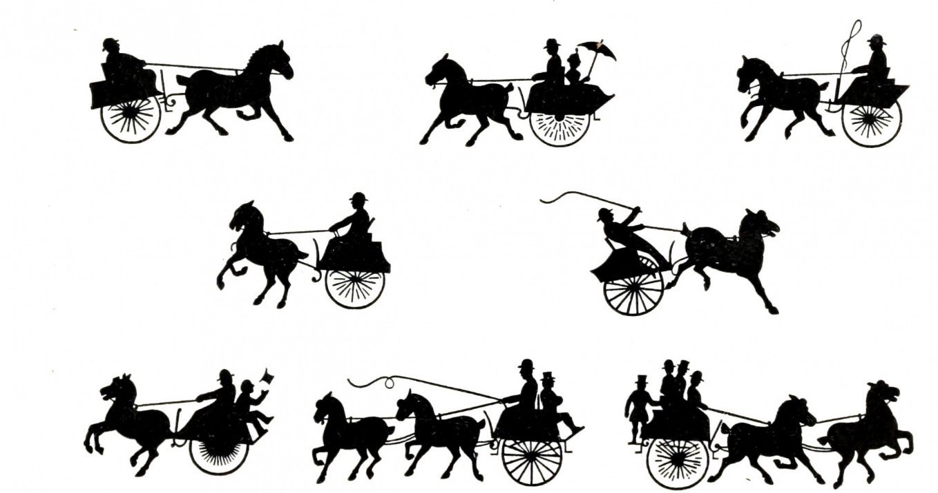
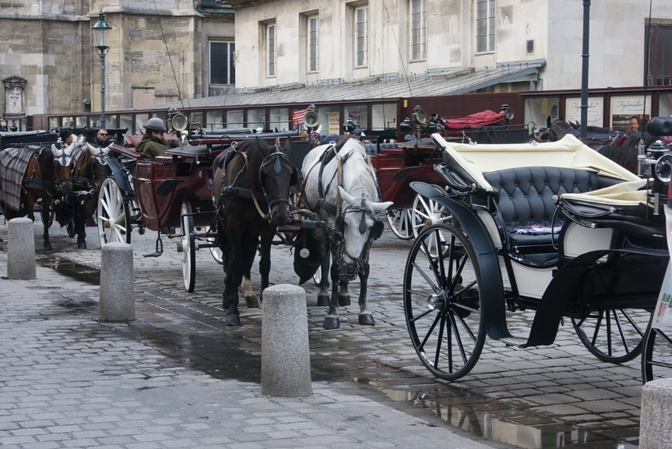
VICTORIAN ERA MANURE CRISIS - 1894
Towards the end of the 19th Century there were tens of thousands of horses on the streets of London and New York transporting people and goods.
Notes:
https://www.publicdomainpictures.net/en/view-image.php?image=297011&picture=horse-carriage-horse-carriages
https://pxhere.com/en/photo/919440

Slide 12
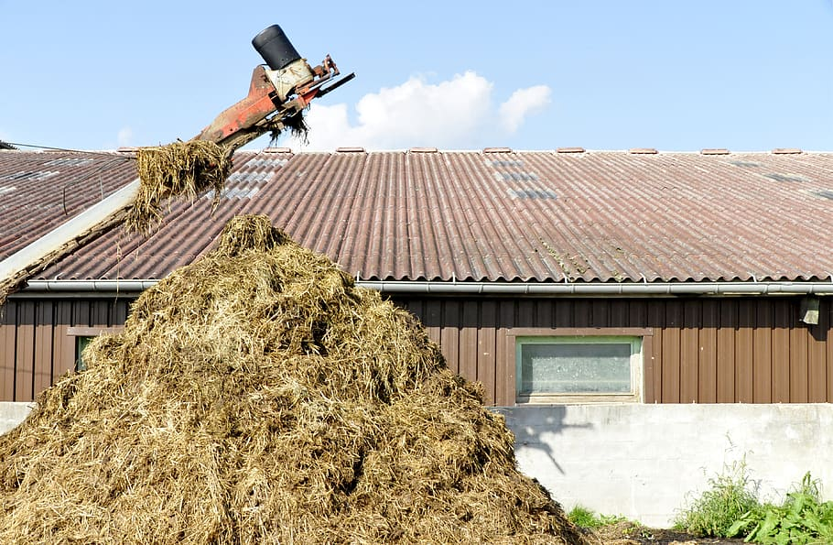
VICTORIAN ERA MANURE CRISIS - 1894
Enormous amounts of manure piled up on the streets attracting insects, including typhoid-carrying flies.
Notes:
https://www.pxfuel.com/en/free-photo-xpvee

Slide 13
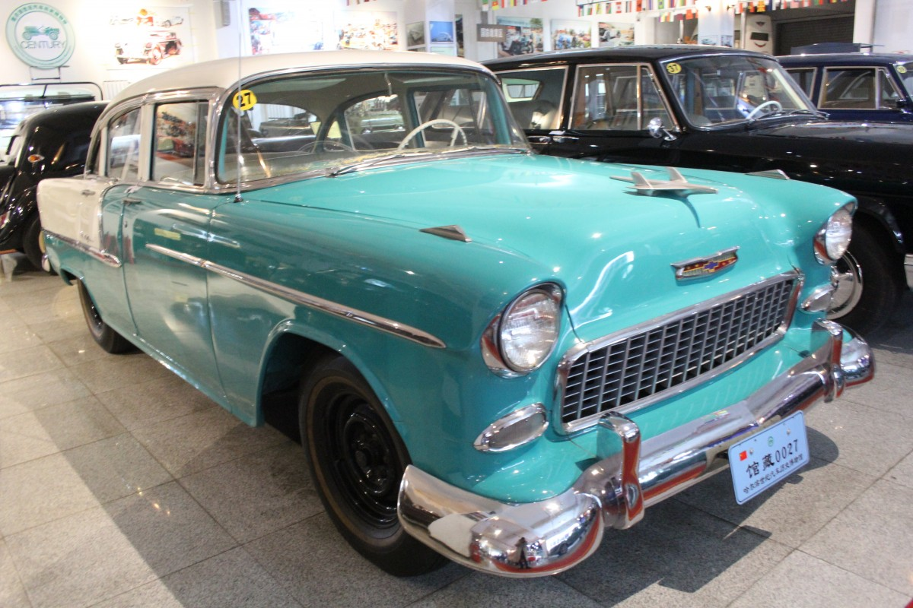
VICTORIAN ERA MANURE CRISIS - 1894
It was predicted that in 50 years, every London street would be buried in 9 feet of manure!!!
The timely invention of affordable motorcars replaced horses, and a dreadful situation was avoided.
Notes:
https://pxhere.com/en/photo/1601157

Slide 14









MM Index
Slide# | Thumbnail | Source and Attribution
2 |  | https://www.pxfuel.com/en/free-photo-ohpto https://pixabay.com/da/photos/hvidl%C3%B8g-knold-krydderi-mad-1336883/
3 |  | https://www.pxfuel.com/en/free-photo-efkzp https://pixabay.com/da/photos/nomader-nomadisk-livsstil-beduin-5590680/
4 |  | https://www.piqsels.com/en/public-domain-photo-fmrlg
5 |  | https://pixabay.com/da/photos/natur-skovbrug-skovrydning-tr%C3%A6-5155047/
6 |  | https://www.pxfuel.com/en/free-photo-irmjm https://freesvg.org/qubodup-sickle
7 |  | https://commons.wikimedia.org/wiki/File:Women_gathering_cowdung,_Ahmadabad_(c._1870).jpg – Public Domain

Slide 15








MM Index
Slide# | Thumbnail | Source and Attribution
8 |  | https://www.pxfuel.com/en/free-photo-elieq
9 |  | https://commons.wikimedia.org/wiki/File:Slash_and_Burn_Agriculture,_Morondava,_Madagascar.jpg – CC BY 2.0 - originally posted to Flickr as Slash and Burn Agriculture, Morondava, MadagascarAuthorFrank Vassen from Brussels, Belgium https://pixabay.com/da/photos/majs-landbrug-jord-plante-snavs-1841271/
10 |  | https://commons.wikimedia.org/wiki/File:An_Indian_village.png – Public Domain
11 |  | https://www.publicdomainpictures.net/en/view-image.php?image=297011&picture=horse-carriage-horse-carriages https://pxhere.com/en/photo/919440
12 |  | https://www.pxfuel.com/en/free-photo-xpvee
13 |  | https://pxhere.com/en/photo/1601157

