Slide 1
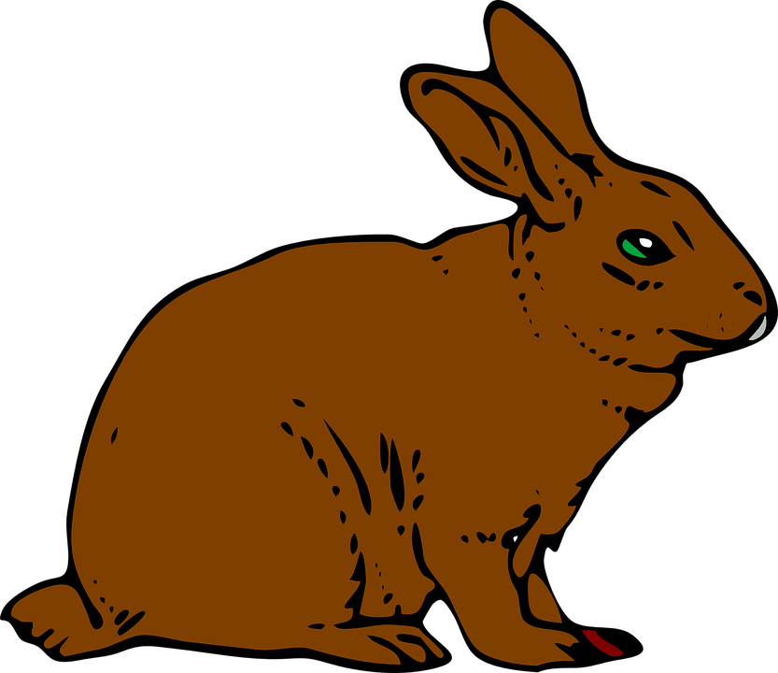
Rabbit Dropping
Notes:
https://pixabay.com/vectors/rabbit-bunny-hare-brown-animal-297212/

Slide 2
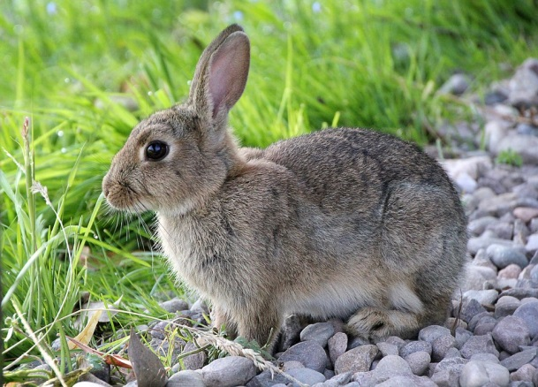
Fertiliser – Nitrogen and Phosphorus
Nitrogen is a very good fertiliser.
Of all animal wastes, rabbit droppings have the highest nitrogen content.
It also has phosphorus which is good for flowers and fruit trees.
Notes:
Rabbit- https://pixabay.com/en/hare-rabbit-animal-cute-sweet-fur-2647220/ - CC0

Slide 3
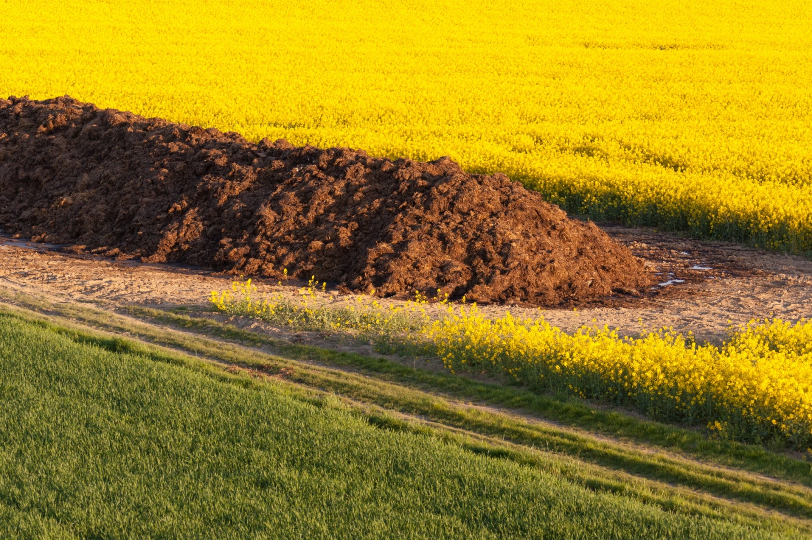
Manure
Many types of manure must first be composted before they can be applied to your garden.
Notes:
Manure – https://www.publicdomainpictures.net/en/view-image.php?image=178658&picture=pile-of-manure – Public domain

Slide 4
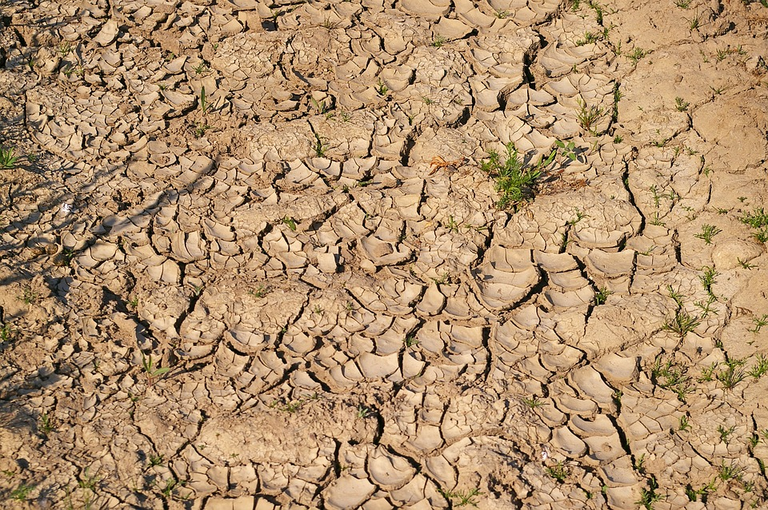
Composting
Composting is treating solid wastes in which organic materials are broken down by microorganisms. If the manure has high salt content, then the plant could die. So in order to save the plant, manure has to be composted.
Notes:
Plants starving- https://pixabay.com/en/dry-soil-drought-dehydrated-3453272/

Slide 5
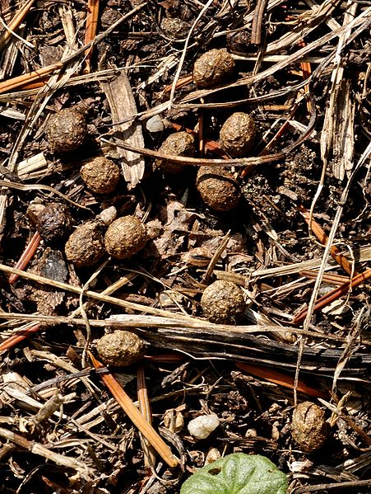
Rabbit droppings
Rabbit droppings do not have to be composted; they can be applied directly to your garden.
Notes:
Rabbit dropping-https://commons.wikimedia.org/wiki/File:Droppings_feral_rabbit.jpg

Slide 6
MM Index
Slide# | Thumbnail | Source and Attribution
1 |  | https://pixabay.com/vectors/rabbit-bunny-hare-brown-animal-297212/
2 |  | Rabbit- https://pixabay.com/en/hare-rabbit-animal-cute-sweet-fur-2647220/ - CC0
3 |  | Manure – https://www.publicdomainpictures.net/en/view-image.php?image=178658&picture=pile-of-manure – Public domain
4 |  | Plants starving- https://pixabay.com/en/dry-soil-drought-dehydrated-3453272/
5 |  | Rabbit dropping-https://commons.wikimedia.org/wiki/File:Droppings_feral_rabbit.jpg

