Slide 1
Growing Crops
Notes:
Notes for Teacher - < Information for further reference or explanation >
Suggestions: <Ideas/ Images/ Animations / Others – To make better representation of the content >
Source of Multimedia Objects (Image/audio/ Video/Animation) used in this slide -
https://openclipart.org/detail/242194/cartoon-woman-thinking

Slide 2
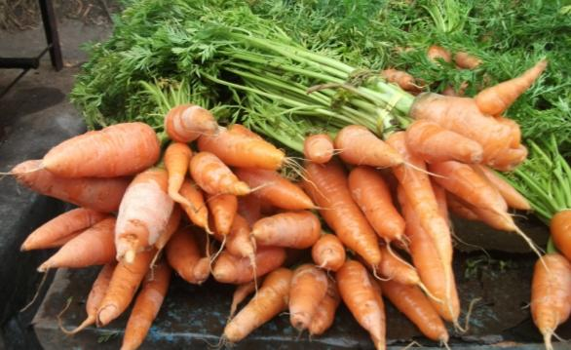
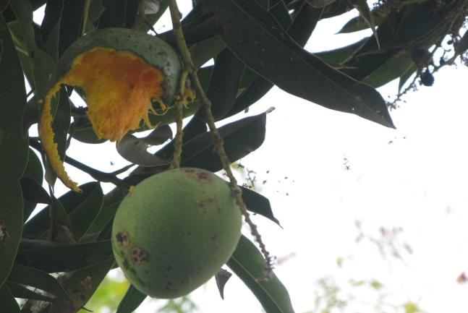
Growing Crops
1. Have you ever wondered why certain fruits and vegetables are available only during certain periods of the year?
Different plants require varied climatic conditions to grow. E.g.
Mangoes - loamy soil and in sunny climate
Carrot - loamy soil and cool winter climate
Notes:
Notes for Teacher - < Information for further reference or explanation >
Suggestions: <Ideas/ Images/ Animations / Others – To make better representation of the content >
Source of Multimedia Objects (Image/audio/ Video/Animation) used in this slide -
Carrot – SSSVV Gallery
Mango – SSSVV Gallery

Slide 3
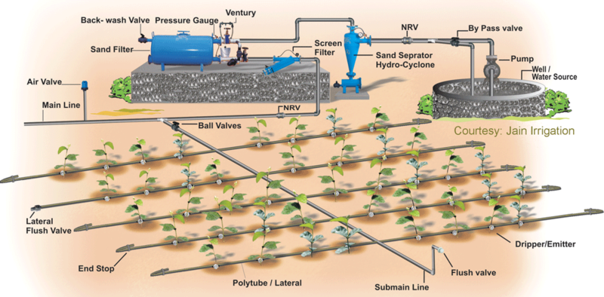
Growing Crops
2. Heera's regions suffer from shortage of water. Which method of irrigation would you suggest and why?
Answer:
Drip irrigation because it minimises the use of water and the water drips or falls exactly near the root zone through pipes.
Notes:
Notes for Teacher - < Information for further reference or explanation >
Suggestions: <Ideas/ Images/ Animations / Others – To make better representation of the content >
Source of Multimedia Objects (Image/audio/ Video/Animation) used in this slide -
Drip irrigation- https://commons.wikimedia.org/wiki/File:Dripirrigation.png?uselang=fr

Slide 4
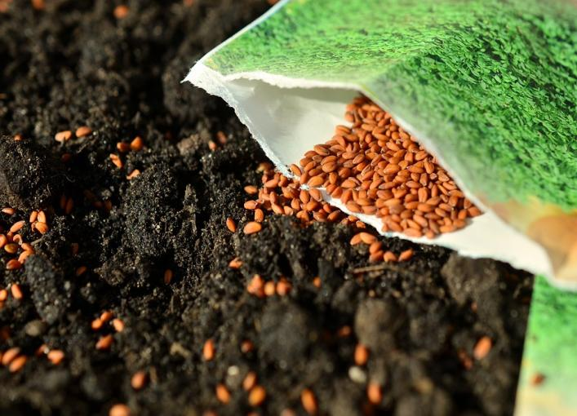
Growing Crops
3. Reena wants to know the drawbacks of an uneven distribution of seeds in a field while sowing. Can you help her?
Answer:
Here, the seeds are distributed unevenly.
Seeds do not germinate properly because of competition among the seeds for
Nutrients
Space
Water
Notes:
Notes for Teacher - < Information for further reference or explanation >
Suggestions: <Ideas/ Images/ Animations / Others – To make better representation of the content >
Source of Multimedia Objects (Image/audio/ Video/Animation) used in this slide -
Uneven distribution- https://pixabay.com/en/seeds-sow-garden-cross-gardening-1302793/

Slide 5
Growing Crops
4. Ram advised Pawan to plant crops in rotation. Can you identify the reason?
To make the soil fertile
To reduce the use of chemical fertilisers
To reduce the weeds and pests
Answer:
Crop Rotation
Notes:
Notes for Teacher - < Information for further reference or explanation >
Suggestions: <Ideas/ Images/ Animations / Others – To make better representation of the content >
Source of Multimedia Objects (Image/audio/ Video/Animation) used in this slide -
1. <Short Description> - <SOURCE URL>

Slide 6
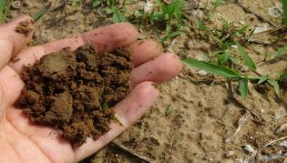
Growing Crops
5. Tina, during a visit to her friend talked a lot about organic farming. What do you think is organic farming?
Answer:
Organic Farming
Using biological materials
Maintains soil fertility
No Chemical pesticides, fertilisers, growth hormones
No wastage
No pollution
Notes:
Compost- https://pixabay.com/en/soil-compost-farm-field-plant-918006/

Slide 7
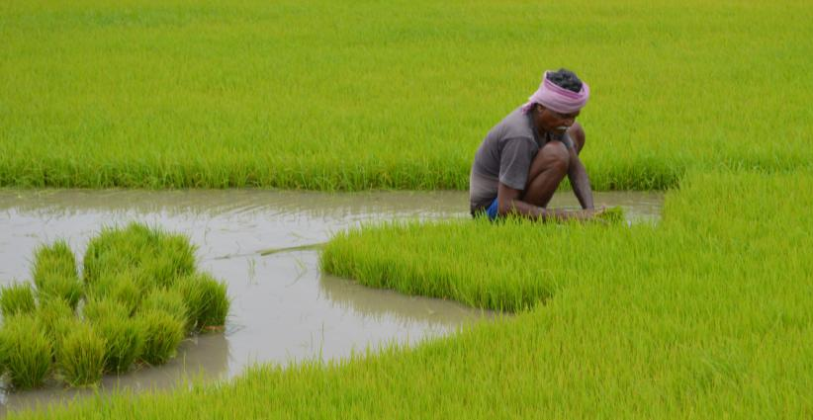
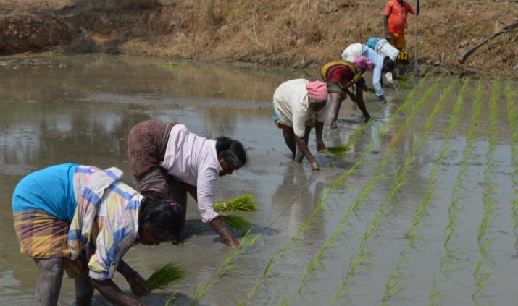
Growing Crops
6. Do you think it is possible to fully grow a crop in a nursery? Give reasons.
Answer:
No, because some crops require larger space and hence have to be cultivated in fields.
Notes:
Notes for Teacher - < Information for further reference or explanation >
Suggestions: <Ideas/ Images/ Animations / Others – To make better representation of the content >
Source of Multimedia Objects (Image/audio/ Video/Animation) used in this slide -
1. Agriculture (both images) : SSSVV Gallery

Slide 8
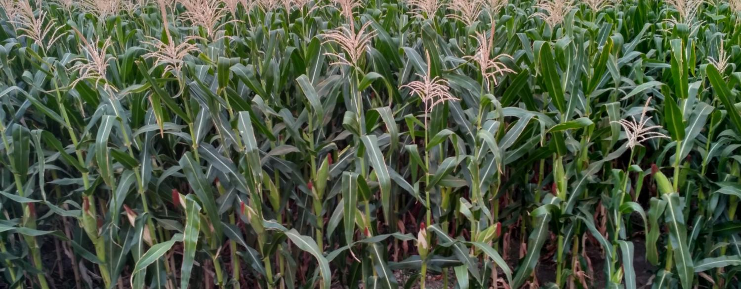
Growing Crops
7. A farmer grows maize in a field year after year. He finds that the yield becomes low. Give one possible reason for it.
Answer: Due to loss of nutrients in the soil.
Notes:
Notes for Teacher - < Information for further reference or explanation >
Suggestions: <Ideas/ Images/ Animations / Others – To make better representation of the content >
Source of Multimedia Objects (Image/audio/ Video/Animation) used in this slide -
1. Maize: SSSVV Gallery

Slide 9
Growing Crops
8. How can he rectify the loss?
Answer: By growing pulses alternately in the same field
Notes:
Notes for Teacher - < Information for further reference or explanation >
Suggestions: <Ideas/ Images/ Animations / Others – To make better representation of the content >
Source of Multimedia Objects (Image/audio/ Video/Animation) used in this slide -
https://pixabay.com/photos/horse-gram-kulthi-pulses-crop-253328/

Slide 10
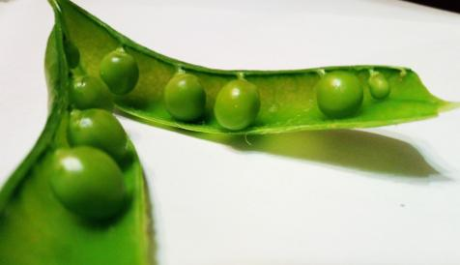
Growing Crops
9. A farmer did not use nitrogenous fertiliser before sowing cereal crop as the field had been enriched with this nutrient by the crop grown earlier. Name the crop the farmer might have grown earlier?
Answer:
Any leguminous (pulses) crop
Peas
Beans
Notes:
Notes for Teacher - < Information for further reference or explanation >
Suggestions: <Ideas/ Images/ Animations / Others – To make better representation of the content >
Source of Multimedia Objects (Image/audio/ Video/Animation) used in this slide -
Beans- https://pixabay.com/en/beans-leguminous-plants-pulse-297301/
Peas- https://pixabay.com/en/legumes-peas-pod-vegetable-healthy-3200097/

Slide 11
MM Index
Slide# | Thumbnail | Source and Attribution
1 |  | https://openclipart.org/detail/242194/cartoon-woman-thinking
3 |  | Drip irrigation- https://commons.wikimedia.org/wiki/File:Dripirrigation.png?uselang=fr
4 |  | Uneven distribution- https://pixabay.com/en/seeds-sow-garden-cross-gardening-1302793/
6 |  | Compost- https://pixabay.com/en/soil-compost-farm-field-plant-918006/
9 |  | https://pixabay.com/photos/horse-gram-kulthi-pulses-crop-253328/
10 |  | Beans- https://pixabay.com/en/beans-leguminous-plants-pulse-297301/ Peas- https://pixabay.com/en/legumes-peas-pod-vegetable-healthy-3200097/

