Slide 1
Storing Food Safely

Slide 2
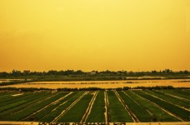
Question - 1
Rizwan had a huge agricultural land on which he grew paddy. Every year he had the best harvest in his village with around 1000 tonnes of paddy. He stored his produce in a large barn which was constructed by his great grandfather. He always waited and kept his produce in store till he got the best price. However, he was disappointed every year and was worried to see that after few months of storage his produce would reduce by 100 tonnes.
Notes:
http://www.publicdomainpictures.net/view-image.php?image=44796&picture=rice-field

Slide 3
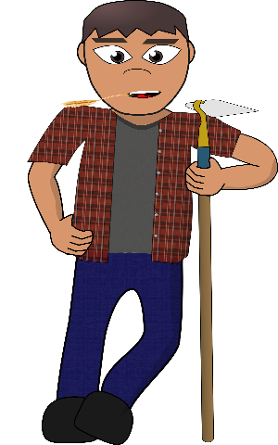
Question - 1 (Continued)
Why did the produce in the store get reduced?
(ii) What remedial measure has to be
taken to prevent it?
(iii) What is the purpose of storing his
produce?
Notes:
https://openclipart.org/detail/252758/farmer-modern
License type : CC0

Slide 4
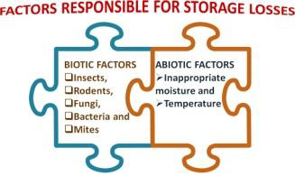
Question 1 (I) - Answer
1 (i). Why did the produce in the store get reduced?
The produce in his store got reduced because of improper storage conditions in his barn. The weight loss in his produce could be attributed to various factors.
The factors that cause storage losses are classified as biotic and abiotic factors.
Notes:
https://pixabay.com/vectors/jigsaw-puzzle-jigsaw-puzzle-piece-303503/

Slide 5
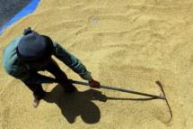
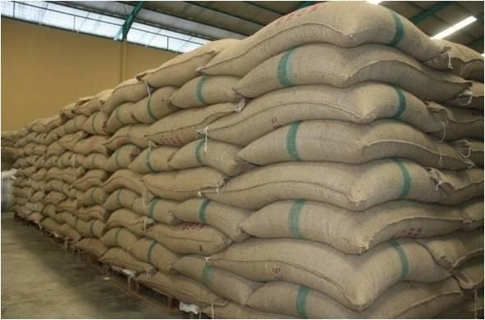
Question 1 (ii) - Answer
1 (ii). What remedial measure has to be taken to prevent it?
Before storing, the food grains should be cleaned well and also sun dried to reduce the moisture levels.
The grains should be stored in clean bags and closed perfectly without holes.
Notes:
https://pixabay.com/photos/paddy-dry-nature-rice-agriculture-658711/
https://pixabay.com/en/gunny-bag-bag-export-gunny-sack-804624/

Slide 6
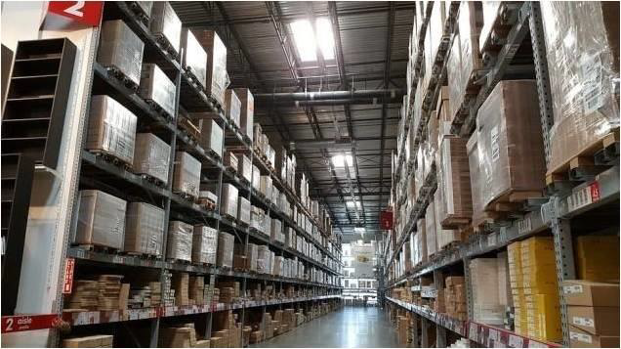
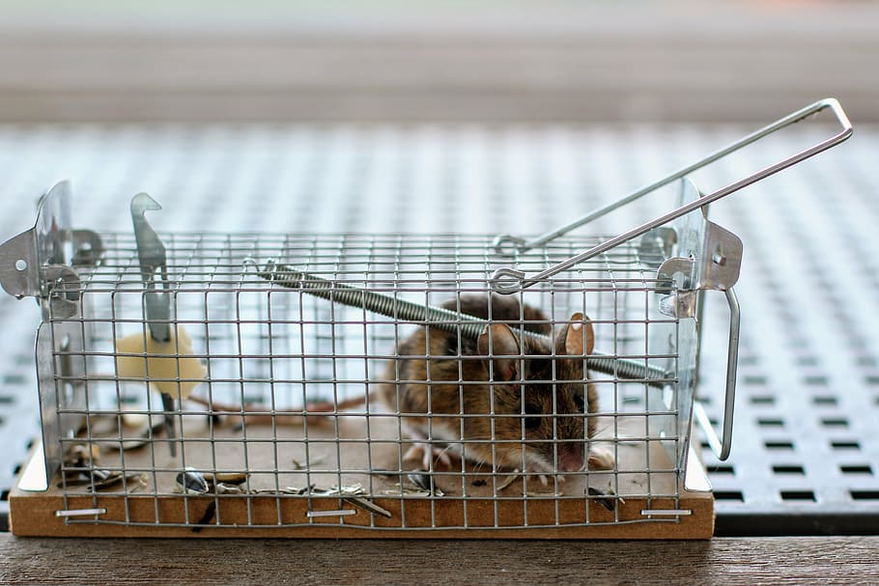
Question 1 (ii) – Answer (Cont.)
The storage area should be clean, well ventilated and closed.
The holes for ventilation should be covered with metal strips to prevent insects and rodents.
Traps can be used to prevent attack by insects and rodents.
The bags can be stacked on a raised plat form to prevent contact with moisture in the floor.
Notes:
https://pixabay.com/photos/ikea-warehouse-industrial-tempe-2714998/
https://www.pxfuel.com/en/free-photo-jolch

Slide 7
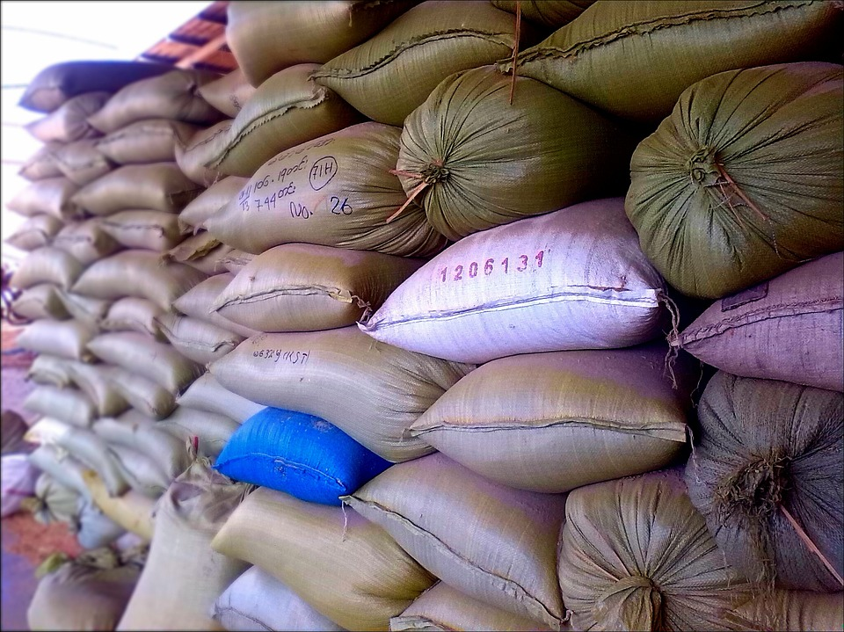
Question 1 (I) - Answer
1 (iii). What is the purpose of storing his produce?
Storing his produce will help him in case of any natural calamities like flood or drought. Storing the grains will also be useful when the yield is very poor the following year. He would also be able to sell the grains for more profit.
Notes:
https://pixabay.com/en/rice-sacks-rice-sacks-storage-283750/

Slide 8
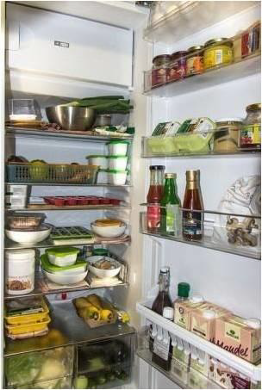
Question - 2
When you are out of the home for a long tour, there might have been a power cut for a long time during which the frozen foods kept in the refrigerator would have thawed. But later it would have frozen again when the power was restored.
Power failure
Power regained
Notes:
https://pixabay.com/photos/refrigerator-icebox-food-cold-1809344/
Ice cubes : https://pixabay.com/en/ice-cubes-ice-cold-melting-blue-48867/

Slide 9
Question - 2 (Continued)
Is it safe to consume that frozen food when you come back home?
Can you think of some way to find out how long the power cut would have lasted when you were away from home?
Notes:
https://pixabay.com/en/man-guy-comic-character-boy-child-294505/

Slide 10
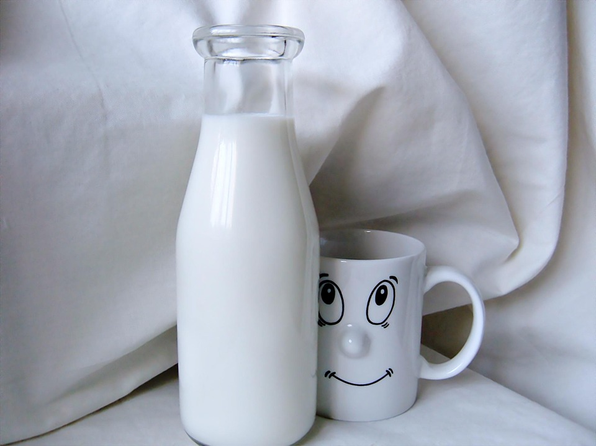
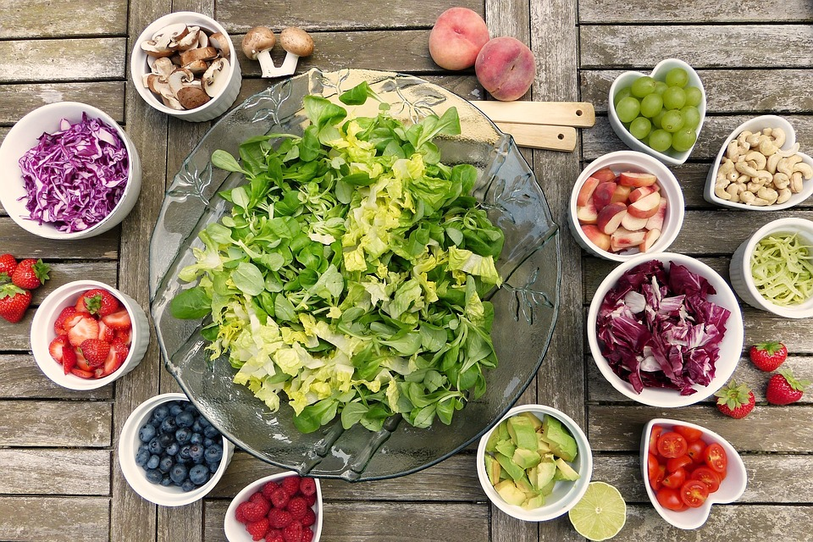
Question 2 (I) - Answer
2 (i). Is it safe to consume that frozen food when you come back home?
The frozen foods can be consumed safely if the power cut had been for a short time. If the power cut had been for a long time, it may not be safe to consume.
These perishable foods need to be discarded if they were thawed and kept above 40 °F for more than 2 hours.
Notes:
Notes to Teacher:
It might be dangerous to consume such foods as they might spread salmonella and other bacteria resulting in food poisoning.
Image:
https://pixabay.com/photos/salad-fruits-berries-healthy-2756467/
https://pixabay.com/en/milk-cow-drink-calcium-642734/

Slide 11
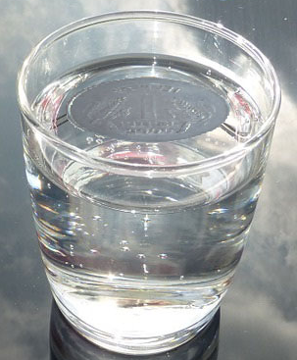
Question 2 (iI) - Answer
2 (ii). Can you think of some way to find out how long the power cut would have lasted when you were away from home?
There is a very simple way to find out how long the power cut lasted. The only things needed are a cup, coin and water.
Fill a cup with water and freeze it and when it is frozen, keep a coin on top of it and leave it in the freezer.
There was no power cut, if the coin is still found on the top of the cup.
Notes:
https://pixabay.com/en/glass-water-sky-live-reflection-475446/
Coin : Original contribution
Photoshop of the two images done by Sai Sanjay – saisanjay@saibrains.com

Slide 12
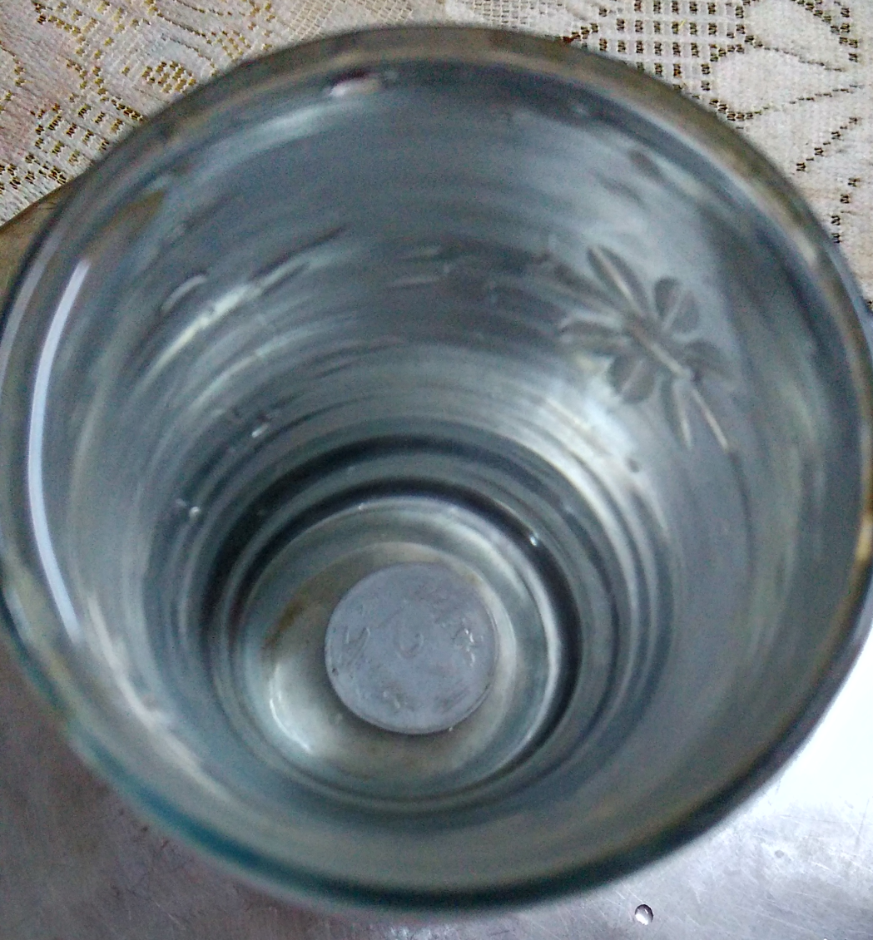
Question 2 (iI) - Answer
The power cut would have been for a short while , if the coin was found near the top or the middle of the cup.
In this case, water would have melted partially, and the coin also sinks partially.
Notes:
Original contribution : jai.sai.sudar@gmail.com

Slide 13
MM Index
Slide# | Thumbnail | Source and Attribution
2 |  | http://www.publicdomainpictures.net/view-image.php?image=44796&picture=rice-field
3 |  | https://openclipart.org/detail/252758/farmer-modern
4 |  | https://pixabay.com/vectors/jigsaw-puzzle-jigsaw-puzzle-piece-303503/
5 |  | https://pixabay.com/photos/paddy-dry-nature-rice-agriculture-658711/
5 |  | https://pixabay.com/en/gunny-bag-bag-export-gunny-sack-804624/
6 |  | https://pixabay.com/photos/ikea-warehouse-industrial-tempe-2714998/
6 |  | https://www.pxfuel.com/en/free-photo-jolch
7 |  | https://pixabay.com/en/rice-sacks-rice-sacks-storage-283750/

Slide 14
MM Index
Slide# | Thumbnail | Source and Attribution
8 |  | https://pixabay.com/photos/refrigerator-icebox-food-cold-1809344/
8 |  | Ice cubes : https://pixabay.com/en/ice-cubes-ice-cold-melting-blue-48867/
9 |  | https://pixabay.com/en/man-guy-comic-character-boy-child-294505/
10 |  | https://pixabay.com/photos/salad-fruits-berries-healthy-2756467/
10 |  | https://pixabay.com/en/milk-cow-drink-calcium-642734/
11 |  | https://pixabay.com/en/glass-water-sky-live-reflection-475446/ Coin : Original contribution Photoshop of the two images done by Sai Sanjay – saisanjay@saibrains.com
12 |  | Original contribution : jai.sai.sudar@gmail.com

