Slide 1
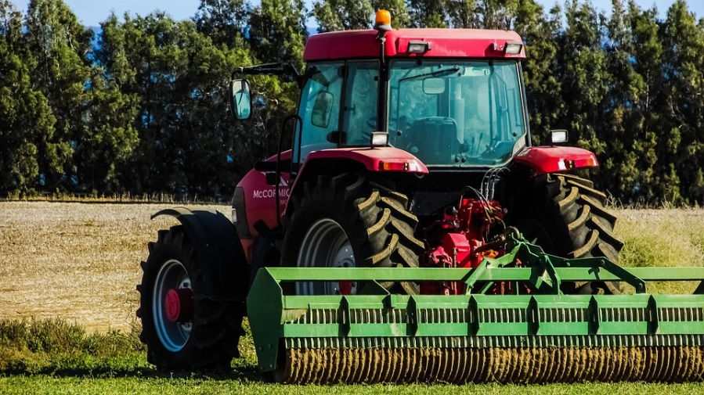
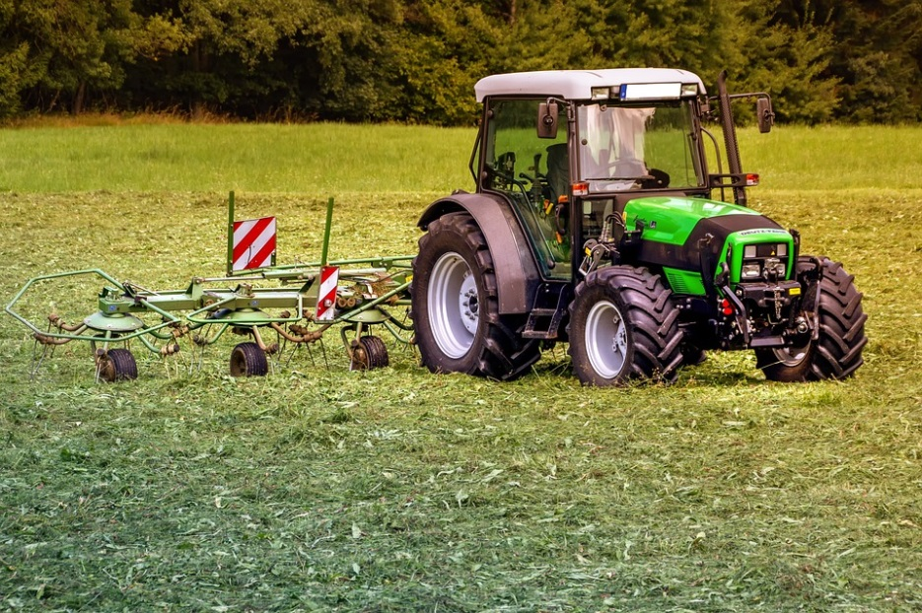
AGRICULTURAL IMPLEMENTS
Notes:
https://pixabay.com/photos/tractors-tractor-mower-pasture-3571452/ - CC0
https://pixabay.com/photos/tractor-field-rural-agriculture-1748636/ - CC0

Slide 2
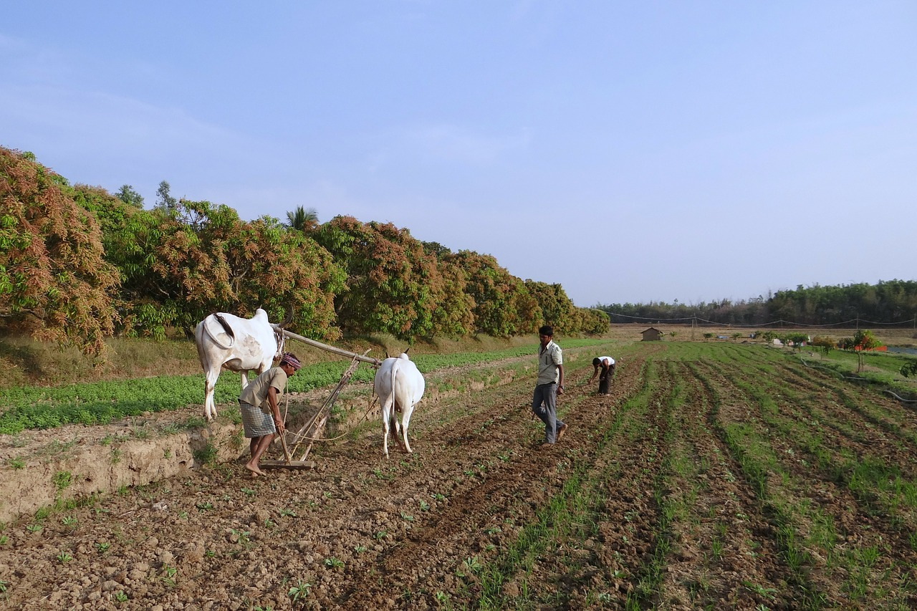
Soil tilling (Ploughing)
The process of turning and loosening soil is called tilling or ploughing. Turning of soil also brings out the organic rich soil that is present in the bottom layer towards the top and thus the crops can utilise it.
The nutrient held by the dead organic materials becomes accessible for crops. Tilling can be done using a wooden or metallic plough.
Notes:
Notes to Teacher:
The process of turning and loosening soil is called tilling or ploughing.
Done using plough which can be either wooden or metallic.
Image:
https://pixabay.com/en/ox-plough-ox-plough-farmer-tilling-253414/

Slide 3
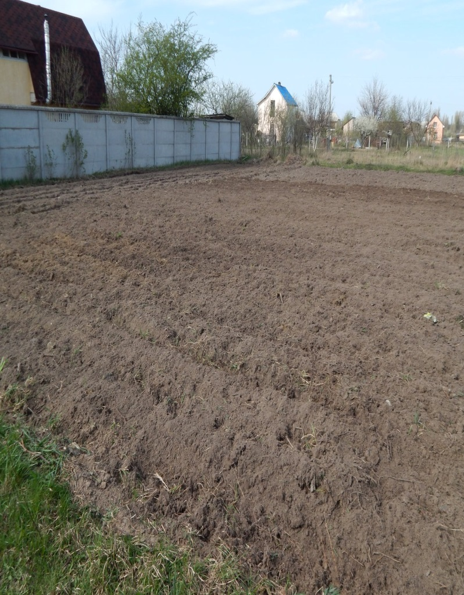
Ploughed Land
After ploughing, the field may have large blocks of soil called crumbs.
This may leave the field unsuitable for cultivating crops.
So, the bigger blocks of the soil have to be broken down to smaller pieces.
This process is called levelling. It is done with a leveller.
Notes:
https://www.pexels.com/photo/agriculture-agronomy-arable-background-1033506/

Slide 4
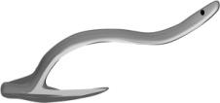
Plough
Earliest agricultural implement
Used for tilling, removing weeds.
It mainly has three parts:
plough shaft,
ploughshare
the beam
Plough shaft is the long handle; plough share is the triangular iron strip and beam is placed on the bulls’ neck.
Notes:
SSSVV Gallery

Slide 5
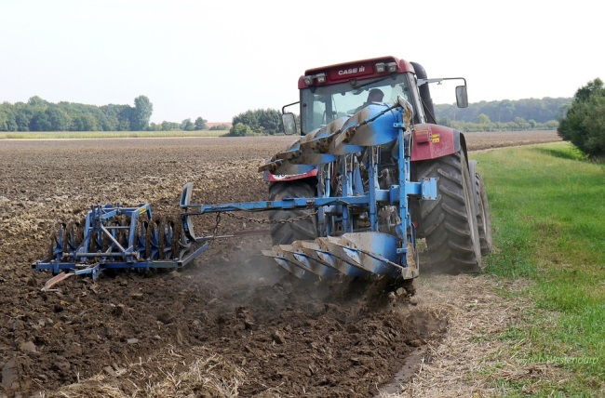
Plough
The older wooden plough is being widely replaced by iron ones now-a-days.
Notes:
https://pixabay.com/en/plow-tractors-m%C3%BCnsterland-1534517/

Slide 6
Hoe
Simple tool used for loosening the soil and removing weeds.
The larger version is pulled by animals.
Similarly we also use pick axe, trowel, cultivator etc.
Notes:
https://pixabay.com/en/hoe-tool-manual-garden-dig-farmer-30427/

Slide 7
MM Index
Slide# | Thumbnail | Source and Attribution
1 |  | https://pixabay.com/photos/tractors-tractor-mower-pasture-3571452/ - CC0
1 |  | https://pixabay.com/photos/tractor-field-rural-agriculture-1748636/ - CC0
2 |  | https://pixabay.com/en/ox-plough-ox-plough-farmer-tilling-253414/
3 |  | https://www.pexels.com/photo/agriculture-agronomy-arable-background-1033506/
5 |  | https://pixabay.com/en/plow-tractors-m%C3%BCnsterland-1534517/
6 |  | https://pixabay.com/en/hoe-tool-manual-garden-dig-farmer-30427/

