Slide 1
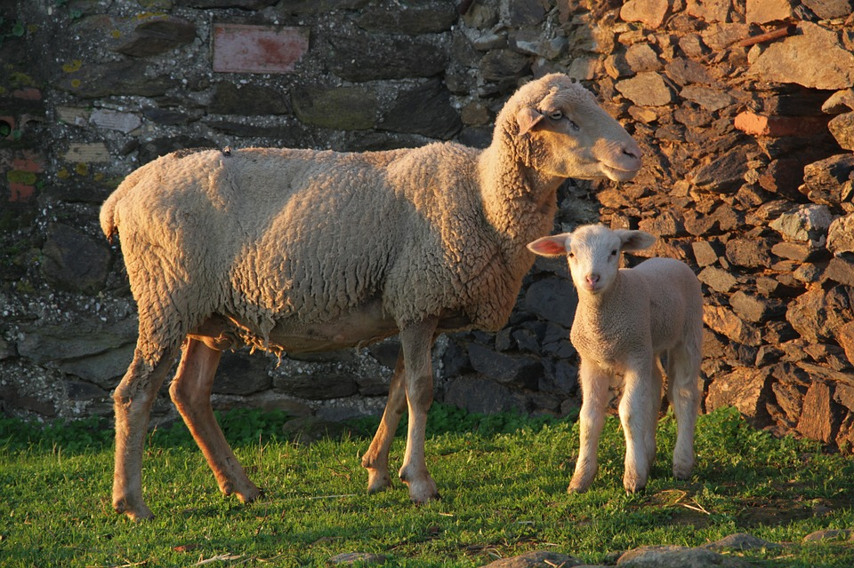
ANIMAL HUSBANDRY AND ITS ELEMENTS
Notes:
https://pixabay.com/photos/nature-animal-husbandry-sheep-1385783/

Slide 2
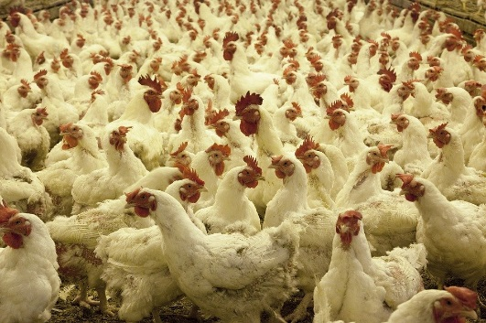
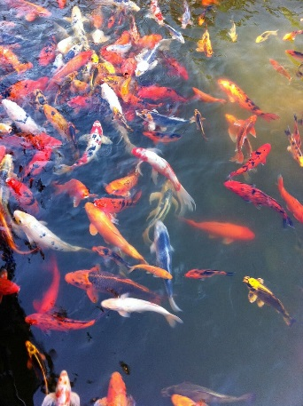
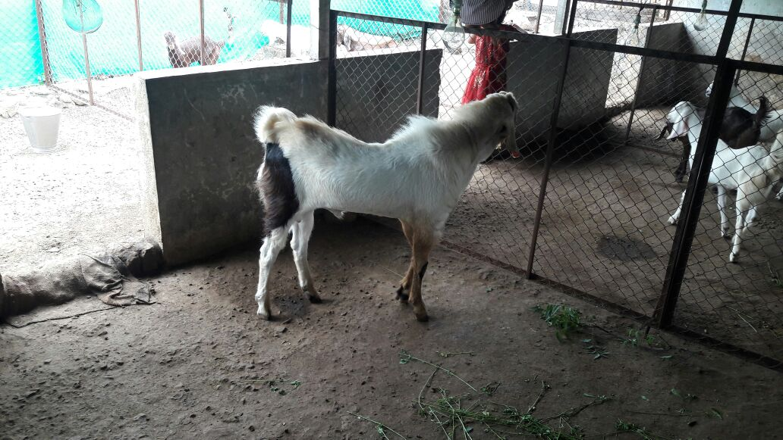
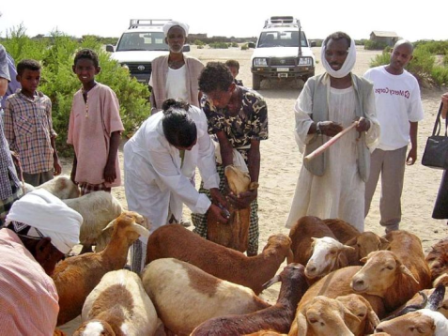
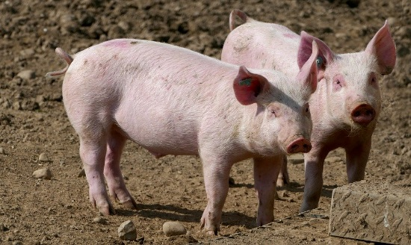
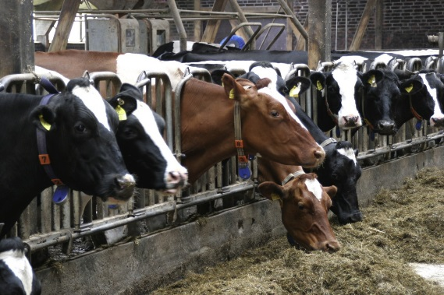
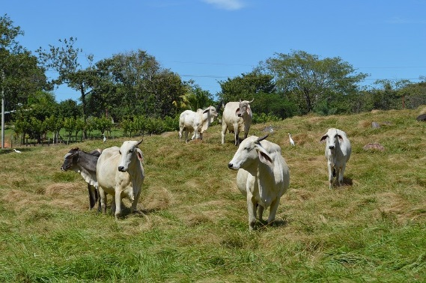
ANIMAL HUSBANDRY
Branch of agriculture
Animal Husbandry
Notes:
Notes to Teacher:
The branch of agriculture which deals with the feeding, shelter, health and breeding of domestic animals or farm animals such as cattle, pigs, horses and fowls is called animal husbandry. It also includes poultry farming and fisheries.
Image Source:
https://www.srisathyasaividyavahini.org/index.php/component/joomgallery/default/poultry-and-livestock-4173.html
https://pixabay.com/photos/agriculture-animal-husbandry-pigs-4077998/
https://pixabay.com/photos/animal-husbandry-cow-livestock-4084104/
https://pxhere.com/en/photo/920175
https://pixnio.com/people/crowd/animal-husbandry-programs-to-improve-the-livestock-health-care-for-the-rural-goat-farmerd
https://pixabay.com/photos/poultry-farm-chickens-agriculture-1544654/
https://www.pxfuel.com/en/free-photo-eqhbs

Slide 3
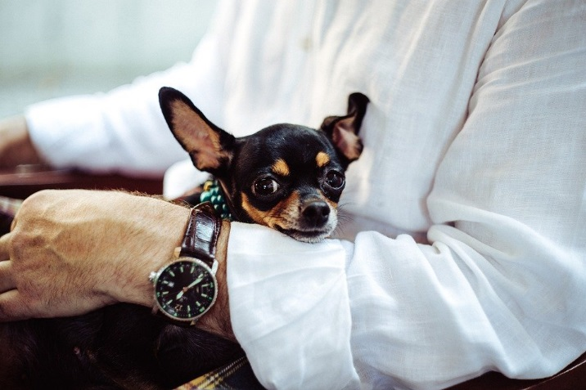
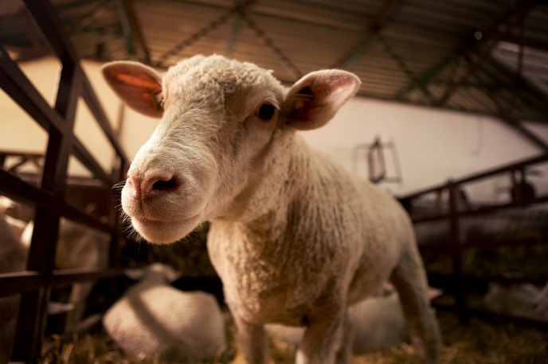
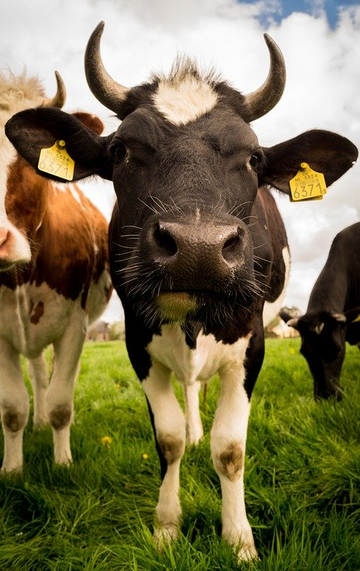
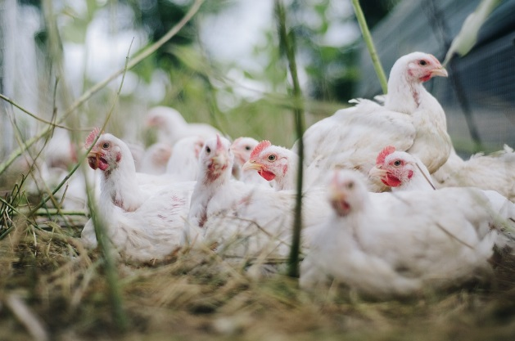
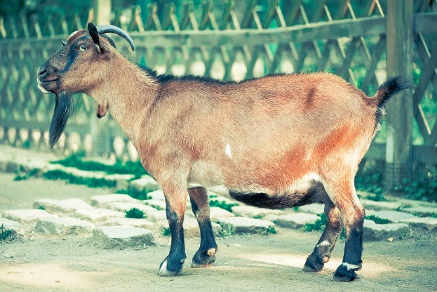
DOMESTICATION
Caring and controlling
For companionship, food, work, wool, etc.
Defining characteristic is selective breeding
Notes:
https://pixabay.com/photos/chihuahua-dog-tiny-canine-loved-1031488/
https://pixabay.com/photos/sheep-head-lamb-nose-glance-look-4432232/
https://pixabay.com/photos/livestock-cow-cattle-rural-mammal-384628/
https://pixabay.com/photos/billy-goat-goat-goatee-animal-459232/
https://pixabay.com/photos/chicken-farm-poultry-bird-animal-4474176/

Slide 4
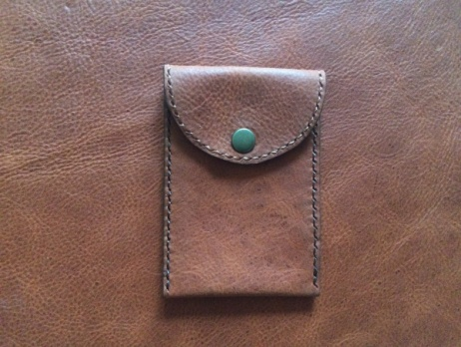
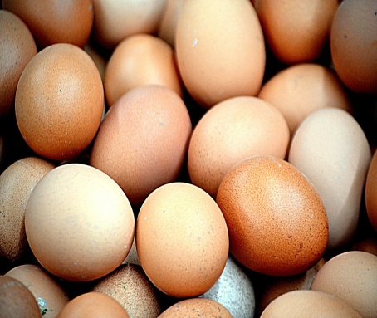
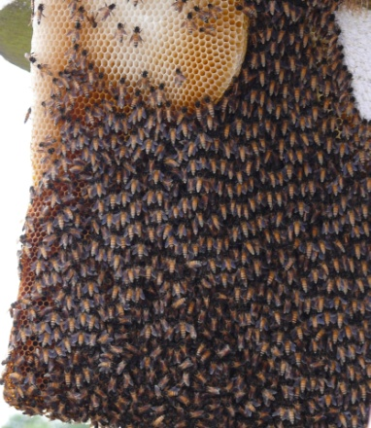
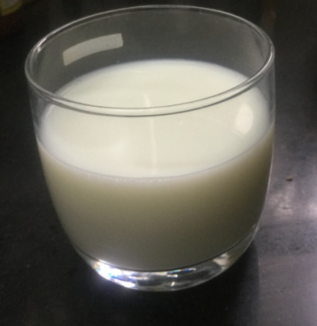
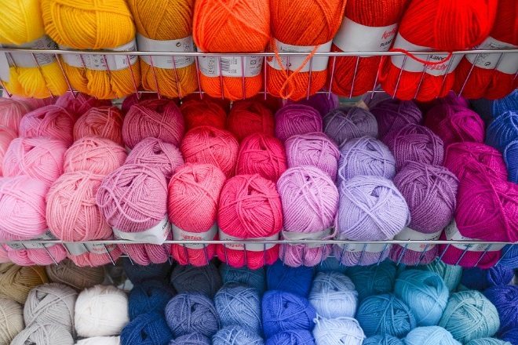
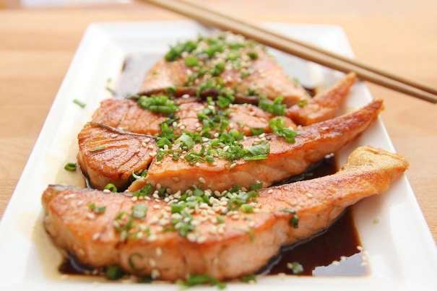
DEPENDENCY ON ANIMALS
Notes:
Notes to Teacher:
Human beings depend on animals for various needs and this includes food products like eggs, milk, meat and honey and other products like woollen garments and leather products.
Image Source:
https://pxhere.com/en/photo/646636
https://www.srisathyasaividyavahini.org/index.php/component/joomgallery/default/milk-6947.html
https://www.srisathyasaividyavahini.org/index.php/component/joomgallery/nature/animals/animals-27.html
https://pixabay.com/photos/food-animals-eggs-chicken-eggs-316412/
https://pixabay.com/photos/wool-shop-hobby-craft-store-2742119/
https://pixabay.com/photos/food-salmon-teriyaki-fish-eat-712665/

Slide 5
ANIMAL HUSBANDARY
Animal husbandry is the scientific management of animal livestock including their feeding, breeding and disease control.
Notes:
Notes to Teacher:
Instead of hunting, it has now become an organised setup.
Image Source:
https://pixabay.com/vectors/hunter-hunting-dog-adult-animal-3614043/
https://www.needpix.com/photo/1121467/animals-hunting-hunting-hunter-target-shooting-rifle-gun-men-shooting-a-weapon-clothing

Slide 6
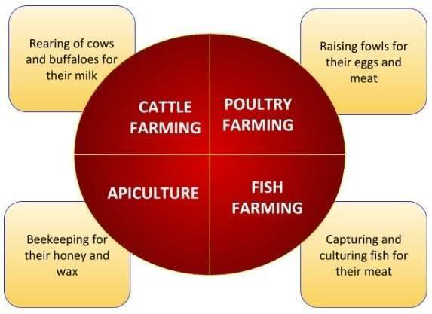
Types of Animal husbandry

Slide 7
Elements of Animal Husbandry
Proper breeding of animal
Prevention and cure of animal diseases
Proper shelter
Provision for clean drinking water
Proper feeding
Elements of Animal husbandry

Slide 8
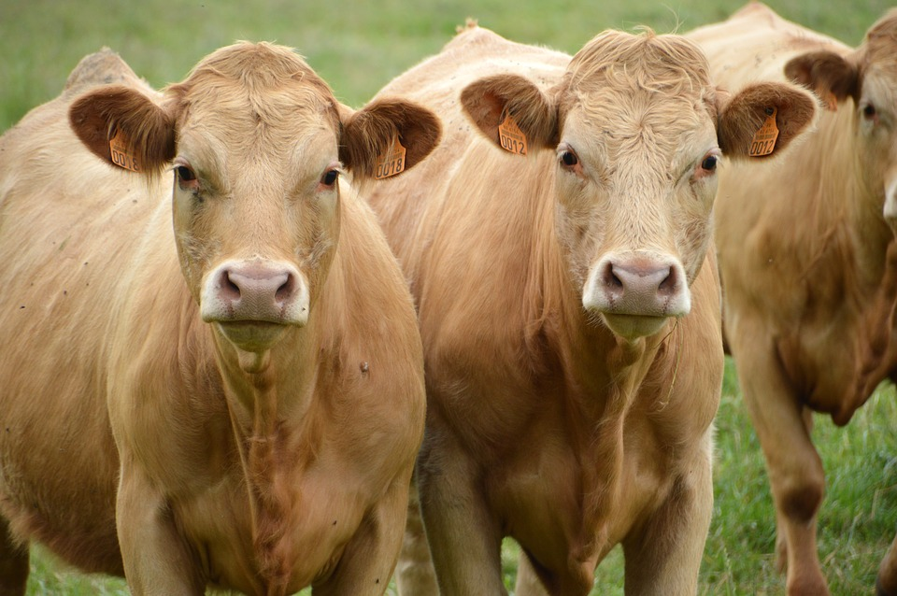
Proper breeding of animals
Hybridisation is the natural or artificially induced crossbreeding of two different but closely related varieties of species of animals.
The new variety or species that results from the crossbreeding is termed a hybrid.
Notes:
https://www.maxpixel.net/Farm-Breeding-Cows-Mammal-Cow-Brown-Animal-Cattle-3515521

Slide 9
Proper breeding of animals
The characteristic features of animals which should be taken into consideration for breeding are –
Resistance to diseases
Tolerance to climatic conditions
General appearance
Size and configuration
Productivity
Good health
Proper age for reproduction

Slide 10
Advantages of Cross breeding
Improvement of milk production in dairy cattle,
Meatiness in pigs
Feed requirements or growth rate in beef cattle
Egg production in chickens

Slide 11
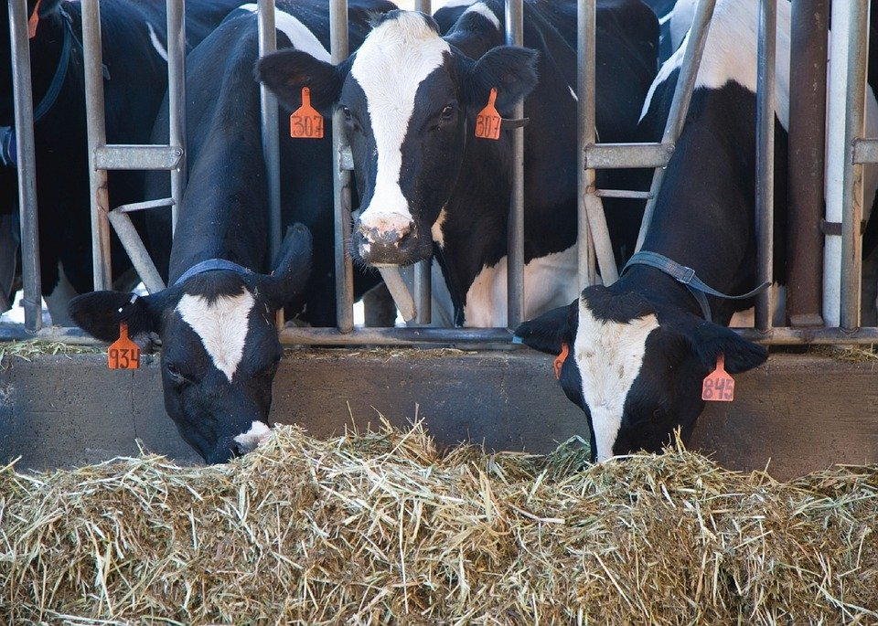
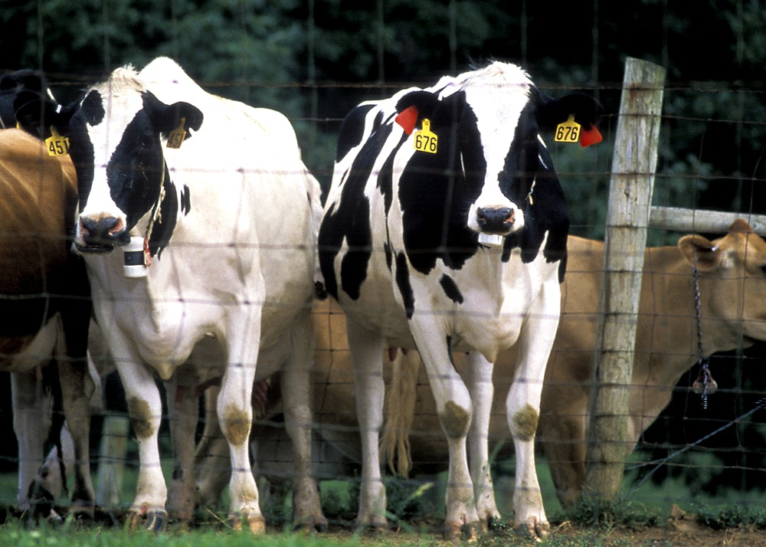
Proper feeding of animals
Animals must be given enough rich food to put on weight.
An animal that is raised for meat must grow and fatten quickly, feed supplements must be given.
Notes:
https://pixabay.com/photos/cows-feeding-eating-milking-stalls-1086049/
https://www.rawpixel.com/image/2288453/free-photo-image-cow-animal-carrier

Slide 12
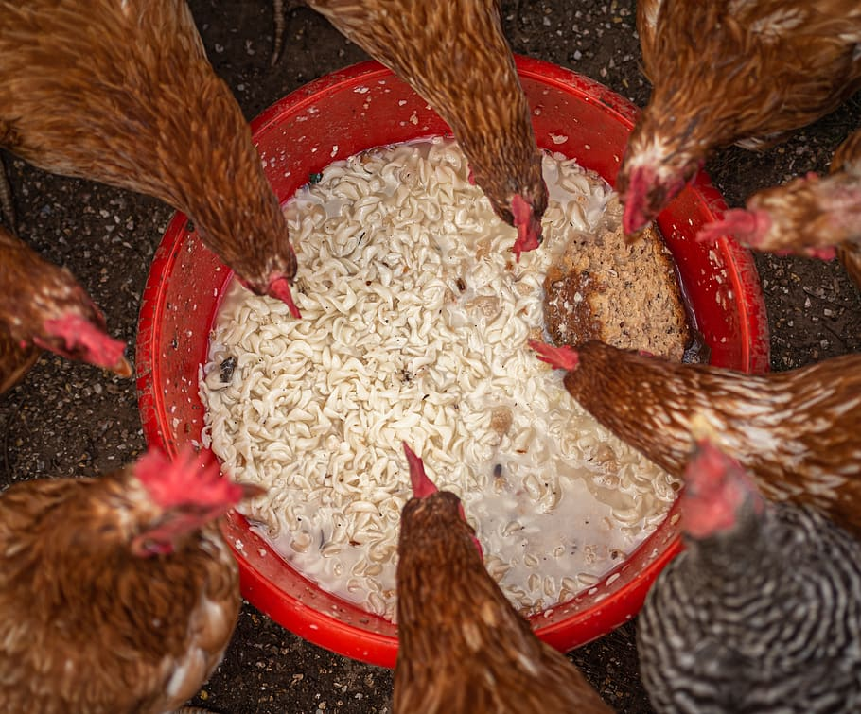
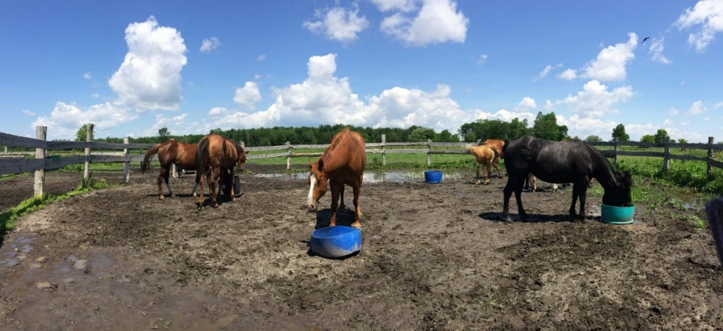
Feeding of the animals
The feed supplement must be given every day at the same time, so that the animal can digest it.
All the year round.
Notes:
https://www.pxfuel.com/en/free-photo-xifeq
https://pxhere.com/en/photo/845431

Slide 13
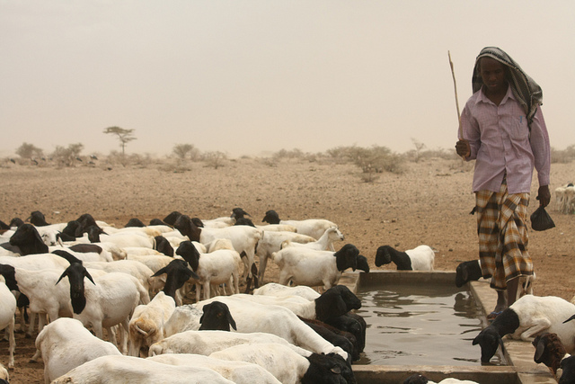
Provision for clean drinking water
Providing enough quality water is essential for good animal husbandry.
Water helps in digestion, waste removal and the absorption of nutrients.
Notes:
Notes to Teacher:
Understanding daily livestock watering needs is a key factor in animal husbandry.
Image Source:
https://www.flickr.com/photos/oxfameastafrica/5932898630 – CC BY 2.0 - Oxfam East Africa

Slide 14
Daily water requirement
Air temperature, humidity, animal exertion, production level – causes for consumption rate of water
Animal’s size and growth depends on water intake
Varies among animal species

Slide 15
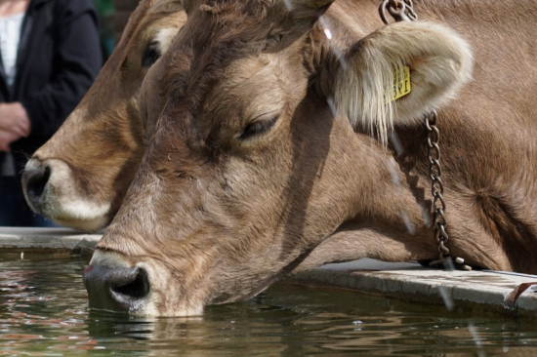
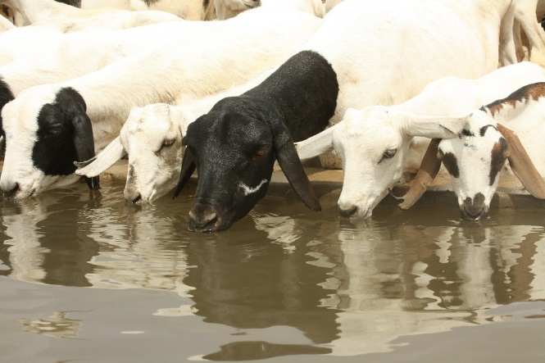
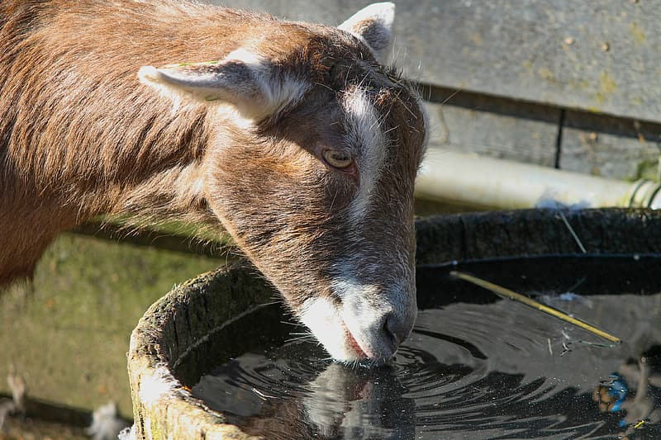
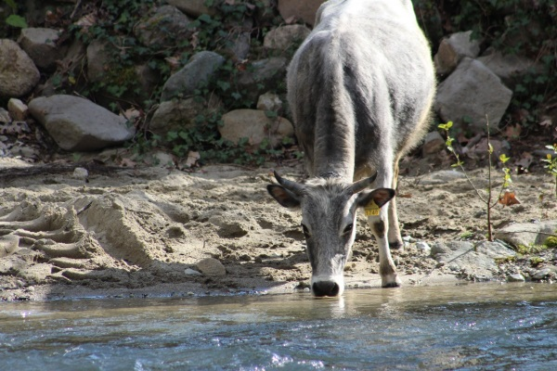
Provision for clean drinking water
The quality of the water, which includes temperature, salinity and impurities affecting taste and odour, will also have an effect.
The water content of the animal's diet will influence its drinking habits.
Notes:
https://www.flickr.com/photos/oxfameastafrica/5930966888 – CC BY 2.0 - Oxfam East Africa https://www.pikrepo.com/fuclq/brown-and-black-horse-drinking-water
https://pixnio.com/fauna-animals/cows-and-calves/agriculturelivestock-cattle-nature-cow-animal-bovine
https://pxhere.com/en/photo/1589793

Slide 16
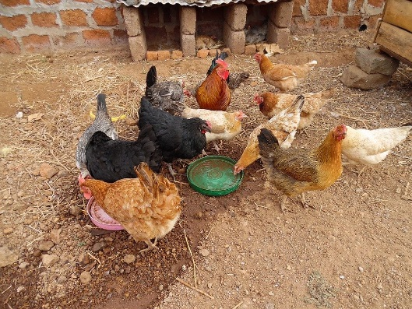
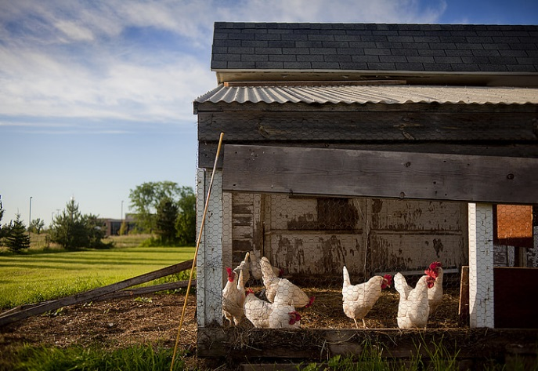
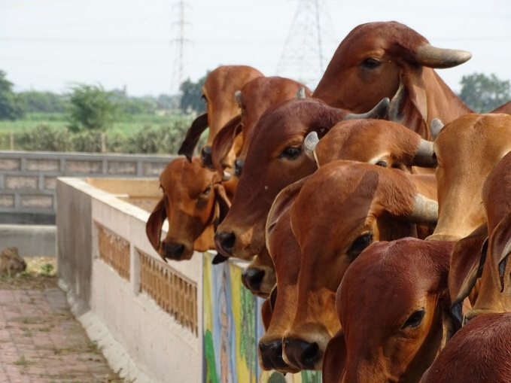
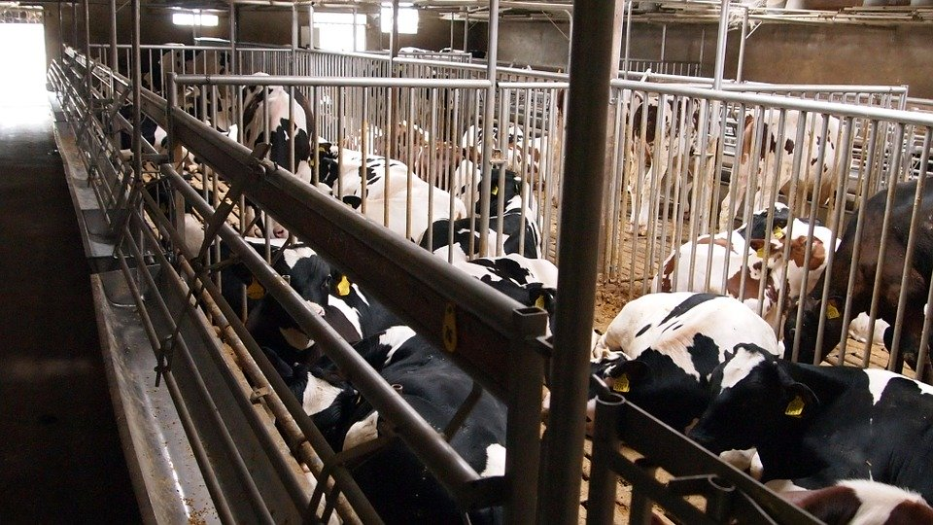
Proper shelter
Animals should be kept in a hygienic manner with proper housing.
Animals and their sheds have to be cleaned regularly.
Notes:
https://pixabay.com/photos/poultry-farming-africa-moshi-2738652/
https://www.pickpik.com/chicken-coop-farm-chickens-coop-chicken-poultry-130378
https://pixabay.com/photos/cow-indian-holy-cow-hinduism-hindu-2755518/
https://pixabay.com/photos/black-fur-veal-livestock-farm-786693/

Slide 17
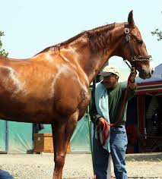
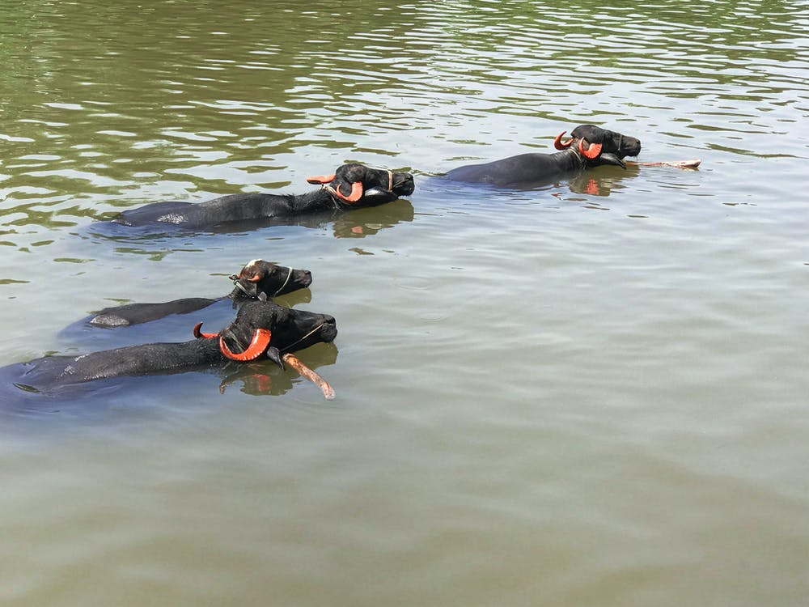
Proper shelter
Animals should be washed or bathed regularly to remove the dirt and bugs in their body.
Notes:
https://www.flickr.com/photos/7326810@N08/2479890092/ - CC BY 2.0 – Jean
https://www.pexels.com/photo/animal-animals-bathing-animal-buffalos-1918788/

Slide 18
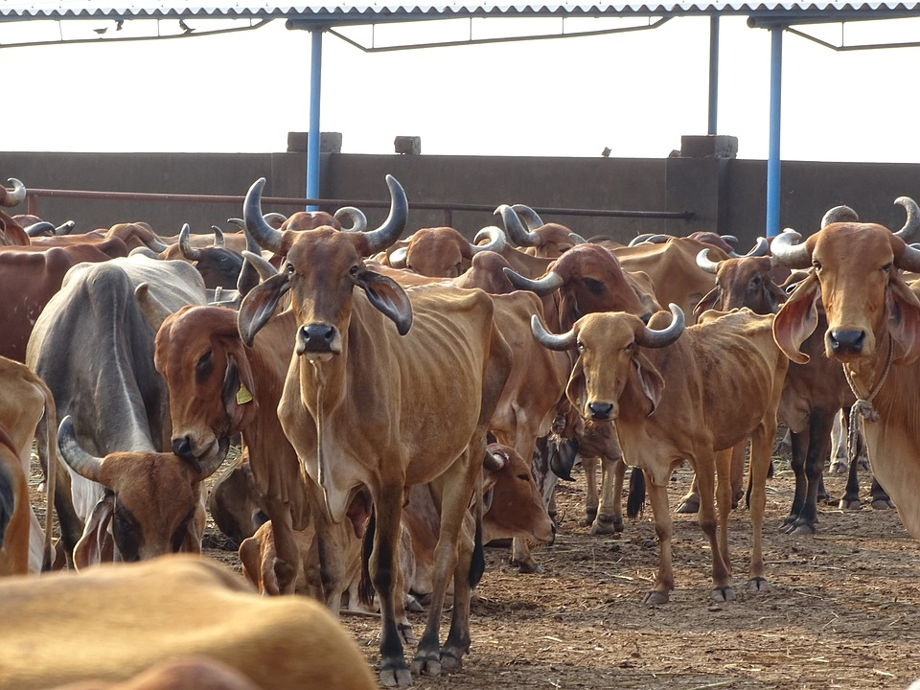
Proper shelter
The shed should be well-ventilated and roofed so that animals are protected from rain, heat, and cold.
A proper drainage system should be there to remove their waste.
Notes:
https://pixabay.com/photos/cow-indian-holy-cow-hinduism-hindu-2808149/

Slide 19
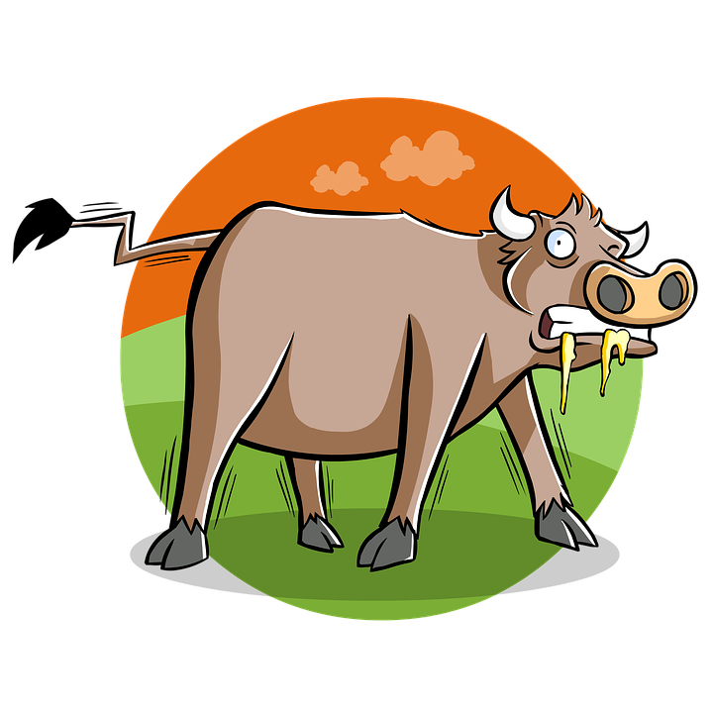
Prevention and cure of animal diseases
The most important element of animal husbandry is to have disease-free breeds.
Animals are also subjected to many diseases.
This may affect the health as well as productivity of animals; even cause their death.
Notes:
https://publicdomainvectors.org/en/free-clipart/Vector-illustration-of-pig-with-a-monocle-in-its-right-eye/19443.html
https://pixabay.com/illustrations/agribusiness-agriculture-livestock-1487029/

Slide 20
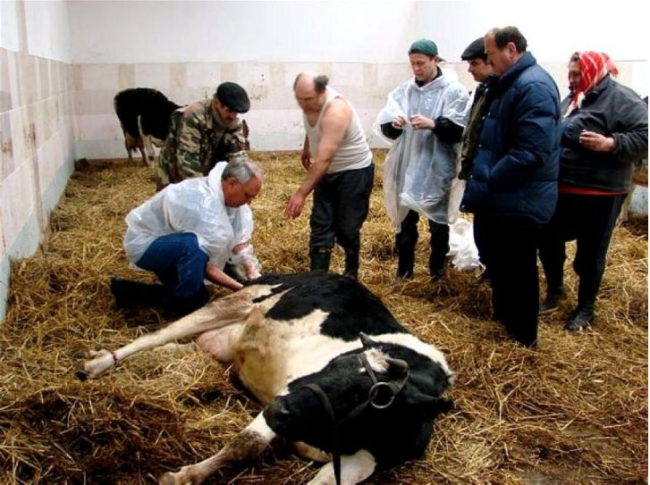
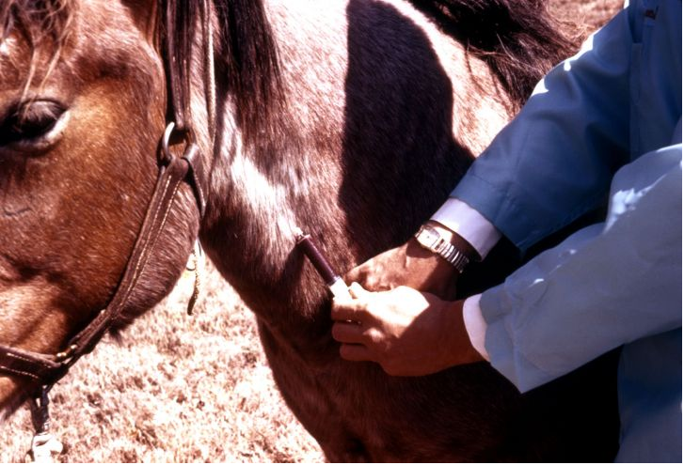
Prevention and cure of animal diseases
Parasites, bacteria and viruses are the ones that cause diseases in animals.
These microbes infect the animals externally as well as internally.
Vaccination is the one solution for the protection against bacterial and viral infections.
Notes:
https://pixnio.com/science/veterinary-medicine/man-assists-with-the-calving-process
https://pixnio.com/science/veterinary-medicine/clinician-is-bleeding-a-horses-jugular-vein-to-test-it-for-the-arboviral-disease

Slide 21
Why do we need animal husbandry?
Growing population needs food for survival.
Animal husbandry takes care of the growing needs of the population.
Animal husbandry includes many occupations such as poultry, cattle farming, etc.

Slide 22
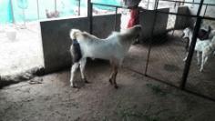
MM Index
Slide# | Thumbnail | Source and Attribution
1 |  | https://pixabay.com/photos/nature-animal-husbandry-sheep-1385783/
2 |  | https://www.srisathyasaividyavahini.org/index.php/component/joomgallery/default/poultry-and-livestock-4173.html https://pixabay.com/photos/agriculture-animal-husbandry-pigs-4077998/
2 |  | https://pixabay.com/photos/animal-husbandry-cow-livestock-4084104/
2 |  | https://pxhere.com/en/photo/920175
2 |  | https://pixnio.com/people/crowd/animal-husbandry-programs-to-improve-the-livestock-health-care-for-the-rural-goat-farmerd
2 |  | https://pixabay.com/photos/poultry-farm-chickens-agriculture-1544654/ https://www.pxfuel.com/en/free-photo-eqhbs

Slide 23
MM Index
Slide# | Thumbnail | Source and Attribution
3 |  | https://pixabay.com/photos/chihuahua-dog-tiny-canine-loved-1031488/ https://pixabay.com/photos/sheep-head-lamb-nose-glance-look-4432232/
3 |  | https://pixabay.com/photos/livestock-cow-cattle-rural-mammal-384628/ https://pixabay.com/photos/billy-goat-goat-goatee-animal-459232/
3 |  | https://pixabay.com/photos/chicken-farm-poultry-bird-animal-4474176/
4 |  | https://pxhere.com/en/photo/646636 https://www.srisathyasaividyavahini.org/index.php/component/joomgallery/default/milk-6947.html
4 |  | https://www.srisathyasaividyavahini.org/index.php/component/joomgallery/nature/animals/animals-27.html https://pixabay.com/photos/food-animals-eggs-chicken-eggs-316412/
4 |  | https://pixabay.com/photos/wool-shop-hobby-craft-store-2742119/ https://pixabay.com/photos/food-salmon-teriyaki-fish-eat-712665/

Slide 24
MM Index
Slide# | Thumbnail | Source and Attribution
5 |  | https://pixabay.com/vectors/hunter-hunting-dog-adult-animal-3614043/ https://www.needpix.com/photo/1121467/animals-hunting-hunting-hunter-target-shooting-rifle-gun-men-shooting-a-weapon-clothing
8 |  | https://www.maxpixel.net/Farm-Breeding-Cows-Mammal-Cow-Brown-Animal-Cattle-3515521
11 |  | https://pixabay.com/photos/cows-feeding-eating-milking-stalls-1086049/ https://www.rawpixel.com/image/2288453/free-photo-image-cow-animal-carrier
12 |  | https://www.pxfuel.com/en/free-photo-xifeq https://pxhere.com/en/photo/845431
13 |  | https://www.flickr.com/photos/oxfameastafrica/5932898630 – CC BY 2.0 - Oxfam East Africa
15 |  | https://www.flickr.com/photos/oxfameastafrica/5930966888 – CC BY 2.0 - Oxfam East Africa https://www.pikrepo.com/fuclq/brown-and-black-horse-drinking-water

Slide 25
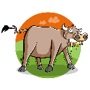
MM Index
Slide# | Thumbnail | Source and Attribution
15 |  | https://pixnio.com/fauna-animals/cows-and-calves/agriculturelivestock-cattle-nature-cow-animal-bovine https://pxhere.com/en/photo/1589793
16 |  | https://pixabay.com/photos/poultry-farming-africa-moshi-2738652/ https://www.pickpik.com/chicken-coop-farm-chickens-coop-chicken-poultry-130378
16 |  | https://pixabay.com/photos/cow-indian-holy-cow-hinduism-hindu-2755518/ https://pixabay.com/photos/black-fur-veal-livestock-farm-786693/
17 |  | https://www.flickr.com/photos/7326810@N08/2479890092/ - CC BY 2.0 – Jean https://www.pexels.com/photo/animal-animals-bathing-animal-buffalos-1918788/
18 |  | https://pixabay.com/photos/cow-indian-holy-cow-hinduism-hindu-2808149/
19 |  | https://publicdomainvectors.org/en/free-clipart/Vector-illustration-of-pig-with-a-monocle-in-its-right-eye/19443.html https://pixabay.com/illustrations/agribusiness-agriculture-livestock-1487029/
20 |  | https://pixnio.com/science/veterinary-medicine/man-assists-with-the-calving-process https://pixnio.com/science/veterinary-medicine/clinician-is-bleeding-a-horses-jugular-vein-to-test-it-for-the-arboviral-disease

