Slide 1
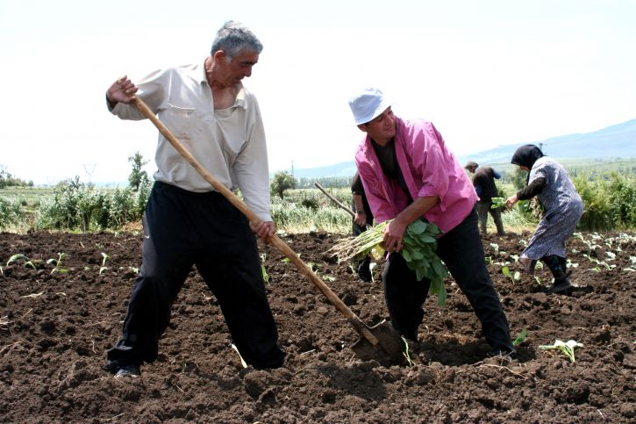
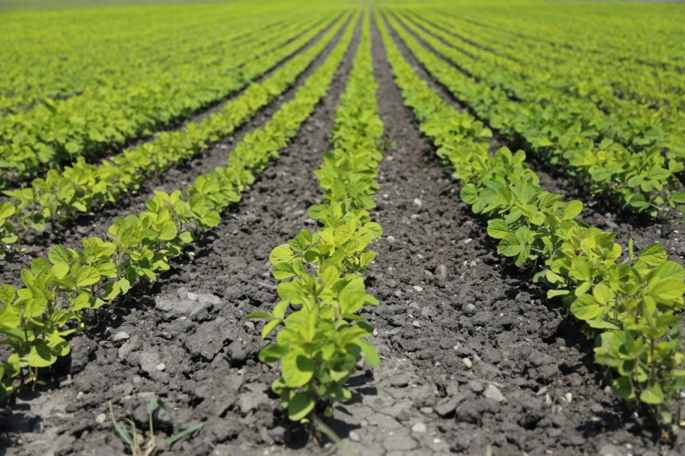
CROP PRODUCTION
Notes:
https://pixnio.com/people/agricultural-programs-in-georgia-assist-in-improving-farmers-crop-production – CC0
https://pxhere.com/en/photo/498914 – CC0

Slide 2
Crop Protection
Farmers have to go through several steps in order to produce the crops .
These are similar to the way plants are grown and nurtured in garden.
These steps involved in crop production are generally termed as agricultural practices.

Slide 3
Agricultural Practices
Preparation of soil
Sowing
Adding manure and fertilisers
Irrigation
Protecting from weeds
Harvesting
Storage

Slide 4
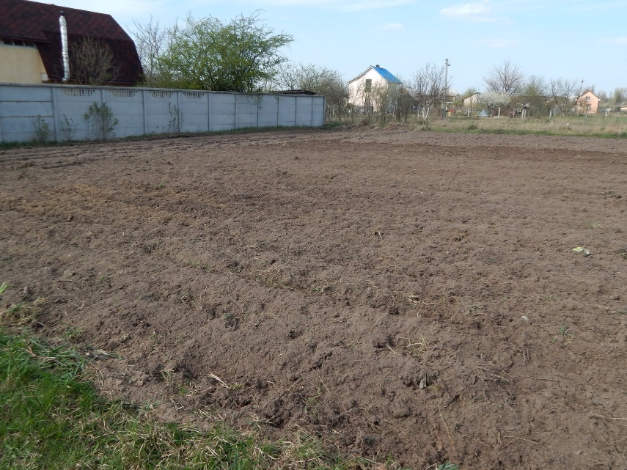
Preparation Of Soil
Tilling (ploughing) helps to loosened the soil and in the growth of microbes in it.
It helps the roots to breathe easier but few weeds are also destroyed and residues of previous crops are mixed and decomposed. .
Notes:
Image:
https://www.pexels.com/photo/agriculture-agronomy-arable-background-1033506/

Slide 5
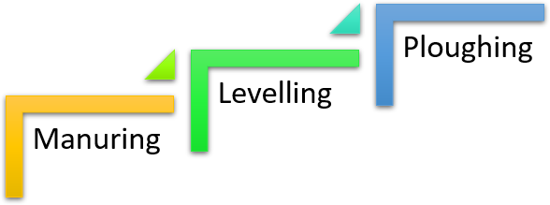
Steps taken by farmer

Slide 6
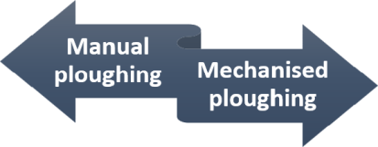
Ploughing
Ploughing is the opening of compact soil with the help of ploughs.
By this process, turning of soil, uprooting of weeds and stubbles are also done.
It is done in two ways:
Notes:
Notes to Teacher:
In fact by ploughing the farmer introduces air in the soil.

Slide 7
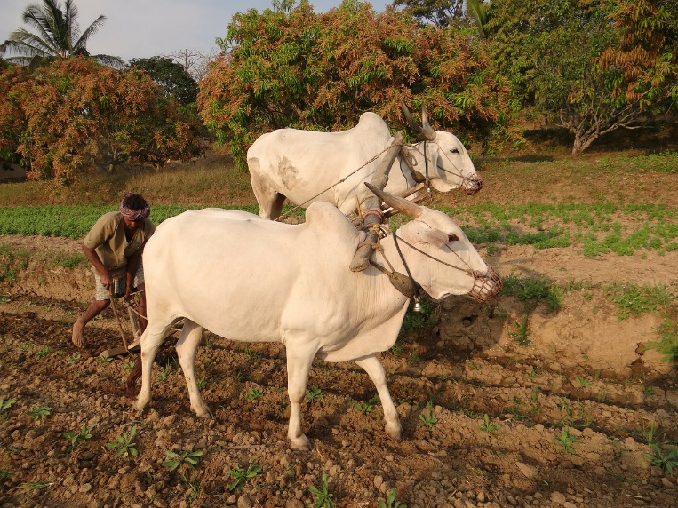
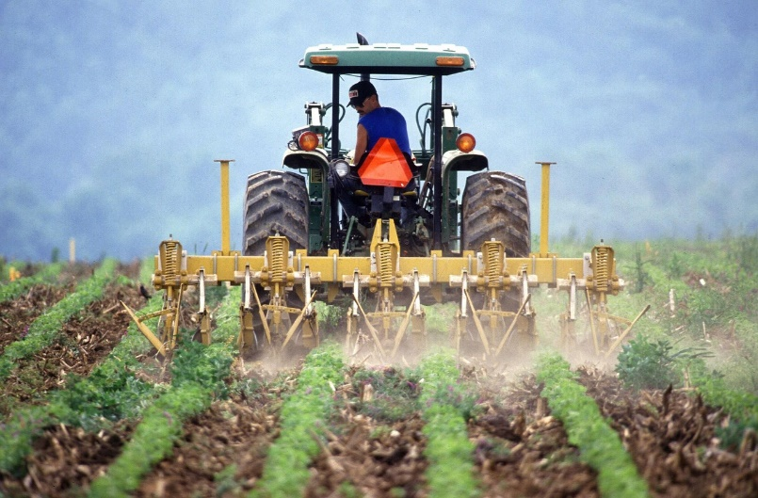
Ploughing
Manual ploughing
Mechanised ploughing
Farmers plough the field with wooden plough with an iron sharp point drawn by a pair of bulls.
Farmers plough the field with a tractor. It saves labour and time.
Notes:
https://pixabay.com/en/ox-plough-bullocks-farmer-tilling-253417/
https://pixabay.com/en/plow-tractors-m%C3%BCnsterland-1534517/

Slide 8
Levelling – Final step of soil preparation
Once the field is ploughed, the topsoil is very loose.
Soil could be easily washed away in case of strong wind or rain.
Soil is levelled with the leveller, which is a heavy wooden or iron plank.
Levelling of the field also helps in uniform distribution of water during irrigation.

Slide 9
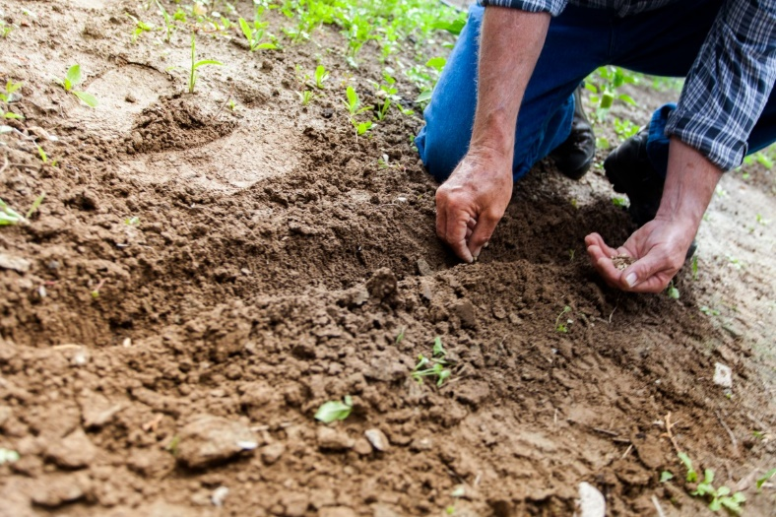
Sowing
The process of planting or scattering seeds in the prepared soil.
This method is also called as broadcasting.
Notes:
https://pxhere.com/en/photo/929198

Slide 10
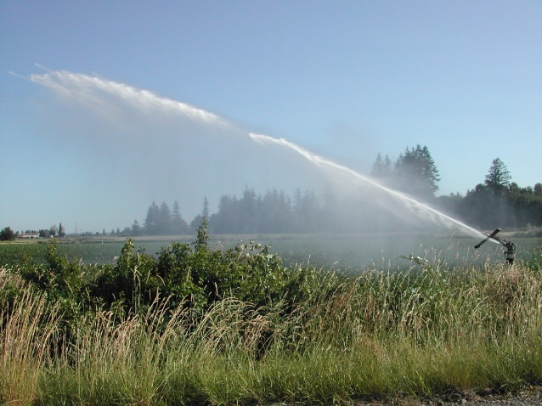
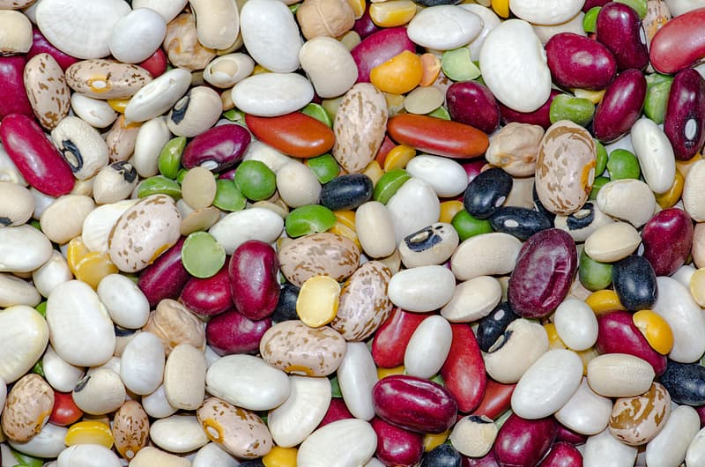
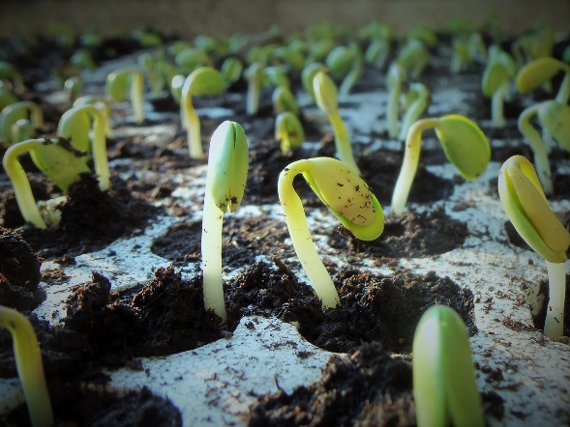
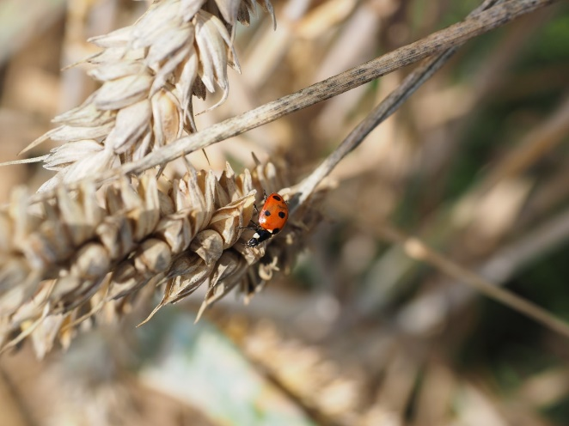
Before sowing, things to keep in mind
Only certified seeds should be sown
Land must be watered
Seeds of other varieties should not be mixed
It should be well developed and they should have passed the requisite dormancy period.
Should be free from pests and diseases
Notes:
https://pxhere.com/en/photo/658471
https://www.pikrepo.com/faros/macro-shot-of-assorted-seeds
https://pixabay.com/en/plants-soybean-soy-nature-1331667/
https://pxhere.com/en/photo/1234443

Slide 11
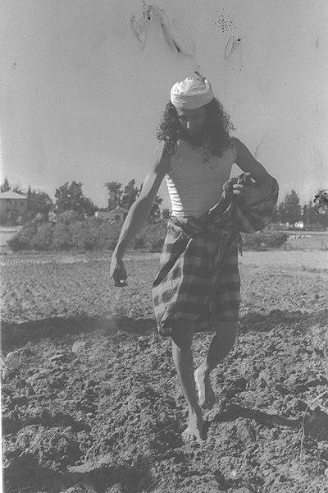
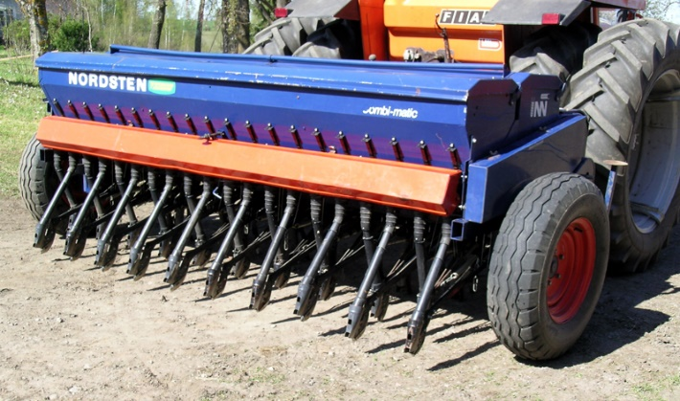
Sowing
Sowing
Broadcasting
Seed Drill
Notes:
Seed Drill: https://commons.wikimedia.org/wiki/File:Sowing_machine_Nordsten.jpg
Broadcasting: https://commons.wikimedia.org/wiki/File:A_YEMNITE_HABANI_FARMER_SOWING_HIS_FIELD._%D7%97%D7%A7%D7%9C%D7%90%D7%99_%D7%AA%D7%99%D7%9E%D7%A0%D7%99_%D7%97%D7%91%D7%A0%D7%99_%D7%96%D7%95%D7%A8%D7%A2_%D7%91%D7%A9%D7%93%D7%95%D7%AA.D12-053.jpg – Public domain

Slide 12
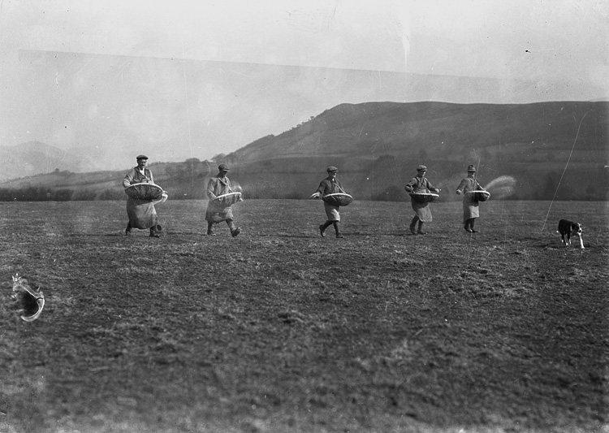
Sowing - Broadcasting
Primitive method of sowing.
Seeds are spread over the field and it is covered by ploughing.
This way spreading of seeds can never be uniform and there is a lot of wastage.
This method is used to sow the fodder crops or other cheaper crops.
Notes:
Asset Type: Main Script
Images:
Broadcasting: https://commons.wikimedia.org/wiki/File:Men_sowing_seed_(3465701854).jpg

Slide 13
Sowing – Seed Drill
Now-a-days seed drill is used for sowing.
Modern and efficient method.
Seeds are scattered evenly and at correct depths.
Done by attaching iron drills to a tractor.
Notes:
Asset Type: Main Script
Images:
Seed Drill: https://commons.wikimedia.org/wiki/File:Sowing_machine_Nordsten.jpg

Slide 14
Manure and Fertilisers
Some fields may not have enough nutrients.
Also continuous growing of crops makes the soil poorer.
In order to replenish the deficient soil to a suitable one we add certain substances.
The substances added to the soil in the form of nutrients are called manure and fertiliser.

Slide 15
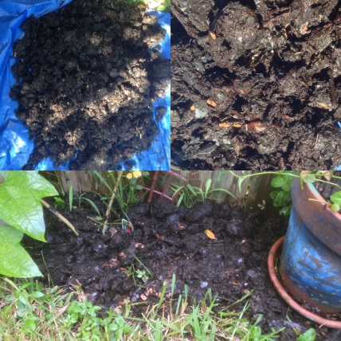
Manure - Organic substance
Obtained from the decomposition of plant or animal wastes.
Decomposed substance is used as organic manure
Farmers dump organic wastes in open pits where it is allowed to decompose.
Notes:
https://www.flickr.com/photos/editor/39695181924
License: CC 2.0 - Bart Everson

Slide 16
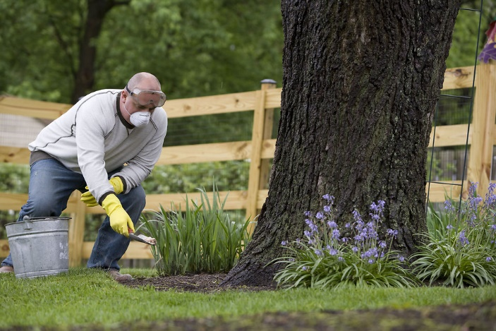
Fertiliser
Chemical substances which are rich in a particular nutrient.
Man-made mineral salts.
produced on a large scale.
Synthetic fertilisers - made in a laboratory and overuse harm the soil.
Can be either natural or synthetic.
Natural fertilisers - derived from plants or animals and never harm the soil and crops.
Example: urea, ammonium sulphate, potash.
Notes:
http://www.freestockphotos.biz/stockphoto/16076

Slide 17
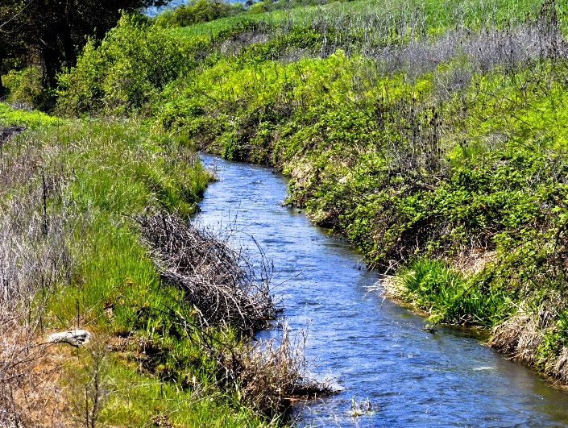
Irrigation
The supply of water to crops at different intervals.
Sources of irrigation are generally wells, tube wells, ponds, lakes, canals, dams etc.
Essential nutrients travel to plants using water.
Some crops require water in order to protect them from extreme conditions.
Notes:
Notes to Teacher:
Seeds cannot germinate in the absence of water.
Water is supplied for a germinating and developing plant at different intervals.
Image:
https://www.publicdomainpictures.net/en/view-image.php?image=160756&picture=irrigation-water

Slide 18
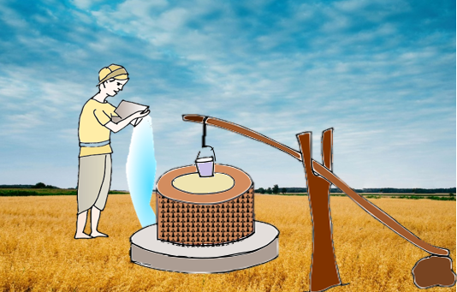
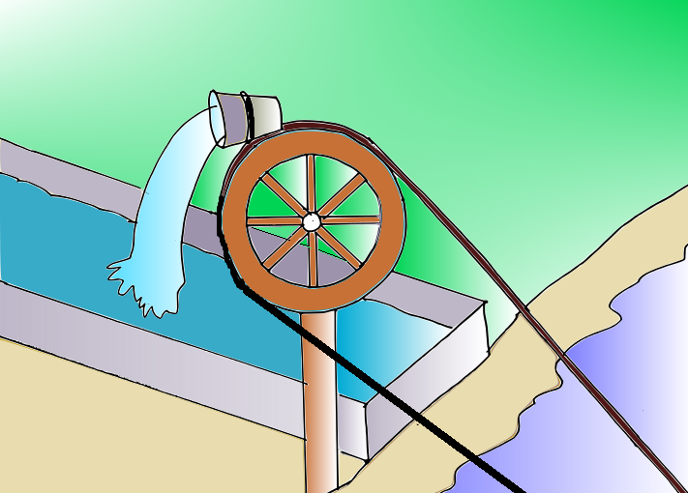
Irrigation – Traditional Methods In India
Moat (pulley -system): It involves pulling water up from a well or other water source. It is not expensive but time consuming.
Chain pump: A container is fixed to a wheel, which helps to draw out water to the field.
Notes:
Both Images – SSSVV Gallery

Slide 19
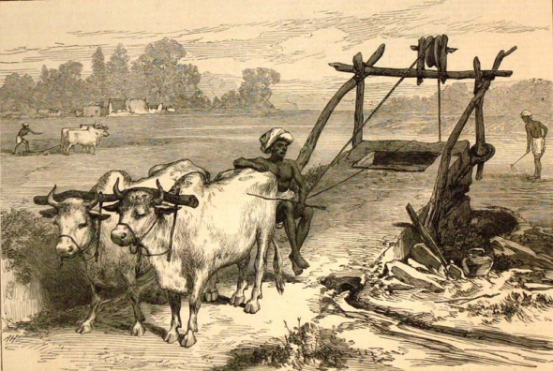
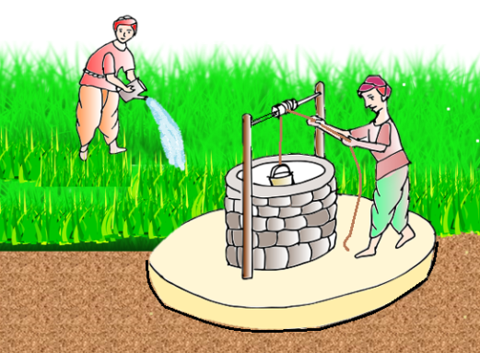
Irrigation – Traditional Methods In India
Rahat (Lever system): A cow or buffalo is used to move the wheels which in turn draw out water to the field.
Dhekli: Water is drawn out using a piece of rock attached to a stick instead of pulley.
Nowadays modern methods like furrow irrigation, sprinkler irrigation, basin irrigation and drip irrigation are used.
Notes:
Both Images – SSSVV Gallery

Slide 20
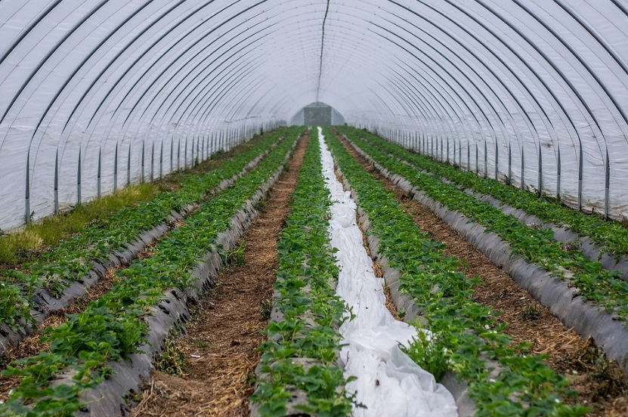
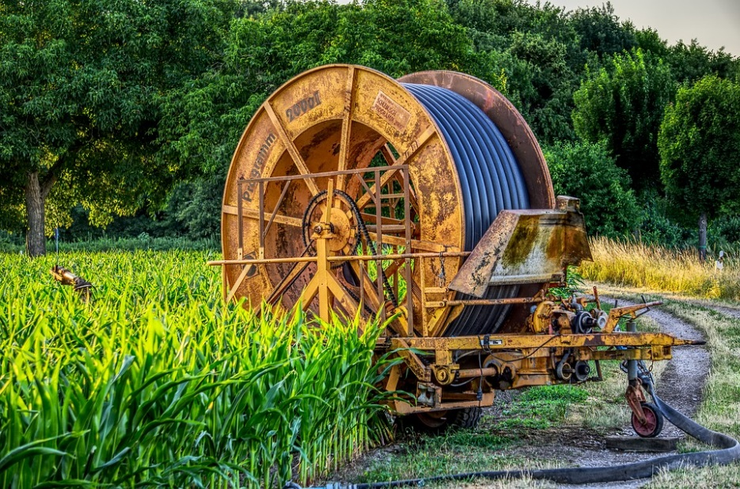
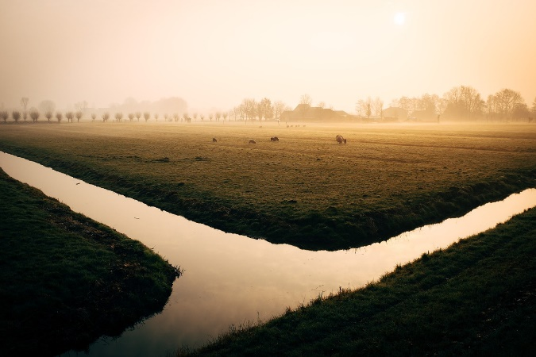
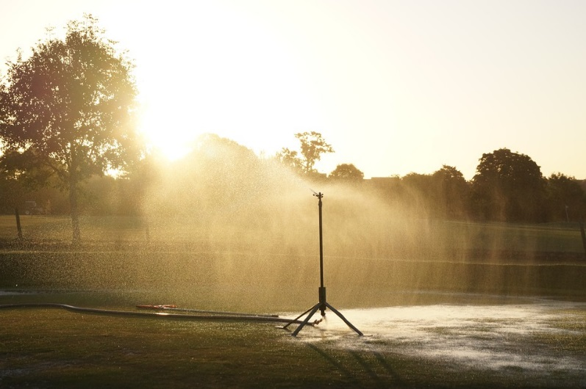
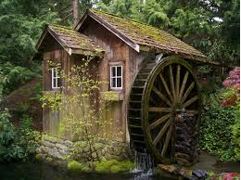
Irrigation – Modern Methods
Drip Irrigation System
Hose Wheel
Canal Irrigation System
Sprinkler Irrigation System
Water Wheel
Notes:
https://pixabay.com/photos/wall-tunnel-slide-tunnel-4181125/
https://pixabay.com/photos/hose-reel-irrigation-agriculture-3520289/
https://pixabay.com/photos/sprinkler-water-watering-irrigation-498514/
https://www.maxpixel.net/River-Fog-Morning-Water-Steam-Canal-Irrigation-933638
https://pixabay.com/en/mill-waterwheel-watermill-old-2078376/

Slide 21
Irrigation – Modern Methods
Modern System
Sprinkler System
Drip System

Slide 22
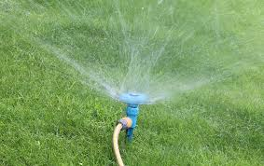
Irrigation – Sprinkler System
More useful where sufficient water is not available and land is uneven.
Water is supplied to the main pipelines using pumps under pressure.
Due to pressure, water escapes through the nozzles and water is sprinkled to the surrounding area.
Notes:
Notes to Teacher:
Pipes fitted perpendicular to the ground which is fitted at the top with rotating nozzle.
Lower end of these pipes is connected to the main pipeline at regular intervals.
Image:
https://pixabay.com/en/garden-sprinkler-hose-water-grass-2591363/

Slide 23
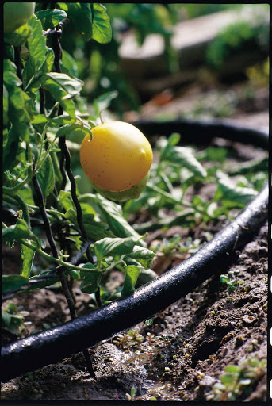
Irrigation – Drip System
Water falls at the roots drop by drop. Hence, it is called drip system.
Suitable method where water supply is poor.
No wastage of water.
Best method for watering fruit plants, gardens and trees.
Notes:
http://www.publicdomainfiles.com/show_file.php?id=13393602066710

Slide 24
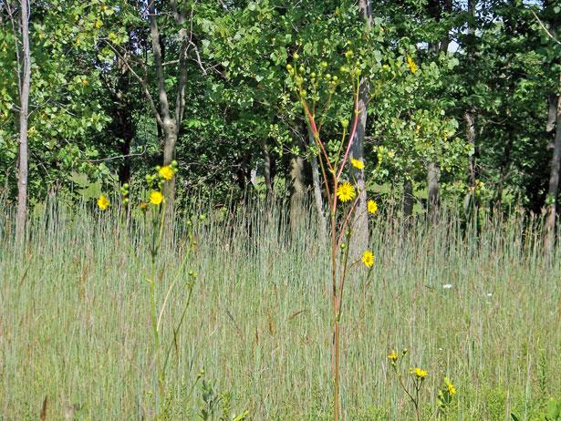
Protecting From Weeds
Removal of weeds from the field is called weeding.
Undesirable plants which grow along with the crop.
Compete for water, nutrients and space and affect their growth.
E.g. Grass, Amaranthus Chenopodium, Convolvulus, and Avena.
Notes:
https://www.publicdomainpictures.net/en/view-image.php?image=14359&picture=field-of-weeds

Slide 25
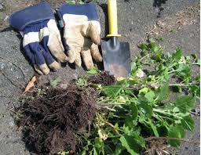
Methods of Weeding
Weeding
Manual Weeding
Chemical Control
Weeds may be removed manually by uprooting them by hand or by using some tools.
Weeds are removed by chemical called ‘weedicides’ which destroy the weeds only.
E.g. Dalapon, metachlor, 2-4-Dichlorophenoxy-acetic acid.
Notes:
https://www.flickr.com/photos/ruthanddave/499719425
License: CC2.0 - Ruth Hartnup

Slide 26
Methods of Weeding
Weeding
When tilling is done and the uprooted weed is mixed with the soil and turns into humus.
Another method is manually cutting or uprooting them at regular intervals.
The third method is applying chemicals to the field which exclusively destroy weeds. These chemicals are called weedicides.

Slide 27
Weedicides
Do not destroy crops.
Applied before the weeds produce flower or seeds.
Care must be taken while applying weedicides.
Can adversely affect the health of the farmers using it.

Slide 28
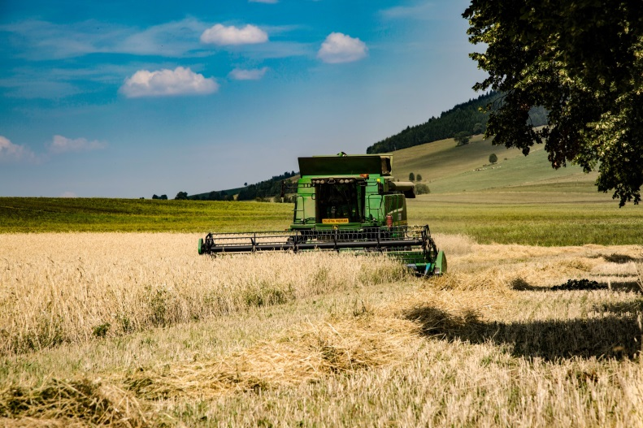
Harvesting – Next step after Weeding
Takes 3 to 4 months before a cereal crop matures.
Either pulled off or cut very close to the ground.
Removal of entire plant or economic parts such as grain, seed, leaf and root after maturity from the field is called as harvesting.
Notes:
https://www.publicdomainpictures.net/en/view-image.php?image=170180&picture=grain-harvesting-combine

Slide 29
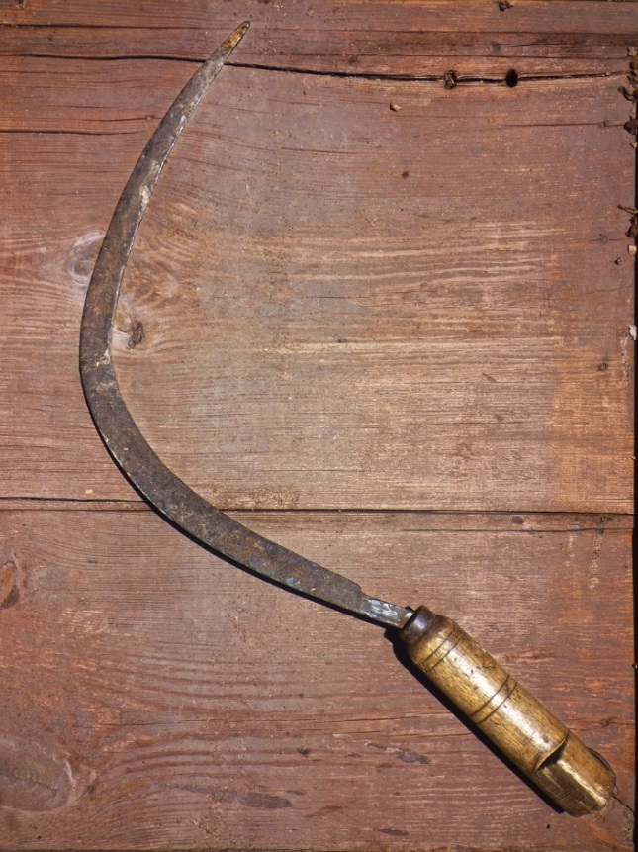
Harvesting - Manual
Harvesting is done either manually or by mechanical means.
Sickle
or
Long knife
Notes:
https://www.maxpixel.net/Falc-Reaper-Tool-Segar-Bon-Cop-De-Falc-Sickle-3369742

Slide 30
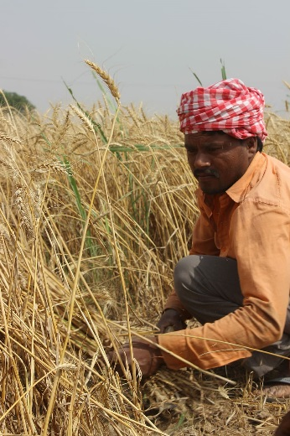
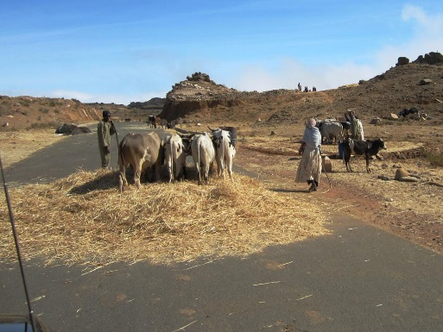
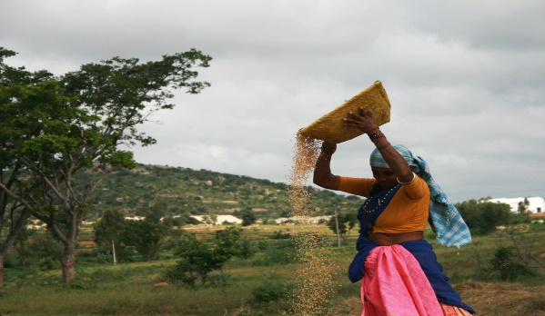
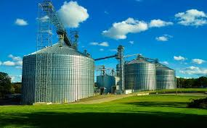
Harvesting - Mechanical
Combined harvesters are used which performs various functions such as :
Cutting of crops
Separation of grains from straw (threshing)
Removal of chaff (winnowing)
Transportation of grains to the storage tanks
Notes:
Cutting crops: https://www.piqsels.com/en/public-domain-photo-sjblj
Threshing: https://www.flickr.com/photos/davidstanleytravel/8384452420 - License: CC2.0 - David Stanley
Winnowing: https://www.flickr.com/photos/icrisat/6119489108 - License: CC – NC - 2.0 - ICRISAT
Transportation: https://www.maxpixel.net/Bins-Large-Farm-Grain-Silos-Massive-Ohio-Steel-1937447

Slide 31
Harvesting
Harvesting was earlier done manually by sickle or by a machine called harvester.
Threshing: Process of separating the grain seeds from the chaff.
Winnowing: Carried out for the separation of grain seeds.
Combine: A machine which is used both as a harvester and thresher.

Slide 32
Storage
After threshing and winnowing the grains/seeds are stored .
Sent either to godowns or market for selling.
Have to be protected from insects and pests.
Grains stored in jute bags or metallic bins.
If the grains have to be stored in a large scale, they opt for granary or silos.
Notes:
Asset Type: Main Script
Source:
Image:
Transportation: https://www.maxpixel.net/Bins-Large-Farm-Grain-Silos-Massive-Ohio-Steel-1937447

Slide 33
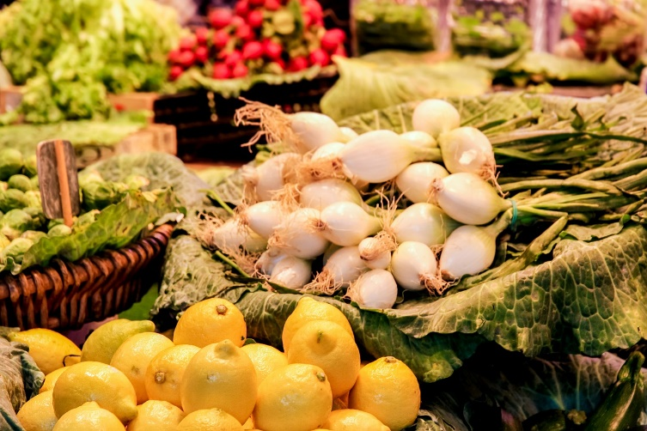
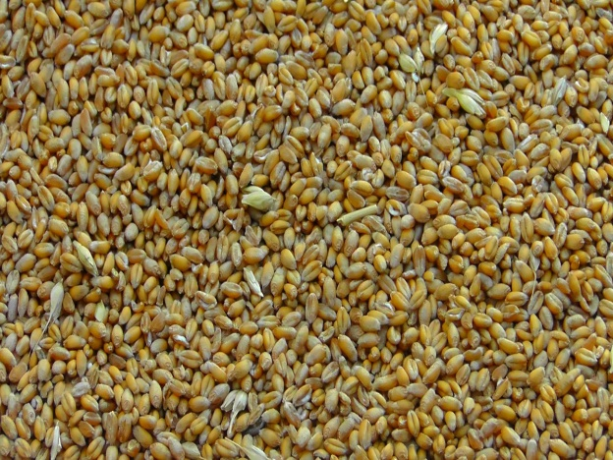
Storage
Storage
Perishable
Non perishable
The mode of storage depends upon the quality of food material.
Notes:
https://pixabay.com/en/fruit-vegetables-market-428063/
https://pxhere.com/en/photo/1121437

Slide 34
Storage
Perishable Foods
Gets spoiled within a short span of time at room temperature.
Stored in cold storage.
Example: Fruits and Vegetables.
Non perishable Foods
Do not get spoilt at room temperature.
Can be stored for longer.
Stored in dry storage.
Example: Grains.

Slide 35
Marketing
Farmers mainly rely on their agricultural products for their livelihood.
Should fetch a remunerative price.
Warehousing and marketing facilities are essential to face the needs of the farmer.

Slide 36
MM Index
Slide# | Thumbnail | Source and Attribution
1 |  | https://pixnio.com/people/agricultural-programs-in-georgia-assist-in-improving-farmers-crop-production – CC0 https://pxhere.com/en/photo/498914 – CC0
4 |  | https://www.pexels.com/photo/agriculture-agronomy-arable-background-1033506/
7 |  | https://pixabay.com/en/ox-plough-bullocks-farmer-tilling-253417/ https://pixabay.com/en/plow-tractors-m%C3%BCnsterland-1534517/
9 |  | https://pxhere.com/en/photo/929198
10 |  | https://pxhere.com/en/photo/658471 https://www.pikrepo.com/faros/macro-shot-of-assorted-seeds
10 |  | https://pixabay.com/en/plants-soybean-soy-nature-1331667/ https://pxhere.com/en/photo/1234443

Slide 37
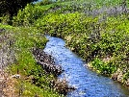
MM Index
Slide# | Thumbnail | Source and Attribution
11, 13 |  | Seed Drill: https://commons.wikimedia.org/wiki/File:Sowing_machine_Nordsten.jpg
11 |  | https://commons.wikimedia.org/wiki/File:A_YEMNITE_HABANI_FARMER_SOWING_HIS_FIELD._%D7%97%D7%A7%D7%9C%D7%90%D7%99_%D7%AA%D7%99%D7%9E%D7%A0%D7%99_%D7%97%D7%91%D7%A0%D7%99_%D7%96%D7%95%D7%A8%D7%A2_%D7%91%D7%A9%D7%93%D7%95%D7%AA.D12-053.jpg – Public domain
12 |  | Broadcasting: https://commons.wikimedia.org/wiki/File:Men_sowing_seed_(3465701854).jpg
15 |  | https://www.flickr.com/photos/editor/39695181924 License: CC 2.0 - Bart Everson
16 |  | http://www.freestockphotos.biz/stockphoto/16076
17 |  | https://www.publicdomainpictures.net/en/view-image.php?image=160756&picture=irrigation-water

Slide 38
MM Index
Slide# | Thumbnail | Source and Attribution
20 |  | https://pixabay.com/photos/wall-tunnel-slide-tunnel-4181125/ https://pixabay.com/photos/hose-reel-irrigation-agriculture-3520289/ https://pixabay.com/photos/sprinkler-water-watering-irrigation-498514/
20 |  | https://www.maxpixel.net/River-Fog-Morning-Water-Steam-Canal-Irrigation-933638 https://pixabay.com/en/mill-waterwheel-watermill-old-2078376/
22 |  | https://pixabay.com/en/garden-sprinkler-hose-water-grass-2591363/
23 |  | http://www.publicdomainfiles.com/show_file.php?id=13393602066710
24 |  | https://www.publicdomainpictures.net/en/view-image.php?image=14359&picture=field-of-weeds
25 |  | https://www.flickr.com/photos/ruthanddave/499719425 License: CC2.0 - Ruth Hartnup
28 |  | https://www.publicdomainpictures.net/en/view-image.php?image=170180&picture=grain-harvesting-combine

Slide 39
MM Index
Slide# | Thumbnail | Source and Attribution
29 |  | https://www.maxpixel.net/Falc-Reaper-Tool-Segar-Bon-Cop-De-Falc-Sickle-3369742
30 |  | Cutting crops: https://www.piqsels.com/en/public-domain-photo-sjblj Threshing: https://www.flickr.com/photos/davidstanleytravel/8384452420 - License: CC2.0 - David Stanley Winnowing: https://www.flickr.com/photos/icrisat/6119489108 - License: CC – NC - 2.0 - ICRISAT
30,32 |  | Transportation: https://www.maxpixel.net/Bins-Large-Farm-Grain-Silos-Massive-Ohio-Steel-1937447
33 |  | https://pixabay.com/en/fruit-vegetables-market-428063/ https://pxhere.com/en/photo/1121437

