Slide 1
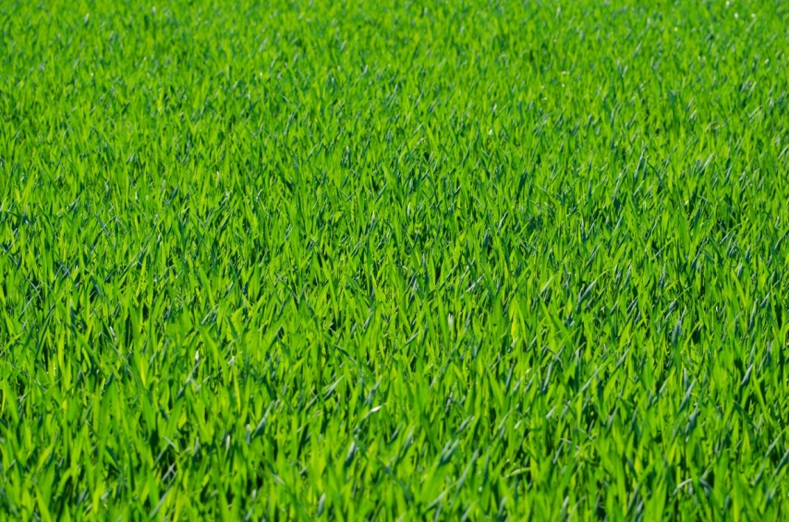
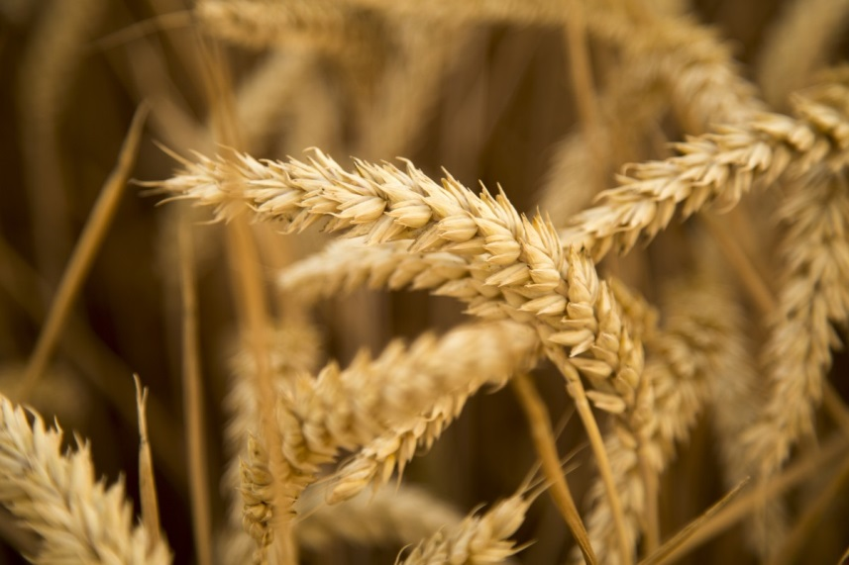
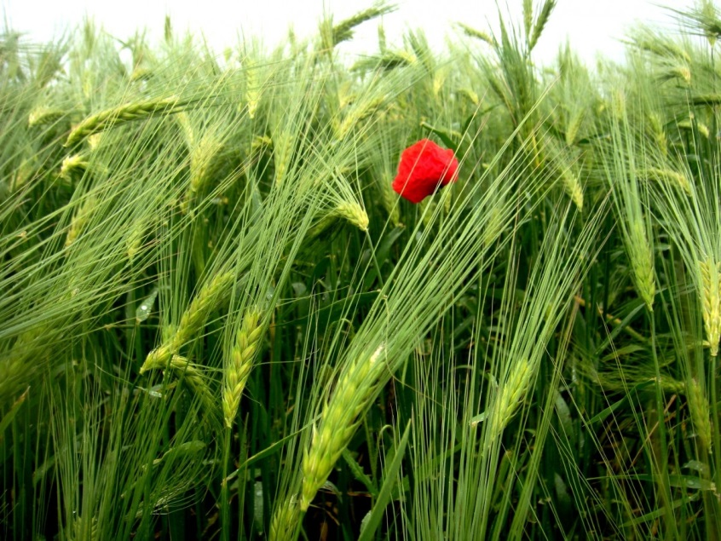
CROPPING SEASONS!
Notes:
https://pxhere.com/en/photo/984937 – CC0
https://pxhere.com/en/photo/871576 – CC0
https://pxhere.com/en/photo/692166 – CC0

Slide 2
Cropping Seasons
There are three chief seasons in India:
Cropping Seasons in India
Kharif
Rabi
Zaid

Slide 3
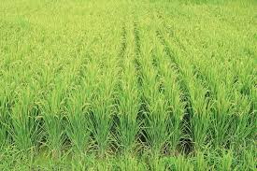
Kharif Season
Crops are sown in the rainy season (June to September).
Crops are harvested from September to October.
Such crops require lots of water.
Example:
Rice, sorghum, maize, tea,
rubber, coffee, sesame, soya beans, etc.
Paddy Field
Notes:
Notes to Teacher:
They are mostly the monsoon crops.
Image:
https://pixabay.com/en/rice-ear-of-rice-paddy-field-3699252/

Slide 4
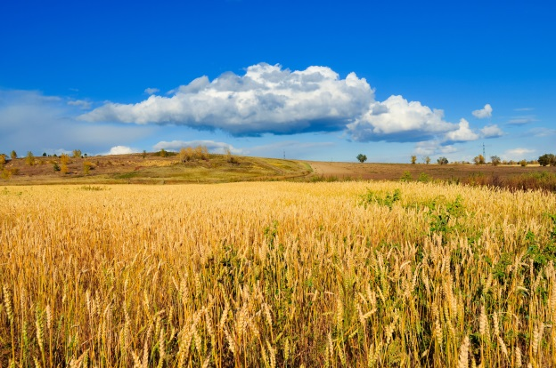
Rabi Season
These crops are grown in the winter season (October to November).
These crops are harvested from February to April.
These crops require cold weather conditions for their growth and also require less water.
Example:
Wheat, oats, barley, pulses, cereals.
Wheat Field
Notes:
https://www.publicdomainpictures.net/en/view-image.php?image=28540&picture=golden-wheat-field

Slide 5
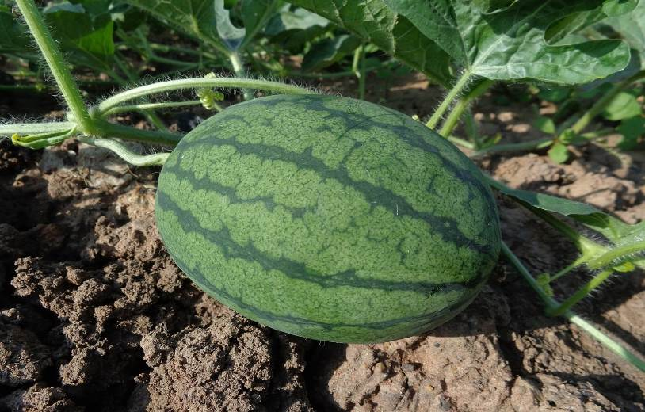
Zaid Season
These crops are sowed between March and June i.e between kharif and rabi.
They require warm and dry weather for their growth.
They require more daylight for flowering.
Example: Seasonal fruits and vegetables.
Watermelon
Notes:
https://pixabay.com/en/watermelon-hybrid-watermelon-seed-551235/

Slide 6
MM Index
Slide# | Thumbnail | Source and Attribution
1 |  | https://pxhere.com/en/photo/984937 – CC0
1 |  | https://pxhere.com/en/photo/871576 – CC0
1 |  | https://pxhere.com/en/photo/692166 – CC0
3 |  | https://pixabay.com/en/rice-ear-of-rice-paddy-field-3699252/
4 |  | https://www.publicdomainpictures.net/en/view-image.php?image=28540&picture=golden-wheat-field
5 |  | https://pixabay.com/en/watermelon-hybrid-watermelon-seed-551235/

