Slide 1
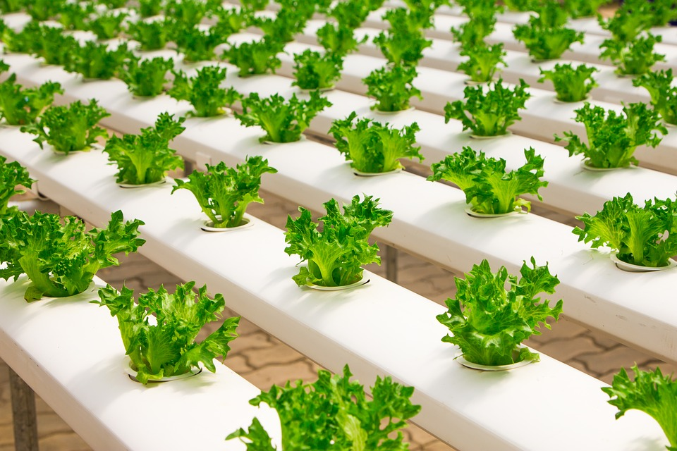
ORGANIC FARMING
Notes:
https://pixabay.com/photos/greenhouse-organic-farming-2139526/ - CC0

Slide 2
Organic Farming
Primarily focuses on cultivating the land and growing crops in an eco-friendly way.
Helps in keeping the soil alive and in good health
This method uses organic fertilisers, pesticides and other biological materials along with beneficial microbes to release nutrients to crops for increased sustainable production.
Notes:
Organic farming focuses on cultivating the land and growing crops in an eco-friendly way. It helps keep the soil alive and in good health by use of organic methods and practices. This method uses organic fertilisers, pesticides and manure (crop, animal and farm wastes, aquatic wastes) and beneficial microbes (bio fertilisers) to release nutrients to crops for increased production. Organic farming ensures an eco- friendly pollution free environment.

Slide 3
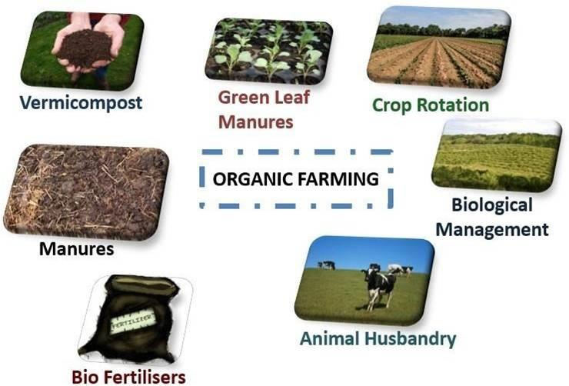
Organic Farming
Notes:
Original contribution – rushmish@gmail.com
https://pixabay.com/photos/fresh-compost-hand-man-2386786/
https://pxhere.com/en/photo/625903
https://www.flickr.com/photos/41284017@N08/10503156453
https://pxhere.com/en/photo/1214499
http://www.freestockphotos.biz/stockphoto/9162
https://www.maxpixel.net/Beef-Cow-Milk-Cattle-Pasture-Animal-Husbandry-1592860

Slide 4
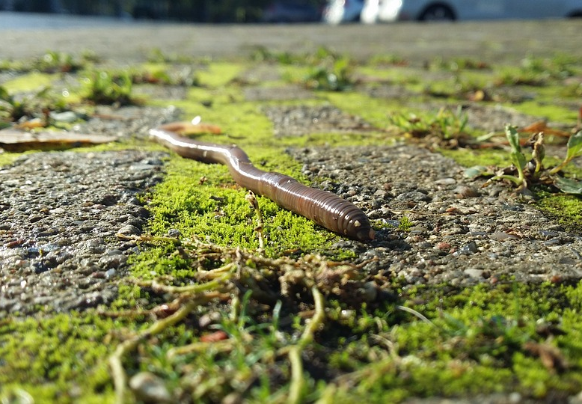
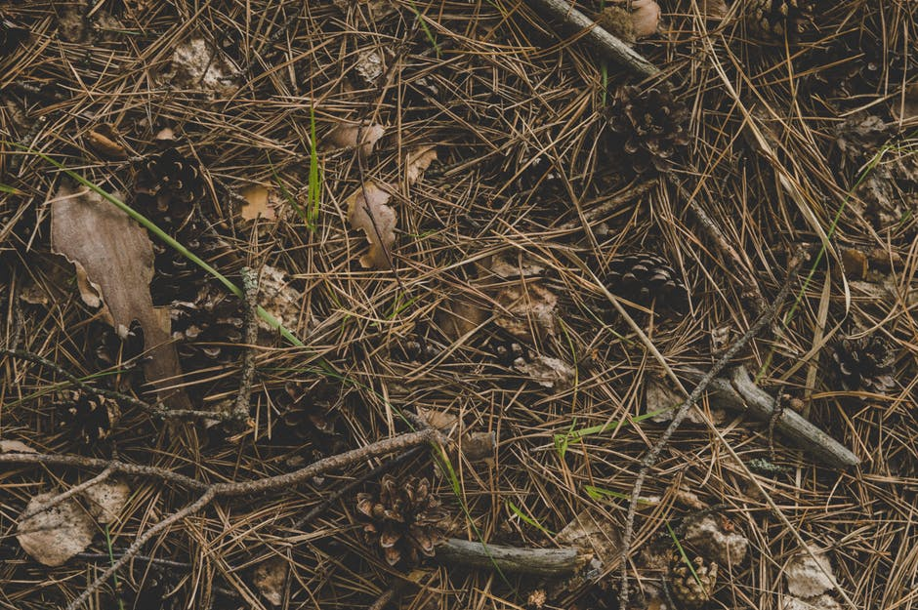
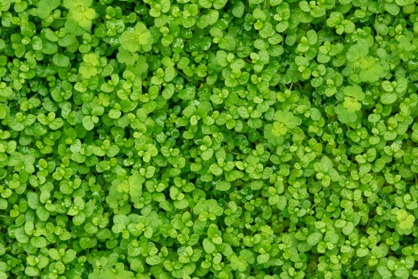
Organic Farming
VERMICOMPOST
A process in which certain worms are used to decompose the decaying matter into a nutrient rich fertiliser.
GREEN LEAF MANURES
A process in which green leaves and twigs of some herbs, shrubs or trees are used as fertilisers in crop cultivation.
Notes:
https://pixabay.com/photos/earthworms-the-frog-s-perspective-2773457/ - CC0
https://www.pexels.com/photo/photography-of-twigs-on-the-ground-698489/ - CC0
https://www.publicdomainpictures.net/en/view-image.php?image=249688&picture=green-leaves – CC0

Slide 5
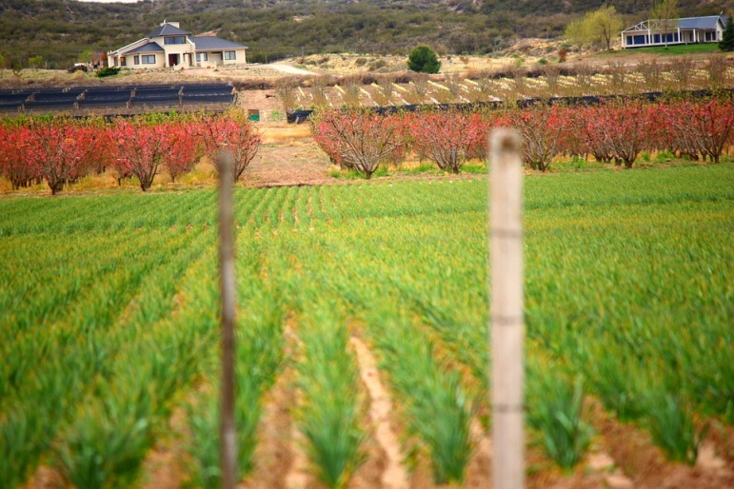
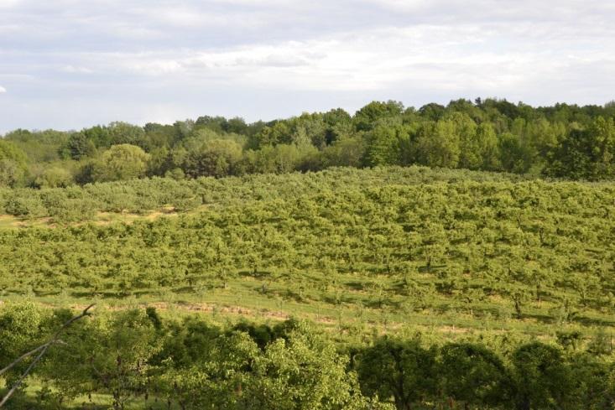
Organic Farming
CROP ROTATION
A method in which different plants are grown one after the other in the same field to increase soil fertility.
BIOFERTILISERS
It is a type of pest control wherein the pests are controlled using other living organisms.
Notes:
https://www.maxpixel.net/Field-Landscape-Plantation-Earth-Agriculture-58093 – CC0
https://pxhere.com/en/photo/1214499 – CC0

Slide 6
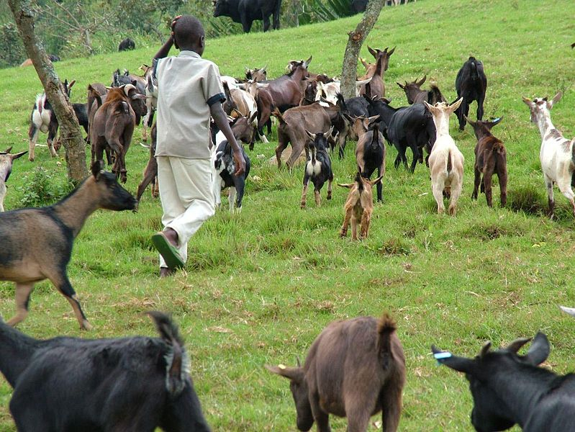
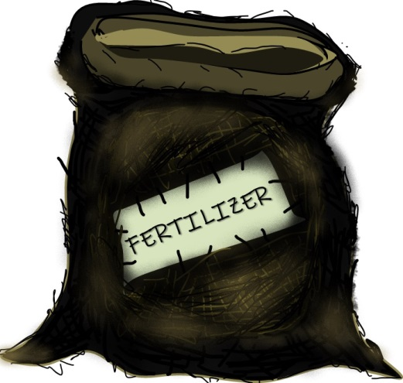
Organic Farming
ANIMAL HUSBANDRY
A type of animal science which involves the rearing and breeding of livestock.
GREEN LEAF MANURES
Biofertilisers are substances which have microorganisms, which when applied to seeds or plants, enhance the nutrient content in the applied plant.
Notes:
https://pixabay.com/photos/cows-field-herd-grazing-cow-farm-73371/
Original contribution – rushmish@gmail.com

Slide 7
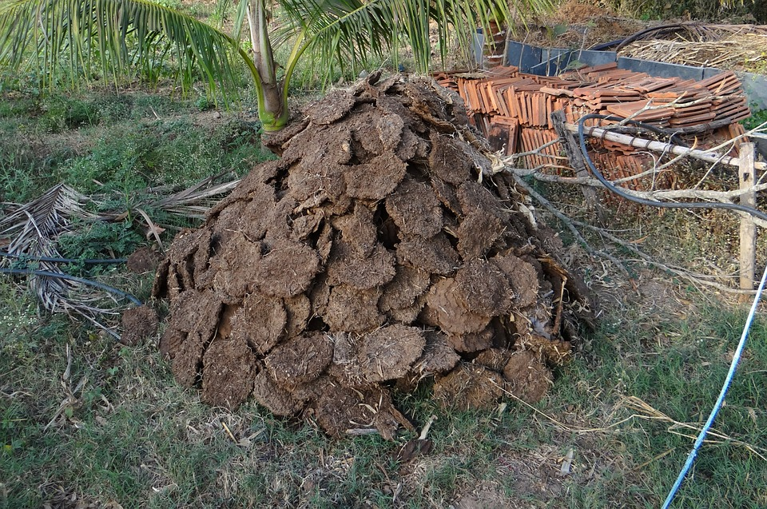
MANURES
Manures are animal faeces or dung that are used as organic fertilisers in agriculture.
Notes:
https://www.maxpixel.net/Cow-Dung-Cow-Manure-Drying-Dried-Cow-Pats-Fuel-272827

Slide 8
Organic Farming - Advantages
Produces high quality nutritious food
Cost effective
Preventive health care and well being
Less toxic to the environment (water, air and soil)
Use soil for a longer period of time
More profitable than old age farming
Reduces the production cost by about 25 - 30%
Does not involve the use of synthetic fertilisers and pesticides
Preserves soil from soil erosion
Soil fertility is maintained for a long time

Slide 9
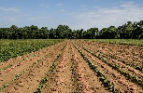
MM Index
Slide# | Thumbnail | Source and Attribution
1 |  | https://pixabay.com/photos/greenhouse-organic-farming-2139526/ - CC0
3 |  | https://pixabay.com/photos/fresh-compost-hand-man-2386786/
3 |  | https://pxhere.com/en/photo/625903
3 |  | https://www.flickr.com/photos/41284017@N08/10503156453
3 |  | https://pxhere.com/en/photo/1214499
3 |  | http://www.freestockphotos.biz/stockphoto/9162
3 |  | https://www.maxpixel.net/Beef-Cow-Milk-Cattle-Pasture-Animal-Husbandry-1592860

Slide 10
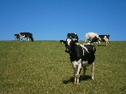
MM Index
Slide# | Thumbnail | Source and Attribution
3,6 |  | Original contribution – rushmish@gmail.com
4 |  | https://pixabay.com/photos/earthworms-the-frog-s-perspective-2773457/ - CC0
4 |  | https://www.pexels.com/photo/photography-of-twigs-on-the-ground-698489/ - CC0 https://www.publicdomainpictures.net/en/view-image.php?image=249688&picture=green-leaves – CC0
5 |  | https://www.maxpixel.net/Field-Landscape-Plantation-Earth-Agriculture-58093 – CC0
5 |  | https://pxhere.com/en/photo/1214499 – CC0
6 |  | https://pixabay.com/photos/cows-field-herd-grazing-cow-farm-73371/
7 |  | https://www.maxpixel.net/Cow-Dung-Cow-Manure-Drying-Dried-Cow-Pats-Fuel-272827

