Slide 1
CROP PRODUCTION -SUMMARY

Slide 2
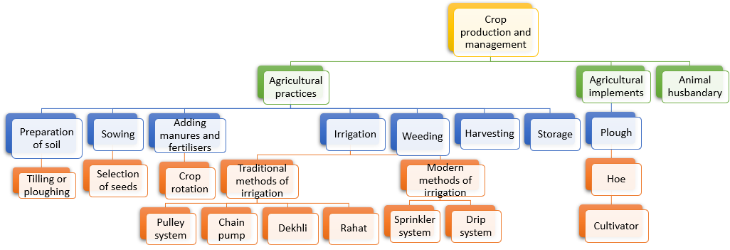
SUMMARY

Slide 3
MM Index
Slide# | Thumbnail | Source and Attribution

