Slide 1
Crop production and Management – A Recap

Slide 2
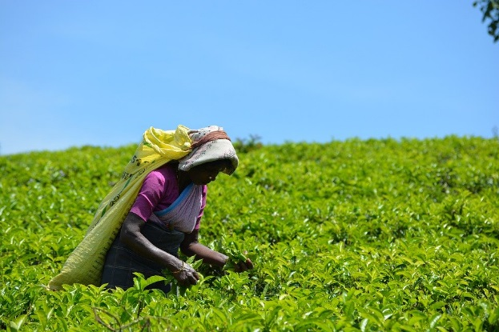
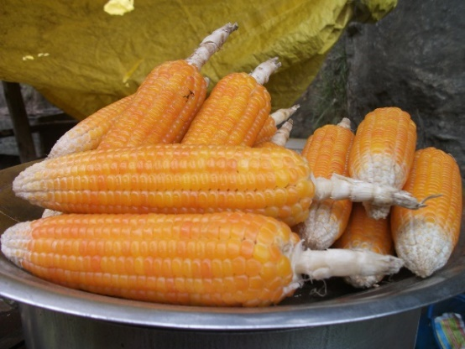
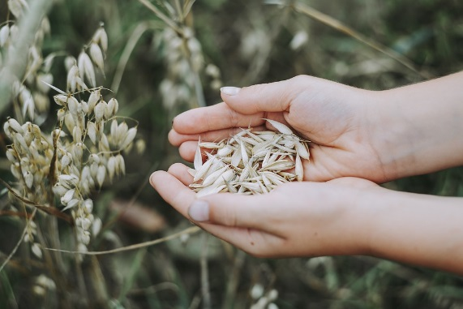
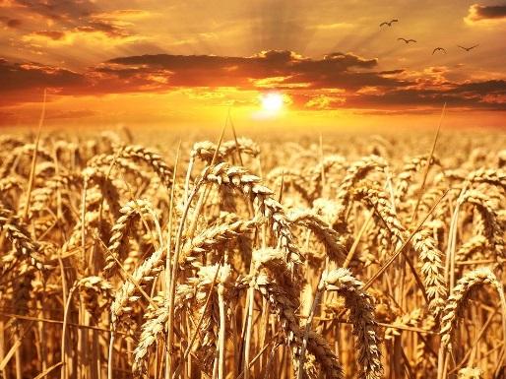
I. Give two examples for each
Tea, Maize
Kharif crop _________________
Rabi crop ________________
Wheat, Oats
Notes:
https://pixabay.com/photos/wheat-field-wheat-cereals-grain-640960/
https://pixabay.com/photos/oats-cereals-field-food-grain-3717095/
https://pixabay.com/photos/nature-field-farm-outdoors-grass-3130702/
SSSVV gallery

Slide 3
II. Write a paragraph in your own words
a) Preparation of soil
This is the first step in growing crops. The soil is turned and loosened so that the soil is well aerated and all the nutrients are mixed properly.
Notes:
https://commons.wikimedia.org/wiki/File:Plough.JPG – Public domain

Slide 4
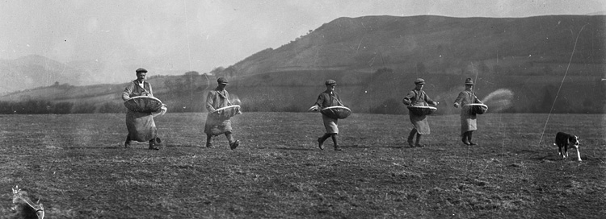
II. Write a paragraph in your own words
b) Sowing
Scattering of seeds is called sowing.
Notes:
https://kn.wikipedia.org/wiki/%E0%B2%9A%E0%B2%BF%E0%B2%A4%E0%B3%8D%E0%B2%B0:Men_sowing_seed_(3465701854).jpg – Public domain

Slide 5
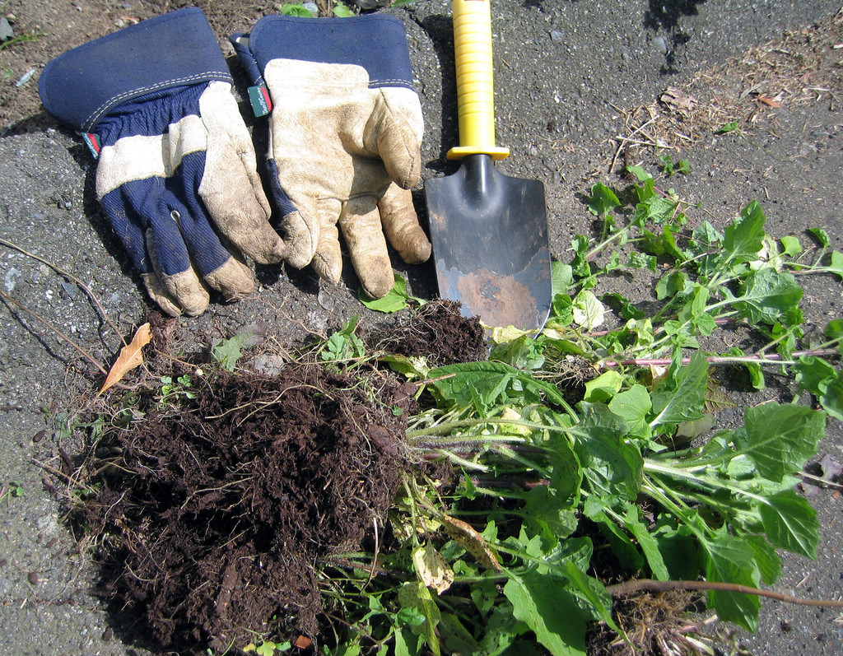
II. Write a paragraph in your own words
c) Weeding
Removal of unwanted plants is called weeding.
Notes:
https://www.flickr.com/photos/ruthanddave/499719425 – CC BY 2.0 - Ruth Hartnup

Slide 6
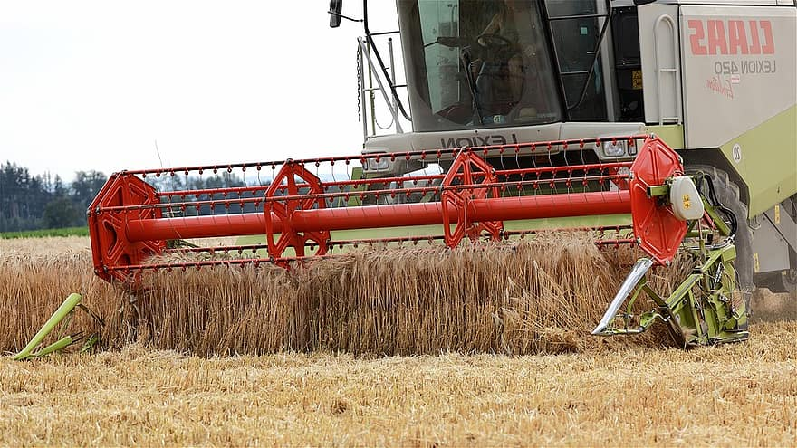
II. Write a paragraph in your own words
d) Threshing
Separating grains from the straw is called threshing.
Notes:
https://www.pikist.com/free-photo-iybxk

Slide 7
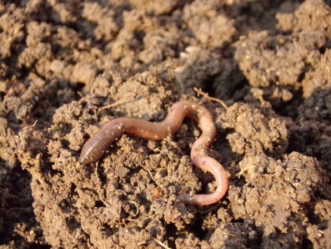
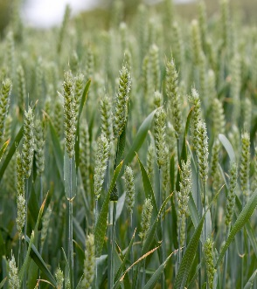
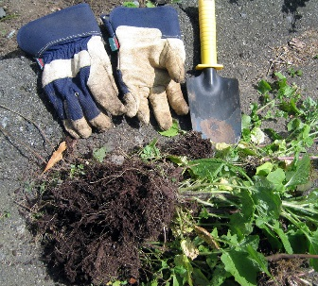
III. Fill in the blanks
1
Earthworms are known as ______________ because of their burrowing habits.
1. Farmers’ friend
2
Kharif crops are grown in __________ season.
2. Rainy
3
____________ compete with the main crops for nutrients.
3. Weeds
Notes:
https://www.publicdomainpictures.net/en/view-image.php?image=47464&picture=wheat-crops
https://pixabay.com/en/earthworm-soil-dirt-macro-686593/ - CC0
https://www.flickr.com/photos/ruthanddave/499719425 – CC BY 2.0 - Ruth Hartnup

Slide 8
III. Fill in the blanks
4
______________ is the tool used for manual method of removing seeds.
4. Khurpi
5
____________________ are commercially available plant nutrients.
5. Fertilisers

Slide 9
IV. Match the following columns
Column A Column B
a. Rabi
1. Fowl
a. Rabi
2. Wheat
b. Irrigation
b. Irrigation
3. Harvesting
c. Weed
c. Weed
4. Amaranthus
d. Manure
d. Manure
5. Decomposition
e. Sickle
e. Sickle
f. Poultry
6. Moat
f. Poultry
Click on each word from Column A to get the answer

Slide 10
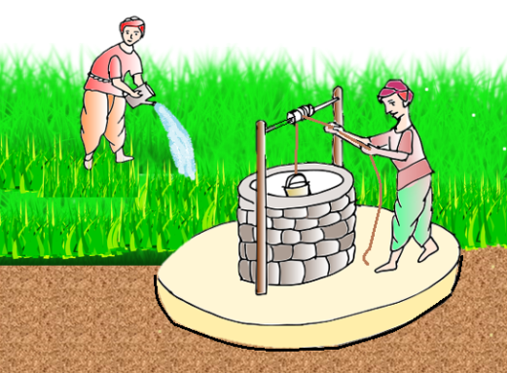
V. Name the different methods of irrigation
Moat
Notes:
Original contribution – radhika.bala@gmail.com
https://openclipart.org/detail/243741/grass-layered

Slide 11
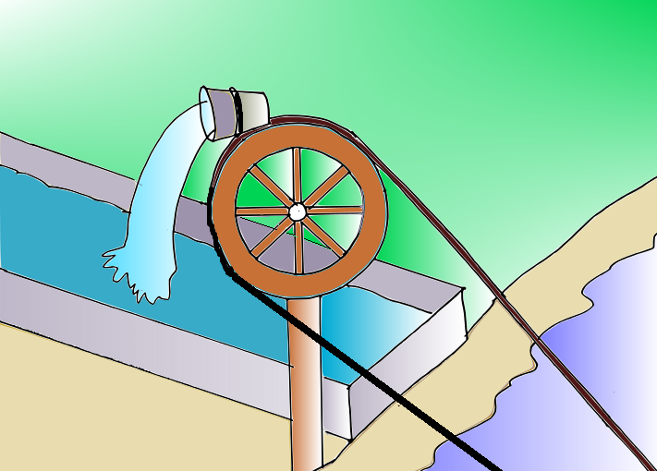
V. Name the different methods of irrigation
Chain pump
Notes:
Original contribution – radhika.bala@gmail.com

Slide 12
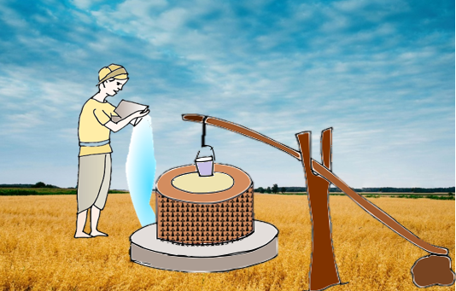
V. Name the different methods of irrigation
Dekhli
Notes:
Original contribution – radhika.bala@gmail.com

Slide 13
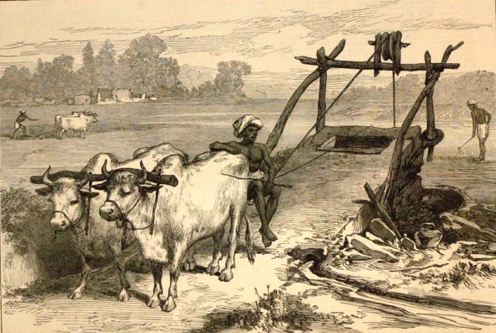
V. Name the different methods of irrigation
Rahat
Notes:
https://commons.wikimedia.org/wiki/File:Irrigation2.jpg

Slide 14
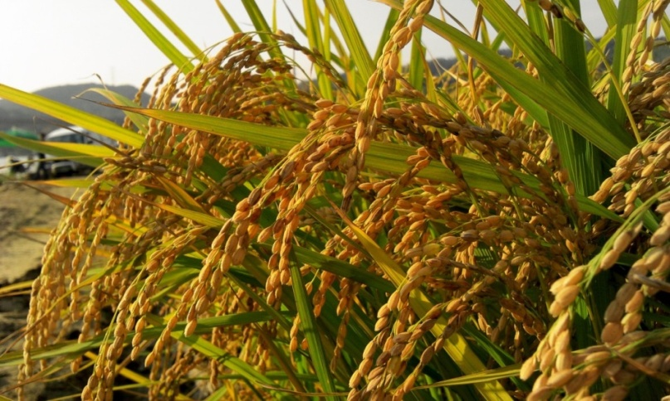
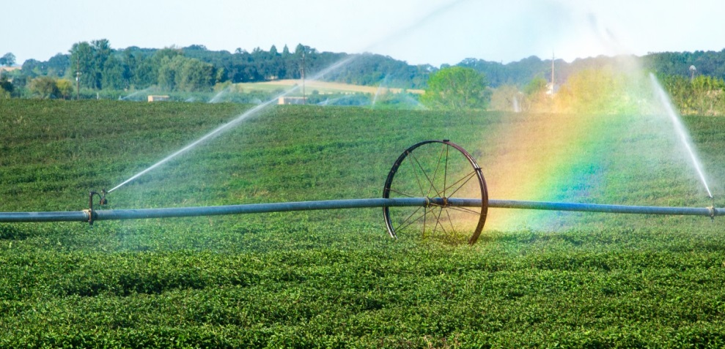
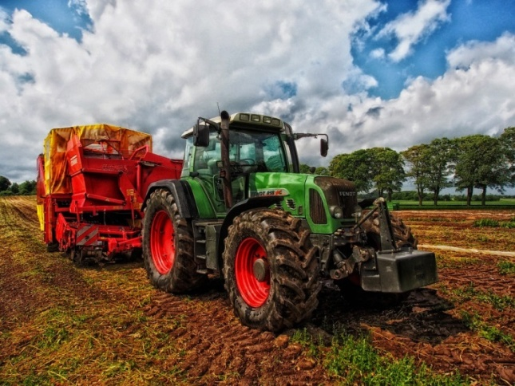
VI. Answer the following questions
1. What are the needs of the farming community to get the best out of agriculture?
Answer: a) good quality crops.
b) irrigation system.
c) advanced technology.
Notes:
https://pixabay.com/photos/tractor-grain-mixer-rural-farm-385681/ - CC0
https://pxhere.com/en/photo/853517 – CC0
https://pxhere.com/en/photo/384325 – CC0

Slide 15
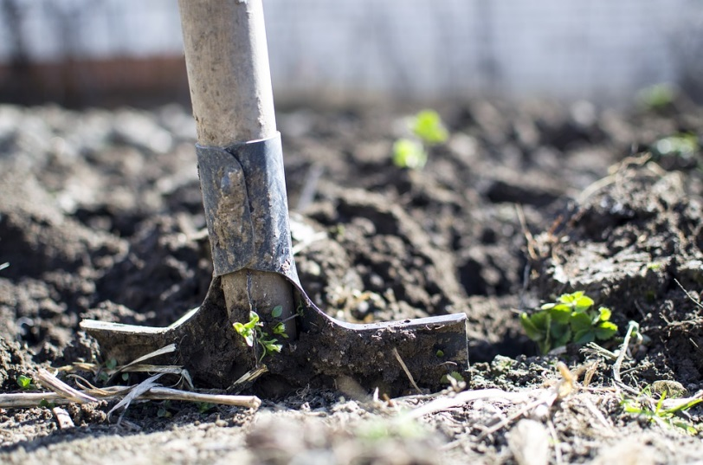
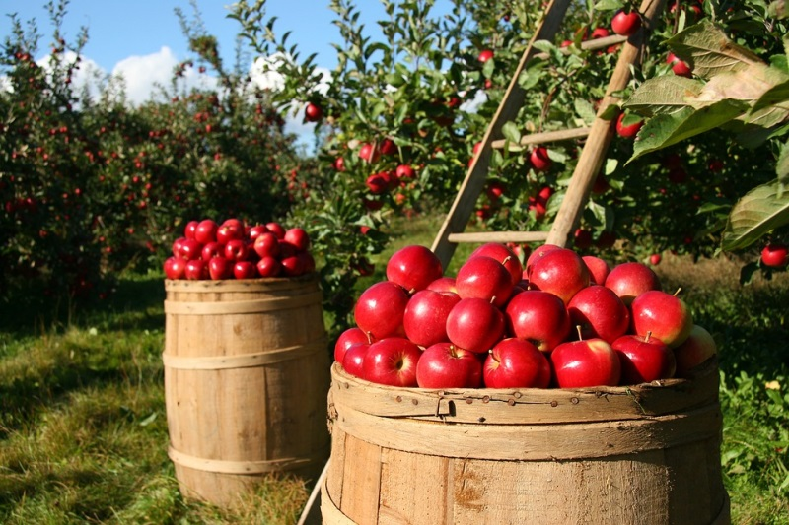
VI. Answer the following questions
2. What is meant by organic farming? What are its benefits?
Answer:
Organic farming is a method of producing crops without utilising pesticides, fertilisers, genetically modified organisms, antibiotics and growth hormone. It aims to reduce pollution and create a healthy environment.
Notes:
https://pixabay.com/photos/equipment-outdoors-dirt-dig-2047314/ - CC0
https://pixabay.com/photos/orchard-apple-apples-fruit-green-1872997/ - CC0

Slide 16
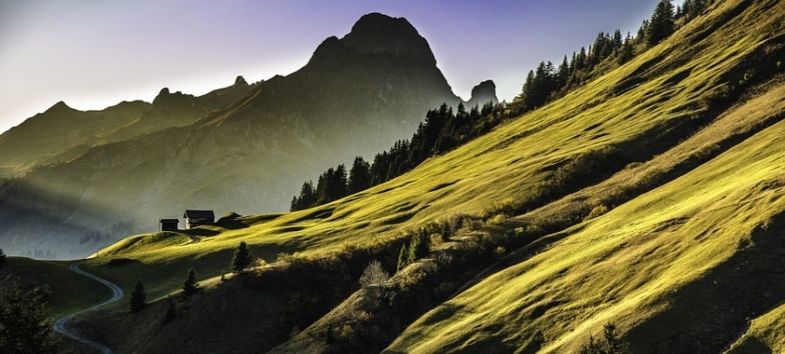
VI. Answer the following questions
3. What are the commercial benefits of soil?
Answer:
Soil provides structural support for buildings, gardening, landscaping, etc.
Forests being a good source of wood for various purposes, survive in favourable soil.
Notes:
https://pixabay.com/photos/chicago-usa-america-united-states-690364/ - CC0
https://pixabay.com/photos/landscape-mountains-abendstimmung-640617/ - CC0
https://pixabay.com/photos/autumn-fog-forest-tree-trunks-away-3193305/ - CC0

Slide 17
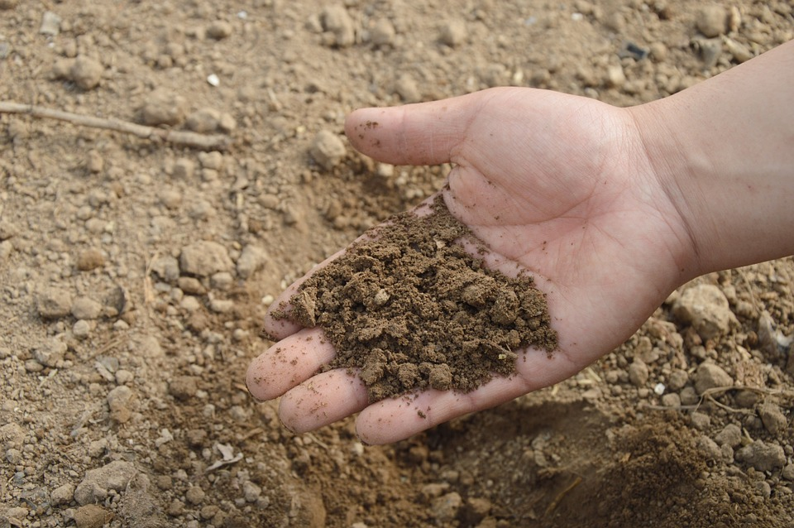
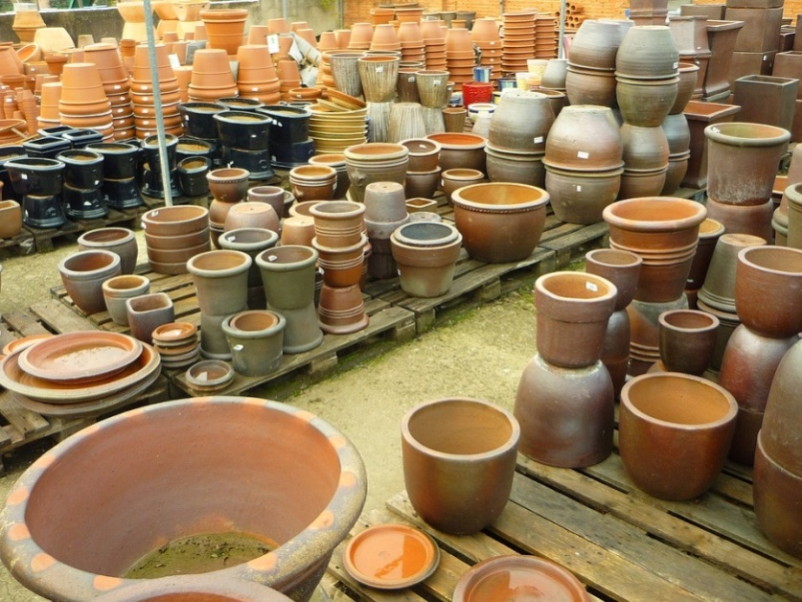
Question 3 – Answer (Continued)
Organic fertilisers are commercially used for better cultivation.
Soil is the basic raw material for building materials like brick, slabs and utensils made of sand and clay.
Notes:
https://pixabay.com/photos/soil-hand-farm-garden-fertilizer-766281/ - CC0
https://pixabay.com/photos/pots-planters-warehouse-sale-mud-221317/ - CC0

Slide 18
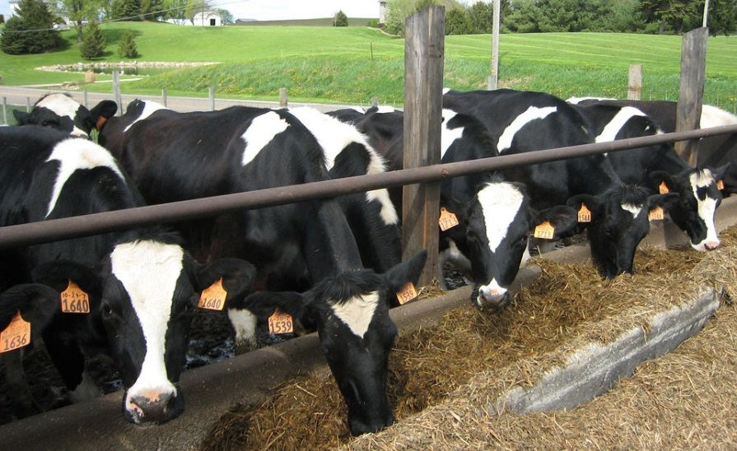
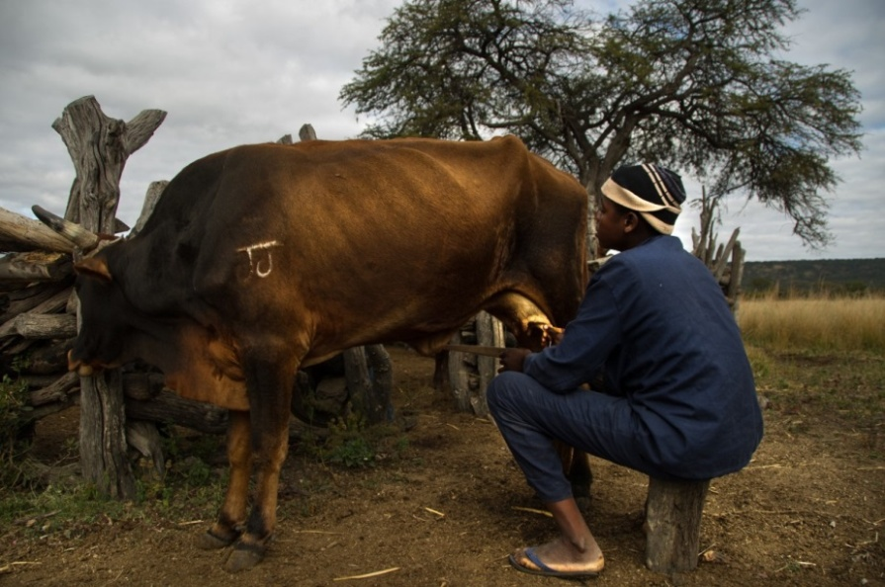
VI. Answer the following questions
4. What is meant by cattle farming?
Answer:
Cattle farming means the raising of cattle or cows and buffaloes from their birth up to the point when they become fully developed to produce food and milk for our use.
Notes:
https://pixabay.com/photos/cattle-farming-cows-black-white-13384/ - CC0
https://pxhere.com/en/photo/854380 – CC0

Slide 19
VII. Say true or false
1. Xanthium and Parthenium are not weeds.
False
Xanthium and Parthenium are commonly known as weeds.
2. Weeds can be controlled by chemicals.
True
3. In drip irrigation system the water is supplied using pipes to one or more central locations within the field.
False
In drip irrigation the water is supplied directly to the roots of the plants.

Slide 20
VII. Say true or false
4. Threshing is done with the help of a machine known as Combine.
True
5. Sowing is the first step in crop production.
False
Preparation of soil is the first step in crop production.

Slide 21
MM Index
Slide# | Thumbnail | Source and Attribution
2 |  | https://pixabay.com/photos/wheat-field-wheat-cereals-grain-640960/ https://pixabay.com/photos/oats-cereals-field-food-grain-3717095/
2 |  | https://pixabay.com/photos/nature-field-farm-outdoors-grass-3130702/ SSSVV gallery
3 |  | https://commons.wikimedia.org/wiki/File:Plough.JPG – Public domain
4 |  | https://kn.wikipedia.org/wiki/%E0%B2%9A%E0%B2%BF%E0%B2%A4%E0%B3%8D%E0%B2%B0:Men_sowing_seed_(3465701854).jpg – Public domain
5,7 |  | https://www.flickr.com/photos/ruthanddave/499719425 – CC BY 2.0 - Ruth Hartnup
6 |  | https://www.pikist.com/free-photo-iybxk
7 |  | https://pixabay.com/en/earthworm-soil-dirt-macro-686593/ - CC0

Slide 22
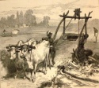
MM Index
Slide# | Thumbnail | Source and Attribution
7 |  | https://www.publicdomainpictures.net/en/view-image.php?image=47464&picture=wheat-crops
10 |  | Original contribution – radhika.bala@gmail.com https://openclipart.org/detail/243741/grass-layered
11 |  | Original contribution – radhika.bala@gmail.com
12 |  | Original contribution – radhika.bala@gmail.com
13 |  | https://commons.wikimedia.org/wiki/File:Irrigation2.jpg
14 |  | https://pxhere.com/en/photo/853517 – CC0
14 |  | https://pxhere.com/en/photo/384325 – CC0

Slide 23
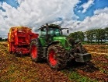
MM Index
Slide# | Thumbnail | Source and Attribution
14 |  | https://pixabay.com/photos/tractor-grain-mixer-rural-farm-385681/ - CC0
15 |  | https://pixabay.com/photos/equipment-outdoors-dirt-dig-2047314/ - CC0
15 |  | https://pixabay.com/photos/orchard-apple-apples-fruit-green-1872997/ - CC0
16 |  | https://pixabay.com/photos/chicago-usa-america-united-states-690364/ - CC0
16 |  | https://pixabay.com/photos/landscape-mountains-abendstimmung-640617/ - CC0
16 |  | https://pixabay.com/photos/autumn-fog-forest-tree-trunks-away-3193305/ - CC0

Slide 24
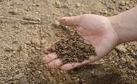
MM Index
Slide# | Thumbnail | Source and Attribution
17 |  | https://pixabay.com/photos/soil-hand-farm-garden-fertilizer-766281/ - CC0
17 |  | https://pixabay.com/photos/pots-planters-warehouse-sale-mud-221317/ - CC0
18 |  | https://pixabay.com/photos/cattle-farming-cows-black-white-13384/ - CC0
18 |  | https://pxhere.com/en/photo/854380 – CC0

