Slide 1
Effect of Manure
and
Fertiliser on Soil

Slide 2
Aim
To demonstrate the effect of manure and fertiliser on soil.

Slide 3
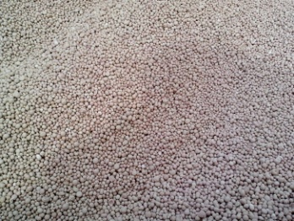
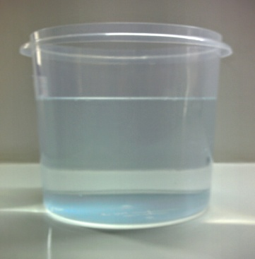
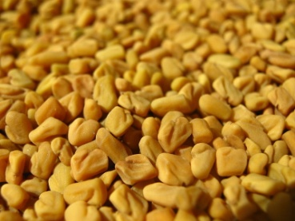
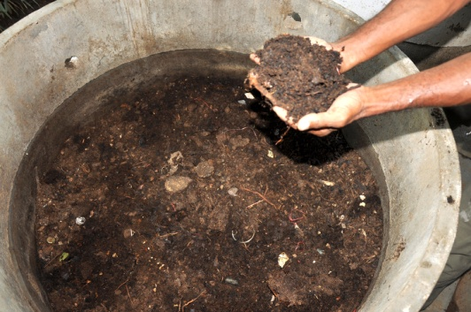
Material required
Fertiliser
Water
3 Beakers
Methi
Manure
Notes:
https://pixnio.com/textures-and-patterns/artificial-fertilizer-agriculture-agriculture-granules-separation
https://pixabay.com/en/flask-beaker-chemistry-container-309923/
https://www.srisathyasaividyavahini.org/index.php/component/joomgallery/default/vermi-compost-4161.html
https://www.srisathyasaividyavahini.org/index.php/component/joomgallery/default/jar-with-water-water-jar-container-4954.html
https://hi.m.wikipedia.org/wiki/%E0%A4%9A%E0%A4%BF%E0%A4%A4%E0%A5%8D%E0%A4%B0:Methi_by_ashish2_closeup.JPG – Public Domain - Ashish Bhatnagar on Hindi Wikipedia
https://pixabay.com/en/flask-beaker-chemistry-container-309923/

Slide 4
Procedure
1. Take 3 glasses - A, B, C.
A
B
C
Notes:
Precaution:
Urea is highly toxic and children should use it under adult supervision only.
Note to the teacher:
This is a project activity, so the time limit can be ignored. Waiting time 1 week
Instructions to teacher include:
✓ The activity is demonstration.
✓ The teacher has to be careful while handling urea.
Image:
https://pixabay.com/en/flask-beaker-chemistry-container-309923/

Slide 5
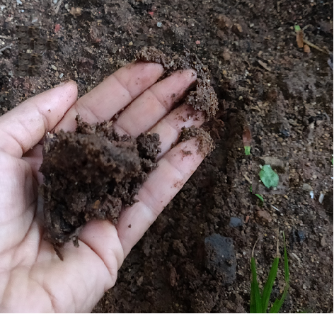
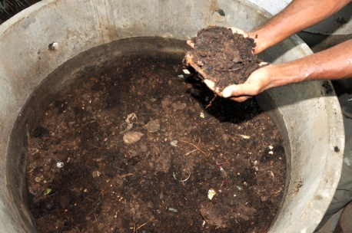
Procedure
2. To A, add little amount of soil mixed with cow dung manure.
A
Notes:
https://www.srisathyasaividyavahini.org/index.php/component/joomgallery/default/loamy-soil-7447.html
https://pixnio.com/textures-and-patterns/artificial-fertilizer-agriculture-agriculture-granules-separation
https://pixabay.com/en/flask-beaker-chemistry-container-309923/

Slide 6
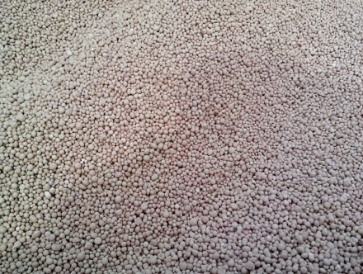
Procedure
3. To B, add same amount of soil with little urea.
B
Notes:
https://www.srisathyasaividyavahini.org/index.php/component/joomgallery/default/loamy-soil-7447.html
https://www.srisathyasaividyavahini.org/index.php/component/joomgallery/default/vermi-compost-4161.html
https://pixabay.com/en/flask-beaker-chemistry-container-309923/

Slide 7
Procedure
4. To C, only same amount of soil.
C
Notes:
https://www.srisathyasaividyavahini.org/index.php/component/joomgallery/default/loamy-soil-7447.html
https://pixabay.com/en/flask-beaker-chemistry-container-309923/

Slide 8
Procedure
Pour same amount of water and plant seedling in each.
Observe the growth and report the result within one week.

Slide 9
Observation
The plants which grew in the fertilised or manure soil grow better when compared to the ordinary soil.

Slide 10
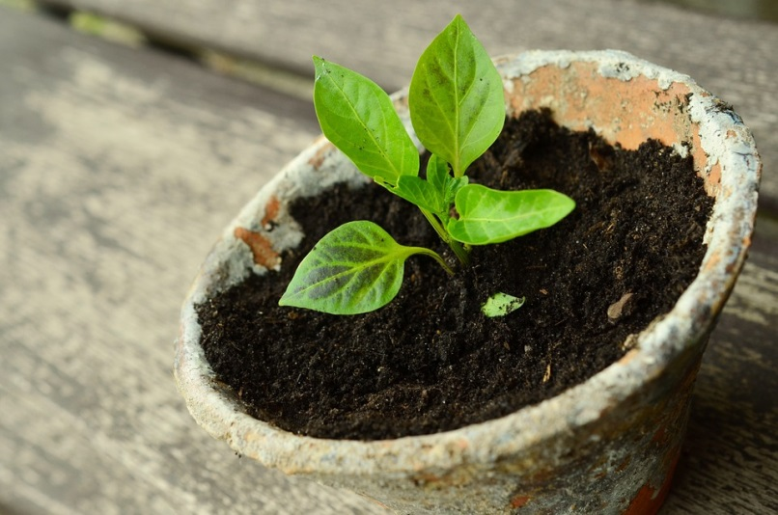
Conclusion
Difference is visible after adding manure and fertiliser.
Notes:
https://pixabay.com/en/plant-young-plants-small-plant-786689/ - CC0

Slide 11
Discussion Questions
1. What is Manure?
Answer: Manure is an organic substance made from decomposed crop residue or animal droppings. They are added to the soil to increase its fertility.
2. What is a fertiliser?
Answer: Fertilisers are used to increase the fertility of soil. They are synthetic and manufactured in factories.
3. What is Urea?
Answer: Urea is a chemical fertiliser. Its formula is CH₄N₂. It is a nitrogenous organic chemical compound.

Slide 12
MM Index
Slide# | Thumbnail | Source and Attribution
3,4,5,6,7 |  | https://pixabay.com/en/flask-beaker-chemistry-container-309923/
3,6 |  | https://www.srisathyasaividyavahini.org/index.php/component/joomgallery/default/vermi-compost-4161.html
3 |  | https://www.srisathyasaividyavahini.org/index.php/component/joomgallery/default/jar-with-water-water-jar-container-4954.html
3 |  | https://hi.m.wikipedia.org/wiki/%E0%A4%9A%E0%A4%BF%E0%A4%A4%E0%A5%8D%E0%A4%B0:Methi_by_ashish2_closeup.JPG – Public Domain - Ashish Bhatnagar on Hindi Wikipedia
3,5 |  | https://pixnio.com/textures-and-patterns/artificial-fertilizer-agriculture-agriculture-granules-separation
5,6,7 |  | https://www.srisathyasaividyavahini.org/index.php/component/joomgallery/default/loamy-soil-7447.html
10 |  | https://pixabay.com/en/plant-young-plants-small-plant-786689/ - CC0

