Slide 1
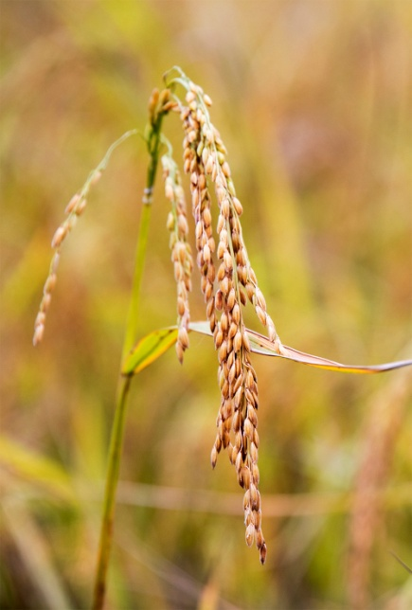
GOOD AND BAD SEEDS
Notes:
https://www.srisathyasaividyavahini.org/index.php/component/joomgallery/default/20160828-3428.html

Slide 2
Good and Bad seeds
Aim: To differentiate between good and poor quality seeds.
Materials Required:
Beaker
Water
Few paddy or wheat seeds.
Notes:
Setting for the Activity [Indoor] : Indoor (classroom activity)
Type of Activity: [Whole class ]

Slide 3
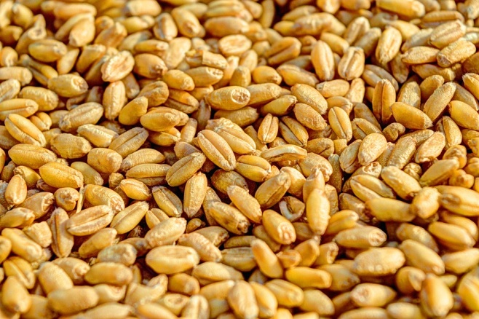
Procedure
1. Take a beaker half filled with water.
2. Put a handful of wheat/paddy seeds.
Notes:
https://pixabay.com/en/water-large-beaker-measured-307668/ - CC0
https://pixabay.com/en/wheat-grain-agriculture-seed-crop-381848/ - CC0

Slide 4
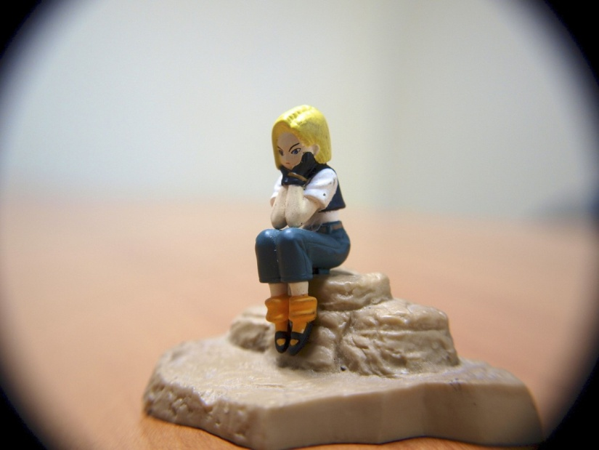
Procedure
3. Wait for some time.
Notes:
https://pxhere.com/en/photo/959472 – CC0

Slide 5
Good and Bad seeds
OBSERVATION:
Damaged seeds float on the top of the water.
CONCLUSION:
Good quality seeds sink and only those are used for cultivation. Rest is discarded.
Notes:
Instructions to Teacher include:
✓ The activity is for the whole class.
✓ The teacher has to demonstrate the activity in the class.
Image:
Original contribution – vandana.nagesh@gmail.com

Slide 6
Discussion Questions
1. Why do damaged seeds float on the top of water?
Answer: Damaged seeds are hollow and do not have nutrients. Hence they float in water.
2. Healthy seeds sink- Give Reasons
Answer: Healthy seeds sink because they have nutrients which makes them heavy.
Notes:
Instructions to Teacher include:
✓ The activity is for the whole class.
✓ The teacher has to demonstrate the activity in the class.

Slide 7
MM Index
Slide# | Thumbnail | Source and Attribution
1 |  | https://www.srisathyasaividyavahini.org/index.php/component/joomgallery/default/20160828-3428.html
3 |  | https://pixabay.com/en/water-large-beaker-measured-307668/ - CC0
3 |  | https://pixabay.com/en/wheat-grain-agriculture-seed-crop-381848/ - CC0
4 |  | https://pxhere.com/en/photo/959472 – CC0
5 |  | Original contribution – vandana.nagesh@gmail.com

