Slide 1
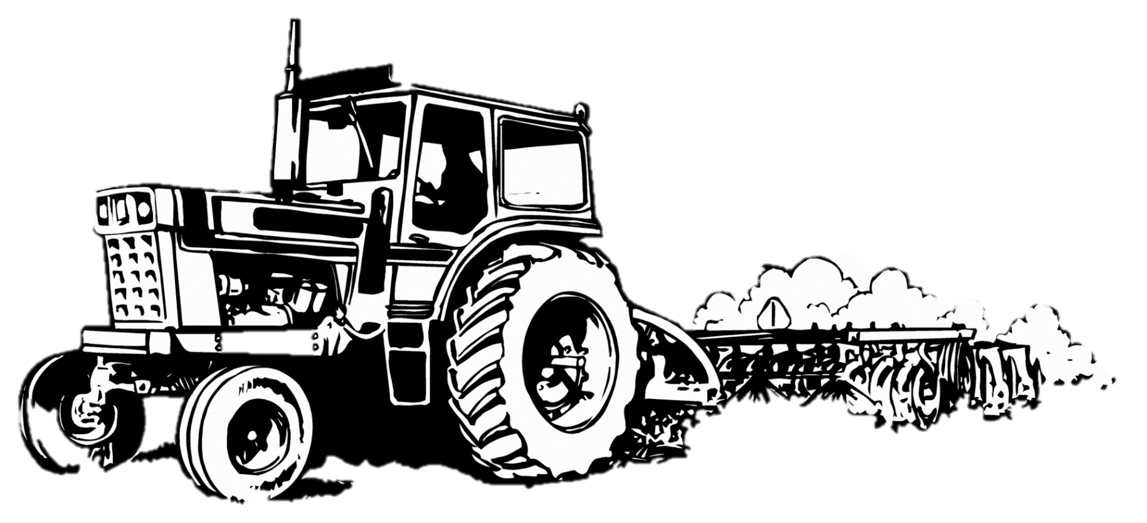
Be Grateful to Farmers
Notes:
Notes for Teacher - < Information for further reference or explanation >
Suggestions: <Ideas/ Images/ Animations / Others – To make better representation of the content > Source of Multimedia Objects (Image/audio/ Video/Animation) used in this slide -
<Short Description> - <SOURCE URL>
<Farmer> : <https://www.publicdomainpictures.net/en/view-image.php?image=162928&picture=farmer>

Slide 2
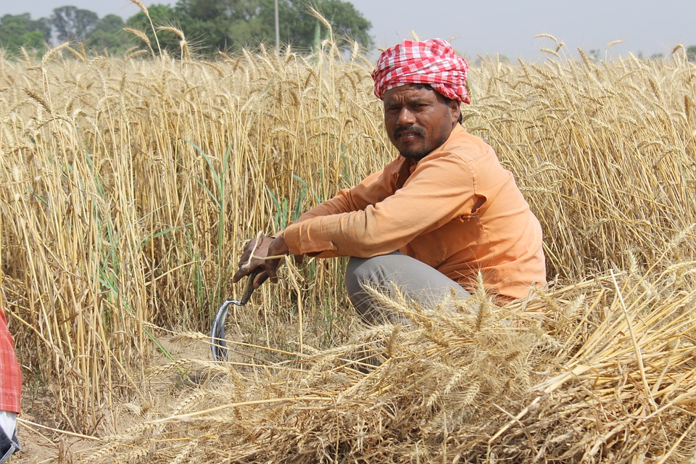
Cultivation of crops
Cultivation of crops involves several activities undertaken by farmers over a period of time.
Notes:
Notes for Teacher - < Information for further reference or explanation >
Suggestions: <Ideas/ Images/ Animations / Others – To make better representation of the content > Source of Multimedia Objects (Image/audio/ Video/Animation) used in this slide -
<Short Description> - <SOURCE URL>
<Farmer> :<https://pixabay.com/photos/wheat-fields-punjab-patiala-men-762213/>

Slide 3
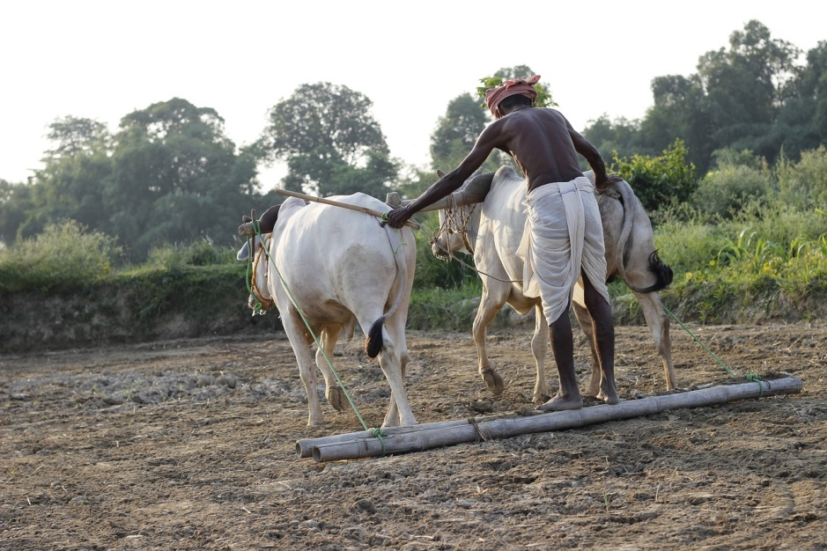
Vital role in harvesting
It is very clear that, in the entire process of crop production till harvesting, the farmer plays a vital role.
Notes:
Notes for Teacher - It is very clear that, in the entire process of crop production, from seeding to producing, organic manures to nurturing, the crops till harvesting, the farmer plays a vital role.
Suggestions: <Ideas/ Images/ Animations / Others – To make better representation of the content >
Source of Multimedia Objects (Image/audio/ Video/Animation) used in this slide -
<Short Description> - <SOURCE URL>
<Plough> : <https://pixabay.com/photos/plough-animal-india-farm-field-1761505/>

Slide 4
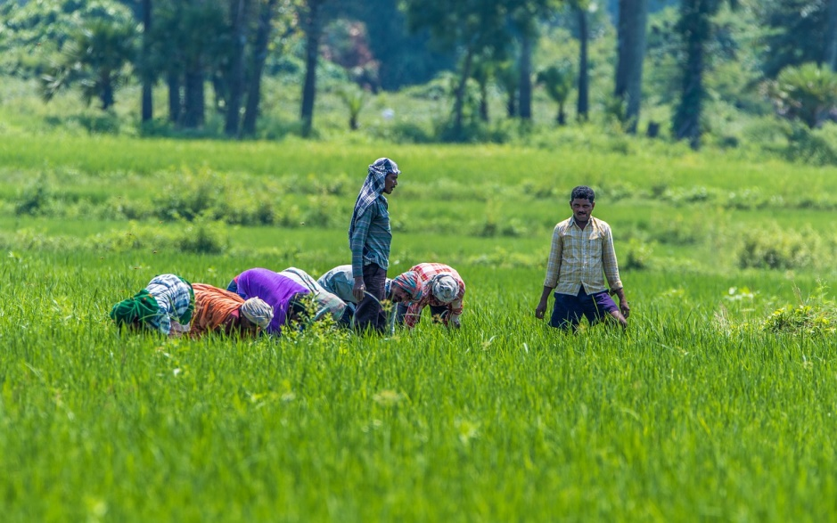
Importance of farmer
Once in our life, we need a doctor, a lawyer, a policeman. But everyday, three times a day, we need a farmer.
Notes:
Notes for Teacher - < Information for further reference or explanation >
Suggestions: <Ideas/ Images/ Animations / Others – To make better representation of the content > Source of Multimedia Objects (Image/audio/ Video/Animation) used in this slide -
<Short Description> - <SOURCE URL>
<Rice field> : <https://pixabay.com/photos/india-andhra-pradesh-east-godavari-4981354/>

Slide 5
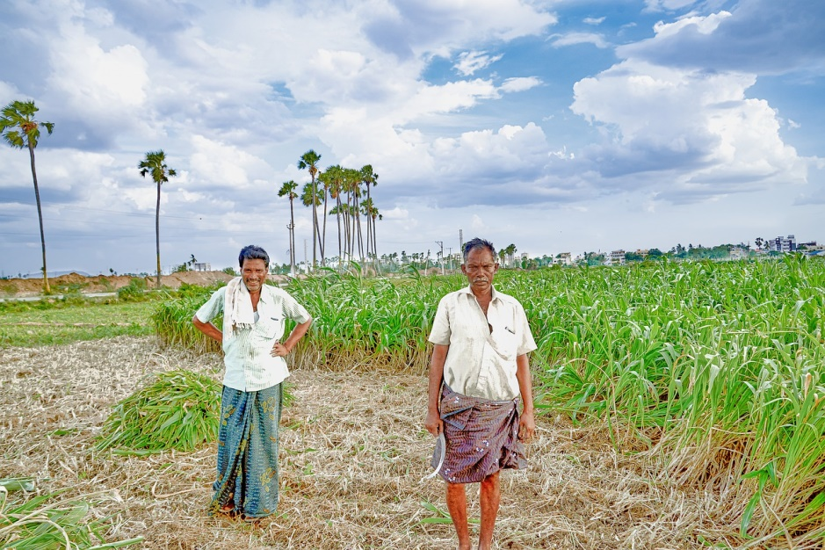
Contribution of farmer
It’s the love and hard work of the farmer, which in the end contribute to real wealth and above all, happiness to all.
Notes:
Notes for Teacher - < Information for further reference or explanation >
Suggestions: <Ideas/ Images/ Animations / Others – To make better representation of the content > Source of Multimedia Objects (Image/audio/ Video/Animation) used in this slide -
<Short Description> - <SOURCE URL>
<Rural> :<https://pixabay.com/photos/rural-village-countryside-farm-4342078/>

Slide 6
Story
To forget how
to dig the earth and to tend the soil is to forget our source.
The following story emphasises this fact.
Notes:
Notes for Teacher - < Information for further reference or explanation >
Suggestions: <Ideas/ Images/ Animations / Others – To make better representation of the content > Source of Multimedia Objects (Image/audio/ Video/Animation) used in this slide -
<Short Description> - <SOURCE URL>
<Frame> : <https://pixabay.com/illustrations/frame-photo-frame-tracery-design-1797367/>

Slide 7
A Boy
A boy once crossed the desert.
Notes:
Notes for Teacher - < Information for further reference or explanation >
Suggestions: <Ideas/ Images/ Animations / Others – To make better representation of the content > Source of Multimedia Objects (Image/audio/ Video/Animation) used in this slide -
<Short Description> - <SOURCE URL>
<Desert> :<https://pixabay.com/en/animal-camel-desert-dunes-1299355/>

Slide 8
Arrive at Ashram
He finally arrived at an ashram in a village. He was told that the guru was delivering a discourse in the evening and the boy was given permission to attend it.
Notes:
Notes for Teacher - < Information for further reference or explanation >
Suggestions: <Ideas/ Images/ Animations / Others – To make better representation of the content > Source of Multimedia Objects (Image/audio/ Video/Animation) used in this slide -
<Short Description> - <SOURCE URL>
<Star> : ORIGINAL(USING MS PPT FEATURES)

Slide 9
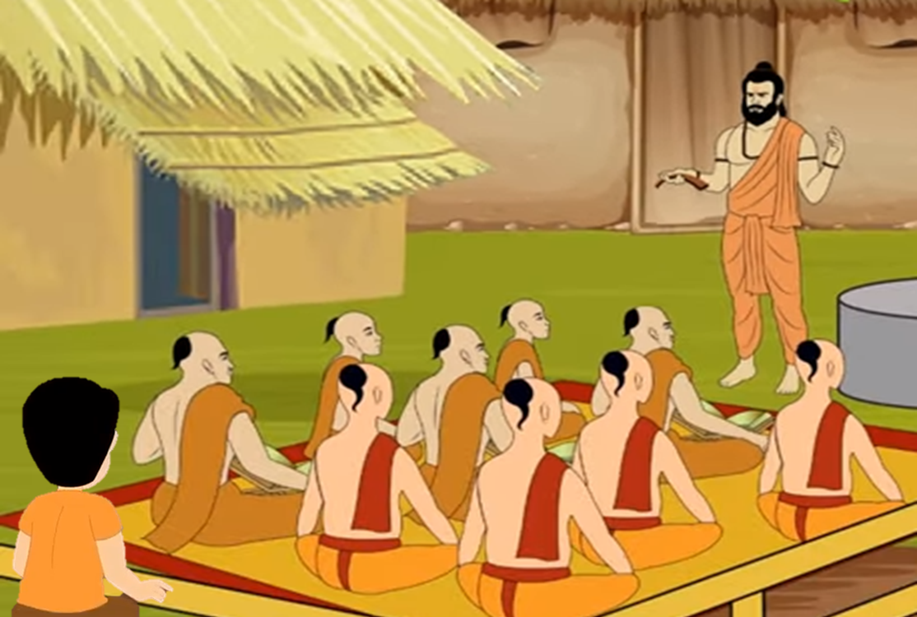
Discourse by Guru
That evening, the Guru spoke only about the importance of farming and the farmers’ work in the fields.
Notes:
Notes for Teacher - < Information for further reference or explanation >
Suggestions: <Ideas/ Images/ Animations / Others – To make better representation of the content > Source of Multimedia Objects (Image/audio/ Video/Animation) used in this slide -
<Short Description> - <SOURCE URL>
<Ashram background> :<https://www.youtube.com/watch?v=sSLYtKyKFRk>
<Boy sitting> : <https://www.youtube.com/watch?v=di2JLGRum1I>

Slide 10
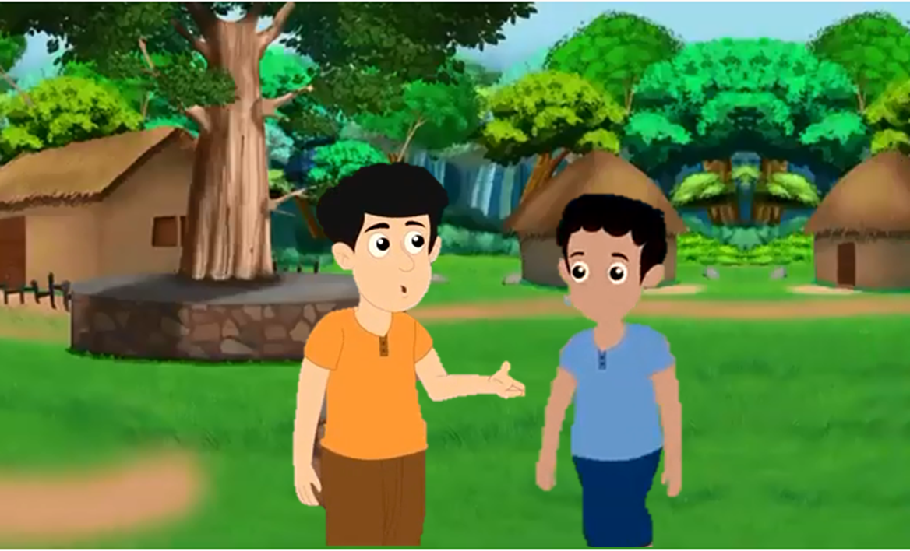
Conversation about speech
At the end of the talk, the boy told one of the boys that he was really shocked as he had expected to hear an enlightened speech. But the Guru only spoke about tomatoes etc.
Notes:
Notes for Teacher - < Information for further reference or explanation >
Suggestions: <Ideas/ Images/ Animations / Others – To make better representation of the content > Source of Multimedia Objects (Image/audio/ Video/Animation) used in this slide -
<Short Description> - <SOURCE URL>
<Boys and background images> : <https://www.youtube.com/watch?v=di2JLGRum1I>

Slide 11
Conversation about speech
He continued saying that from the place where he came from, they believed that God had created this universe and praying to HIM would be sufficient.
Notes:
Notes for Teacher - < Information for further reference or explanation >
Suggestions: <Ideas/ Images/ Animations / Others – To make better representation of the content > Source of Multimedia Objects (Image/audio/ Video/Animation) used in this slide -
<Short Description> - <SOURCE URL>
<Boys and background images> : <https://www.youtube.com/watch?v=di2JLGRum1I>

Slide 12
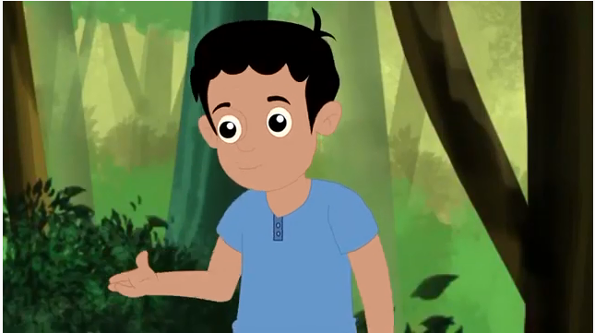
Conversation about speech
The other boy smiled and replied that they believed that God had done HIS part and now it was up to them to continue HIS work.
Notes:
Notes for Teacher - < Information for further reference or explanation >
Suggestions: <Ideas/ Images/ Animations / Others – To make better representation of the content > Source of Multimedia Objects (Image/audio/ Video/Animation) used in this slide -
<Short Description> - <SOURCE URL>
<Boy image> :<https://www.youtube.com/watch?v=di2JLGRum1I>

Slide 13
Appreciate Farmers
Children, nature has provided the necessary inputs for growing the crops. One of the reasons why we can appreciate farmers is that they are a great example of this.
Notes:
Notes for Teacher - < Information for further reference or explanation >
Suggestions: <Ideas/ Images/ Animations / Others – To make better representation of the content > Source of Multimedia Objects (Image/audio/ Video/Animation) used in this slide -
<Short Description> - <SOURCE URL>
<You smiley> :<https://pixabay.com/illustrations/you-finger-pointing-finger-smilli-2386968/>
<Rectangles> : ORIGINAL(USING MS PPT FEATURES)

Slide 14
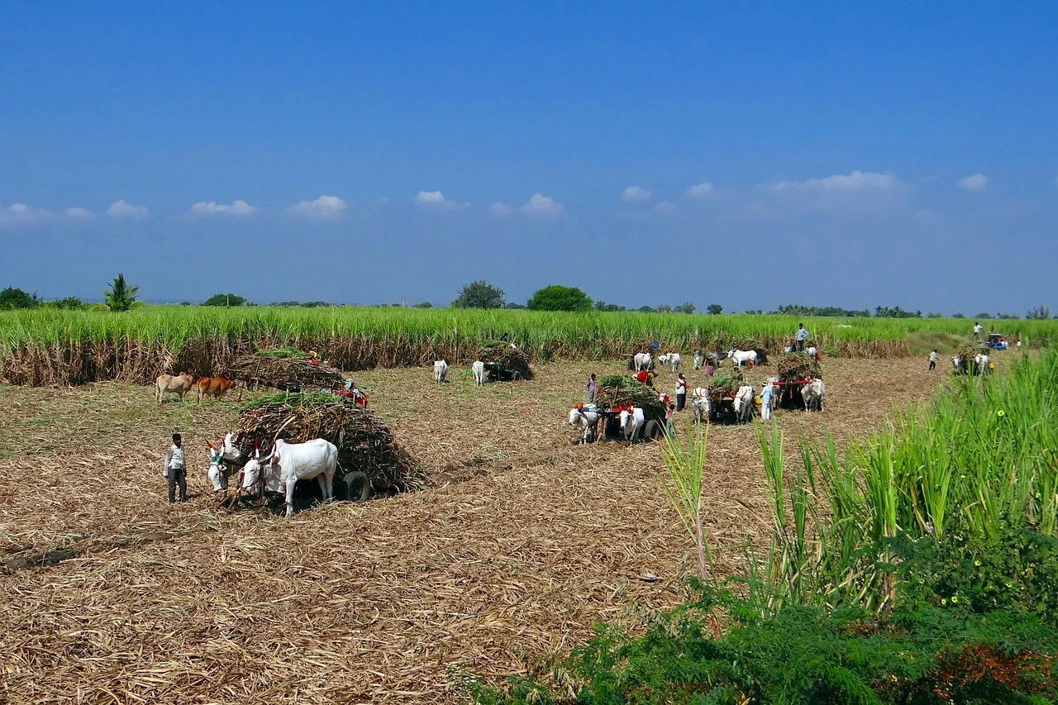
Hard work
They still have to get up early every day and do all the necessary work to look after their crops - they are a great example of working hand in hand with God to do our part of the bargain.
Notes:
Notes for Teacher - < Information for further reference or explanation >
Suggestions: <Ideas/ Images/ Animations / Others – To make better representation of the content > Source of Multimedia Objects (Image/audio/ Video/Animation) used in this slide -
<Short Description> - <SOURCE URL>
<Sugarcane> :<https://pixabay.com/photos/sugarcane-harvest-bullock-cart-223437/>

Slide 15
Thanks to Farmers
If we find food on our table three times a day, we should be grateful to the farmers.
Notes:
Notes for Teacher - < Information for further reference or explanation >
Suggestions: <Ideas/ Images/ Animations / Others – To make better representation of the content > Source of Multimedia Objects (Image/audio/ Video/Animation) used in this slide -
<Short Description> - <SOURCE URL>
<Food plate> :<https://commons.wikimedia.org/wiki/File:Thali.svg>

Slide 16
Respect the hard work
Let us realise that every labour is dignified.
Notes:
Notes for Teacher - < Information for further reference or explanation >
Suggestions: <Ideas/ Images/ Animations / Others – To make better representation of the content > Source of Multimedia Objects (Image/audio/ Video/Animation) used in this slide -
<Short Description> - <SOURCE URL>
<Indian woman>: <https://freesvg.org/indian-woman>

Slide 17
MM Index
Slide# | Thumbnail | Source and Attribution
1 |  | https://www.publicdomainpictures.net/en/view-image.php?image=162928&picture=farmer Creative Commons Attributions – Public Domain
2 |  | https://pixabay.com/photos/wheat-fields-punjab-patiala-men-762213/ Creative Commons Attributions – Public Domain
3 |  | https://pixabay.com/photos/plough-animal-india-farm-field-1761505/ Creative Commons Attributions – Public Domain
4 |  | https://pixabay.com/photos/india-andhra-pradesh-east-godavari-4981354/ Creative Commons Attributions – Public Domain
5 |  | https://pixabay.com/photos/rural-village-countryside-farm-4342078/ Creative Commons Attributions – Public Domain
6 |  | https://pixabay.com/illustrations/frame-photo-frame-tracery-design-1797367/ Creative Commons Attributions – Public Domain

Slide 18
MM Index
Slide# | Thumbnail | Source and Attribution
7 |  | https://pixabay.com/en/animal-camel-desert-dunes-1299355/ Creative Commons Attributions – Public Domain
9 |  | https://www.youtube.com/watch?v=sSLYtKyKFRk Creative Commons Attributions – Reuse allowed
9,10,11, 12 |  | https://www.youtube.com/watch?v=di2JLGRum1I (Attribution - Sandy Entertainments)
13 |  | https://pixabay.com/illustrations/you-finger-pointing-finger-smilli-2386968/ Creative Commons Attributions – Public Domain
14 |  | https://pixabay.com/photos/sugarcane-harvest-bullock-cart-223437/ Creative Commons Attributions – Public Domain
15 |  | https://commons.wikimedia.org/wiki/File:Thali.svg Creative Commons Attributions – Public Domain
16 |  | https://freesvg.org/indian-woman Creative Commons Attributions – Public Domain

