Slide 1
Use of Algebraic expressions and Factorization
Notes:
Notes for Teacher – N/A
Suggestions: N/A
Source of Multimedia Objects (Image/audio/ Video/Animation) used in this slide - N/A

Slide 2
Algebraic expressions & factorization
Some carriers require the use of polynomials and calculation of their roots by factorization.
For Example:
Scientists: Physicists, Chemists, Astronomers need to use polynomials in their job.
Notes:
Notes for Teacher - Scientists: Physicists, Chemists, Astronomers need to use polynomials in their job.
Algebraic expressions and factorization help Physicists to measure relationships between characteristics like force, mass acceleration etc. Astronomers get polynomial equations in finding the distances and studying the features of celestial bodies such as stars, planets, moons etc.
Suggestions: N/A
Source of Multimedia Objects (Image/audio/ Video/Animation) used in this slide -
Science: https://pixabay.com/illustrations/head-test-tube-chemistry-experiment-938459/

Slide 3
Algebraic expressions & factorization
Statisticians: Use polynomial equations and factorization in fields like economics, social, political.
Engineers: Civil, Electrical, Mechanical and Industrial engineers need Mathematical skills
Notes:
Notes for Teacher – Only 1 click for full slide.
Suggestions: N/A
Source of Multimedia Objects (Image/audio/ Video/Animation) used in this slide -
Economist : https://pixabay.com/illustrations/chart-businessman-growing-african-4105121/
Engineer: https://pixabay.com/vectors/sketch-character-funny-man-art-3075369/

Slide 4
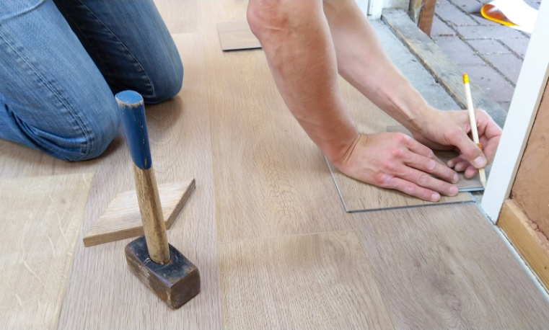
Algebraic expressions & factorization
The carpenters , architects, interior decorators need to calculate the exact quantity of supplies required for a particular area that needs to be landscaped.
Algebraic expressions are used extensively in our day to day lives and so it is important to have knowledge of Algebraic expressions so that we can calculate things easily.
Notes:
Notes for Teacher – Only 1 click for full slide.
Suggestions: N/A
Source of Multimedia Objects (Image/audio/ Video/Animation) used in this slide -
Architect: https://www.pexels.com/photo/person-holding-pencil-1388944/

Slide 5
MM Index
Slide# | Thumbnail | Source and Attribution
2 |  | Science: https://pixabay.com/illustrations/head-test-tube-chemistry-experiment-938459/
3 |  | Economist : https://pixabay.com/illustrations/chart-businessman-growing-african-4105121/
3 |  | Engineer: https://pixabay.com/vectors/sketch-character-funny-man-art-3075369/
4 |  | Architect: https://www.pexels.com/photo/person-holding-pencil-1388944/

