Slide 1
Cryptography and Factorization
Notes:
Notes for Teacher –N/A
Suggestions: N/A
Source of Multimedia Objects (Image/audio/ Video/Animation) used in this slide -
1. Security: https://pixabay.com/illustrations/security-castle-sure-internet-1202344/

Slide 2
Cryptography and Factorization
Crypto
graphy
Crypto
graphy
hidden
writing
‘Cryptography is the science of hiding the information in order to conceal it from unauthorized access.
Notes:
Notes for Teacher –N/A
Suggestions: N/A
Source of Multimedia Objects (Image/audio/ Video/Animation) used in this slide -
1. Security: https://pixabay.com/illustrations/security-castle-sure-internet-1202344/

Slide 3
Cryptography and Factorization
sender Data
unreadable format
cipher text
secret key
decrypt or decode the data
receiver Data
All the data transmitted between the computers where the data is kept and where it is received must be encrypted. It is very important in Internet.
Notes:
Notes for Teacher –N/A
Suggestions: N/A
Source of Multimedia Objects (Image/audio/ Video/Animation) used in this slide - N/A

Slide 4
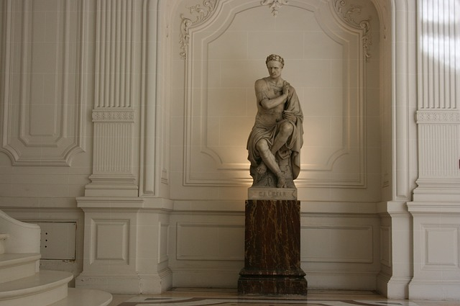
Caesar Shift Cipher
Around 100 B.C., Julius Caesar
used cryptography to convey secret messages to his army generals
In this method the letters of a message were shifted by a number 3
Example
c
o
m
e
a
w
p.
c
o
m
e
a
t
t
w
o
p.
m.
t
t
o
m.
shifted by 2 alphabets
e
q
o
g
c
v
v
y
q
r.
o.
Notes:
Notes for Teacher –N/A
Suggestions: N/A
Source of Multimedia Objects (Image/audio/ Video/Animation) used in this slide –
1. Julius Caesar: https://pixabay.com/photos/julius-caesar-roman-emperor-492489/

Slide 5
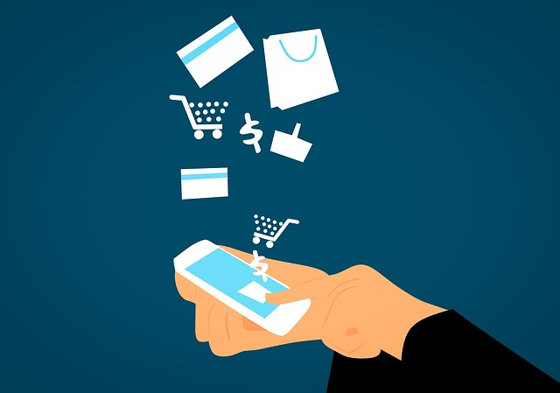
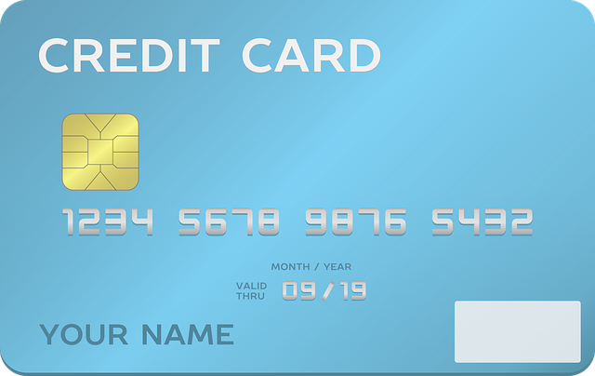
Uses of Cryptography
Protects
Electronic transactions
Credit card information E-mail messages
Notes:
Notes for Teacher –N/A
Suggestions: N/A
Source of Multimedia Objects (Image/audio/ Video/Animation) used in this slide -
Electronic buying: https://pixabay.com/illustrations/visa-business-buying-card-3082813/
Email: https://pixabay.com/illustrations/email-newsletter-marketing-online-3249062/
Credit card: https://pixabay.com/vectors/credit-card-withdrawals-calculation-1369111/

Slide 6
Cryptography and Factorization
Example:
let n = pxq where p,q are prime numbers
The number ‘n’ can be used as a public key to open the box in which private information are stored
Using n, any person can open the box
But to access the information inside, one should know ‘p,q'
Notes:
Notes for Teacher –N/A
Suggestions: N/A
Source of Multimedia Objects (Image/audio/ Video/Animation) used in this slide - N/A

Slide 7
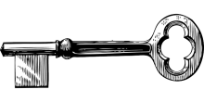
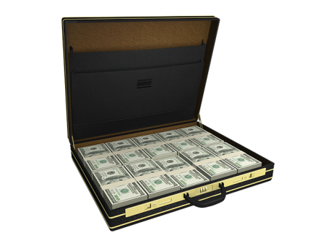
Cryptography and Factorization
BANK
The number n can be used as a ‘public key’ which can be read by anyone in the network
p⨯q
The ‘public key’ is to open the box in which private information are stored.
Let n is the product of two primes p and q while encrypting
n
To access the information inside, one should have the ‘private key’.
n
Notes:
Notes for Teacher –N/A
Suggestions: N/A
Source of Multimedia Objects (Image/audio/ Video/Animation) used in this slide -
Public: https://pixabay.com/illustrations/kid-school-child-blackboard-hat-3072605/
Box: https://pixabay.com/vectors/luggage-travel-suitcase-business-1626470/
Metal Key: https://pixabay.com/vectors/key-old-skeleton-lock-metal-door-30417/
Open box: https://pixabay.com/illustrations/jackpot-prosperity-isolated-1198050/

Slide 8
Cryptography and Factorization
BANK
The bank and the owner of the credit card process this ‘private key’.
n
The ‘private key’ contains the two prime numbers p and q and to use the ‘private key’
Notes:
Notes for Teacher –N/A
Suggestions: N/A
Source of Multimedia Objects (Image/audio/ Video/Animation) used in this slide -
Banker: https://pixabay.com/vectors/boy-business-cartoon-comic-1300242/
Businessman: https://pixabay.com/illustrations/boy-business-businessman-cartoon-1921381/
Box: https://pixabay.com/vectors/luggage-travel-suitcase-business-1626470/

Slide 9
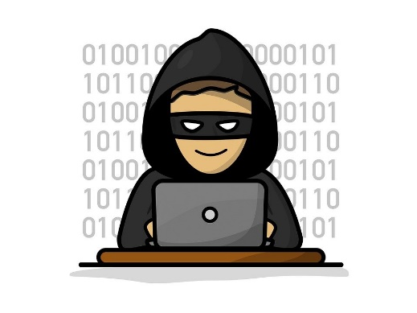
Cryptography and Factorization
n
The thief (hacker) must factorize n which could take thousands of years by computers if p and q are hundreds of digits long.
Notes:
Notes for Teacher –N/A
Suggestions: N/A
Source of Multimedia Objects (Image/audio/ Video/Animation) used in this slide -
Hacker: https://pixabay.com/illustrations/hacker-hacking-theft-cyber-malware-5027679/
Metal Key: https://pixabay.com/vectors/key-old-skeleton-lock-metal-door-30417/
Open box: https://pixabay.com/illustrations/jackpot-prosperity-isolated-1198050/
Businessman: https://pixabay.com/illustrations/boy-business-businessman-cartoon-1921381/

Slide 10
MM Index
Slide# | Thumb Nail | Source and Attributions
1,2 |  | Security: https://pixabay.com/illustrations/security-castle-sure-internet-1202344/
4 |  | Julius Caesar: https://pixabay.com/photos/julius-caesar-roman-emperor-492489/
5 |  | Electronic buying: https://pixabay.com/illustrations/visa-business-buying-card-3082813/
5 |  | Email: https://pixabay.com/illustrations/email-newsletter-marketing-online-3249062/
5 |  | Credit card: https://pixabay.com/vectors/credit-card-withdrawals-calculation-1369111/
7 |  | Public: https://pixabay.com/illustrations/kid-school-child-blackboard-hat-3072605/
7 |  | Box: https://pixabay.com/vectors/luggage-travel-suitcase-business-1626470/
7 |  | Metal Key: https://pixabay.com/vectors/key-old-skeleton-lock-metal-door-30417/
7, 8 |  | Open box: https://pixabay.com/illustrations/jackpot-prosperity-isolated-1198050/
8 |  | Banker: https://pixabay.com/vectors/boy-business-cartoon-comic-1300242/
8,9 |  | Businessman: https://pixabay.com/illustrations/boy-business-businessman-cartoon-1921381/
9 |  | Hacker: https://pixabay.com/illustrations/hacker-hacking-theft-cyber-malware-5027679/
7 |  | Public: https://pixabay.com/illustrations/kid-school-child-blackboard-hat-3072605/

