Slide 1
Factors of the Algebraic Expression
Notes:
Notes for Teacher – N/A
Suggestions: N/A
Source of Multimedia Objects (Image/audio/ Video/Animation) used in this slide - N/A

Slide 2
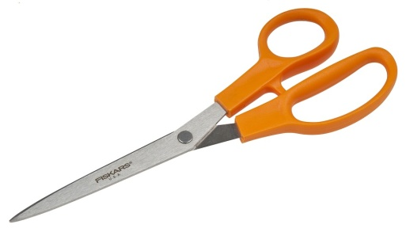
Factors of the Algebraic Expression
Activity
Aim: To determine factors of given algebraic expression.
Materials required: Two medium size boxes, placards, one white sheet, scissor, glue.
Notes:
Notes for Teacher - Instruction:
Two days before the activity, let the teacher write a list of enough number of
algebraic expressions and their factors (Approximately the number of expressions
is at least one third of the class strength). Avoid expressions of the form
(a + b)² so that each expression has two distinct factors.
Thus, each expression is associated with two factors. For each expression choose three students and assign one to an expression and to the rest, a factor each. For example if the expression is x² + 5x + 6 then its factors are x + 2 and x + 3. Now assign x² + 5x + 6 to student 1, x + 2 to student 2 and x + 3 to students 3. Repeat it for all. Ask each student to prepare a placard of size 8cmx5cm and write the expression assigned to them.
Suggestions: N/A
Source of Multimedia Objects (Image/audio/ Video/Animation) used in this slide
Scissors: https://pixabay.com/photos/scissors-cut-fiskars-cutting-paper-2202215/
Glue: https://pixabay.com/illustrations/school-supplies-crayons-scissors-3832556/
3. White paper: https://pixabay.com/photos/marble-mockup-flatlay-ecommerce-3683818/

Slide 3
Factors of the Algebraic Expression
Procedure:
Step 1: Collect the cards from the teacher.
Step 2: Identify whether it is an algebraic expression or factors.
Step 3: Come and put your cards in the respective boxes.
Algebraic expression
Factors
Notes:
Notes for Teacher – N/A
Suggestions: N/A
Source of Multimedia Objects (Image/audio/ Video/Animation) used in this slide –
1. Boy: https://pixabay.com/illustrations/kids-play-child-children-playing-1340525/

Slide 4
Factors of the Algebraic Expression
Procedure:
Class is divided into two groups, approximately one-third of students in group A and the remaining students in group B and make them sit separately.
Step 4
Each student of group A to pick a card from the first box, start factorizing the algebraic expression in that card.
Step 5
Group B will also pick one card from the second box. Then the students are made to stand in one or two rows holding their cards.
Step 6
Notes:
Notes for Teacher – N/A
Suggestions: N/A
Source of Multimedia Objects (Image/audio/ Video/Animation) used in this slide – N/A

Slide 5
Factors of the Algebraic Expression
Procedure:
Student who completes his factorization work will move to the other side, try to find students holding the cards with factors calculated by him.
Step 4
The activity can be repeated so that each student gets the chance to do the factorization exercise at least once.
Step 4
Notes:
Notes for Teacher – N/A
Suggestions: N/A
Source of Multimedia Objects (Image/audio/ Video/Animation) used in this slide – N/A

Slide 6
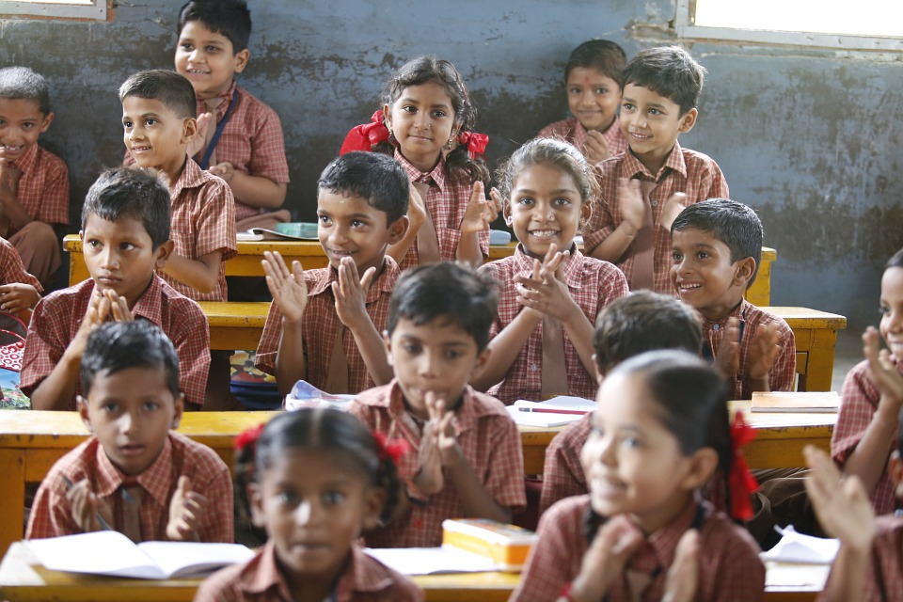
Factors of the Algebraic Expression
Conclusion:
The activity makes the students to enjoy factorization.
Notes:
Notes for Teacher – N/A
Suggestions: N/A
Source of Multimedia Objects (Image/audio/ Video/Animation) used in this slide – N/A
1. Children: https://pixabay.com/photos/happy-children-education-876541/

Slide 7
MM Index
Slide# | Thumbnail | Source and Attribution
2 |  | Glue: https://pixabay.com/illustrations/school-supplies-crayons-scissors-3832556/
2 |  | White Paper: https://pixabay.com/photos/marble-mockup-flatlay-ecommerce-3683818/
2 |  | Scissors: https://pixabay.com/photos/scissors-cut-fiskars-cutting-paper-2202215/
3 |  | Boy: https://pixabay.com/illustrations/kids-play-child-children-playing-1340525/
6 |  | Children: https://pixabay.com/photos/happy-children-education-876541/

