Slide 1
Regrouping our Value System
Notes:
Notes for Teacher – N/A
Suggestions: N/A
Source of Multimedia Objects (Image/audio/ Video/Animation) used in this slide - N/A

Slide 2
Common Factor
SOCIETY
SOCIETY
SOCIETY
All are children of God,
All have the need to love and be loved,
All want peace in lives.
Notes:
Notes for Teacher – NA
Suggestions: N/A
Source of Multimedia Objects (Image/audio/ Video/Animation) used in this slide -
Religion: https://pixabay.com/vectors/silhouette-black-religion-ethics-1321398/
Thumb - https://pixabay.com/vectors/thumb-fingerprint-print-thumbprint-23776/
Hat - https://pixabay.com/illustrations/hat-graduation-cap-education-1674894/
Small house - https://pixabay.com/vectors/hut-house-cottage-vacation-roof-312420/
Big house - https://pixabay.com/illustrations/houses-set-architecture-clip-art-1094900/

Slide 3
Student
The different factors of students are:
S
Sincerity
T
Tenacity
U
Unity
D
Discipline
E
Energetic
Common factor
=
Good Character
N
Neatness
T
Truthfulness
S
Steadfastness
Notes:
Notes for Teacher – Only one click for factors of students to appear on the slide
Suggestions: N/A
Source of Multimedia Objects (Image/audio/ Video/Animation) used in this slide -
1. Smiley - https://pixabay.com/illustrations/smile-cool-best-smiley-perfect-ok-3233682/

Slide 4
Good Character
Develop good character as your distinct achievement.
“Ability may take you to the top. But it takes good character to keep you there” ~ John Wooden
Notes:
Notes for Teacher – N/A
Suggestions: N/A
Source of Multimedia Objects (Image/audio/ Video/Animation) used in this slide - N/A

Slide 5
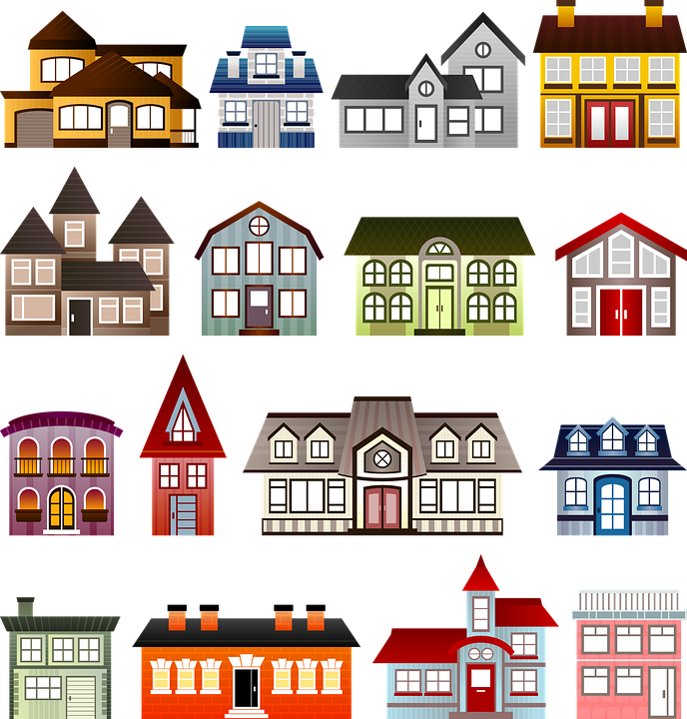
MM Index
Slide# | Thumbnail | Source and Attribution
2 |  | Religion: https://pixabay.com/vectors/silhouette-black-religion-ethics-1321398/
2 |  | Big house: https://pixabay.com/illustrations/houses-set-architecture-clip-art-1094900/
2 |  | Small house: https://pixabay.com/vectors/hut-house-cottage-vacation-roof-312420/
2 |  | Hat :https://pixabay.com/illustrations/hat-graduation-cap-education-1674894/
2 |  | Thumb: https://pixabay.com/vectors/thumb-fingerprint-print-thumbprint-23776/
3 |  | Smiley: https://pixabay.com/illustrations/smile-cool-best-smiley-perfect-ok-3233682/

