Slide 1
Iron and Steel in Daily Lives
Notes:
Notes for Teacher - < Information for further reference or explanation >
Suggestions: <Ideas/ Images/ Animations / Others – To make better representation of the content > Source of Multimedia Objects (Image/audio/ Video/Animation) used in this slide -

Slide 2
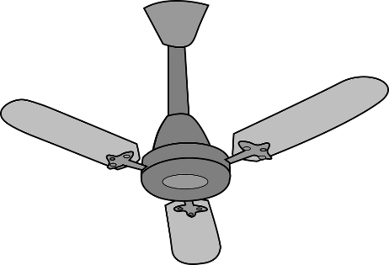
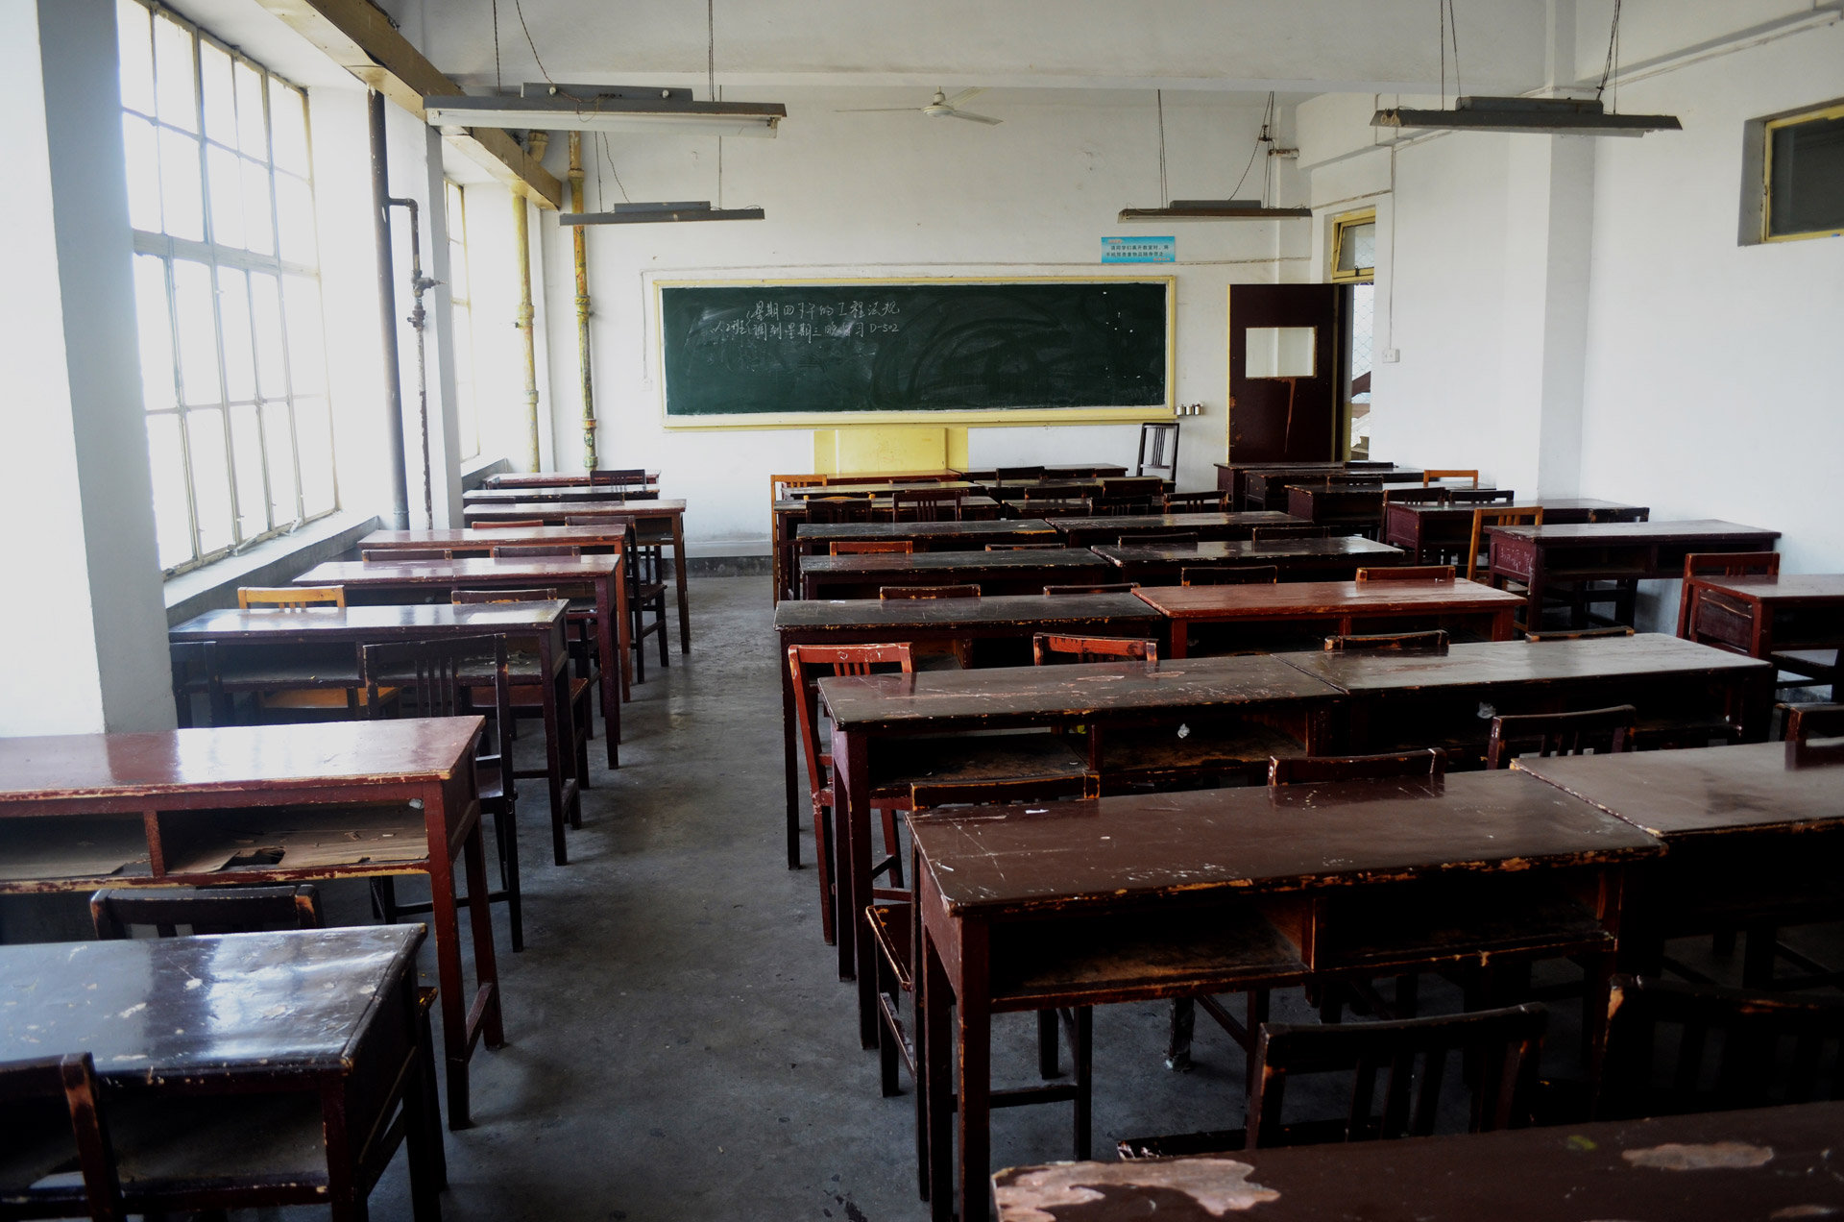
IRON AND STEEL AROUND US
Look around the classroom. We can find many things that are made of iron and steel.
Notes:
Notes for Teacher – use ‘CLICK ON ‘ to reveal the answers.
Suggestions: <Ideas/ Images/ Animations / Others – To make better representation of the content > Source of Multimedia Objects (Image/audio/ Video/Animation) used in this slide -
Classroom: https://www.publicdomainpictures.net/en/view-image.php?image=20108
Fan: https://pixabay.com/vectors/ceiling-fan-electrical-isolated-air-309623/
Door latch: https://openclipart.org/detail/242726/doorlatch-with-lock
https://pixabay.com/vectors/alarm-bell-doorbell-electric-2027136/
Scissors: https://pixabay.com/vectors/cut-scissors-tool-1295044/

Slide 3
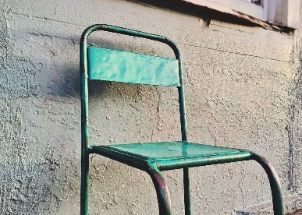
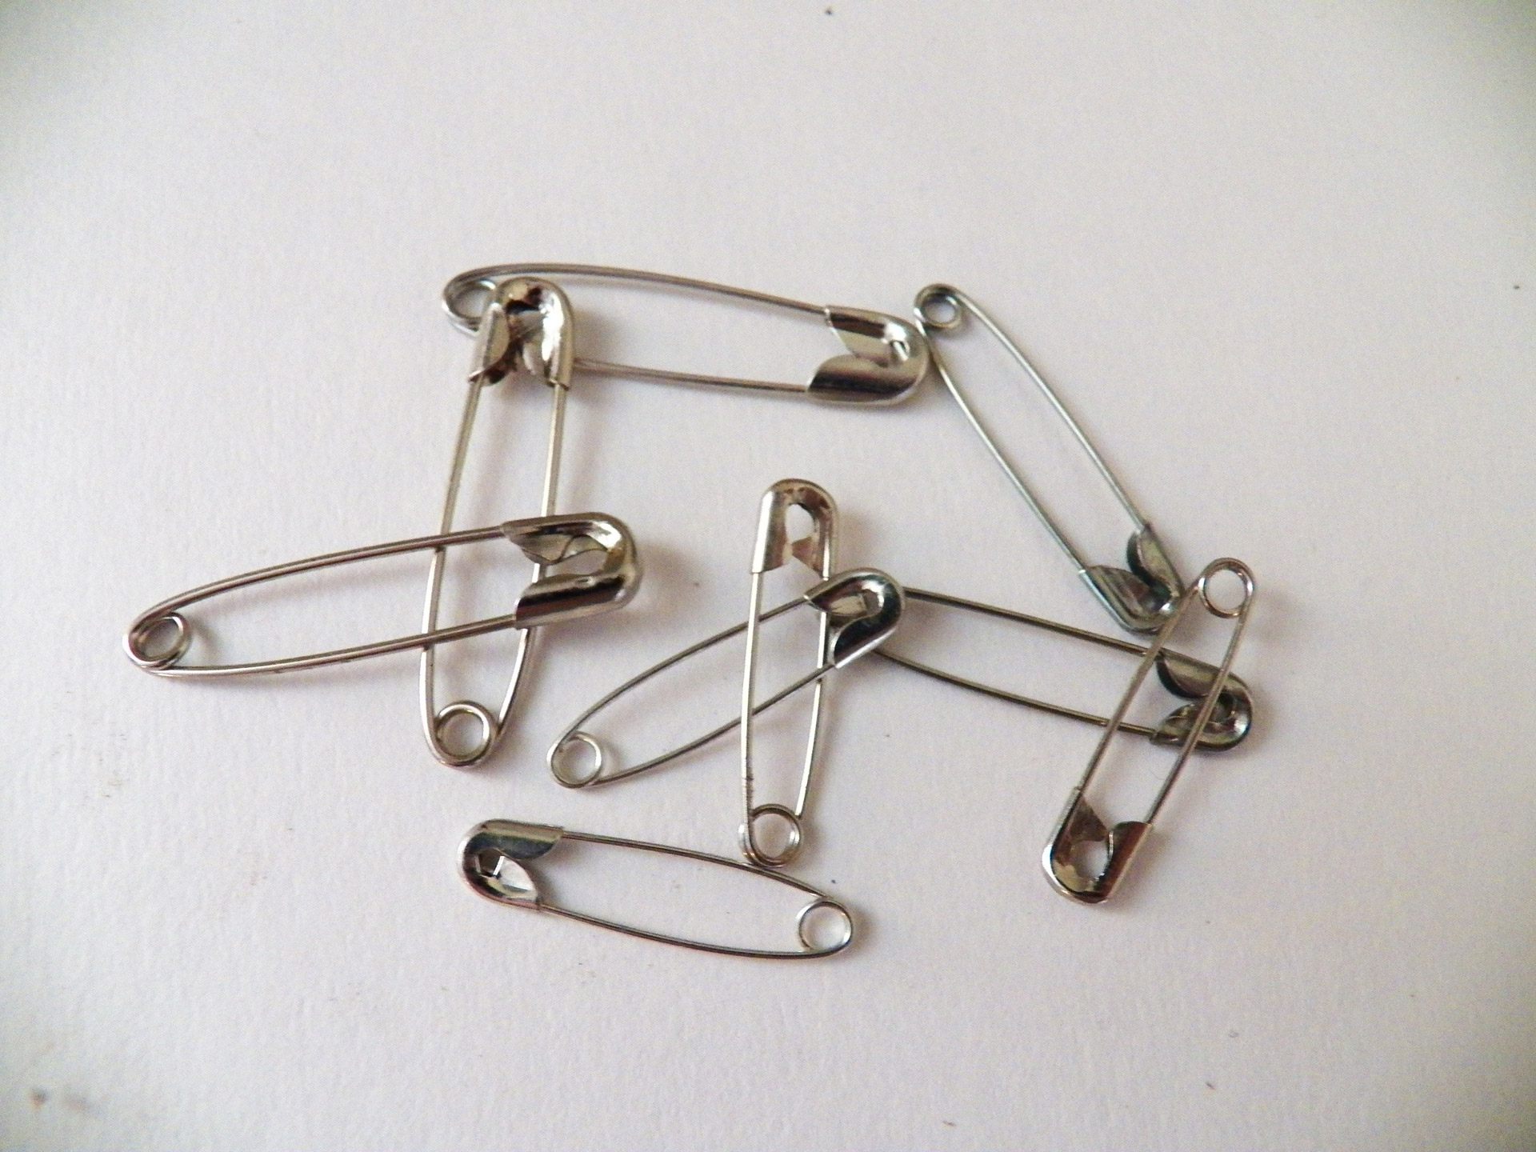
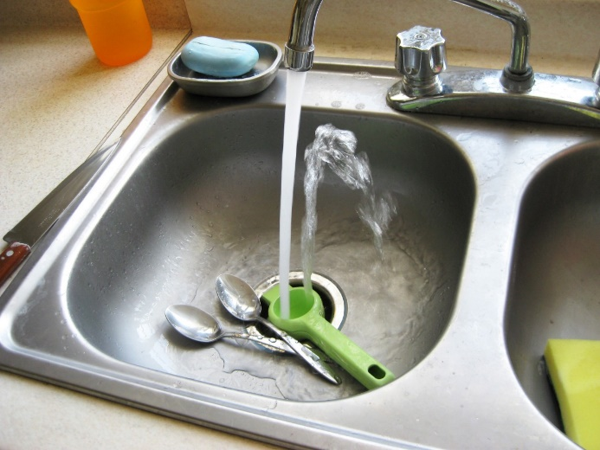
DOMESTIC USE
Iron is used in every part of home - kitchen, living room, bathroom.
Stainless steel is used in the kitchen accessories, cutlery and cookware.
Notes:
Notes for Teacher - < Information for further reference or explanation >
Suggestions: <Ideas/ Images/ Animations / Others – To make better representation of the content > Source of Multimedia Objects (Image/audio/ Video/Animation) used in this slide -
https://www.publicdomainpictures.net/en/view-image.php?image=24838&picture=safety-pins
Kitchen sink: https://pxhere.com/en/photo/1114318
Chair: https://www.pexels.com/photo/abandoned-broken-broken-down-cement-279616/

Slide 4
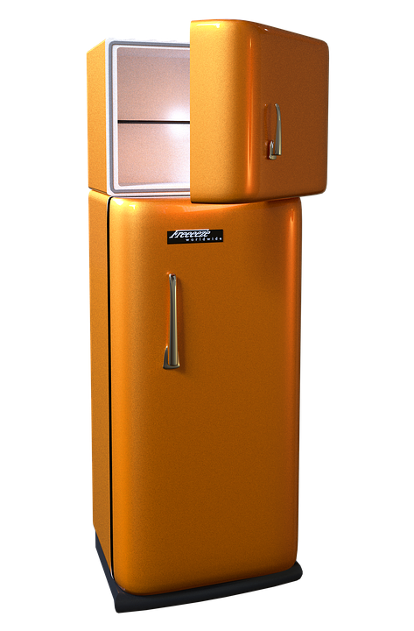
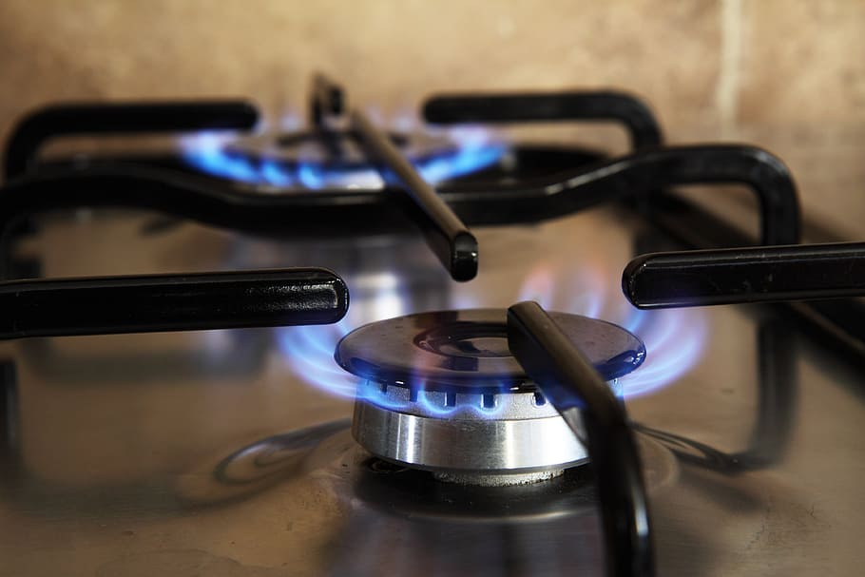
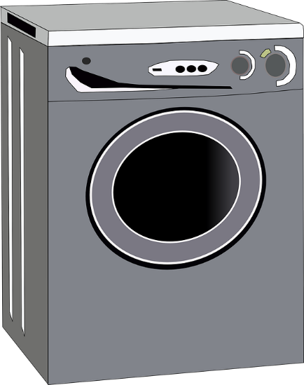
DOMESTIC USE
Washing machines, cooking stoves, microwave ovens, refrigerators and their motors, all contain iron and steel.
About 75% of the average appliance by weight is steel.
Notes:
Notes for Teacher - < Information for further reference or explanation >
Suggestions: <Ideas/ Images/ Animations / Others – To make better representation of the content > Source of Multimedia Objects (Image/audio/ Video/Animation) used in this slide -
https://www.maxpixels.net/Seventies-Refrigerator-Fridge-freezer-Retro-Freezer-2420419
https://www.pxfuel.com/en/free-photo-oucjs
https://pixabay.com/vectors/washing-machine-gray-housework-29789/

Slide 5
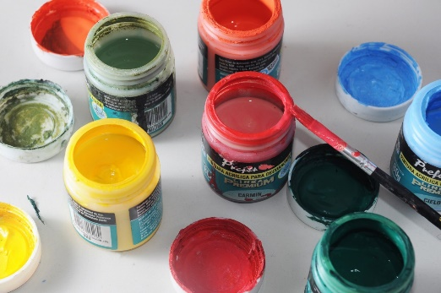
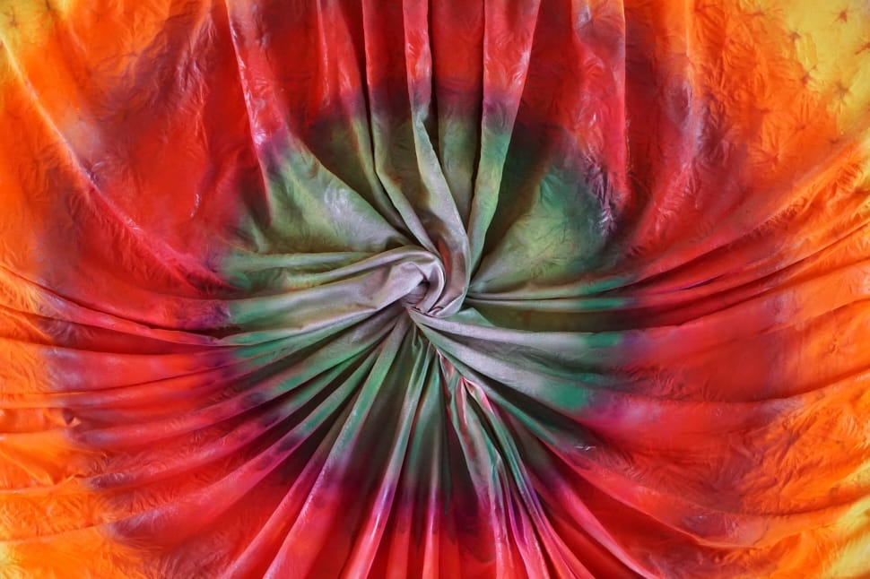
COMMERCIAL AND MEDICAL
COMMERCIAL
Iron oxide pigments are used in dyeing cloth.
Iron is also used as a coloring agent for paints.
MEDICAL
Doctors use surgical instruments made using high quality stainless steel that are non-rusty.
Notes:
Notes for Teacher - < Information for further reference or explanation >
Suggestions: <Ideas/ Images/ Animations / Others – To make better representation of the content > Source of Multimedia Objects (Image/audio/ Video/Animation) used in this slide -
https://pxhere.com/id/photo/885497
https://www.peakpx.com/483078/teal-red-orange-yellow-textile
https://pxhere.com/en/photo/1112450

Slide 6
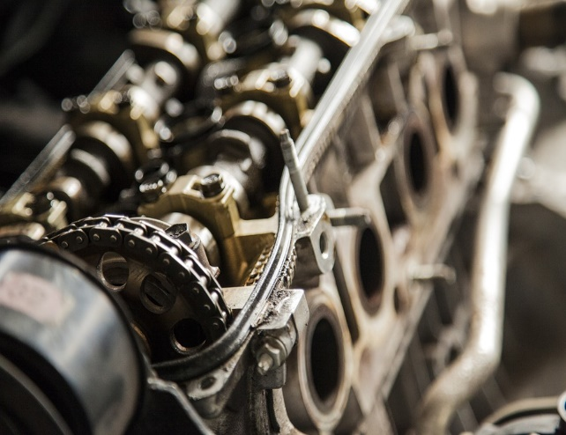
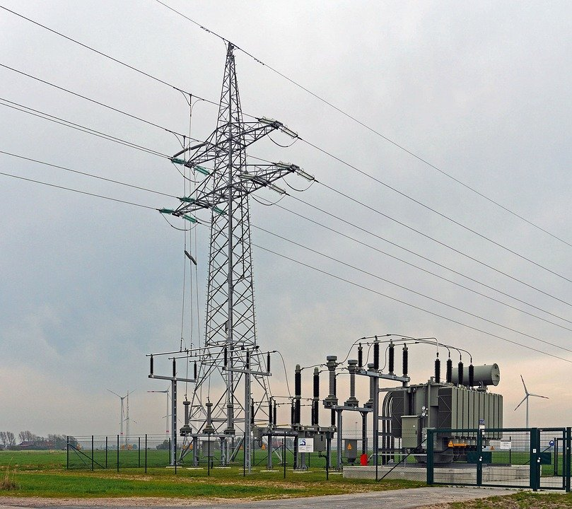
ELECTRICAL EQUIPMENT
Electric motors
Electrical equipment is made of iron and steel to increase the strength.
Transformers, generators
Steel cables
Notes:
Notes for Teacher - < Information for further reference or explanation >
Suggestions: <Ideas/ Images/ Animations / Others – To make better representation of the content > Source of Multimedia Objects (Image/audio/ Video/Animation) used in this slide -
Transformer: https://pixabay.com/photos/high-voltage-feed-windstrom-1290375/
Motor: https://pixabay.com/photos/motor-machine-mechanical-engine-768750/
Steel cable: https://pixabay.com/photos/rope-knot-steel-cable-secure-1609688/

Slide 7
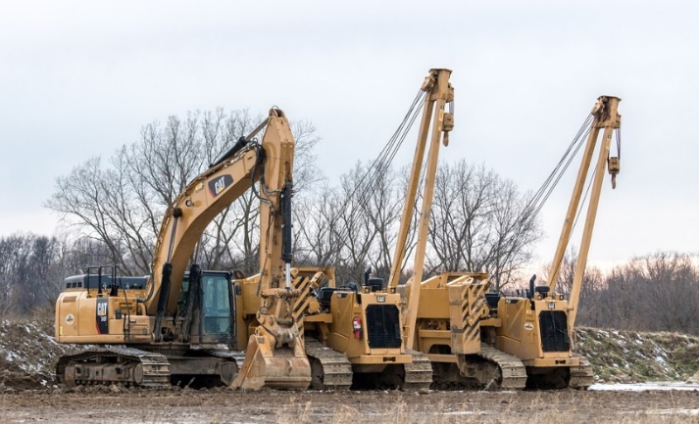
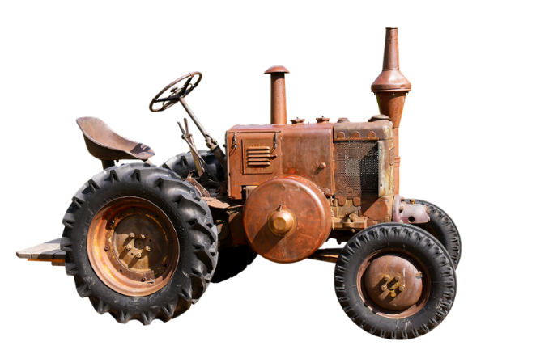
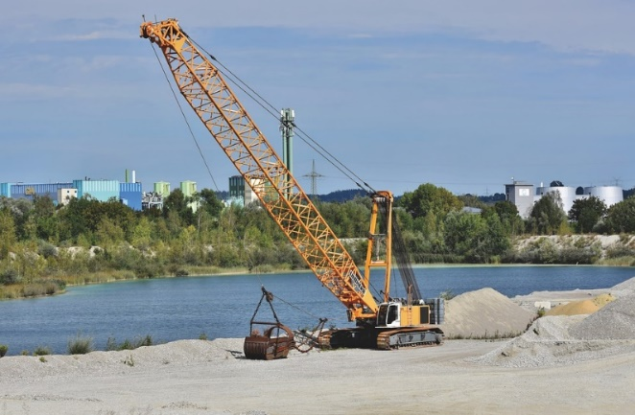
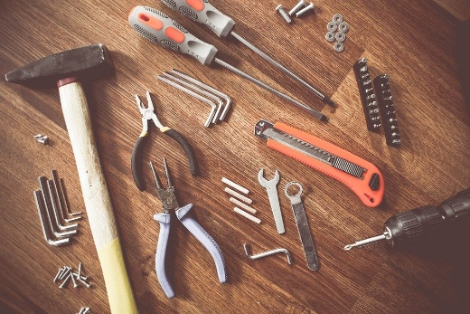
MECHANICAL EQUIPMENT
The use of iron and steel includes mechanical equipment like bulldozers, tractors and cranes.
BULL DOZERS
TRACTOR
CRANE
Hand tools such as hammers and shovels are also made of iron and steel.
Notes:
Notes for Teacher - < Information for further reference or explanation >
Suggestions: <Ideas/ Images/ Animations / Others – To make better representation of the content > Source of Multimedia Objects (Image/audio/ Video/Animation) used in this slide -
Tractors: https://pixabay.com/photos/traffic-tractor-agriculture-lanz-2767943/
Crane:https://pixabay.com/photos/excavators-crane-heavy-crane-5556325/
Bulldozer: https://pixabay.com/photos/heavy-equipment-bull-dozer-3412130/
Tools; https://pixabay.com/photos/tools-construct-craft-repair-864983/

Slide 8
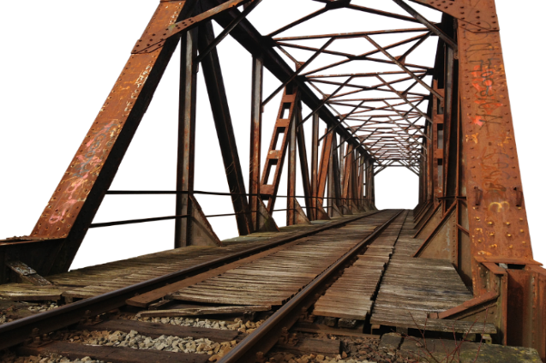
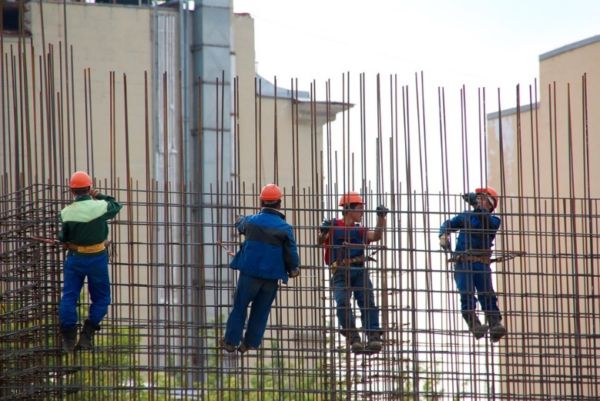
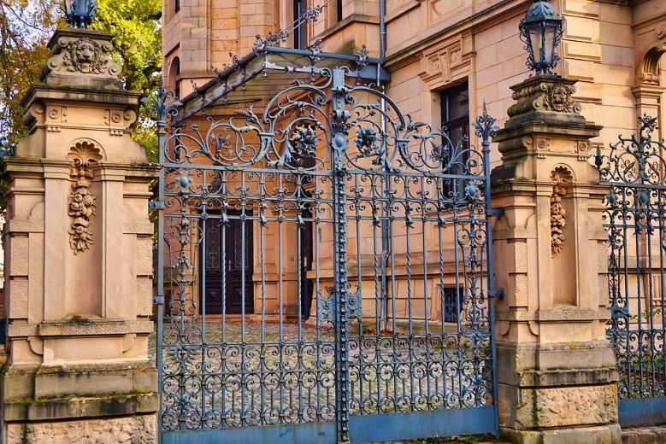
ARCHITECTURE AND CONSTRUCTION
The roofs and walls of buildings and bridges are constructed with iron bars and steel sheets to increase strength and durability.
Bridge
Iron bars for building construction
Gates and window grills
Notes:
Notes for Teacher - < Information for further reference or explanation >
Suggestions: <Ideas/ Images/ Animations / Others – To make better representation of the content > Source of Multimedia Objects (Image/audio/ Video/Animation) used in this slide -
https://pixabay.com/photos/bridge-steel-construction-2692595/
https://pixabay.com/photos/town-hall-goal-iron-gate-4578081/
https://pixabay.com/photos/steelworkers-concrete-formwork-1029665/

Slide 9
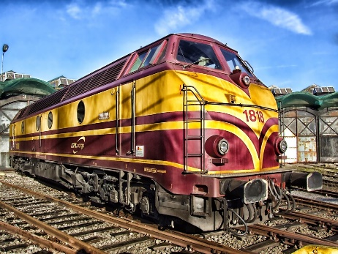
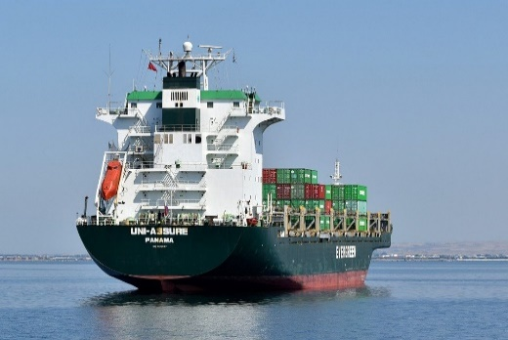
TRANSPORT INDUSTRY
The body structures and doors of many motor vehicles such as cars, trains, buses and even ships and some parts of air planes are made using iron and steel.
Notes:
Notes for Teacher - < Information for further reference or explanation >
Suggestions: <Ideas/ Images/ Animations / Others – To make better representation of the content > Source of Multimedia Objects (Image/audio/ Video/Animation) used in this slide -
https://pixabay.com/vectors/truck-box-car-vehicle-delivery-2181037/
https://pixabay.com/photos/train-locomotive-luxembourg-143847/
https://pixabay.com/photos/ship-cargo-vessel-container-5349847/
https://pixabay.com/photos/aircraft-airplane-flying-airport-4885805/

Slide 10
MM Index
Slide# | Thumbnail | Source and Attribution
2 |  | Classroom: https://www.publicdomainpictures.net/en/view-image.php?image=20108
2 |  | Fan: https://pixabay.com/vectors/ceiling-fan-electrical-isolated-air-309623/
2 |  | Door latch: https://openclipart.org/detail/242726/doorlatch-with-lock
2 |  | Scissors:https://pixabay.com/vectors/cut-scissors-tool-1295044/
3 |  | https://www.publicdomainpictures.net/en/view-image.php?image=24838&picture=safety-pins
3 |  | Kitchen sink: https://pxhere.com/en/photo/1114318
3 |  | Chair: https://www.pexels.com/photo/abandoned-broken-broken-down-cement-279616/
4 |  | https://www.maxpixels.net/Seventies-Refrigerator-Fridge-freezer-Retro-Freezer-2420419
4 |  | https://www.pxfuel.com/en/free-photo-oucjs
4 |  | https://pixabay.com/vectors/washing-machine-gray-housework-29789/
2 |  | https://pixabay.com/vectors/alarm-bell-doorbell-electric-2027136/
Notes:
Notes for Teacher - < Information for further reference or explanation >
Suggestions: <Ideas/ Images/ Animations / Others – To make better representation of the content > Source of Multimedia Objects (Image/audio/ Video/Animation) used in this slide -

Slide 11
MM Index
Slide# | Thumbnail | Source and Attribution
5 |  | https://www.peakpx.com/483078/teal-red-orange-yellow-textile
5 |  | https://pxhere.com/en/photo/1112450
5 |  | https://pxhere.com/id/photo/885497
6 |  | Transformer: https://pixabay.com/photos/high-voltage-feed-windstrom-1290375/
6 |  | Motor: https://pixabay.com/photos/motor-machine-mechanical-engine-768750/
6 |  | Steel cable: https://pixabay.com/photos/rope-knot-steel-cable-secure-1609688/
7 |  | Tractors: https://pixabay.com/photos/traffic-tractor-agriculture-lanz-2767943/
7 |  | Crane:https://pixabay.com/photos/excavators-crane-heavy-crane-5556325/
7 |  | Bulldozer: https://pixabay.com/photos/heavy-equipment-bull-dozer-3412130/
7 |  | Tools; https://pixabay.com/photos/tools-construct-craft-repair-864983/
Notes:
Notes for Teacher - < Information for further reference or explanation >
Suggestions: <Ideas/ Images/ Animations / Others – To make better representation of the content > Source of Multimedia Objects (Image/audio/ Video/Animation) used in this slide -

Slide 12
MM Index
Slide# | Thumbnail | Source and Attribution
8 |  | https://pixabay.com/photos/bridge-steel-construction-2692595/
8 |  | https://pixabay.com/photos/town-hall-goal-iron-gate-4578081/
8 |  | https://pixabay.com/photos/steelworkers-concrete-formwork-1029665/
9 |  | https://pixabay.com/vectors/truck-box-car-vehicle-delivery-2181037/
9 |  | https://pixabay.com/photos/train-locomotive-luxembourg-143847/
9 |  | https://pixabay.com/photos/ship-cargo-vessel-container-5349847/
9 |  | https://pixabay.com/photos/aircraft-airplane-flying-airport-4885805/
Notes:
Notes for Teacher - < Information for further reference or explanation >
Suggestions: <Ideas/ Images/ Animations / Others – To make better representation of the content > Source of Multimedia Objects (Image/audio/ Video/Animation) used in this slide -

